Slide 1




2022 Indio Subbasin Alternative Plan Update
Workshop #5
June 24, 2021

Slide 2
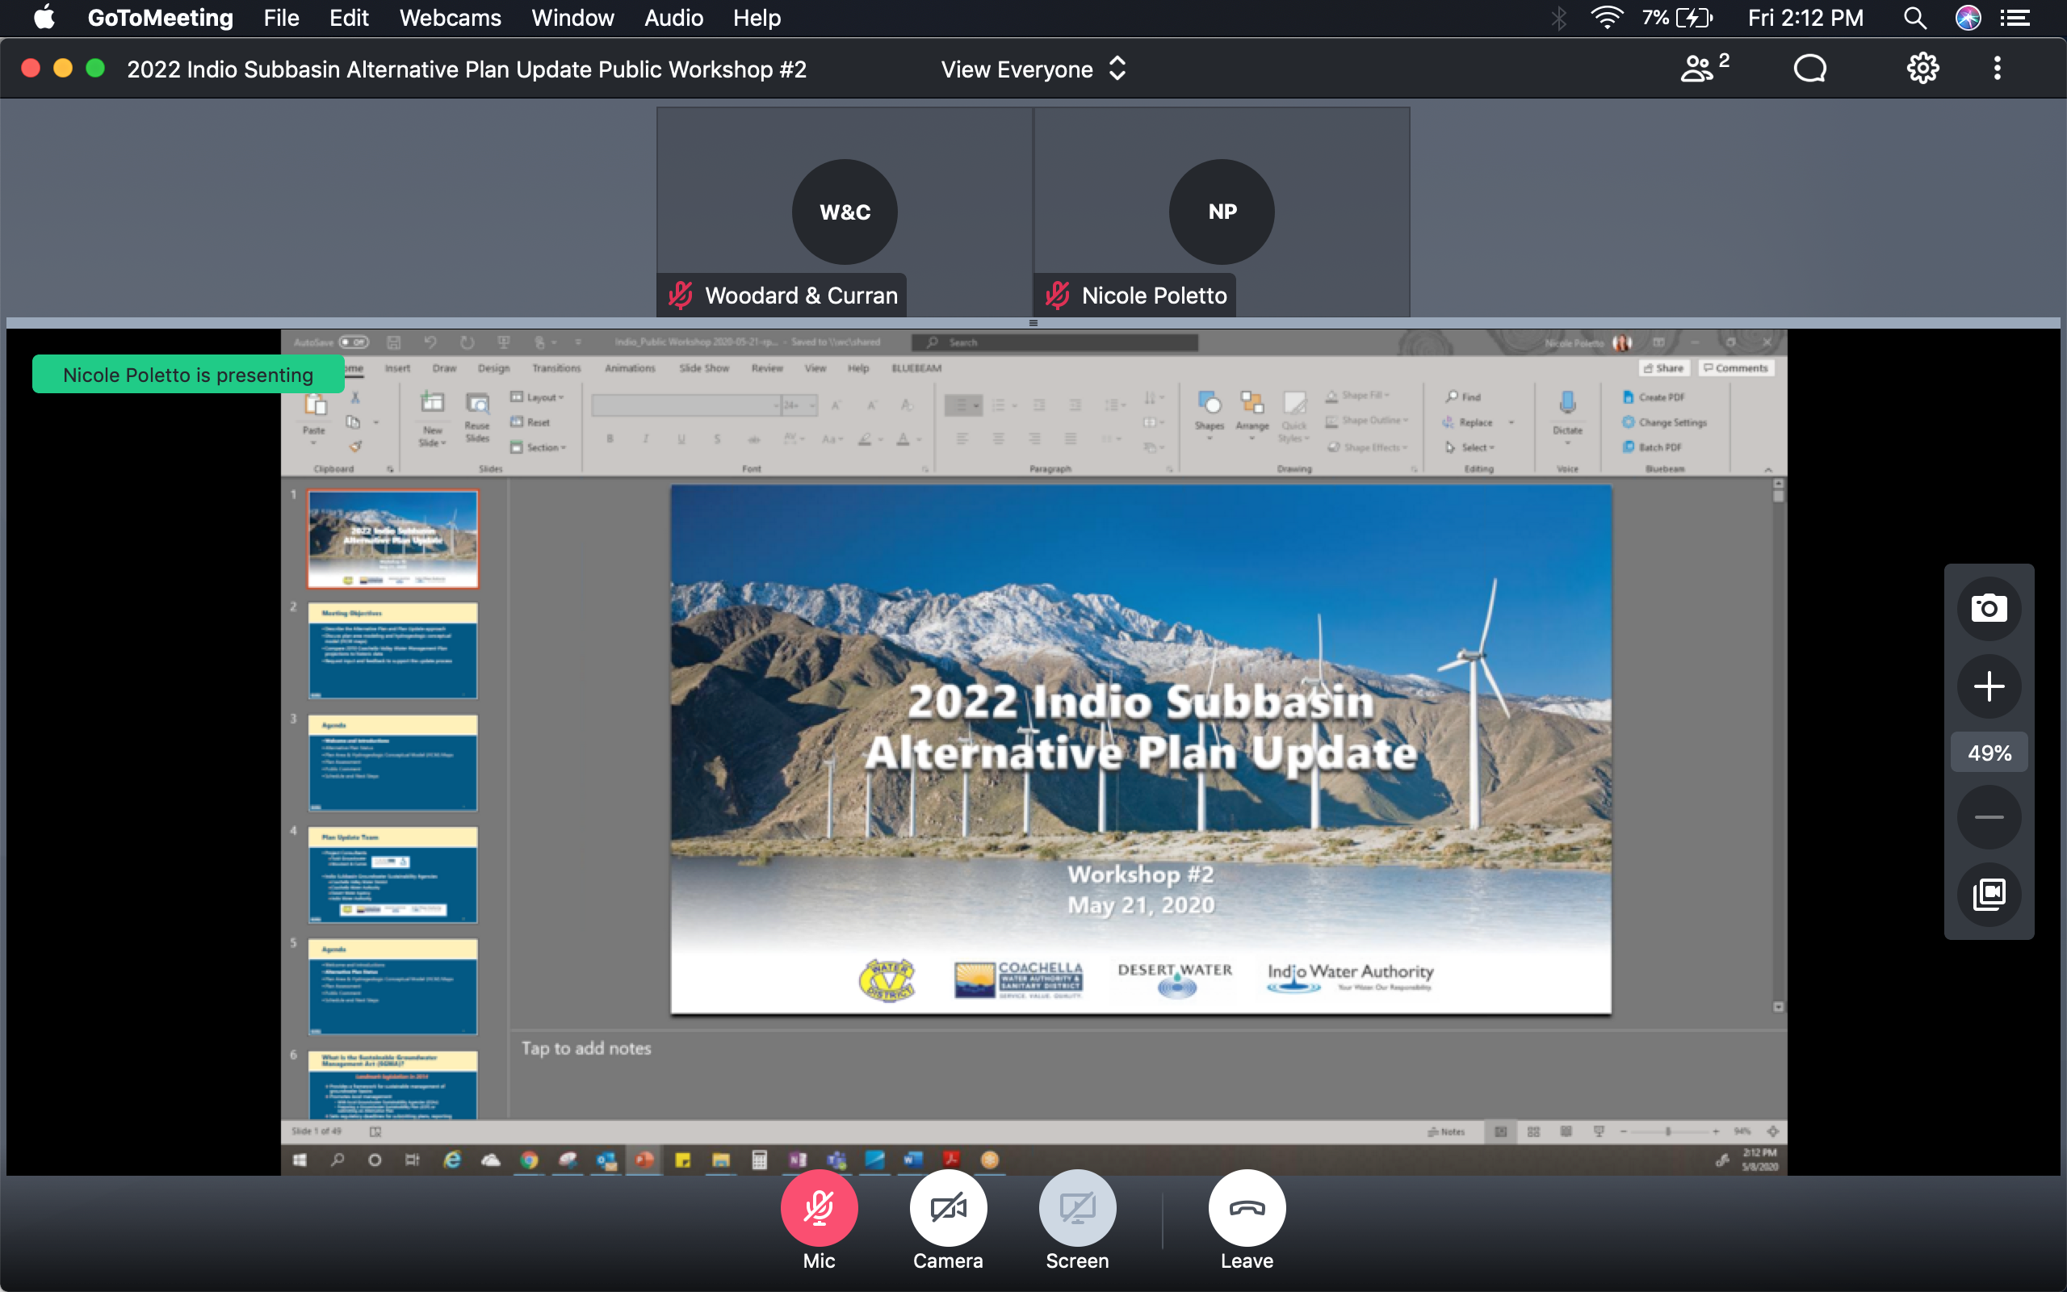
GoToMeeting – Quick How To
Your screen should look like this:
Turn on/off your Mic (mute) and Camera (video) using the controls along the bottom
During the meeting, you may need to wiggle your mouse to make the controls appear
For Callers: use *6 to unmute on the phone

Slide 3
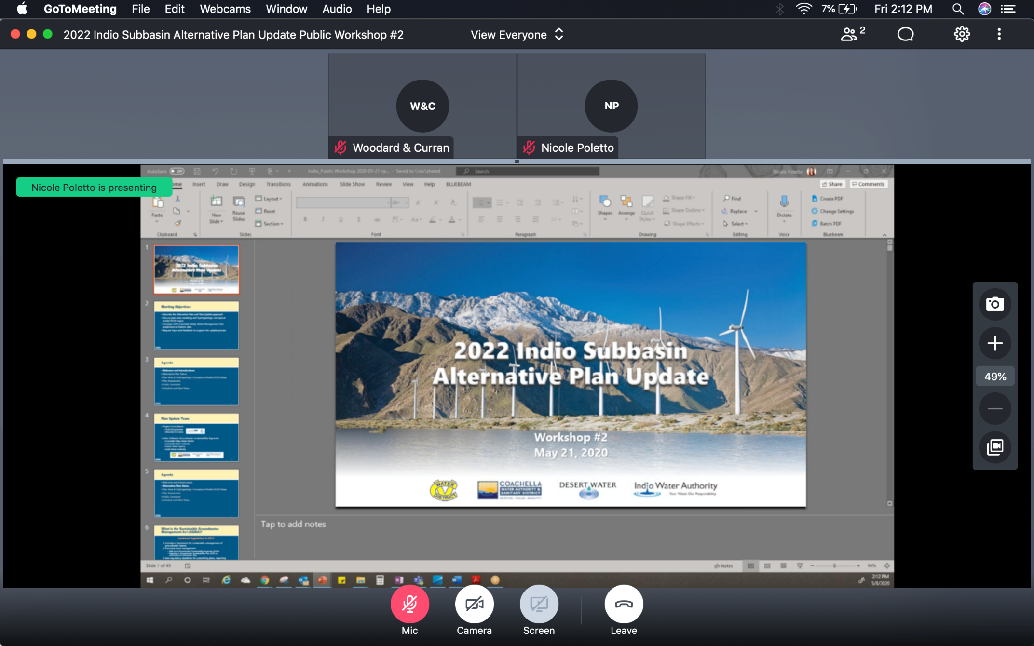
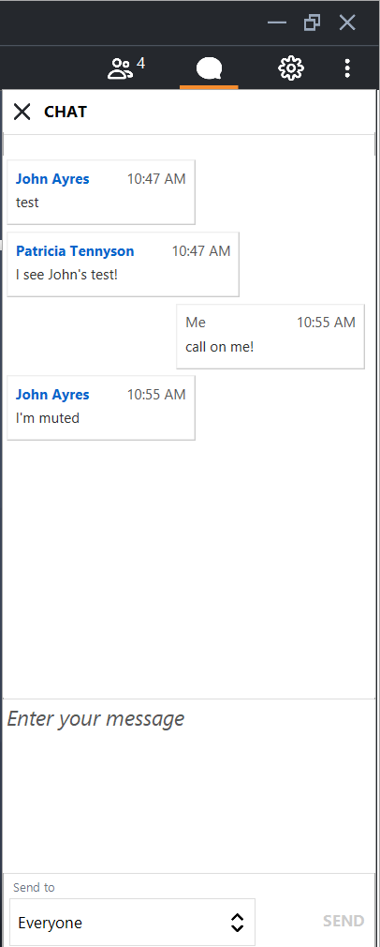
GoToMeeting – How to Ask a Question
Our organizer will mute everyone at the beginning of the meeting
Let us know you have a question by clicking the Chat icon in the top right
  Click on Enter your message, type your message and hit SEND
Once we receive your Chat, we will call on you and answer your question
For Callers: when ask for your questions or comments, use *6 to unmute

Slide 4
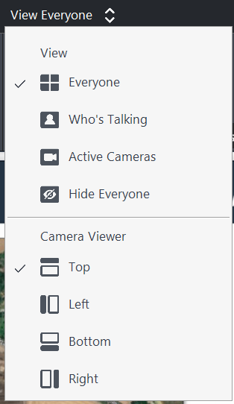
GoToMeeting – How to See Everyone
To change your display options, select the View menu in the top center
  Select View-Everyone to display all attendees in the meetings
  Select Camera Viewer-Top to display participant images along the top of your screen
The grey divider can be raised or lowered, which will change the screen size

Slide 5
Meeting Objectives
Provide overview and status of the Alternative Plan Update
Discuss Groundwater Conditions for water quality and GDEs
Present an update on Sustainable Management
Update on status of the Groundwater Model Update and modeling for Plan Scenarios
Request input and feedback to support the Plan Update

Slide 6
Agenda
Welcome and Introductions
Alternative Plan Status
Groundwater Conditions
Sustainable Management
Groundwater Model and Plan Scenarios
Public Comment
Get Involved

Slide 7

Plan Update Team
Project Consultants
  Todd Groundwater
  Woodard & Curran
Indio Subbasin Groundwater Sustainability Agencies
  Coachella Valley Water District
  Coachella Water Authority
  Desert Water Agency
  Indio Water Authority
`

Slide 8
Agenda
Welcome and Introductions
Alternative Plan Status
Groundwater Conditions
Sustainable Management
Groundwater Model and Plan Scenarios
Public Comment
Get Involved
Notes:
Our goals are to:
Enhance public understanding about water resources in the basin
Keep you—the public and stakeholders—informed about the GSP
Engage diverse interested parties and stakeholders
Respond to your concerns

Slide 9
Status of Alternative Plan Update
Outreach
Assess existing Plan
Document groundwater conditions
Evaluate water demand and supply
Update numerical model
Consider emerging issues
Establish sustainability goals + criteria
Evaluate management actions
Assess monitoring programs
Update implementation plan

Slide 10
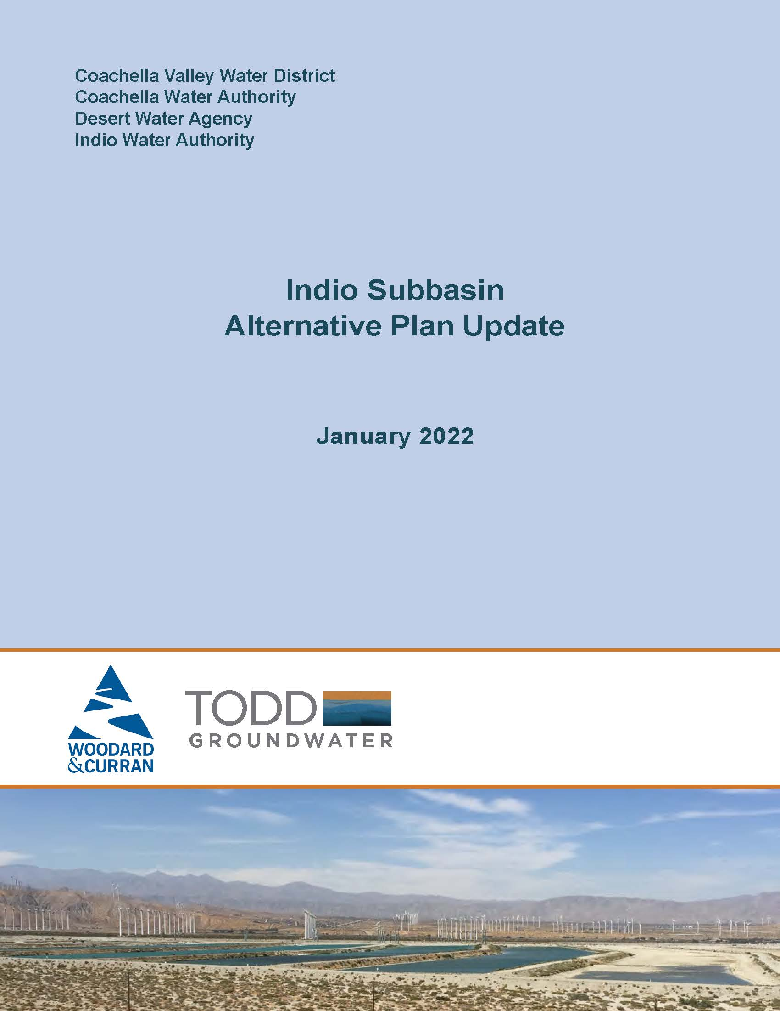
Status of Alternative Plan Update
Outline of 2022 Alternative Plan Update presents a progression of work
Introduction
Plan Area
Hydrogeologic Conceptual Model
Groundwater Conditions
Water Demand Projections
Existing Water Supplies
Water Budgets and Plan Scenarios
Emerging Issues
Sustainable Management Criteria
Monitoring Program
Projects and Management Actions
Implementation Plan

Slide 11
Agenda
Welcome and Introductions
Alternative Plan Status
Groundwater Conditions: Quality
Sustainable Management
Groundwater Model and Plan Scenarios
Public Comment
Get Involved

Slide 12
Groundwater Conditions: Water Quality
Alternative Plan Update includes:
Groundwater quality analysis
Maps for eight constituents
  Most recent samples from 1990-2019
  Relatively deep wells (>300 feet) in production zones
Cross-sections for TDS, NO3, Arsenic, Cr-6 to show vertical variation
Time concentration plots for TDS and nitrate
Discussion of significance, source(s), distribution factors
Constituents of Concern Included
Salinity (TDS)
Nitrate
Arsenic
Hexavalent chromium (Cr-6)
Fluoride
Perchlorate
Uranium
DBCP
12

Slide 13
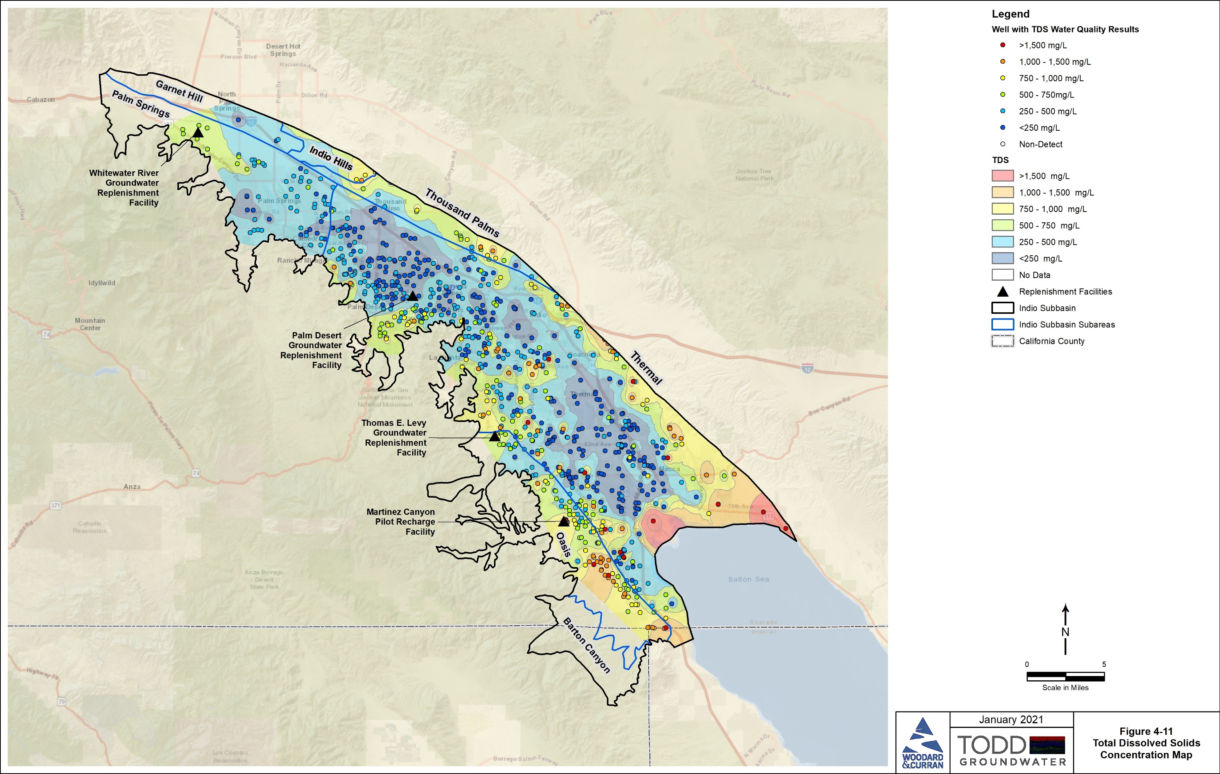
Groundwater Conditions: TDS
SWRCB Consumer Acceptance Levels
  recommended 500 mg/L
  upper 1,000 mg/L
  short-term 1,500 mg/L
From natural sources, return flows, imported water recharge, septic and wastewater disposal, subsurface inflow, and historical seawater inflow
Large areas are <500 mg/L with highest concentrations near Salton Sea and along basin margins
13

Slide 14
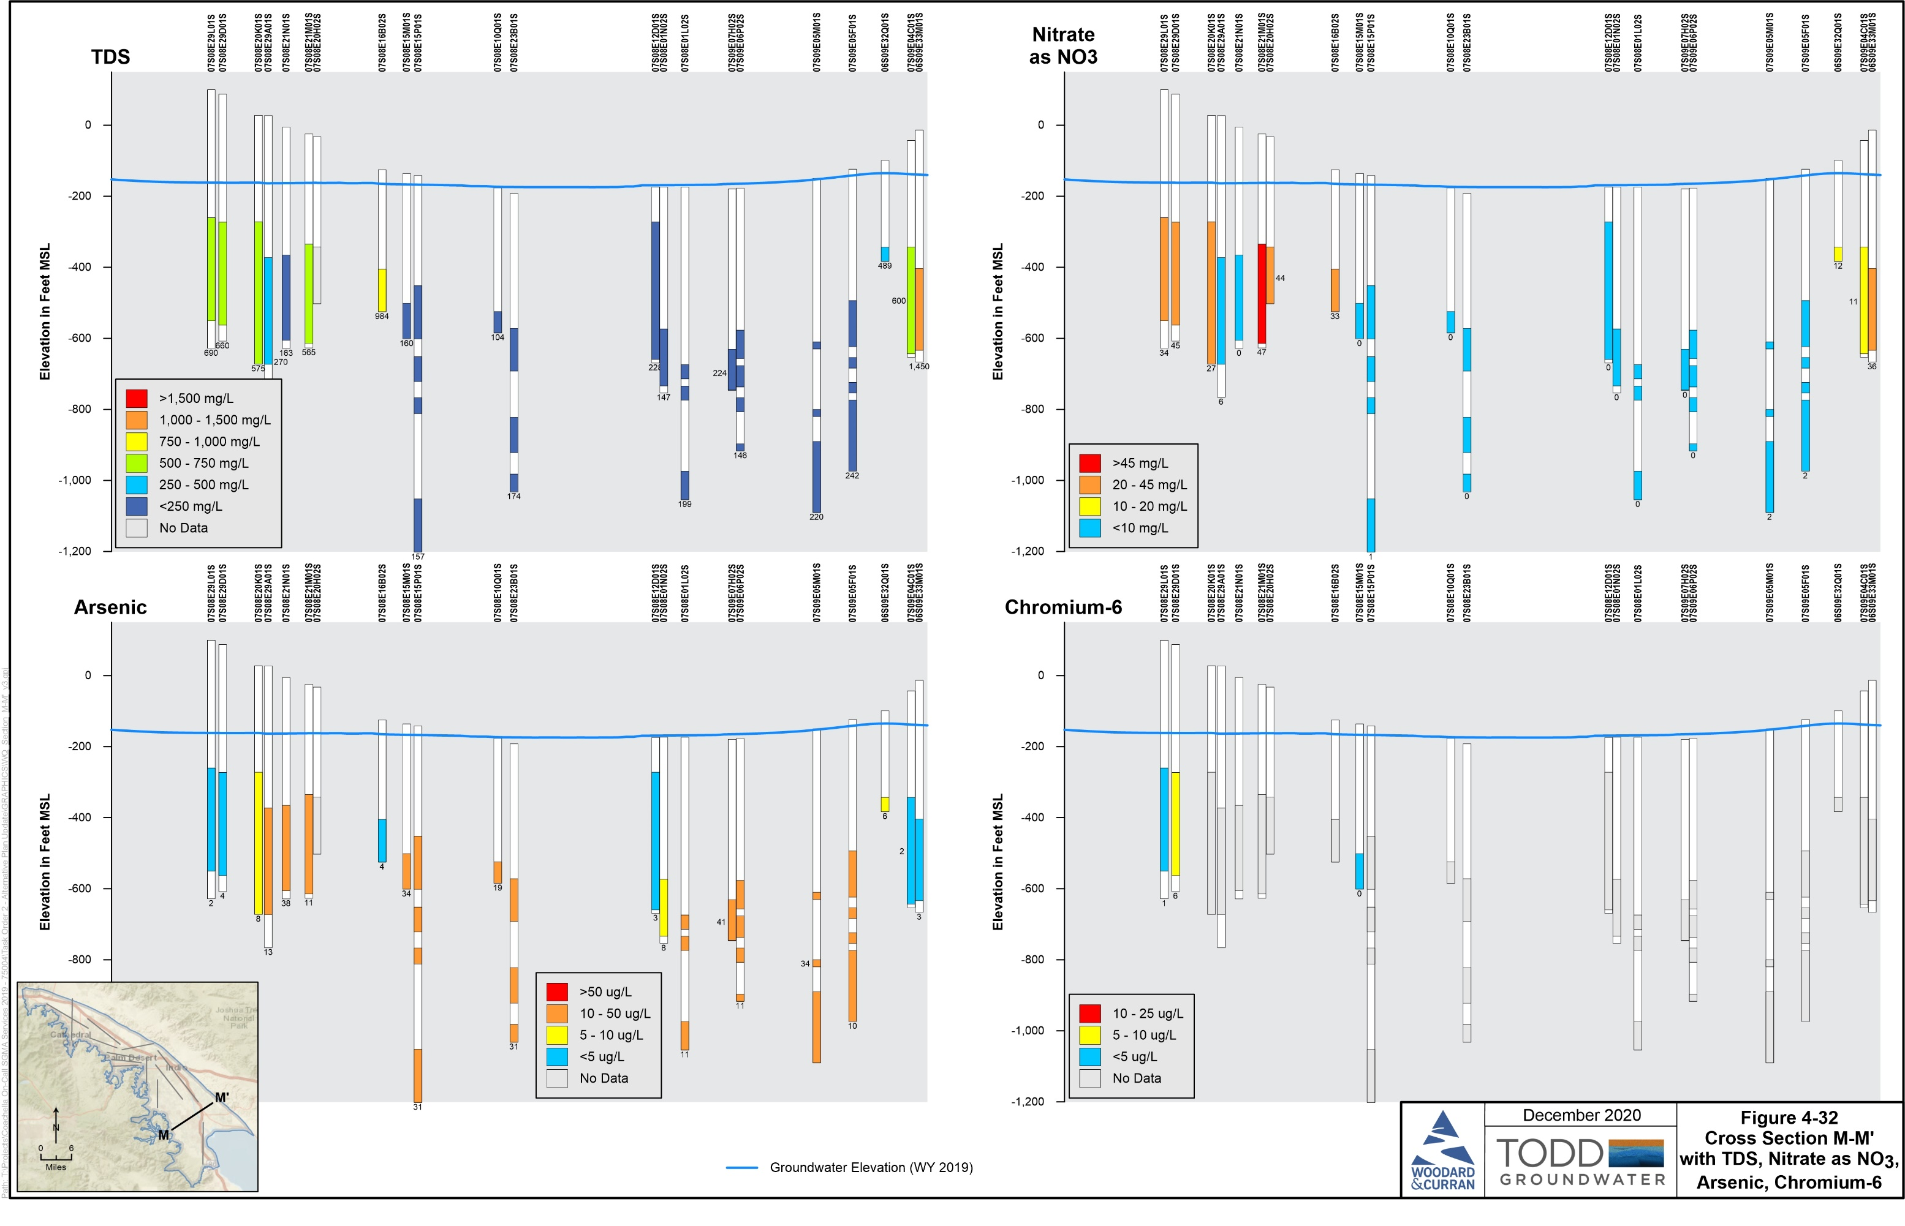
TDS Cross Sections
14 cross sections with TDS
Shallow wells (<300 feet) included to show vertical variations
Higher concentrations in shallower zones
Lower concentrations in deep wells
14

Slide 15
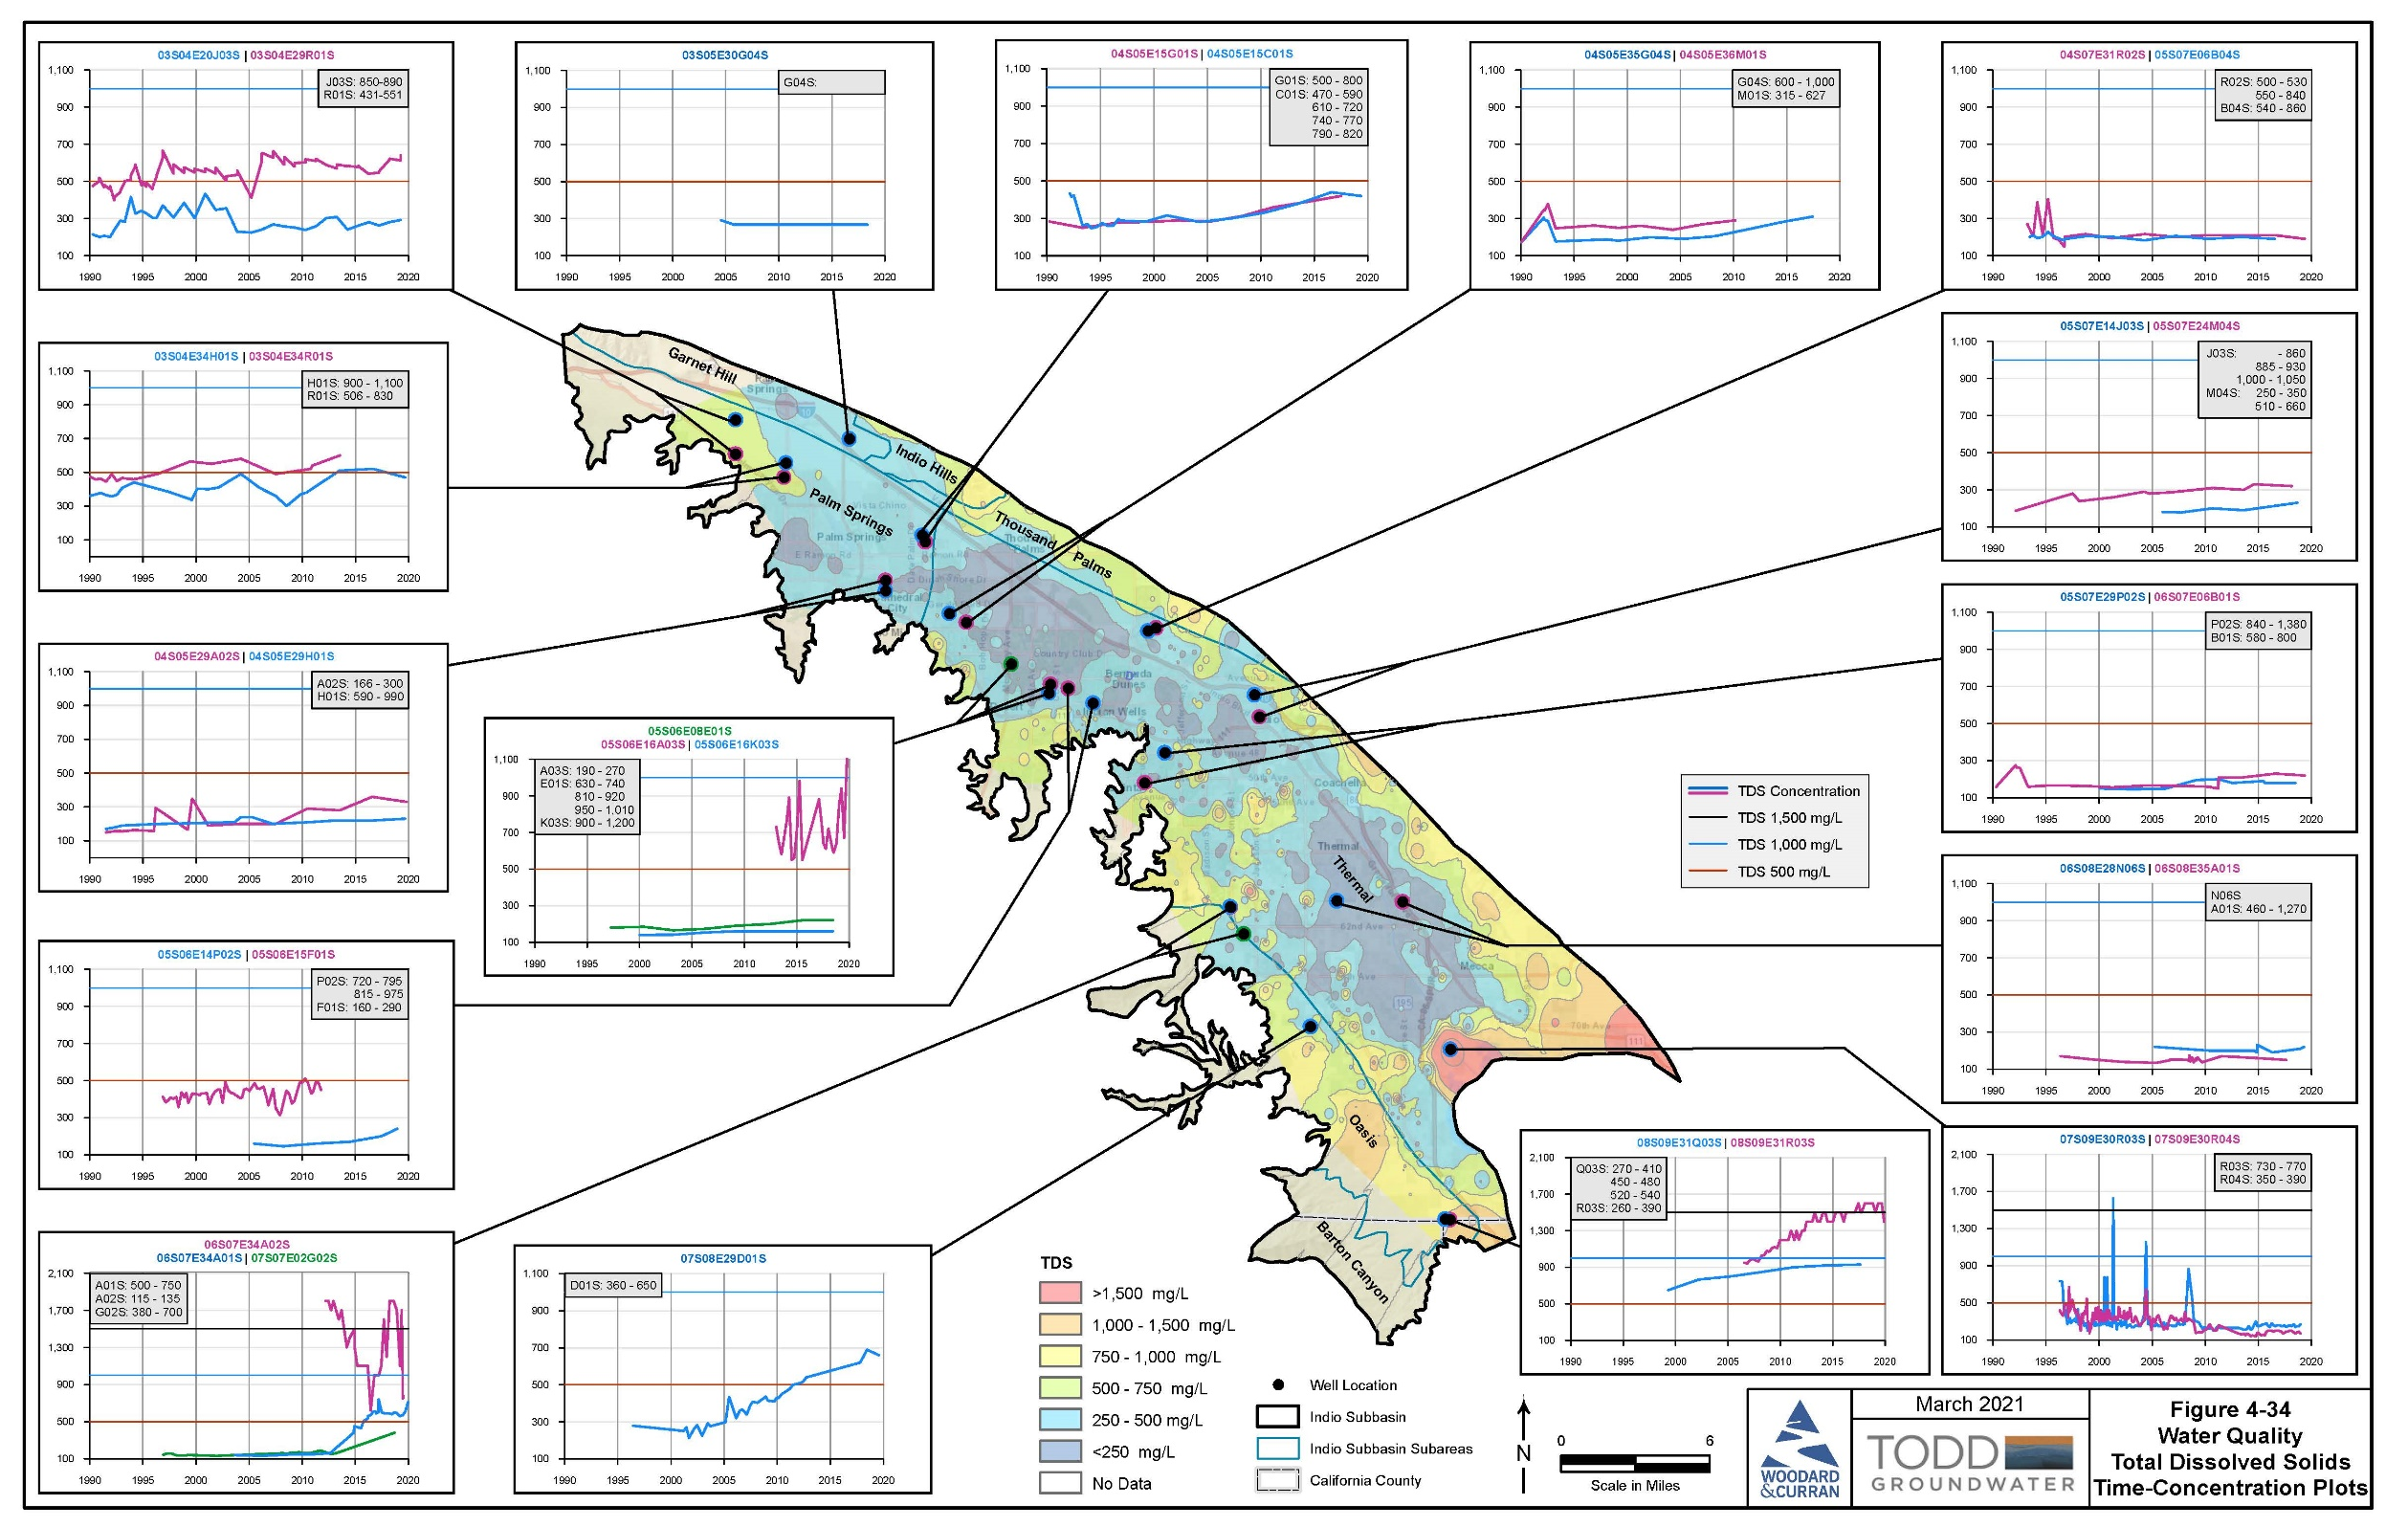
TDS Time-Concentration Plots
Shallow zones tend to have higher and more variable TDS
Increases in TDS since 1990 are shown with lower rates of increase in deep zones and in central/eastern Thermal subarea
These data will be used in CV-SNMP
15

Slide 16
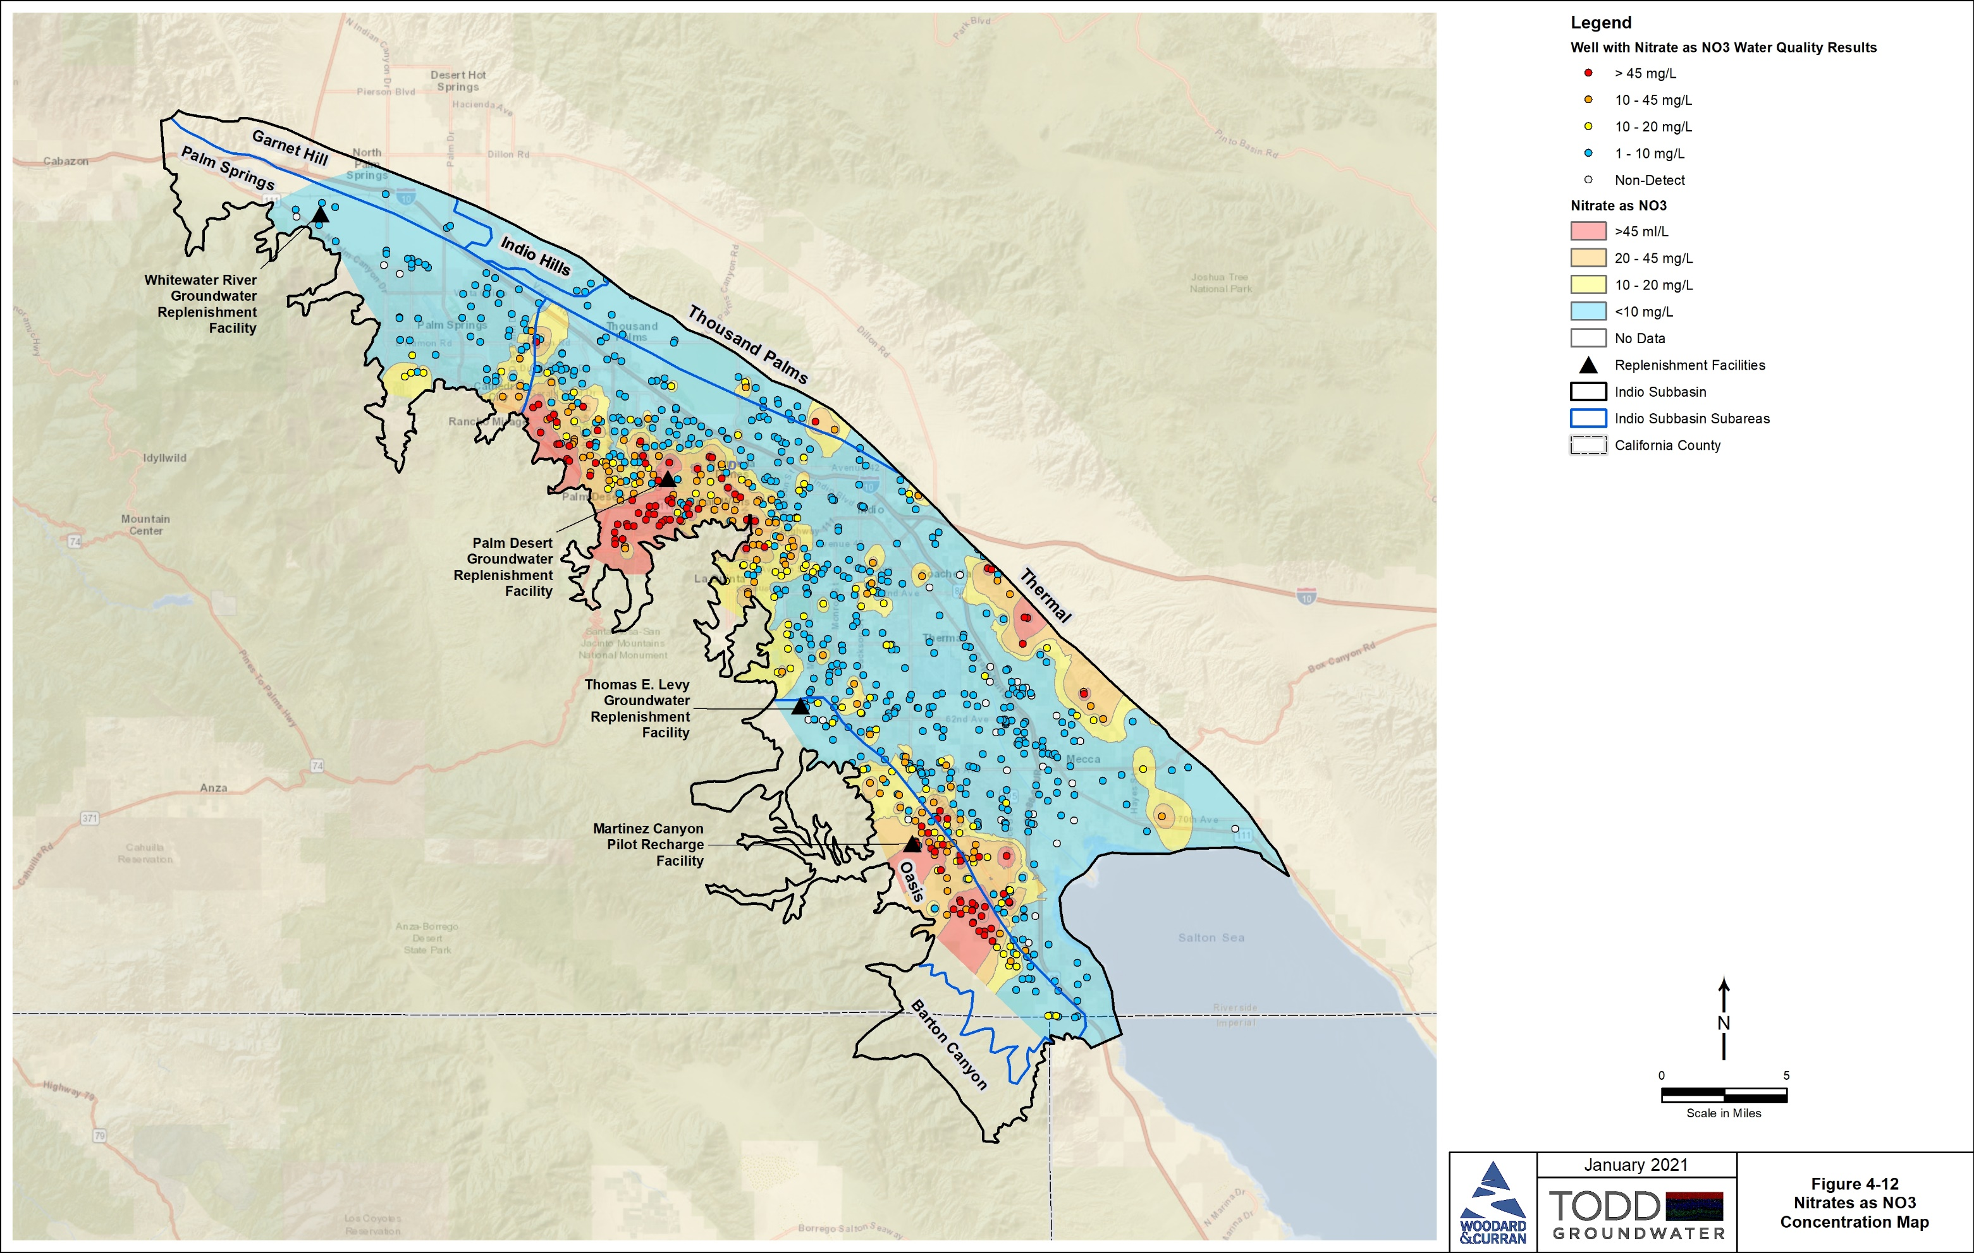
Groundwater Conditions: Nitrate
MCL is 45 mg/L as NO₃
Natural mesquite sources and loading from historical agriculture, landscaping, septic and wastewater disposal
Higher concentrations in shallow groundwater
16

Slide 17
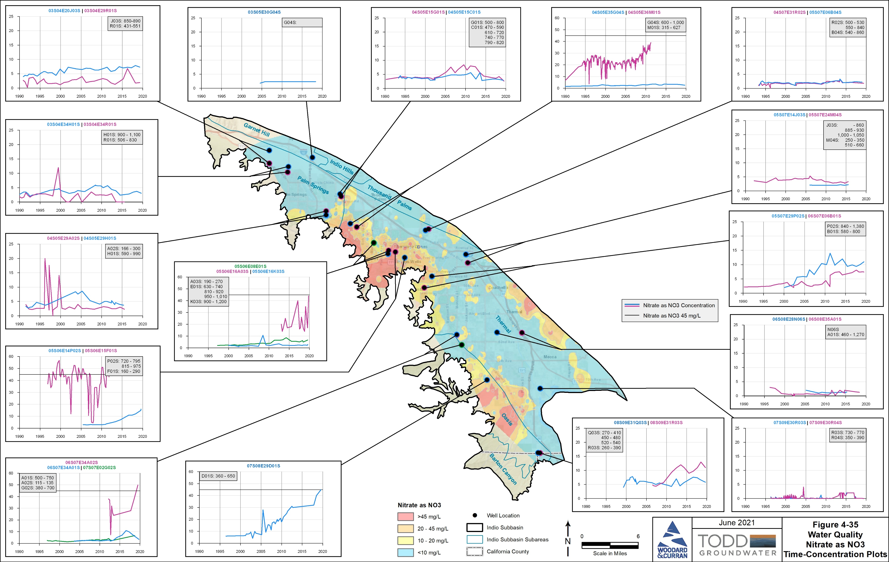
Time-Concentration Plots: Nitrate
Higher NO₃ in shallow zones than deep and more variable through time
Locally increasing in western areas that already have higher concentrations in shallow wells
These data will be used in CV-SNMP
17

Slide 18
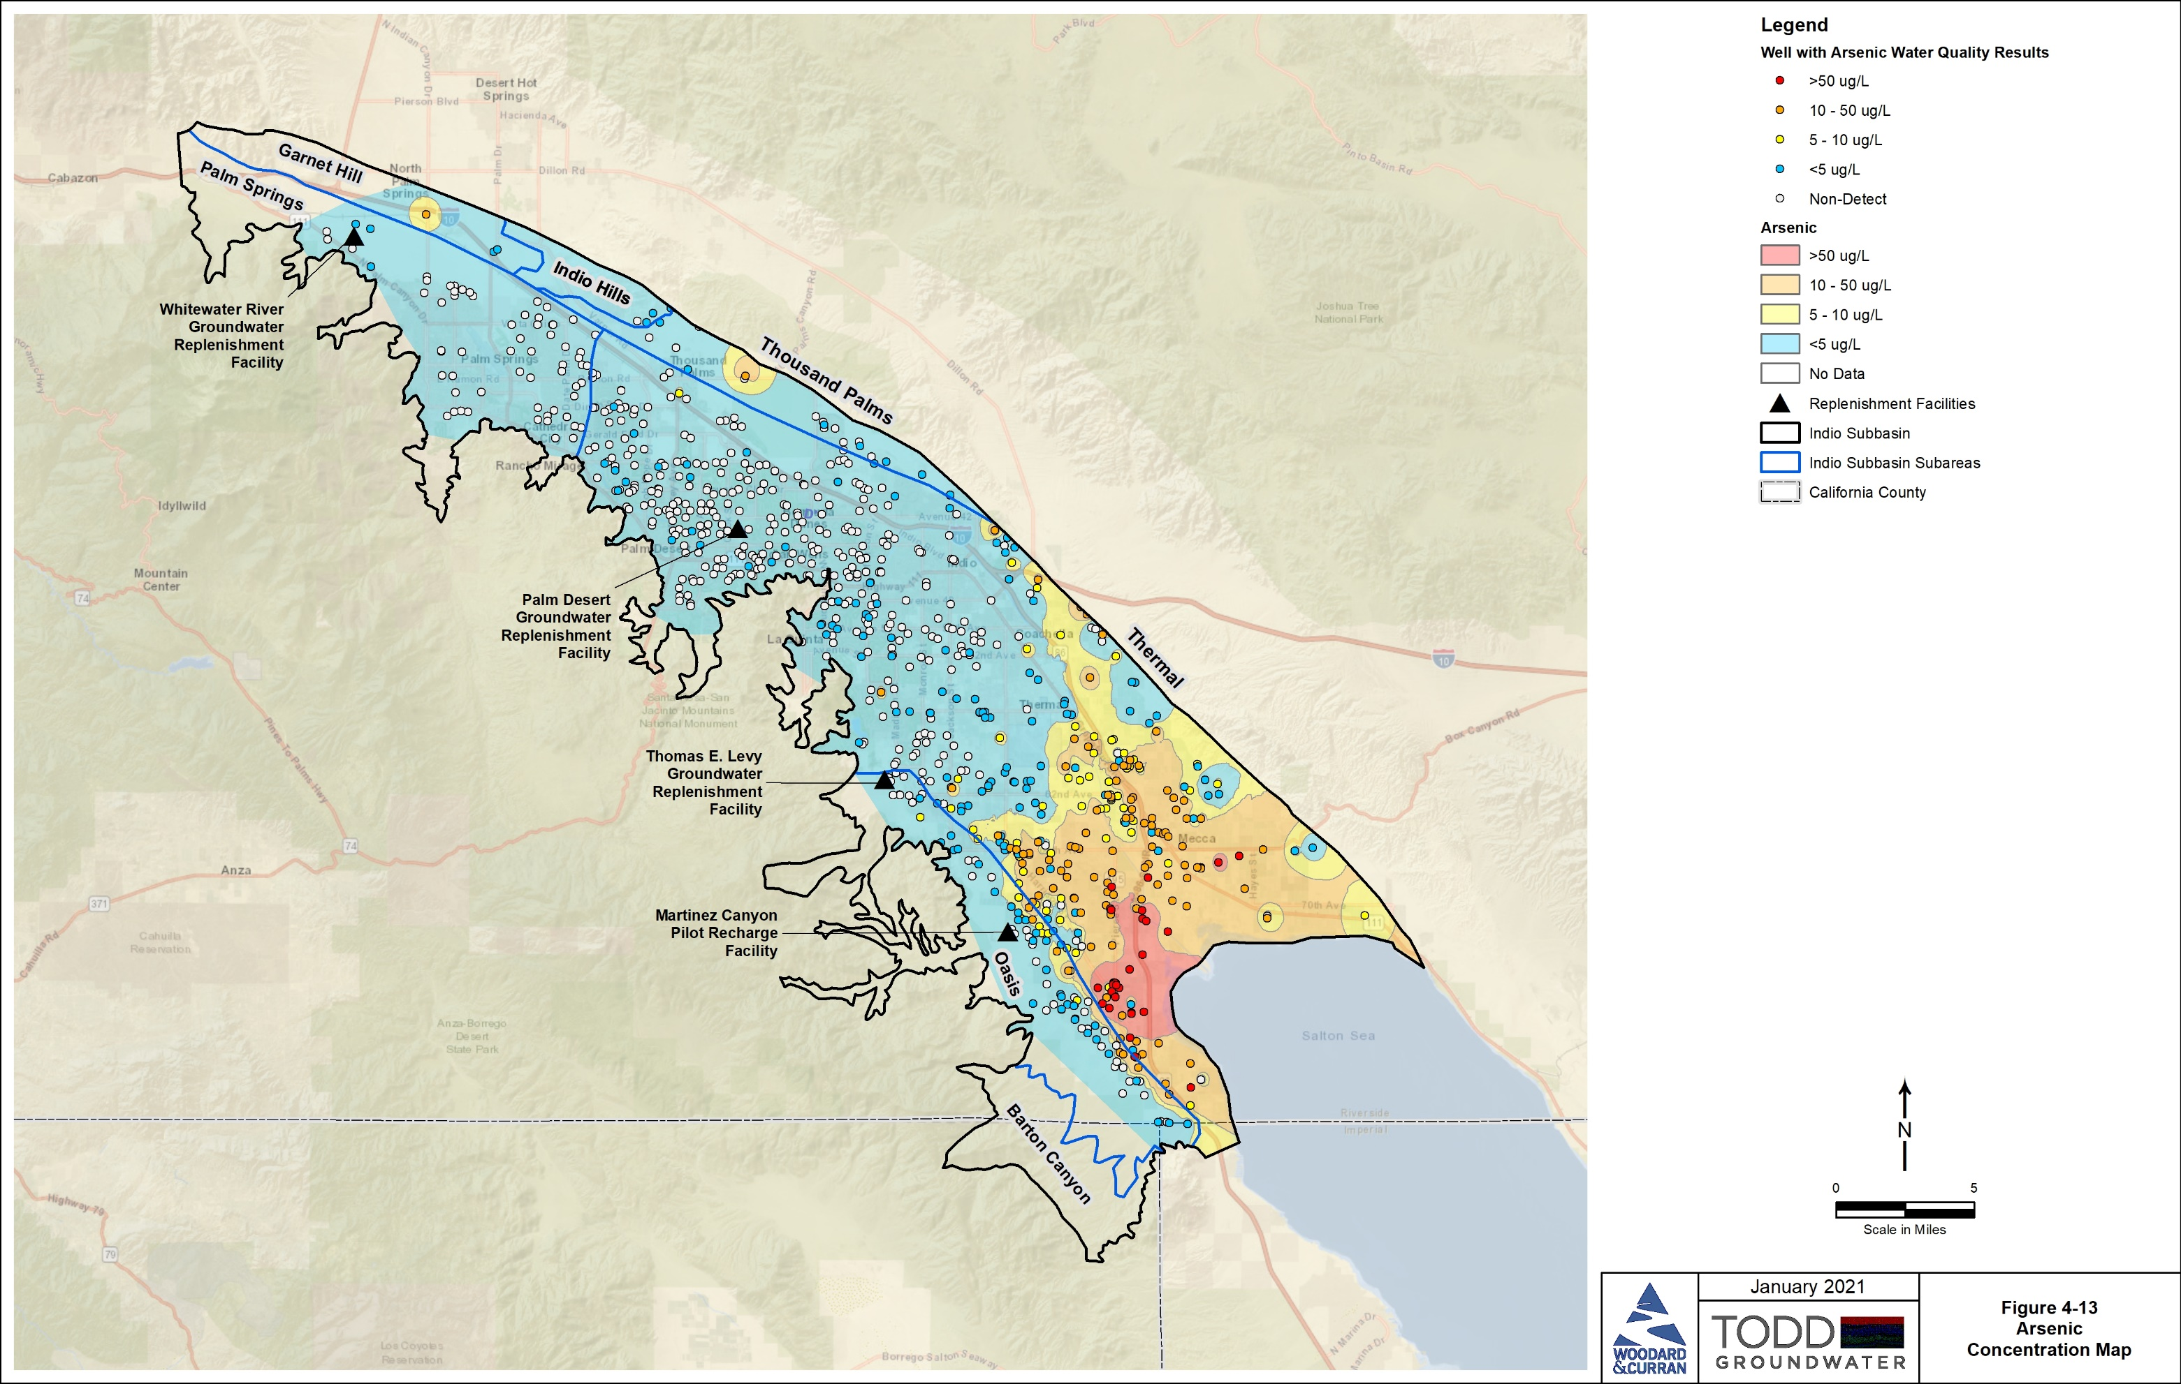
Groundwater Conditions: Arsenic
MCL is 10 μg/L
Natural due to geochemistry and/or geothermal factors
Wide occurrence in East Valley
Higher levels at depth
18

Slide 19
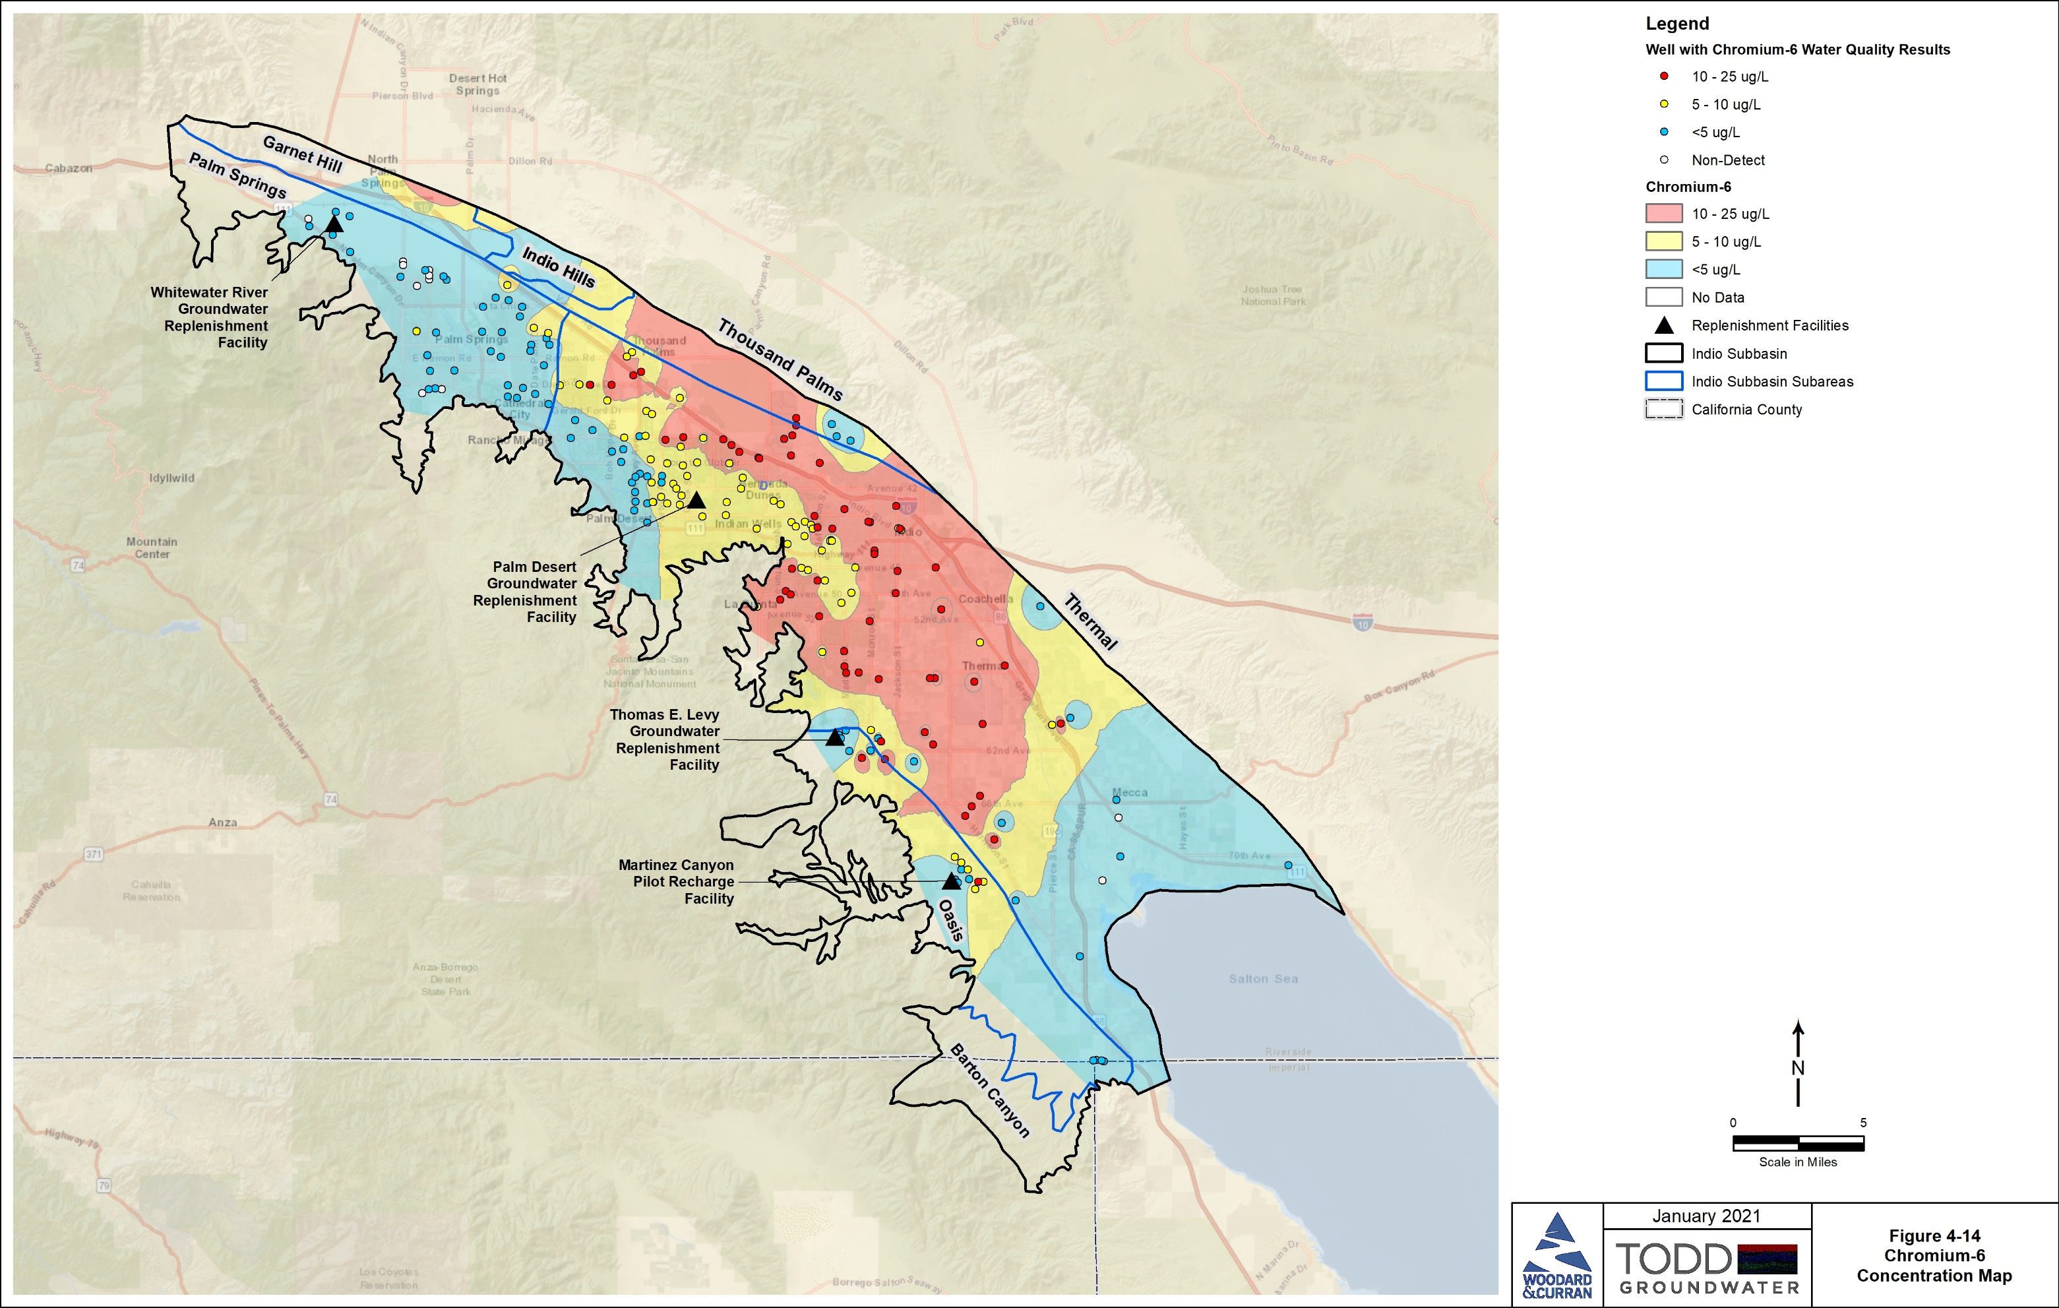
Groundwater Conditions: Chromium-6
MCL is 50 ug/L for total chromium
MCL for Cr-6 may be set lower requiring treatment
Natural sources likely in Indio Subbasin
Higher concentrations at depth
Levels are stable in most wells and decreasing near GRFs
19

Slide 20
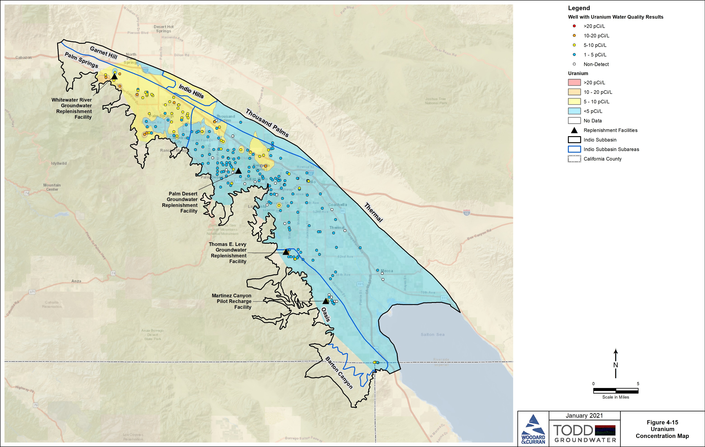
Groundwater Conditions: Uranium
MCL of 20 picocuries per liter
Likely from natural geologic sources
Higher in northwest, but below MCL
20

Slide 21
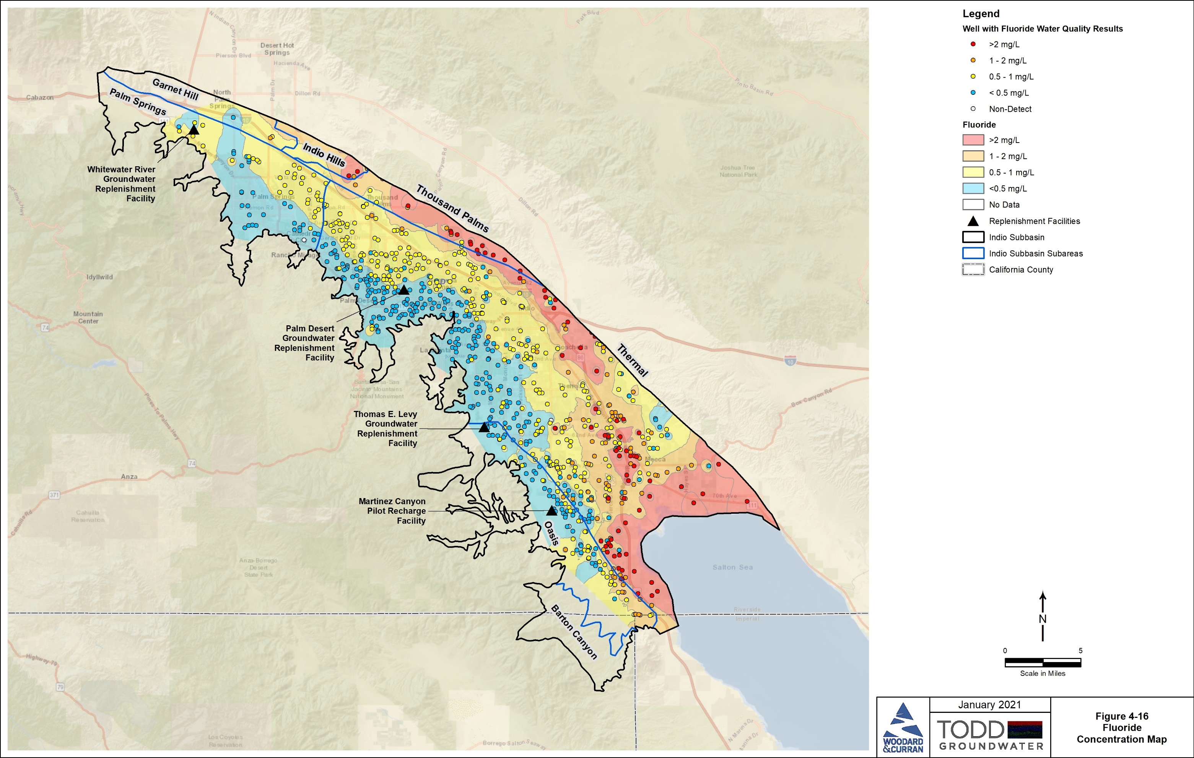
Groundwater Conditions: Fluoride
MCL of 2 mg/L
Naturally occurring
Associated with faulting and with geothermal areas near Salton Sea
21

Slide 22
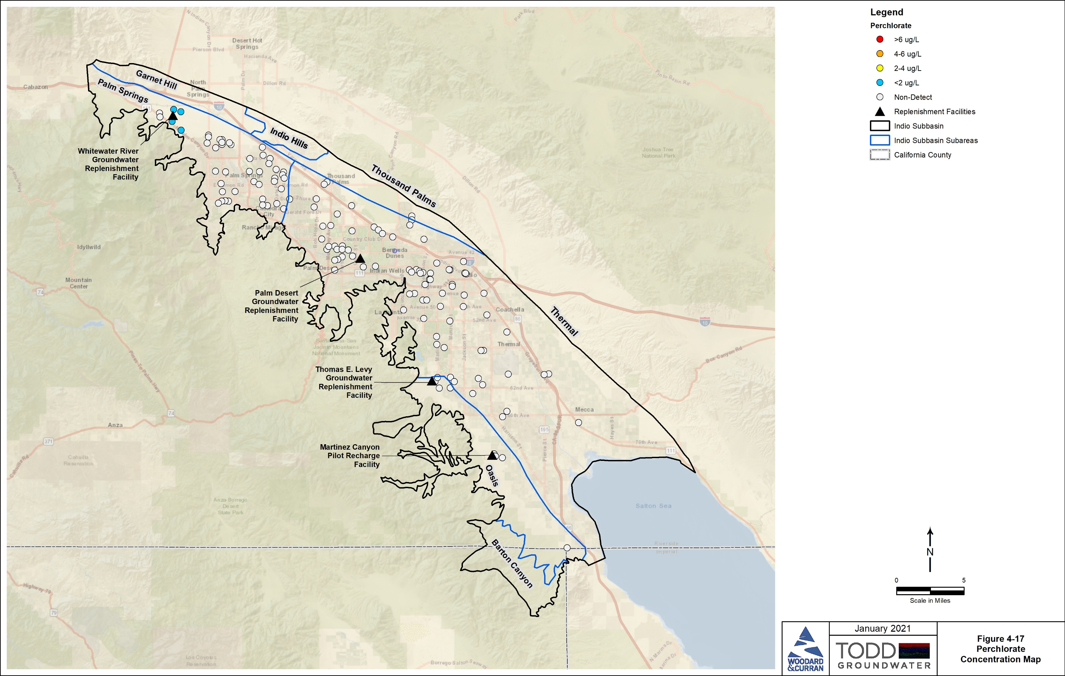
Groundwater Conditions: Perchlorate
MCL of 6 ug/L
Potential sources include industrial, fertilizer, and natural
Localized detections in groundwater are below MCL
22

Slide 23
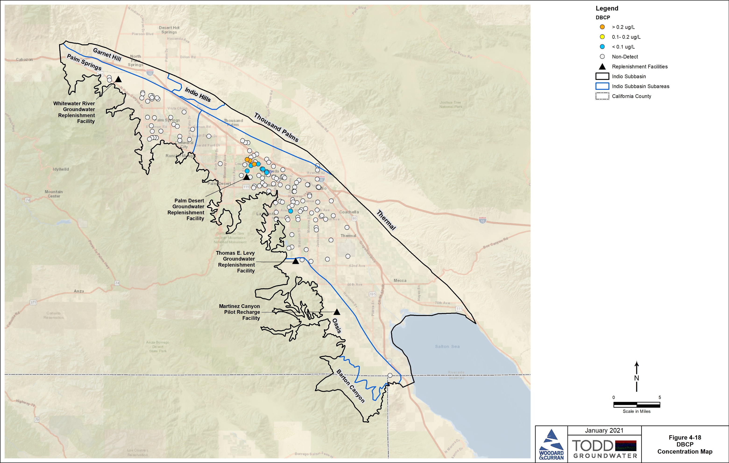
Groundwater Conditions: DBCP
MCL of 0.2 ug/L
Pesticide banned since 1979
Persistent in groundwater
Detected in small historical agricultural area
Most recent water samples show levels above MCL in only three private irrigation wells
23

Slide 24
Summary of Groundwater Quality
These constituents are being tracked by GSAs
Water from large water systems meets all drinking water standards
Domestic wells and small water systems may be affected by some constituents
  Nitrate (multiple sources)
  Naturally occurring Cr-6
  Naturally occurring Arsenic

Slide 25
Indio Subbasin – Groundwater Quality
Questions?

Slide 26
Agenda
Welcome and Introductions
Alternative Plan Status
Groundwater Conditions: GDEs
Sustainable Management
Groundwater Model and Plan Scenarios
Public Comment
Get Involved
Notes:
Our goals are to:
Enhance public understanding about water resources in the basin
Keep you—the public and stakeholders—informed about the GSP
Engage diverse interested parties and stakeholders
Respond to your concerns

Slide 27
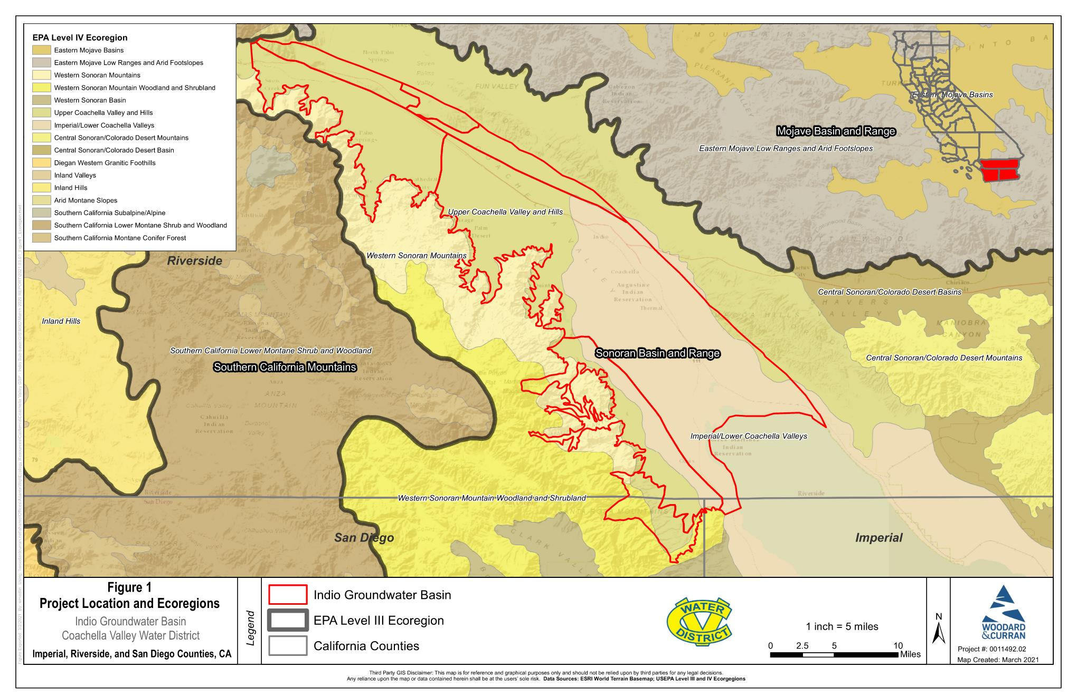
Review of USEPA Ecoregions
USEPA Level III and IV Ecoregions
Indio Subbasin sits within the Sonoran Basin and Range
Hot, dry mix of desert scrub and woodlands that occupy washes and canyons
27

Slide 28
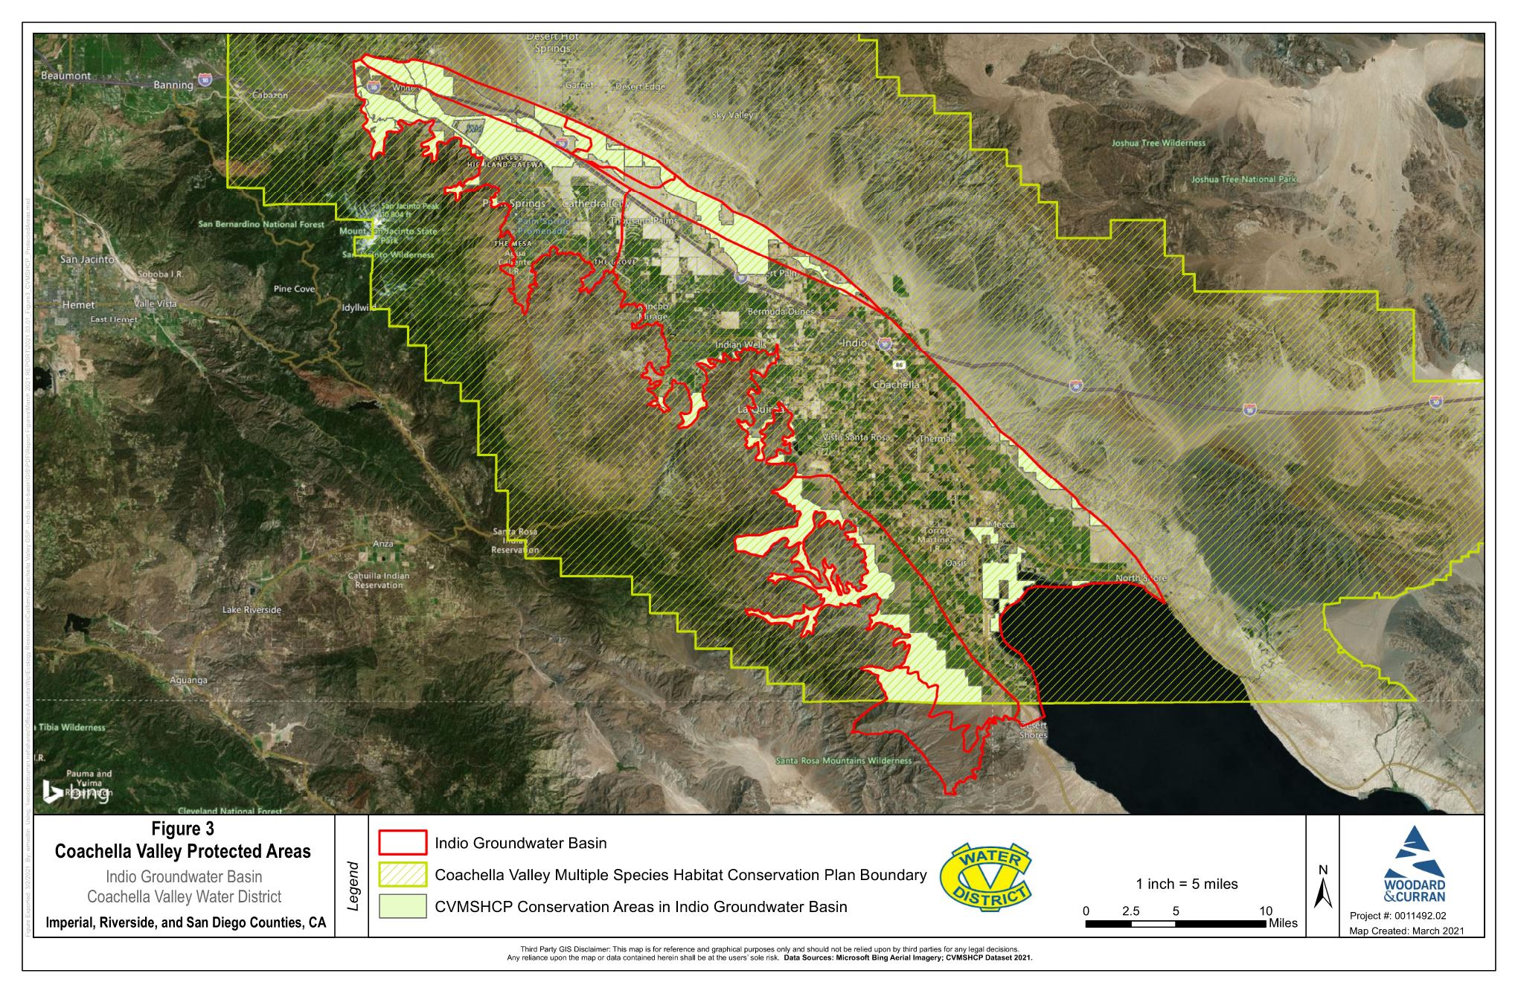
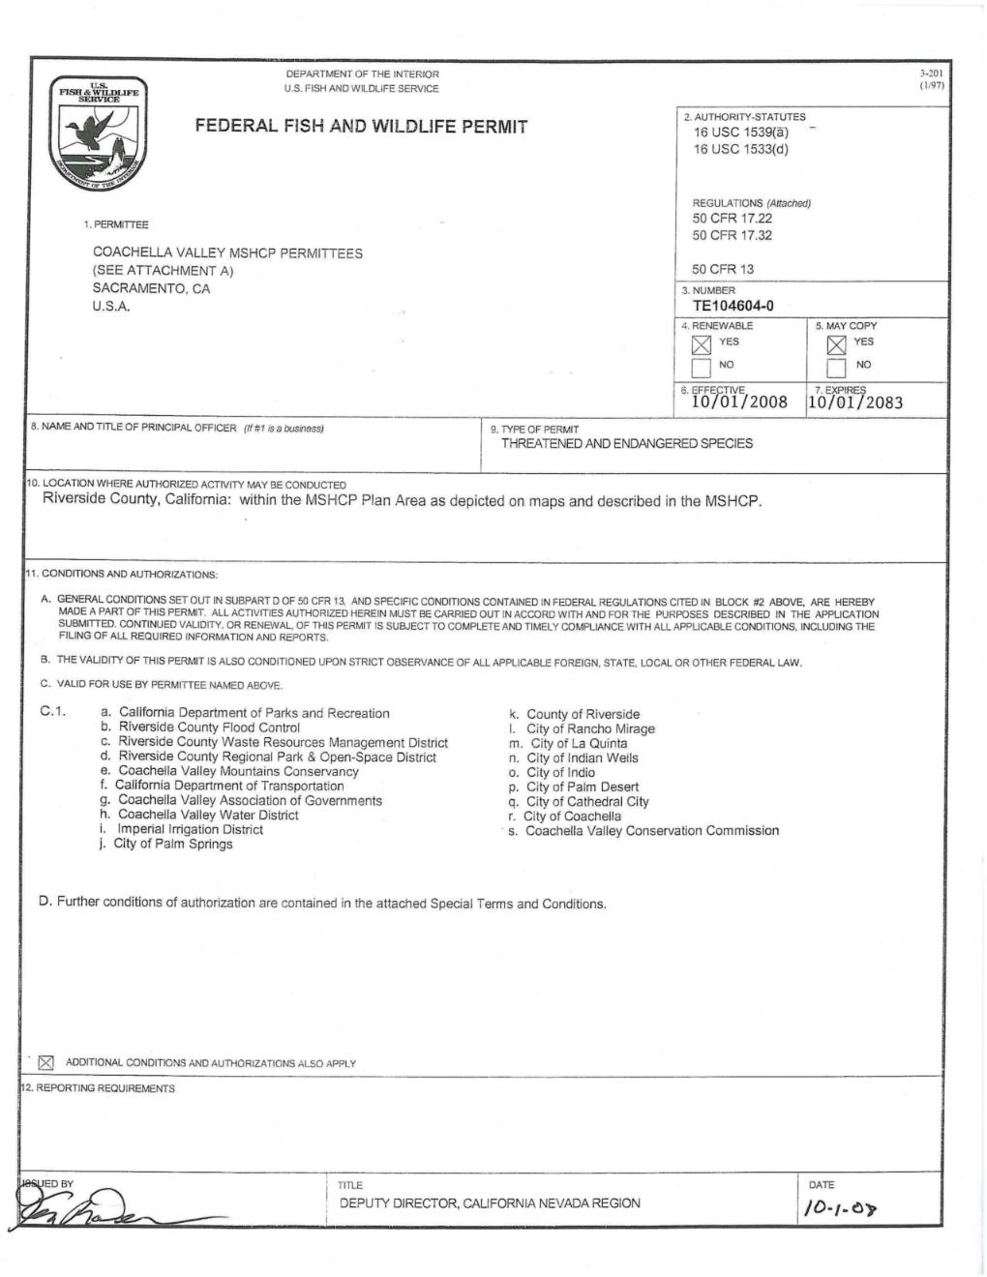
Review of Coachella Valley MSHCP
Indio Subbasin is largely covered by the Coachella Valley Multiple Species Habitat Conservation Plan (MSHCP)
CVWD, CWA, and IWA are permittees
28

Slide 29
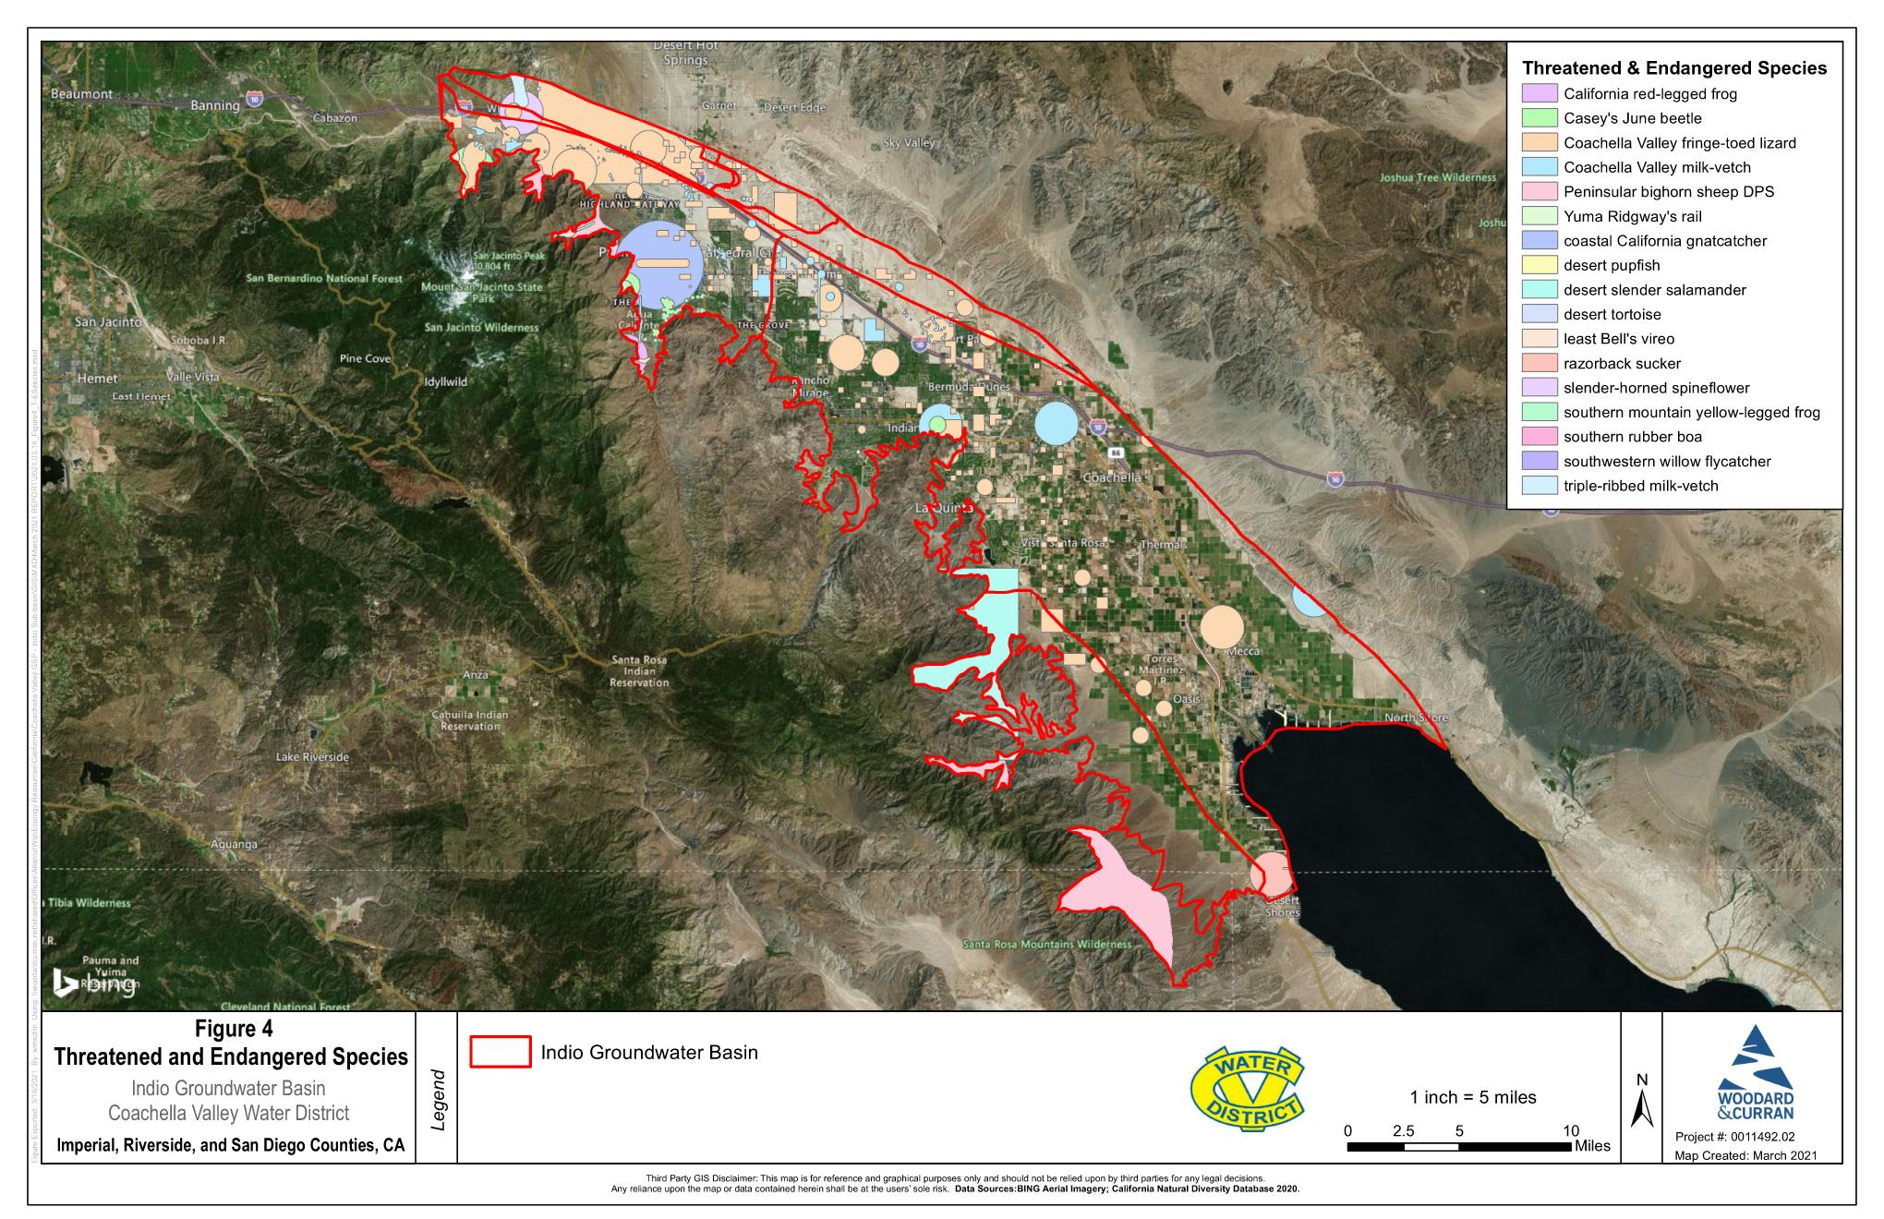
Review of Protected Species
Focused only on federal- and state-listed “Threatened & Endangered” species
17 listed species in Indio Subbasin
(CNDDB 2020)
  6 species “direct” reliance on groundwater
  7 species “indirect” reliance on groundwater
  Habitats along the mountain front may provide habitat for southwest willow flycatcher and least bell’s vireo
  Habitats around Salton Sea may provide habitat for desert pupfish and Yuma Ridgway’s rail

Slide 30
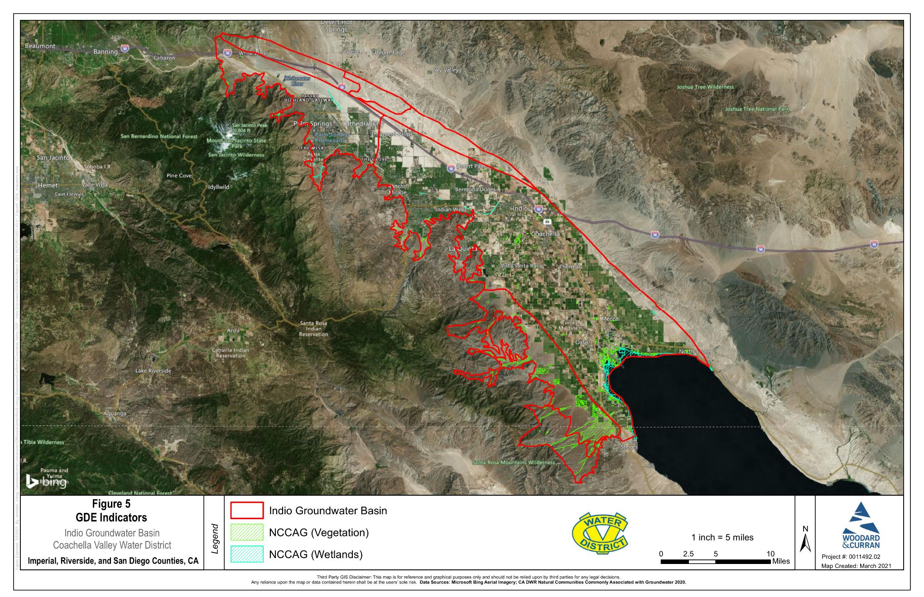
Groundwater Dependent Ecosystem (GDE)
Assessment and Results
Preliminary desktop analysis completed in 2020
Focused only on 882 mapped NCCAG Polygons
  746 NCCAG Vegetation
  136 NCCAG Wetland
30

Slide 31
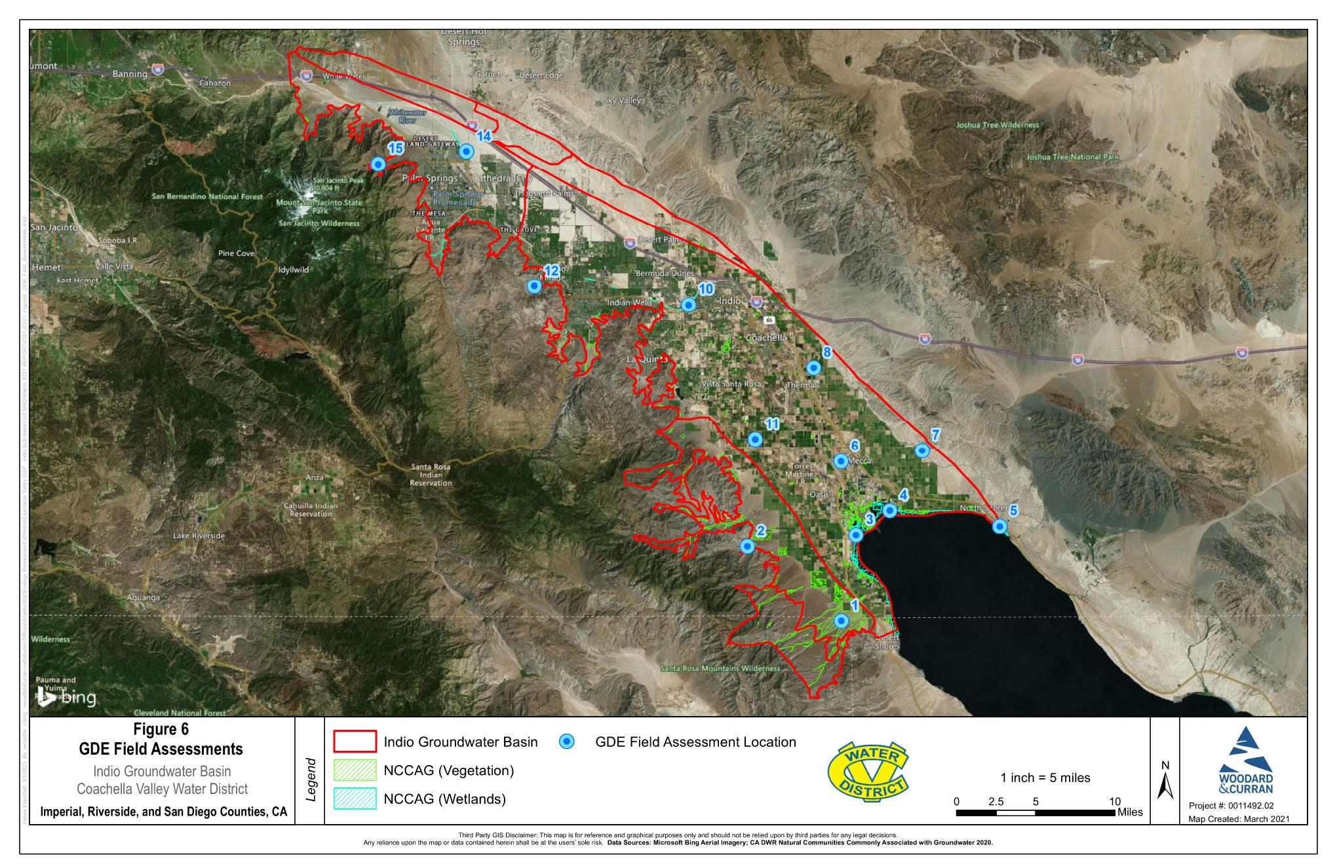
GDE Assessment and Results
Field surveys completed in January 2021
15 sites originally planned
Only 13 sites visited/surveyed due to access limitations
  Probable GDE =
  1 site (8%)
  Probable Non-GDE =
  9 sites (69%)
  Playa Wetlands =
  3 points (23%)
31

Slide 32
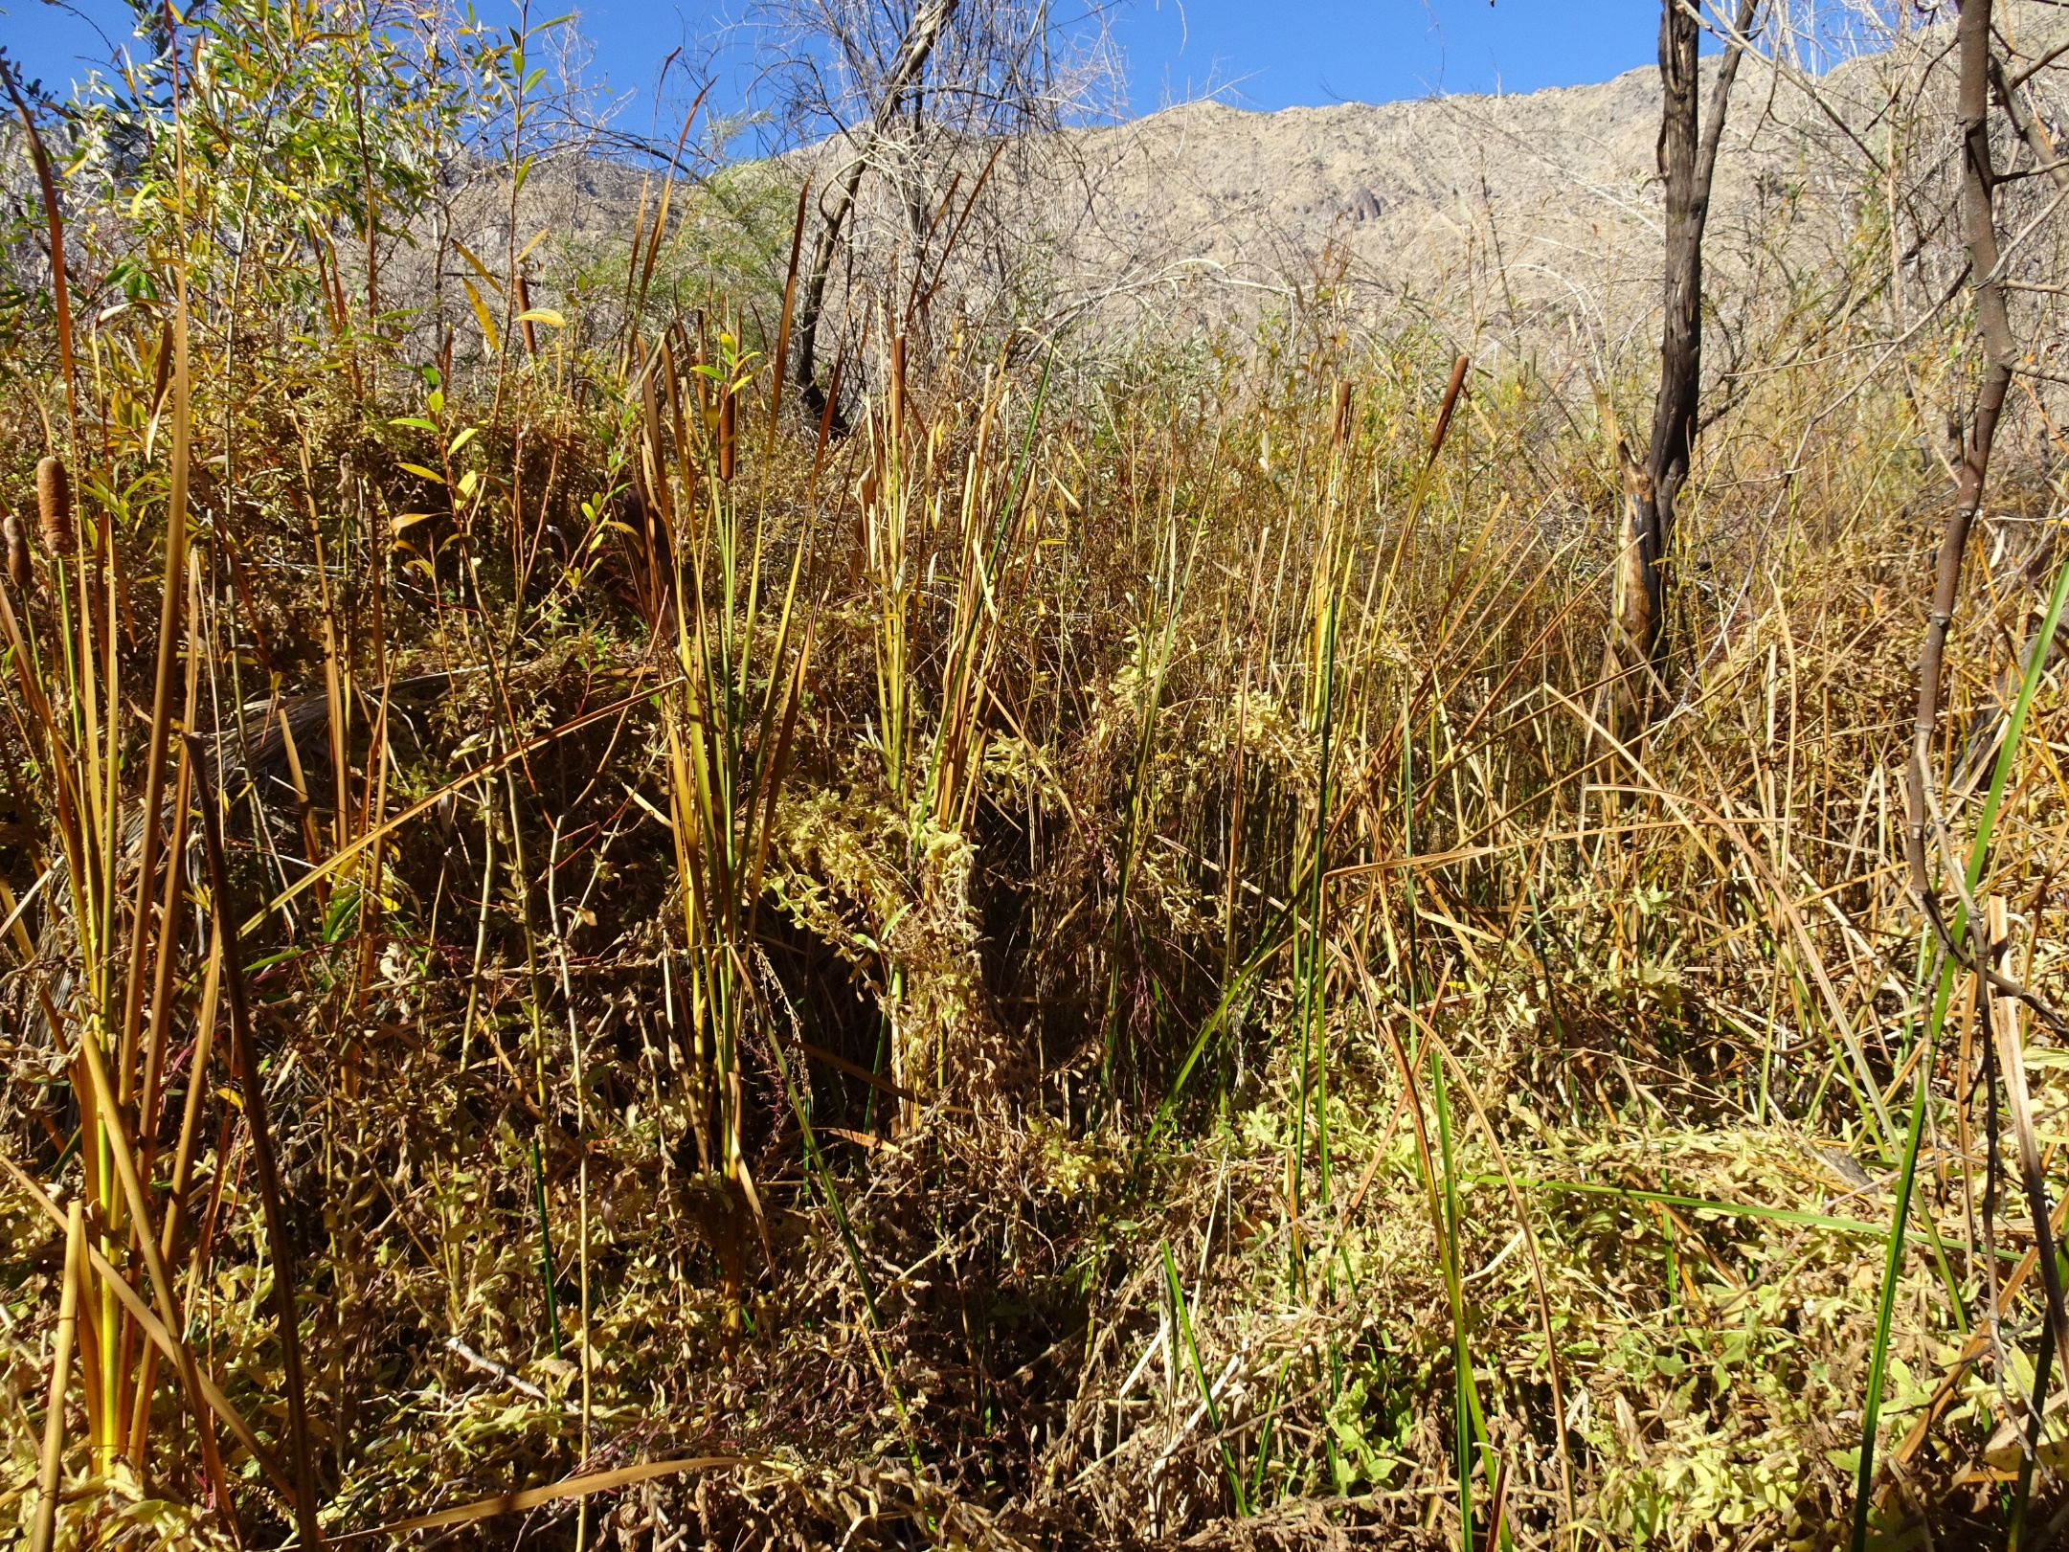
Probable GDEs – Site 15
Site 15 may be the only “Probable GDE” out of the 13 locations assessed in the field
Water was observed seeping from the ground during the field survey
Hydrophytes and phreatophytes present

Slide 33
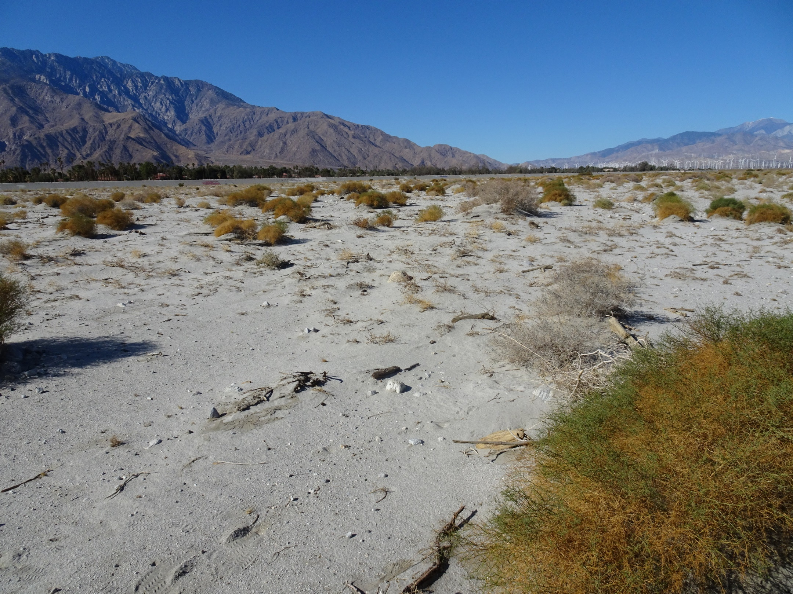
Probable Non-GDEs – Site 14
Site 14 is within the floodplain of the Whitewater River, a dry wash
No evidence of groundwater observed
Per CVWD, this area floods once every 2-3 years

Slide 34
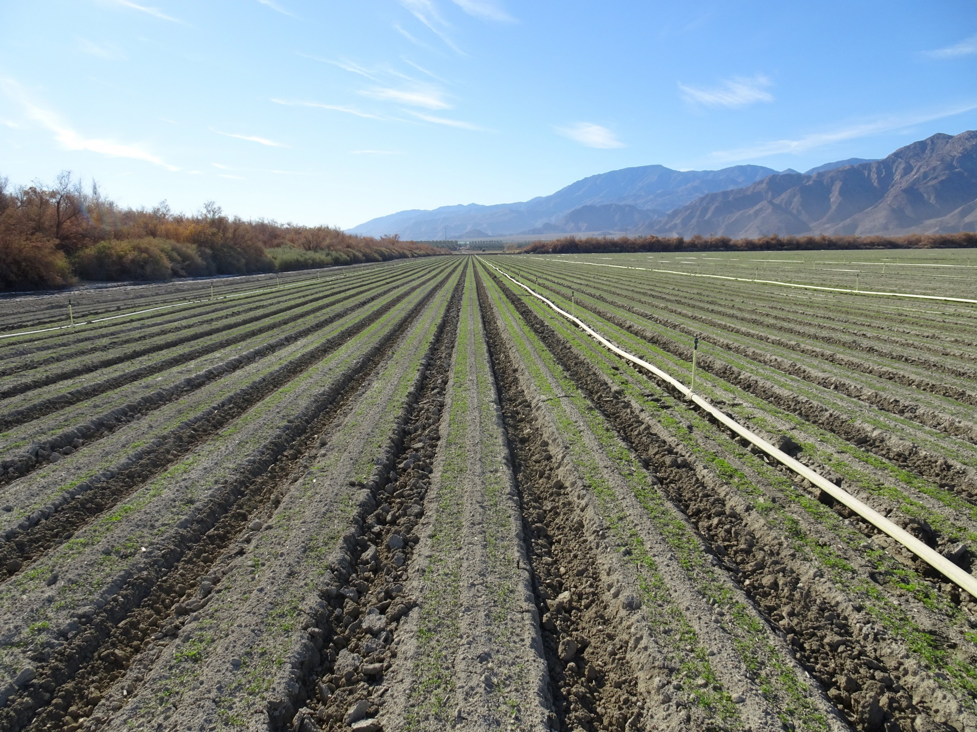
Probable Non-GDEs – Site 6
Site 6 is a recently planted agricultural field
Irrigation systems were observed actively watering fields
No evidence of groundwater observed

Slide 35
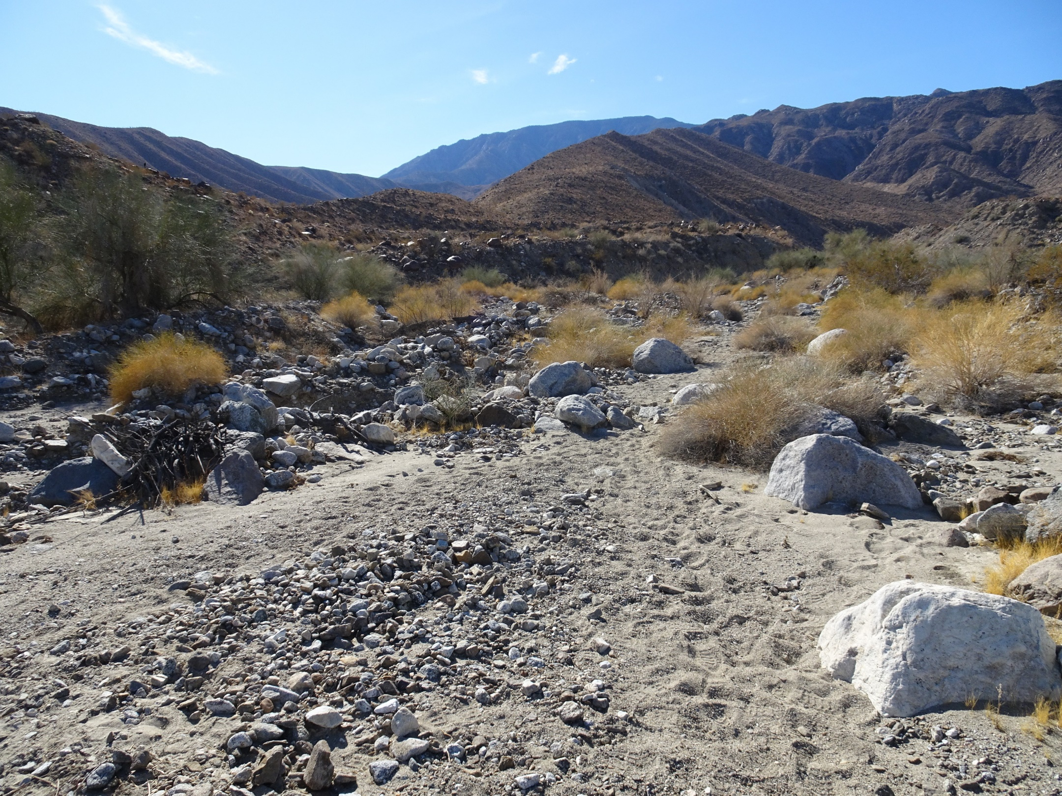
Probable Non-GDEs – Site 2
Site 2 is situated in a “bajada” or dry streambed full of alluvial material
Per CVWD, this area floods once every 2-3 years
No evidence of groundwater observed

Slide 36
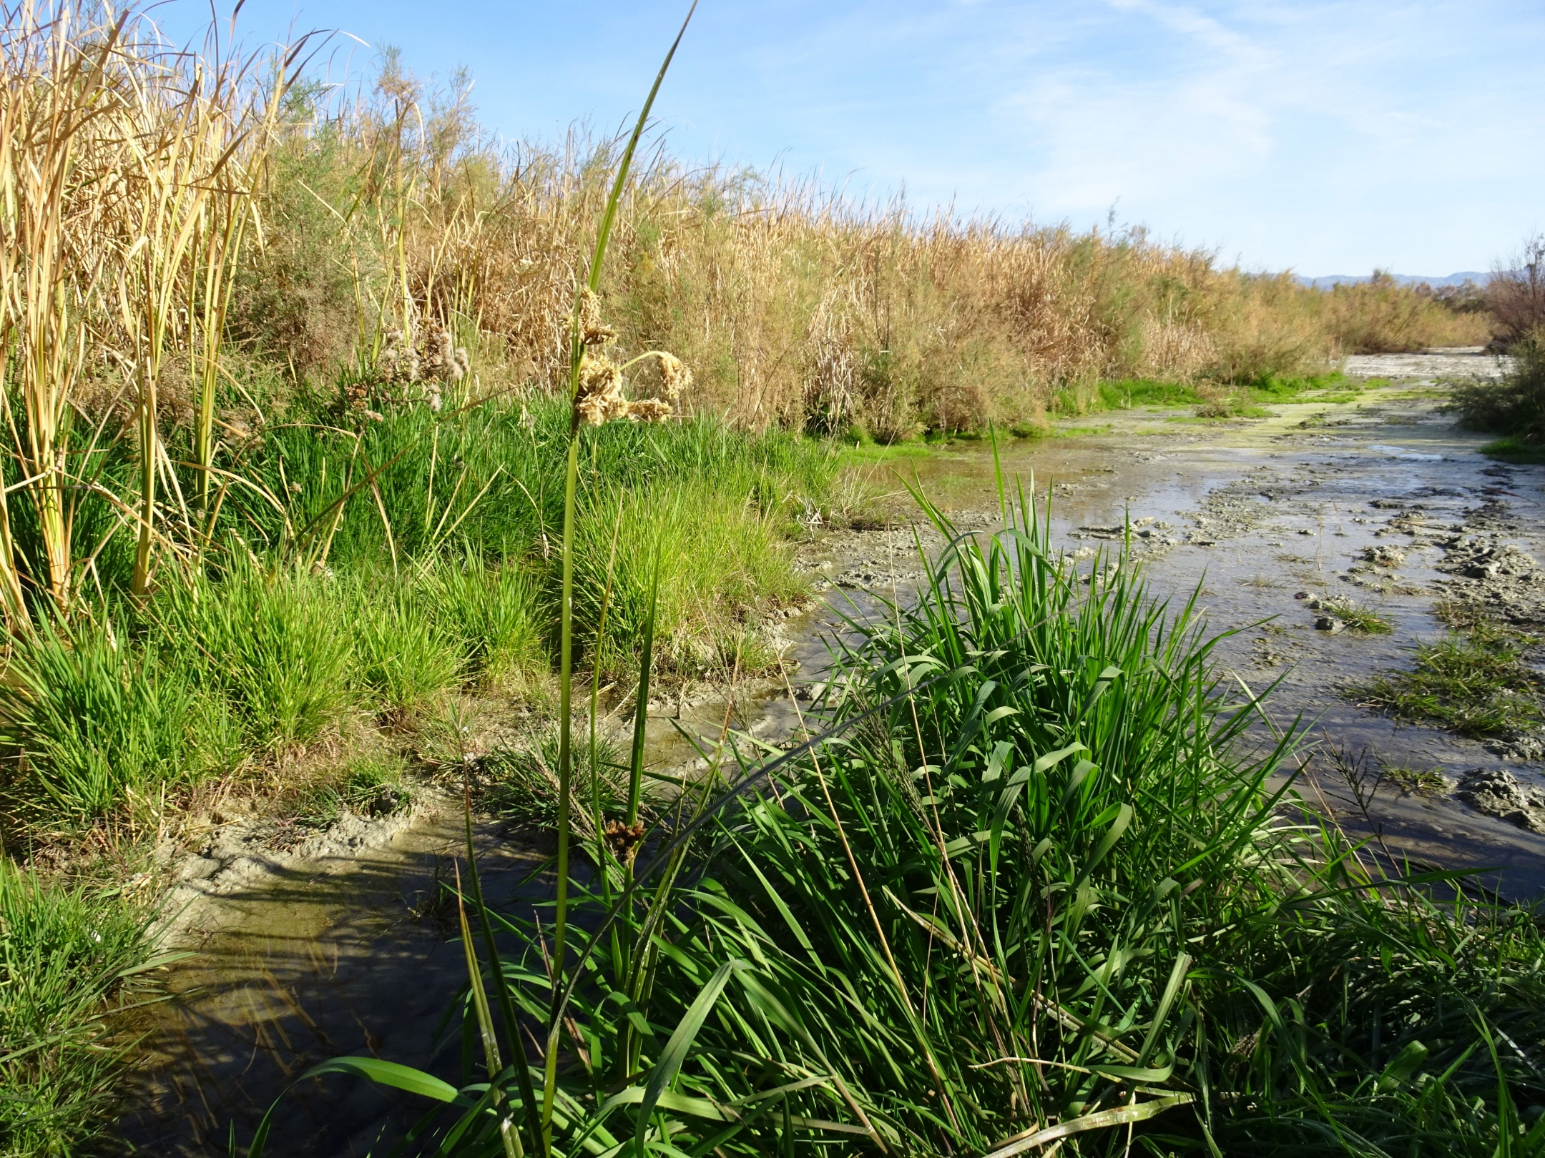
Playa Wetlands – Site 4
Site 4 is a lacustrine fringe emergent marsh wetland that receives irrigation return flow from the Grant Street Drain
Surface water and wetland dependent wildlife (fish and birds) observed
Hydrophytes and phreatophytes present

Slide 37
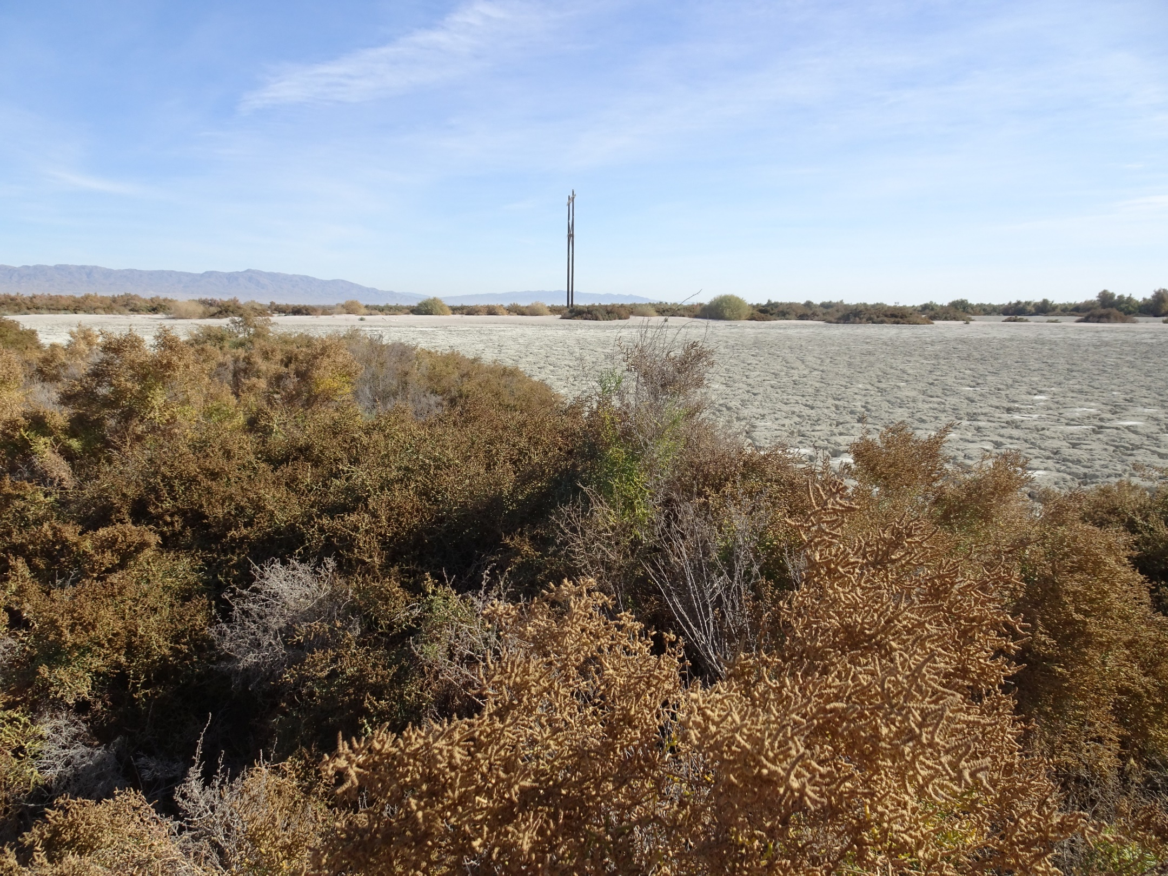
Playa Wetlands – Site 3
Site 3 is an exposed alkaline flat dominated by halophytes
Located east of the
74th Avenue Drain
Evidence of periodic inundation and saturation observed
Hydrophytes and phreatophytes present

Slide 38
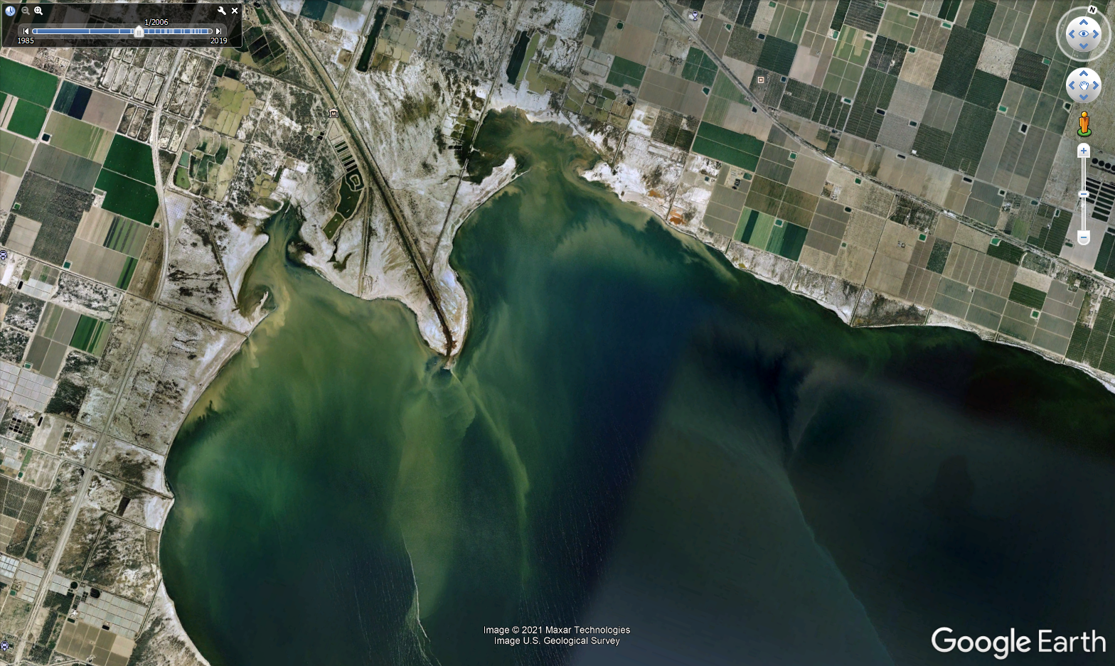
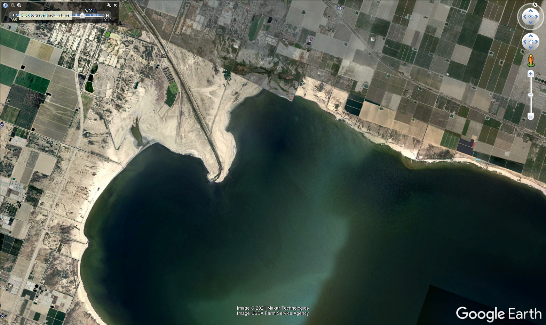
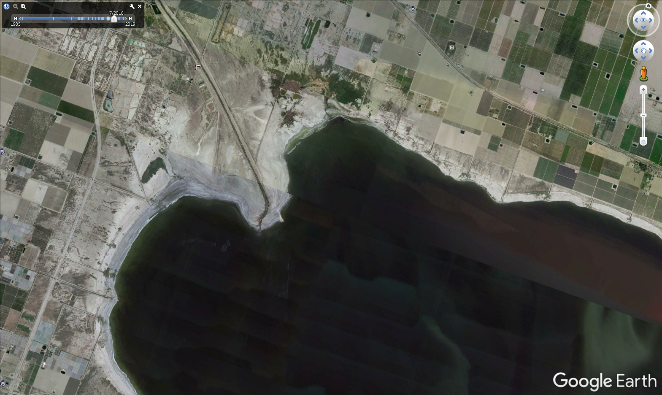
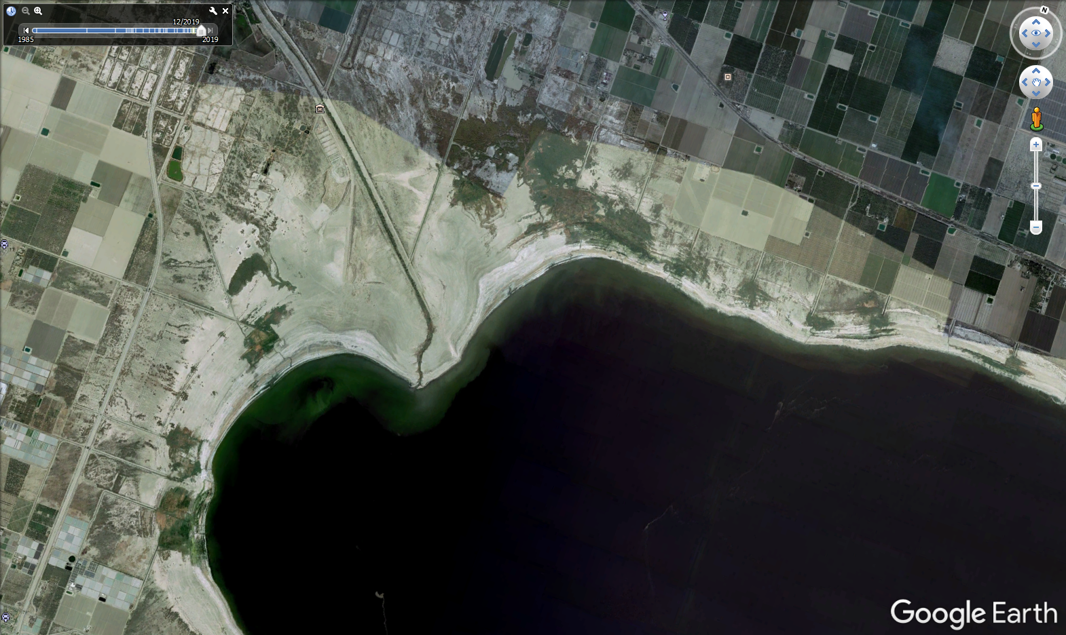
2006
2011
2016
2019

Slide 39
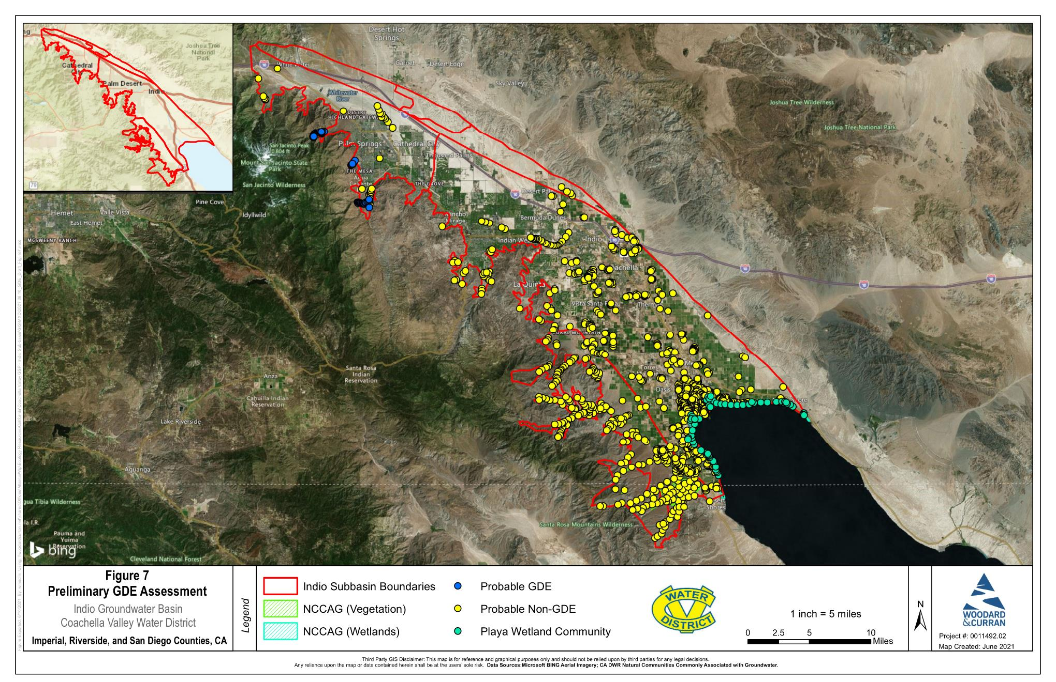
GDE Assessment and Results
Desktop work was then refined based on field survey information
1,045 assessment points
  Probable GDE =
  50 points (5%)
  Probable Non-GDE = 932 points (89%)
  Playa Wetlands =
  63 points (6%)
39

Slide 40
GDE Assessment Conclusions
GDEs have been assessed and mapped in the Indio Subbasin
Probable GDEs occur in mountain-front canyons and may rely partially on surface water or snowmelt
Playa wetlands occur along the Salton Sea exposed seabed near drain and surface water outlets
40

Slide 41
Indio Subbasin – GDE Assessment
Questions?

Slide 42
Agenda
Welcome and Introductions
Alternative Plan Status
Groundwater Conditions
Sustainable Management
Groundwater Model and Plan Scenarios
Public Comment
Get Involved
Notes:
Our goals are to:
Enhance public understanding about water resources in the basin
Keep you—the public and stakeholders—informed about the GSP
Engage diverse interested parties and stakeholders
Respond to your concerns

Slide 43






Sustainable Management: Recap
Chronic lowering of groundwater levels
Reduction of groundwater storage
Land subsidence
Degraded water quality
Seawater intrusion
Depletions of connected surface water with impacts on beneficial uses including GDEs
We discussed these criteria in detail last workshop.
Here is a recap.

Slide 44
Sustainable Management: Recap
DWR Recommendations:
  Set Minimum Thresholds (MTs) for groundwater levels
  Consider using levels as a proxy for storage and subsidence
Groundwater levels, storage, and subsidence are correlated.
MT defined to avoid undesirable results of significant + unreasonable:
  Loss of yield from existing production wells due to chronic level decline
  Reduction of groundwater storage
  Reduction in the viability of water conveyance, flood control and other infrastructure due to subsidence

Slide 45
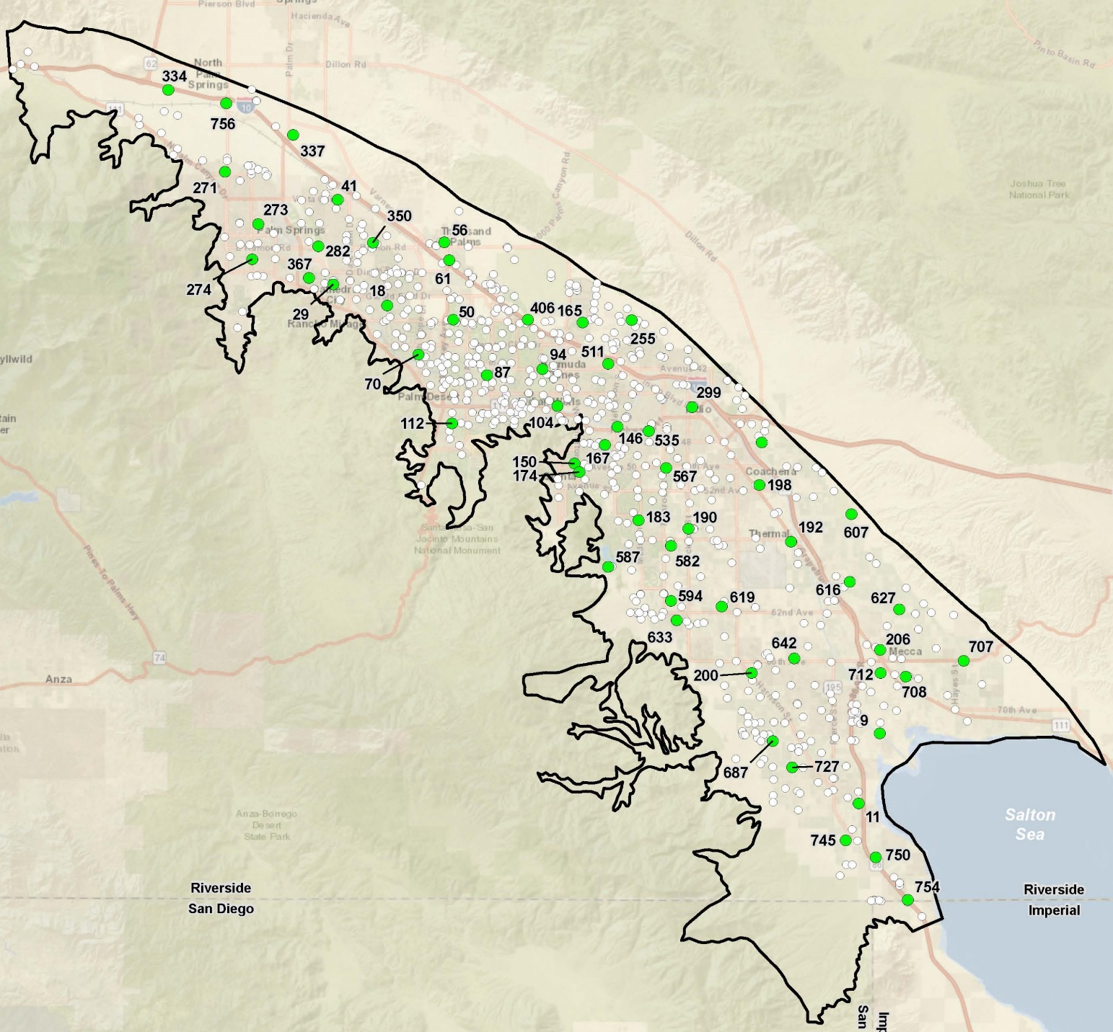
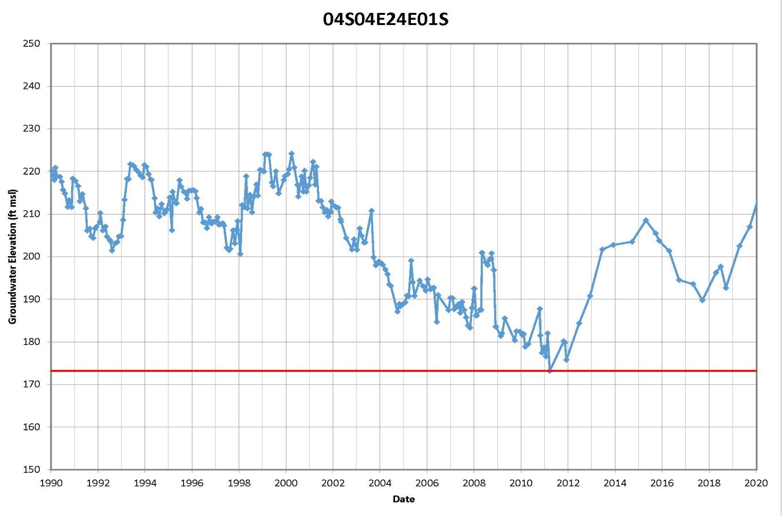
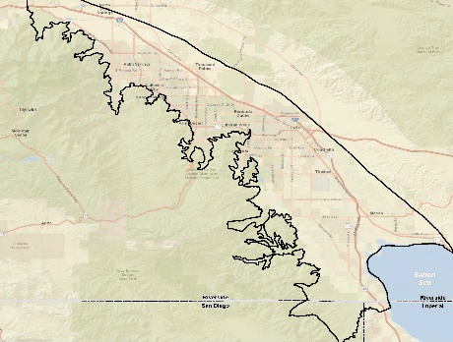
Sustainable Management: Recap
MTs for groundwater levels defined as historical lows as measured at 57 Key Wells:
An undesirable result occurs when the MT is crossed in five consecutive low-season monitoring events in 25% of wells across the subbasin
GSAs will monitor levels, respond as needed, and provide annual reporting

Slide 46
Sustainable Management Update
Chronic lowering of groundwater levels
Reduction of groundwater storage
Land subsidence
Degraded water quality
Seawater intrusion
Depletions of connected surface water with impacts on beneficial uses including GDEs
DWR provided specific recommendations for these criteria.
Here is an update.

Slide 47
Sustainable Management: Water Quality
DWR Recommendation:
Provide maps of constituents of concern:
Fluoride
Arsenic
Hexavalent chromium
DBCP
This update also provided:
Salinity
Nitrate
Uranium
Perchlorate

Slide 48
Sustainable Management: Water Quality
DWR Recommendation:
Continue to study the rate and level of increased salt contents in groundwater due to the importation of Colorado River water.
Incorporate an approved Salt and Nutrient Management Plan into future iterations of the Alternative Plan.

Slide 49
Groundwater Conditions: Salinity Studies/SNMP
Alternative Plan Update includes:
Substantial groundwater quality data compilation into databases
Groundwater quality analyses including maps, cross-sections, time concentration plots for TDS and nitrate
Discussion of significance, source(s), distribution factors
Coordination with CV-SNMP update started in 2020
    Monitoring workplan approved in February 2021
    Workplan to update CV-SNMP submitted in May 2021
Application to DWR for installation of additional monitoring wells
Update and improvement of numerical flow model that can be basis for salt and nutrient balance studies

Slide 50
Sustainable Management: Water Quality and Drain Flows
DWR Recommendation:
Clarify: is there a minimum threshold associated with subsurface drain flow?
2002 CVWMP and 2010 CVWMP
Recognized potential degradation of water quality, including downward migration of shallow water/return flows in the East Valley into deep zones
Simulated (and implemented) a mix of projects to raise groundwater levels in deep productive zones and cause upward gradients/flow
Available data indicate high groundwater levels generally protect deep zones
While higher drain flows are beneficial--because they are associated with higher groundwater levels--they were not intended to be a numeric minimum threshold

Slide 51
Sustainable Management: Seawater Intrusion
DWR Recommendation:
Provide the modeled elevation that minimizes risk of saltwater intrusion
Discuss how recent groundwater levels compare
Correlate the inflow with recent groundwater levels and the model

Slide 52
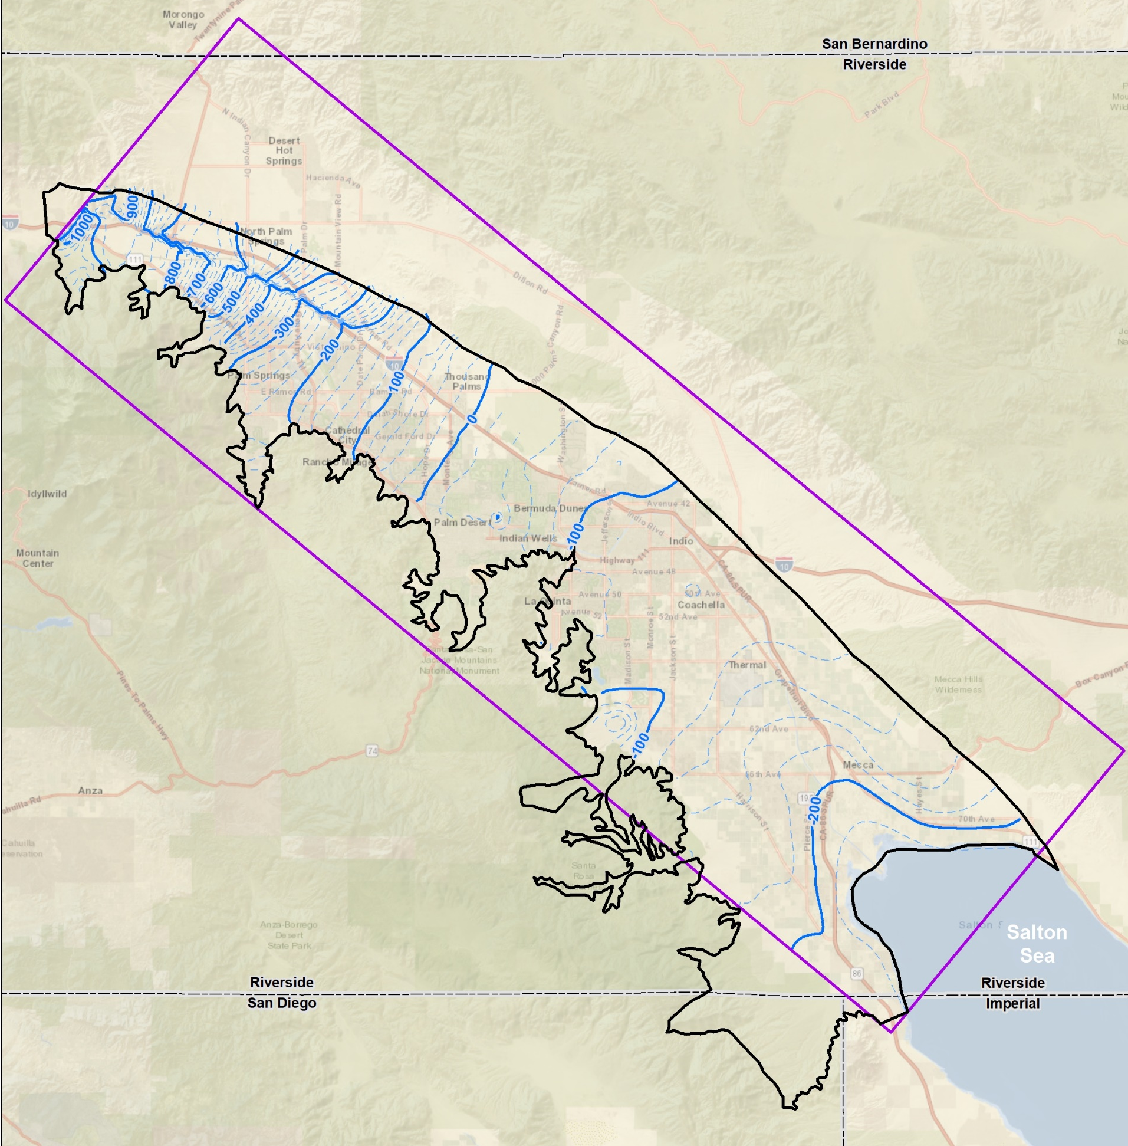
Sustainable Management: Seawater Intrusion
Modeling indicates:
  net inflow from Sea 1997-2014
  net outflow to Sea, 2015 on
Simulated 2020 shallow groundwater contour (-220 feet) is higher than Salton Sea
Simulated 2020 deep groundwater contour (-200 feet) is even higher (groundwater flowing upward)
Modeling results match observed groundwater levels, rising from 2010 on
Simulated Levels in Shallow Aquifer, 2020
-220 ft
Salton Sea currently is about -238 ft

Slide 53
Sustainable Management: GDEs
DWR Recommendation:
  Provide an identification of GDEs in the Subbasin
Alternative Plan Update includes as an appendix:
Technical Memorandum,
Indio Subbasin Groundwater Dependent Ecosystems Study

Slide 54
Agenda
Welcome and Introductions
Alternative Plan Status
Groundwater Conditions
Sustainable Management
Groundwater Model and Plan Scenarios
Public Comment
Get Involved
Notes:
Our goals are to:
Enhance public understanding about water resources in the basin
Keep you—the public and stakeholders—informed about the GSP
Engage diverse interested parties and stakeholders
Respond to your concerns

Slide 55
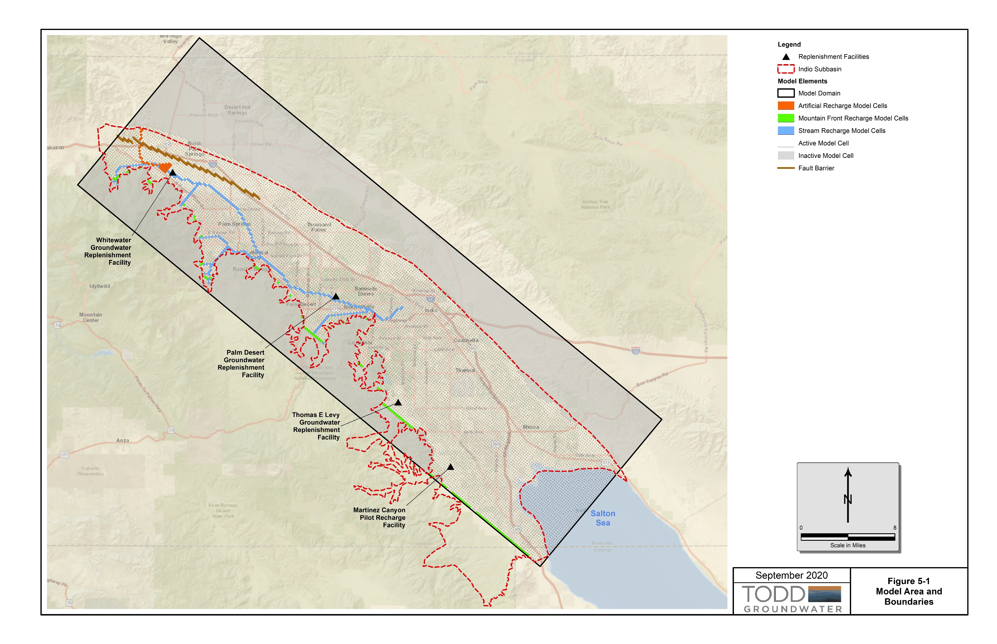
Groundwater Model Update
Original Historical Simulation 1936-1996
2010 CVWMP Model Simulation (beginning in 1997)
Updated and calibrated for historical period 2009-2017
Being applied to future scenarios (revised)

Slide 56


Revised Plan Scenarios
Baseline/No Project
Baseline w/Climate Change
Near Term Projects
Future Projects
Future Projects w/Climate Change
Near Term w/Climate Change
Existing supplies & facilities
Existing supplies & facilities limited by climate changes
5-Year CIP supplies & facilities
5-Year CIP supplies & facilities limited by climate changes
All planned supplies & facilities
All planned supplies & facilities limited by climate changes
56

Slide 57
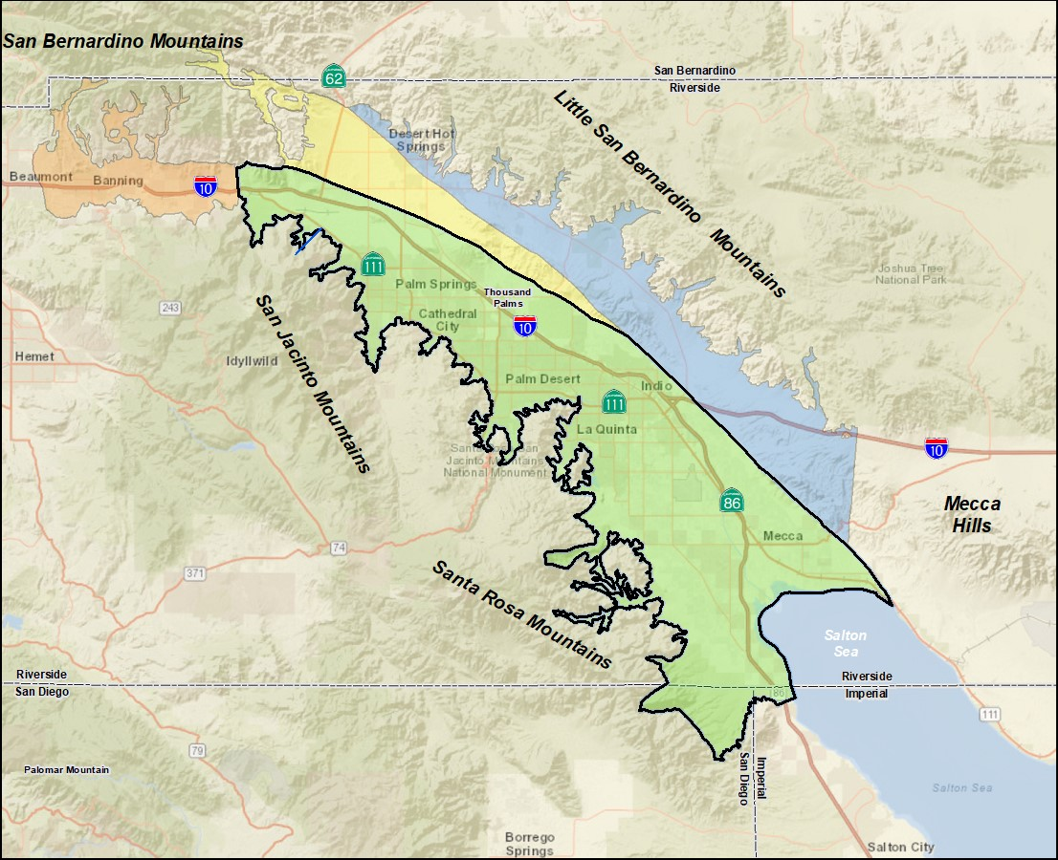
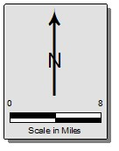
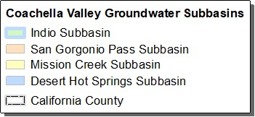
Local Hydrology
Baseline – assumes 50-year hydrology, 1970-2019
Climate Change – assumes more recent 25-year hydrology with multiple dry cycles, 1994-2019
Colorado River
Aqueduct
Colorado River
Aqueduct
Coachella
Canal
Notes:
Note: Average natural Inflows = 58,908 acre-feet

Slide 58
State Water Project (SWP) Water
Baseline – assumes 45% reliability, the historical average since Wanger decision, 2007-2021
  Future Projects includes participation in Delta Conveyance Facility, which increases reliability to 58%
Climate Change – assumes 45% reliability + DWR’s projected climate change factor by 2045
Whitewater River GRF
Colorado River
Aqueduct
Coachella
Canal

Slide 59
Colorado River Water
Baseline – assumes QSA entitlement minus conveyance losses
  Future Projects includes expansion of NPW (Canal + RW) deliveries
Climate Change – assumes QSA entitlement minus conveyance losses, with Lower Basin DCP contribution in phases
Colorado River
Aqueduct
Whitewater River GRF
Colorado River
Aqueduct
Palm
Desert GRF
Mid-Valley
Pipeline
Coachella
Canal
Thomas E. Levy GRF
*

Slide 60
Recycled Water
Baseline – assumes ~30% water demands return to sewer
  Future Projects includes expansion of NPW (Canal + RW) deliveries
Climate Change – no change – assumes ~30% water demands return to sewer
Colorado River
Aqueduct
DWA WRP
CVWD WRP-7
CVWD WRP-10
Mid-Valley
Pipeline
Coachella
Canal
- DRAFT -
Notes:
Currently treating 40k of WW, but only recycling 14k

Slide 61
Next Steps
July 2021 – September 2021
  Finalize Plan Scenarios in groundwater model and quantify water budgets
    Review at next public workshop: August 26th
  Publish DRAFT Indio Subbasin Alternative Plan Update for stakeholder review
    Anticipated 45-day review: September/October
    Will send an e-blast upon release of Alternative Plan Update

Slide 62
Agenda
Welcome and Introductions
Alternative Plan Status
Groundwater Conditions
Sustainable Management
Groundwater Model and Plan Scenarios
Public Comment
Get Involved
Notes:
Our goals are to:
Enhance public understanding about water resources in the basin
Keep you—the public and stakeholders—informed about the GSP
Engage diverse interested parties and stakeholders
Respond to your concerns

Slide 63
Public Comment
Input and feedback are welcomed
For Callers – you may need to press *6 to unmute

Slide 64
Agenda
Welcome and Introductions
Alternative Plan Status
Groundwater Conditions
Sustainable Management
Groundwater Model and Plan Scenarios
Public Comment
Get Involved
Notes:
Our goals are to:
Enhance public understanding about water resources in the basin
Keep you—the public and stakeholders—informed about the GSP
Engage diverse interested parties and stakeholders
Respond to your concerns

Slide 65
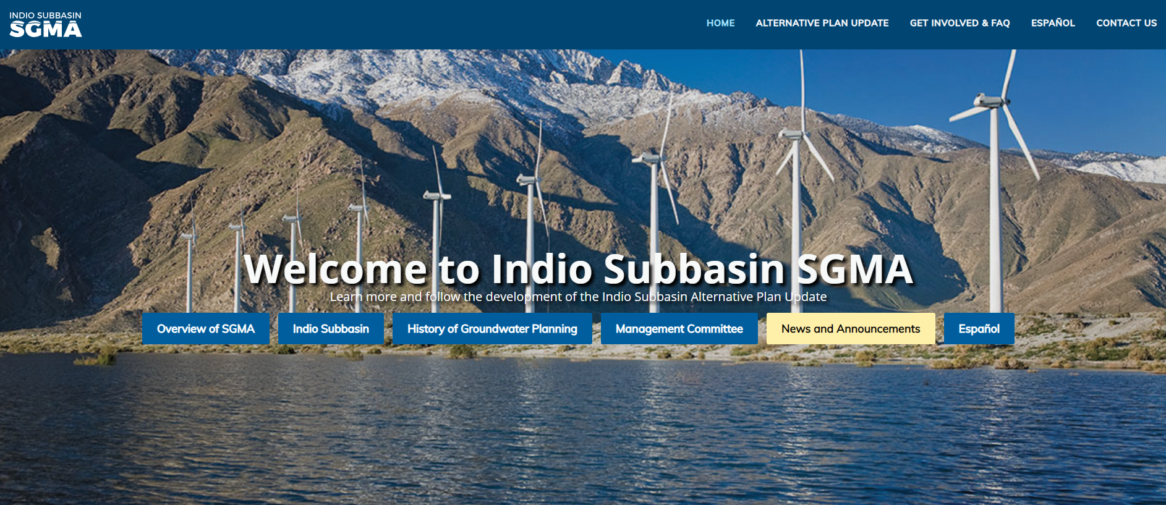

Get Involved – Visit our Website
www.IndioSubbasinSGMA.org

Slide 66
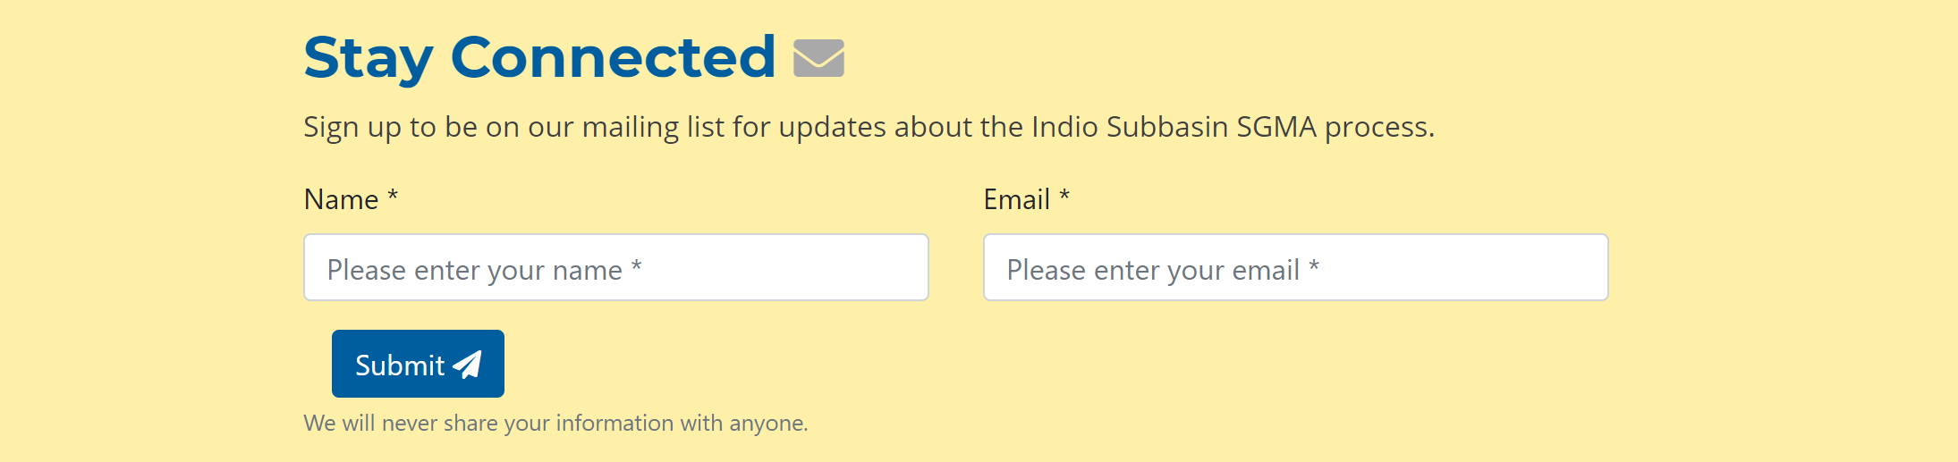
Get Involved – Visit our Website
Sign up for email invites, updates, and data/report releases at
www.IndioSubbasinSGMA.org

Slide 67




Get Involved – Next Workshop
August 26, 2021
2:00 – 4:00 PM
Location: TBD
For additional information, please contact:
Rosalyn Prickett
IndioSubbasinSGMA@woodardcurran.com
(858) 875-7420

