Slide 1




2022 Indio Subbasin
Water Management Plan Update:
SGMA Alternative Plan
Workshop #7
October 20, 2021

Slide 2
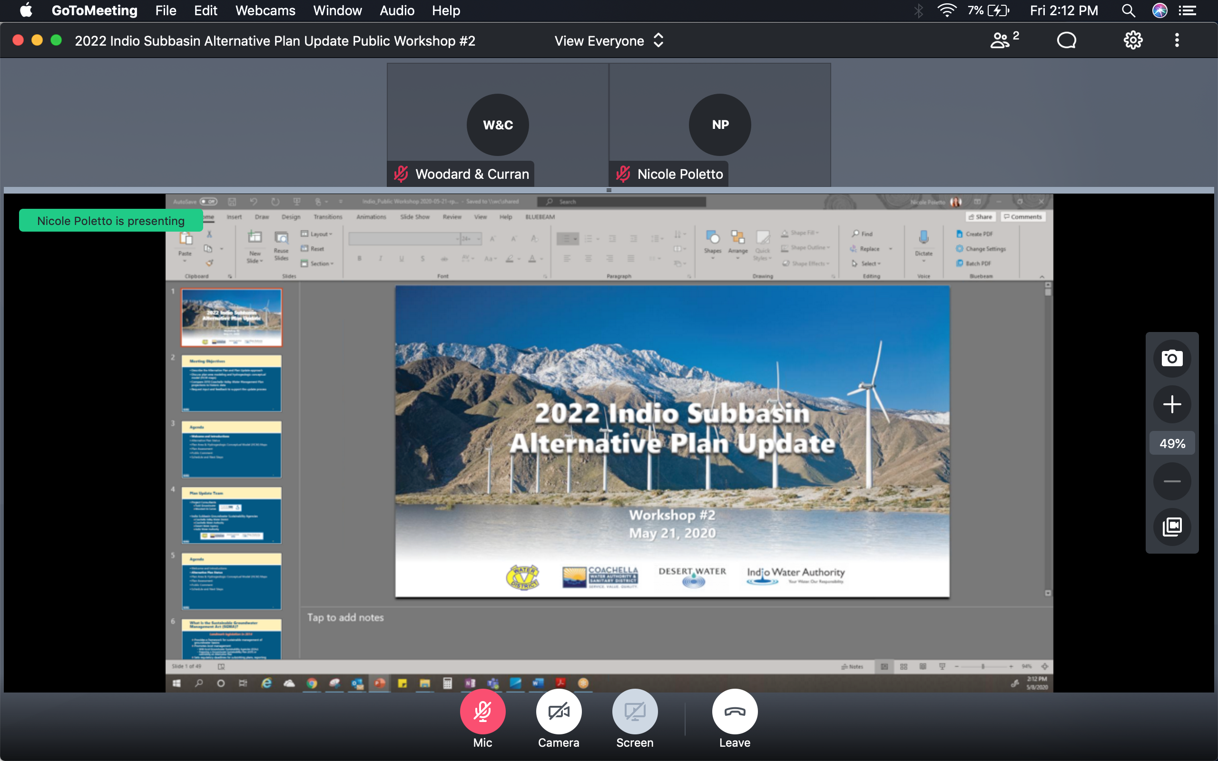
GoToMeeting – Quick How To
Your screen should look like this:
Turn on/off your Mic (mute) and Camera (video) using the controls along the bottom
During the meeting, you may need to wiggle your mouse to make the controls appear
For Callers: use *6 to unmute on the phone

Slide 3
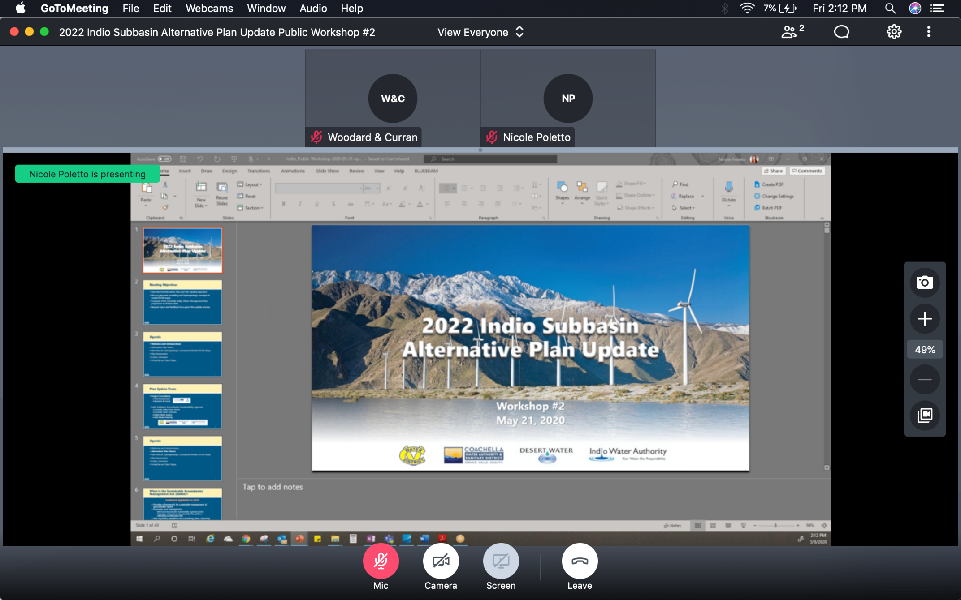
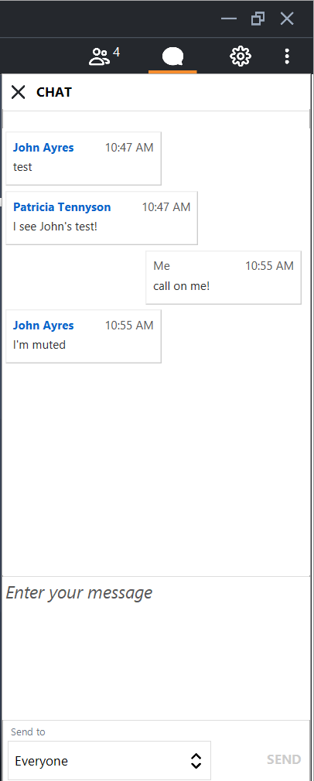
GoToMeeting – How to Ask a Question
Our organizer will mute everyone at the beginning of the meeting
Let us know you have a question by clicking the Chat icon in the top right
  Click on Enter your message, type your message and hit SEND
Once we receive your Chat, we will call on you and answer your question
For Callers: when ask for your questions or comments, use *6 to unmute

Slide 4
GoToMeeting – How to Ask a Question
Our organizer will mute everyone at the beginning of the meeting
Let us know you have a question by clicking the Chat icon in the top right
  Click on Enter your message, type your message and hit SEND
Once we receive your Chat, we will call on you and answer your question
For Callers: when ask for your questions or comments, use *6 to unmute

Slide 5
Agenda
Welcome and Introductions
2022 Water Management Plan Update (Alternative Plan Update)
Groundwater Conditions and Sustainable Management
Water Demands and Supplies
Numerical Model, Plan Scenarios, and Projects & Management Actions (PMAs)
Plan Evaluation and Implementation
Public Comment
Get Involved

Slide 6

Plan Update Team
Project Consultants
  Todd Groundwater
  Woodard & Curran
Indio Subbasin Groundwater Sustainability Agencies
  Coachella Valley Water District
  Coachella Water Authority
  Desert Water Agency
  Indio Water Authority
`

Slide 7
Agenda
Welcome and Introductions
2022 Water Management Plan Update (Alternative Plan Update)
Groundwater Conditions and Sustainable Management
Water Demands and Supplies
Numerical Model, Plan Scenarios, and Projects & Management Actions (PMAs)
Plan Evaluation and Implementation
Public Comment
Get Involved

Slide 8
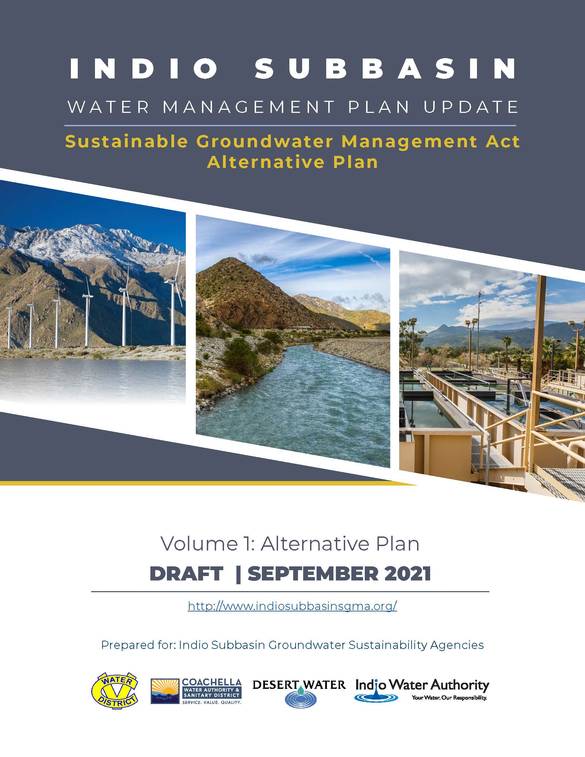
Introducing the 2022 Alternative Plan Update
Builds on 2010 Coachella Valley Water Management Plan Update submitted in 2016 and approved by DWR as an “Alternative Plan” to a Groundwater Sustainability Plan
Five-Year updates are required by Sustainable Groundwater Management Act (SGMA)
This is the first Five-Year Update
2017
2022
2027
2032
2037
Alternative Plan submitted
Dec 2016
Plan Update to be submitted
Dec 2021
Plan Update to be submitted
Dec 2026
Plan Update to be submitted
Dec 2031
Plan Update to be submitted
Dec 2036
Ongoing Subbasin sustainability
Notes:
Thanks Rosalyn.
Allow me to introduce the 2022 Alternative Plan Update:
Builds on 2010 Coachella Valley Water Management Plan Update –which preceded SGMA and than was
submitted in 2016 and approved by DWR as an “Alternative Plan” to a Groundwater Sustainability Plan.
Five-Year updates are required by Sustainable Groundwater Management Act (SGMA);
This is the first Five-Year Update
The timeline here indicates the progression of the Alternative Plan from when it was submitted through the successive 5-year updates and ongoing sustainability

Slide 9

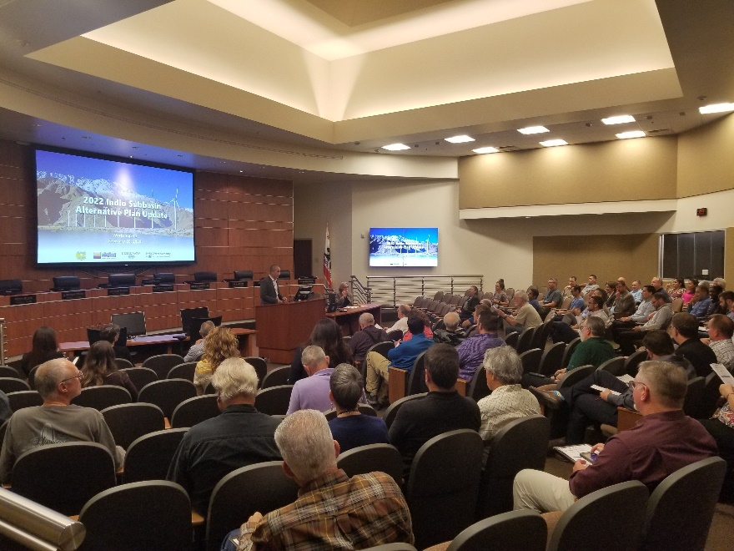



How Did We Engage People?
7 Public Workshops
7 SGMA Tribal Workgroups
Website with Monthly Updates
Workshop #1
Regular Email Announcements and Updates
Notes:
And, as an important part of this process, there has been ongoing engagement with the community and stakeholders through:
And now, we would like to provide an overview of the Alternative Plan Update document, not necessarily chapter by chapter, but summarizing highlights of what’s important

Slide 10
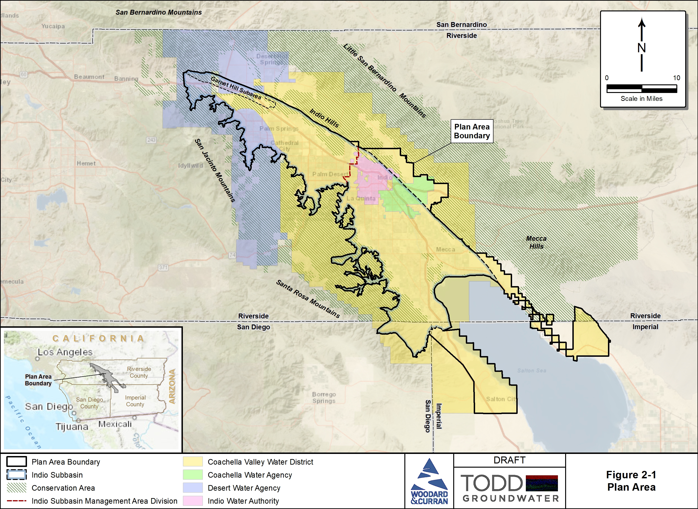
Plan Area and Groundwater Sustainability Agencies (GSAs)
The Plan Area is the Indio Subbasin and areas that are-or are likely to be-supplied groundwater from the Subbasin
The GSAs are:
  CVWD
  CWA
  DWA
  IWA
10
Notes:
By way of orientation, this is the Plan Area, which is the Indio Subbasin and areas that are-or are likely to be-supplied groundwater from the Subbasin
The Groundwater Sustainability Agencies –GSAs—who collaboratively developed this plan also are shown, including:

Slide 11
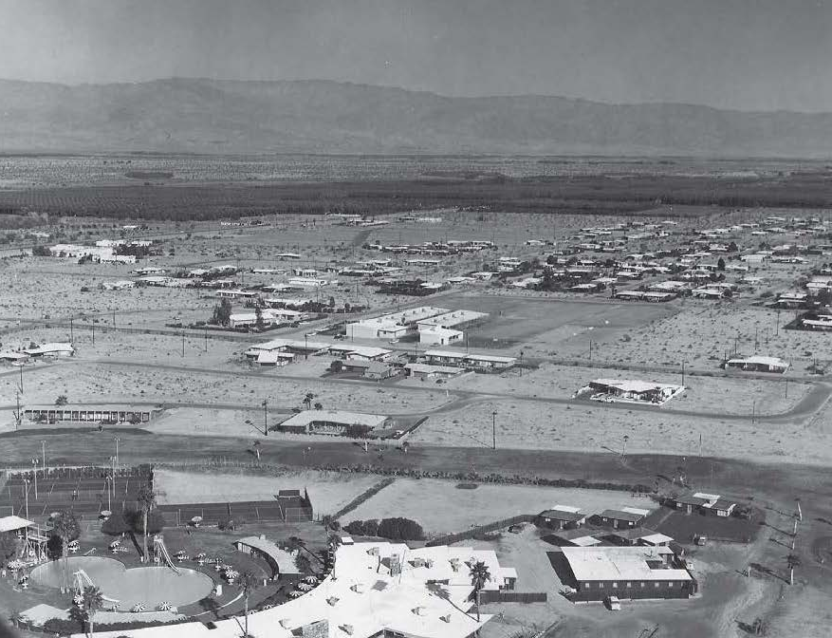
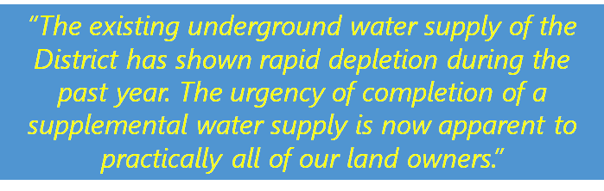
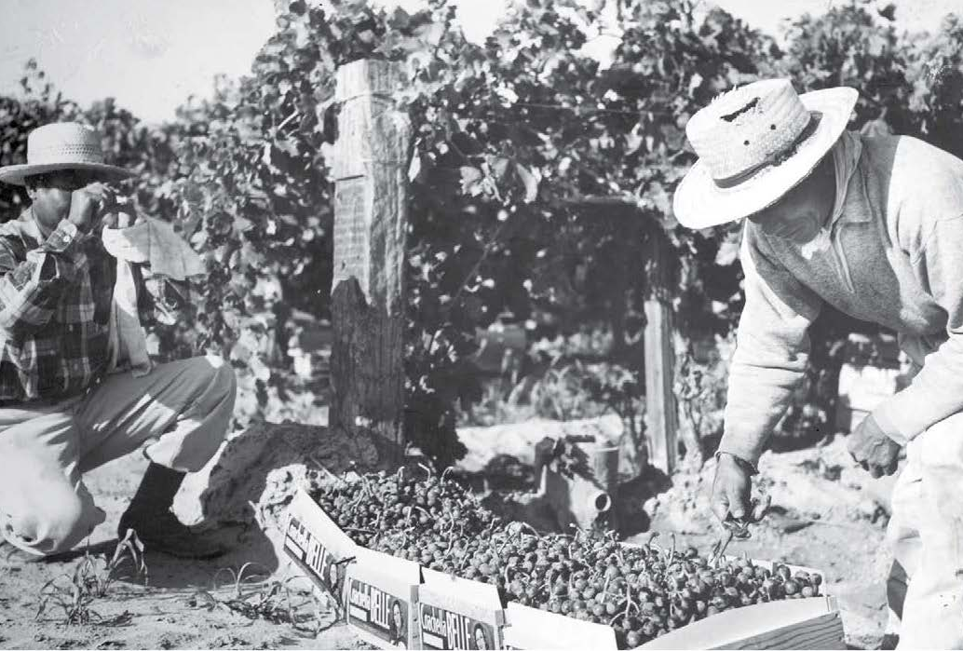
Plan Update Builds on a Long History of Active Local Water Management
The history of Coachella Valley is one of agricultural and urban growth, accompanied by increasing water demand and periods of groundwater overdraft
Excerpt from 1945 Annual Report, CVCWD
Notes:
And some history:
The history of Coachella Valley is one of agricultural and urban growth,
accompanied by increasing water demand and periods of groundwater overdraft
Here is a quote from 1945:
That leads us to the significance of supplemental water supply...

Slide 12
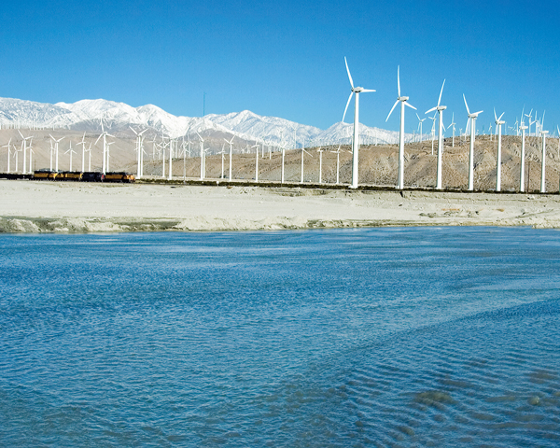
Multiple Water Sources have been Developed to Ensure a Reliable Supply
Capture and recharge of Whitewater River stormflows began in 1918
Coachella Canal completed in 1949
  Bringing Colorado River water to support agriculture in East Valley
CVWD and DWA contracts for State Water Project (SWP) water in 1963
  SWP exchanged for Colorado River Water via Colorado River Aqueduct
  Recharge at Whitewater River Groundwater Replenishment Facility (GRF) begins in 1973
Water recycling began in 1965
Coachella Canal construction
Whitewater River GRF
12
Notes:
As noted here:
Multiple Water Sources have been Developed to Ensure a Reliable supply
Capture and recharge of Whitewater River stormflows began in 1918–
Coachella Canal completed in 1949 shown upper right Bringing Colorado River water to support agriculture in East Valley
CVWD and DWA contracts for State Water Project (SWP) water in 1963
SWP exchanged for Colorado River Water via Colorado River Aqueduct
Recharge at Whitewater River Groundwater Replenishment Facility (GRF) begins in 1973 shown lower right
Water recycling began in 1965
le Supply

Slide 13
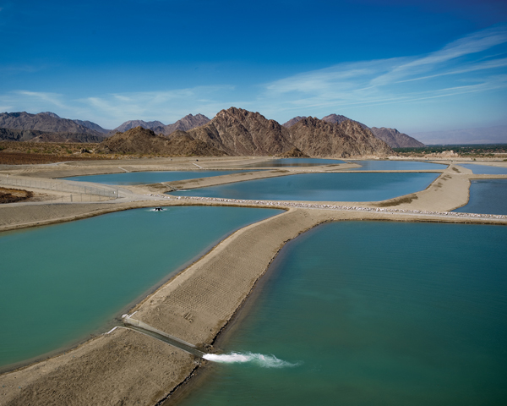
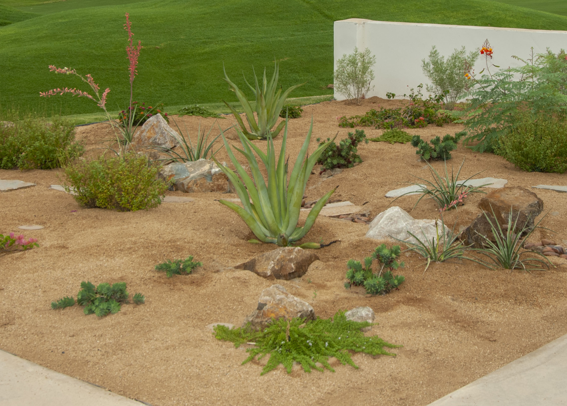
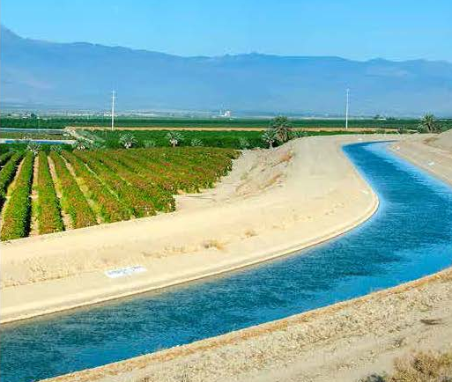
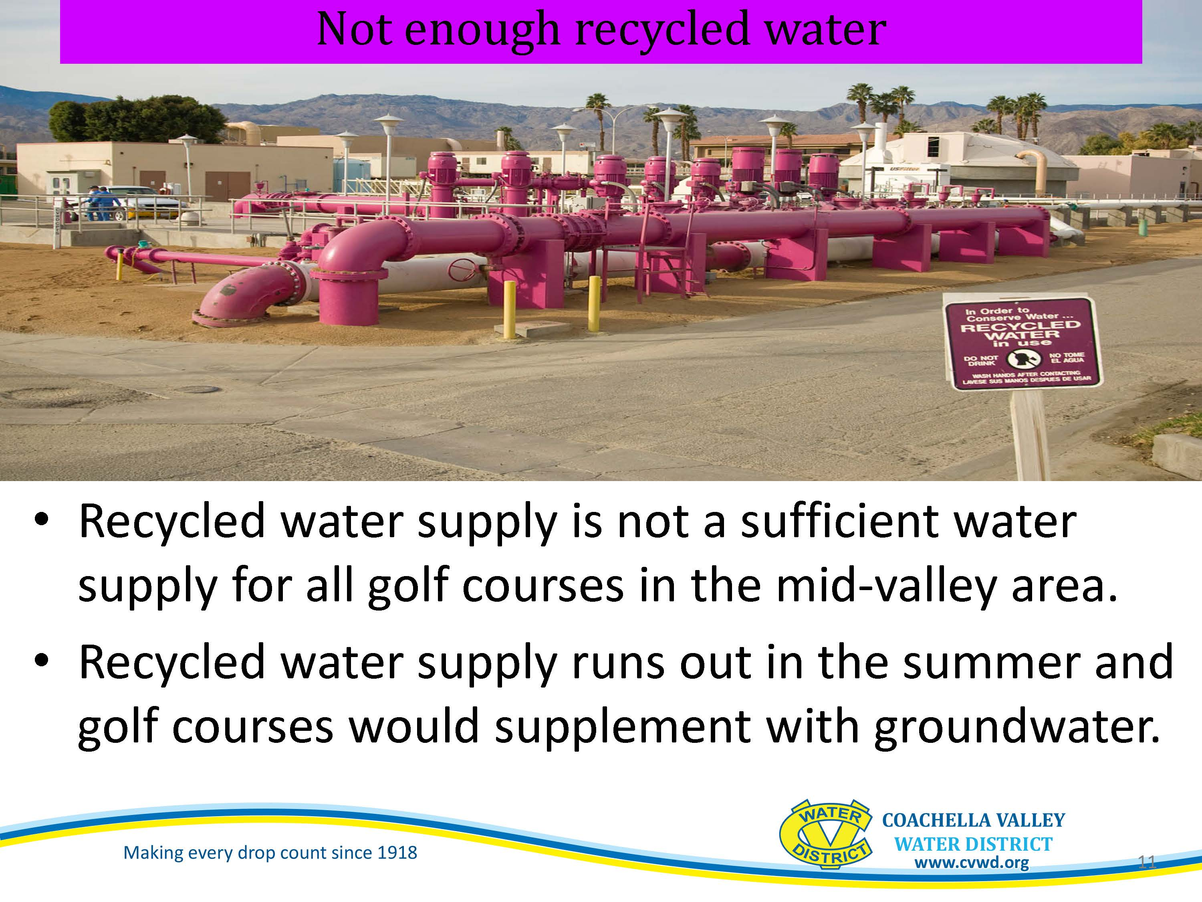
A Combination of Management Actions are Essential to Meeting Local Water Demands
Local stormwater and imported water for direct replenishment of groundwater
Source substitution provides non-potable water for irrigation, reducing groundwater pumping
Agricultural, golf, and urban conservation reduces water demand
13
Notes:
So now there is a really suite of management actions to meet local demands:
Local stormwater and imported water for direct replenishment of groundwater
Source substitution provides non-potable water for irrigation, reducing groundwater pumping
Agricultural, golf, and urban conservation reduces water demand

Slide 14
Plan Update – Goal and Objectives
Plan Goal: To reliably meet current and future water demands in a cost-effective and sustainable manner.
Plan Objectives:
  Meet current and future municipal water demands with 10 percent supply buffer
  Avoid chronic groundwater overdraft
  Manage and protect water quality
  Collaborate with tribes, state and federal agencies on shared objectives
  Manage future costs
  Minimize adverse environmental impacts
  Reduce vulnerability to climate change and drought impacts
Notes:
So the management has been guided by an overall plan goal: To reliably meet current and future water demands in a cost-effective and sustainable manner.
And by Plan Objectives, which have been updated for this 2022 Plan:
Meet current and future municipal water demands with 10 percent supply buffer
Avoid chronic groundwater overdraft
Manage and protect water quality
Collaborate with tribes, state and federal agencies on shared objectives
Manage future costs
Minimize adverse environmental impacts and a new objective:
Reduce vulnerability to climate change and drought impacts

Slide 15
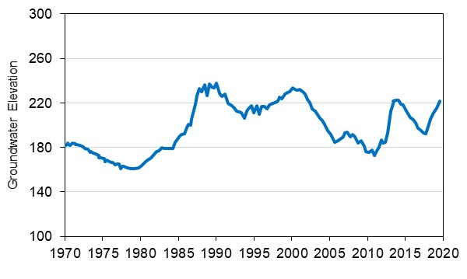
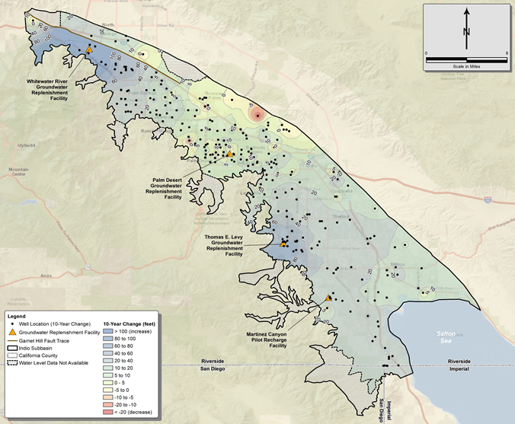
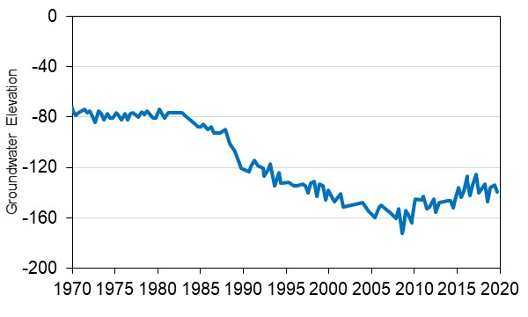
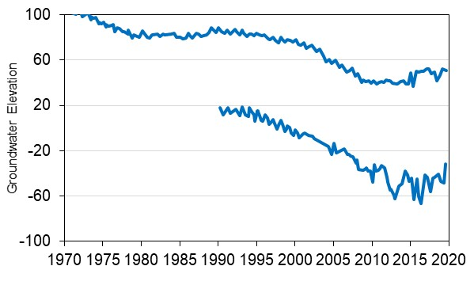
How is the Water Management Plan Working?
Plan implementation has resulted in significant groundwater storage increases across the Indio Subbasin
Over the last 10 years, groundwater levels have increased regionally
More work is planned or underway to ensure sustainable management consistent with SGMA
2009 to 2019
water level change
15
Notes:
So, how is the Water Management Plan working?
In brief:
Plan implementation has resulted in significant groundwater storage increases across the Indio Subbasin
Over the last 10 years, groundwater levels have increased regionally and this is illustrated by a few hydrographs here showing recent upward trends
And
More work is planned or underway to ensure sustainable management consistent with SGMA

Slide 16
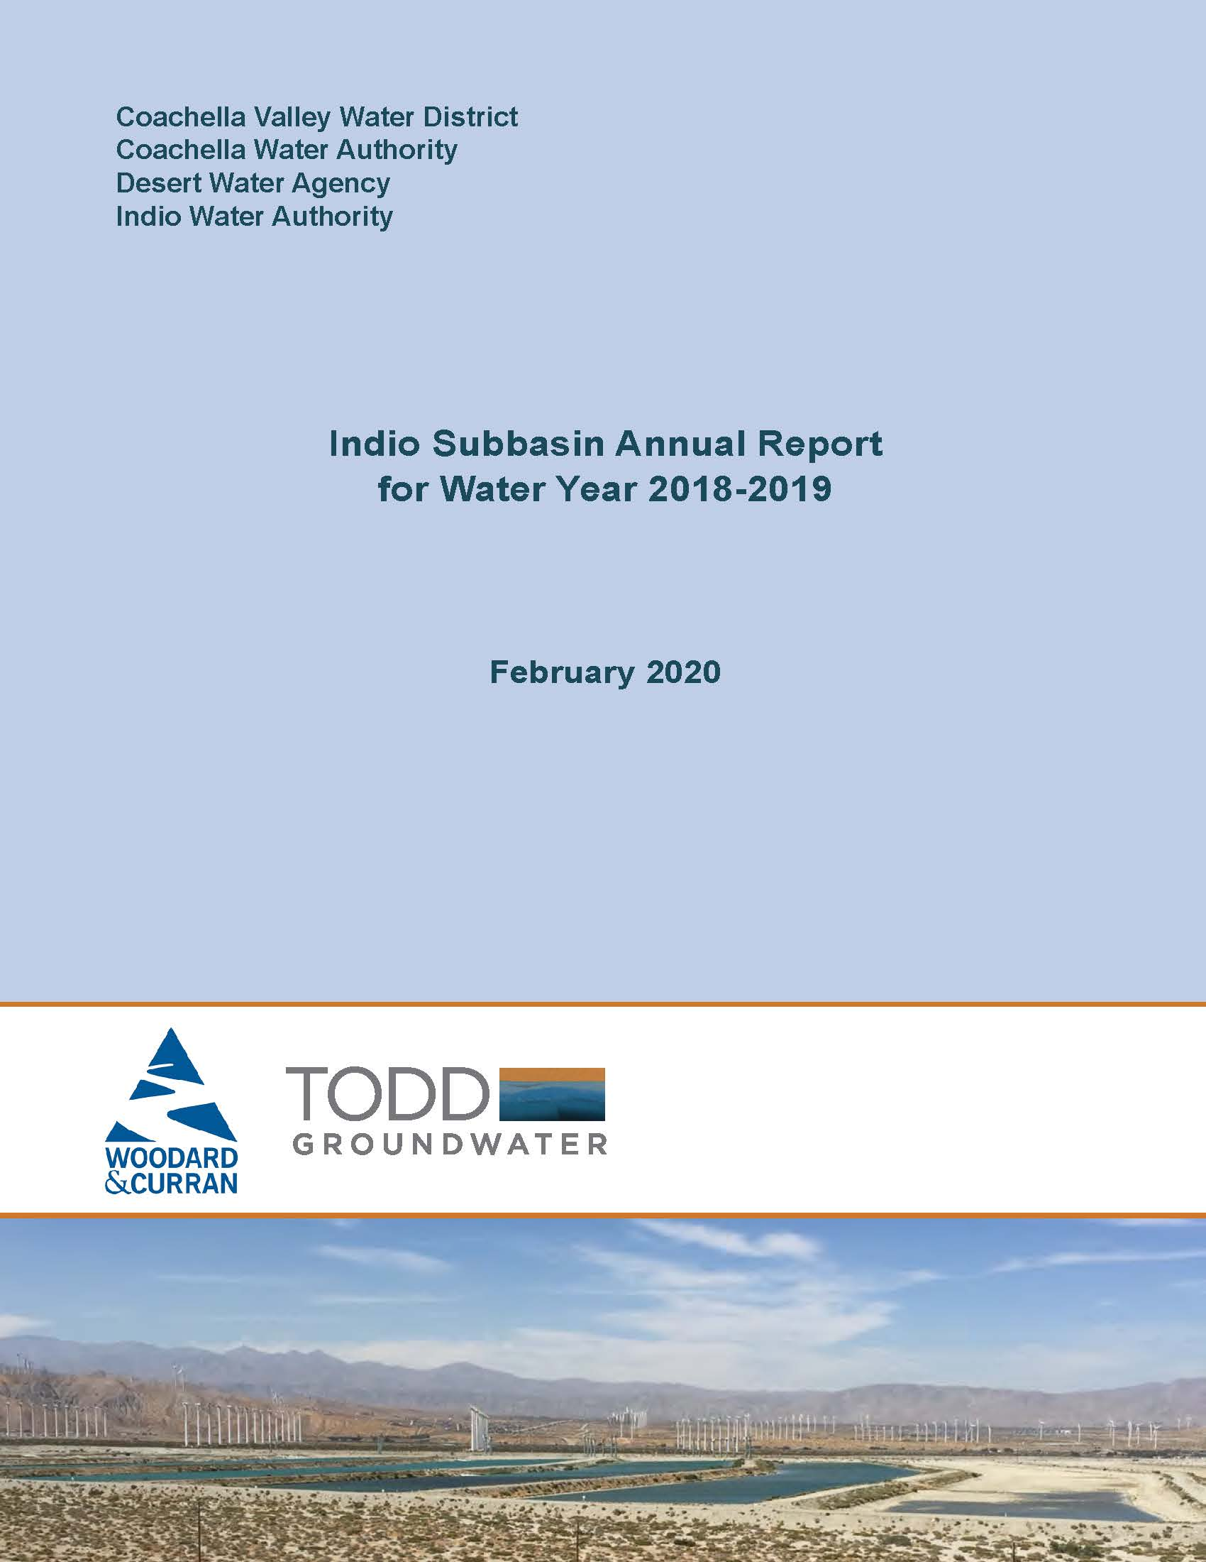
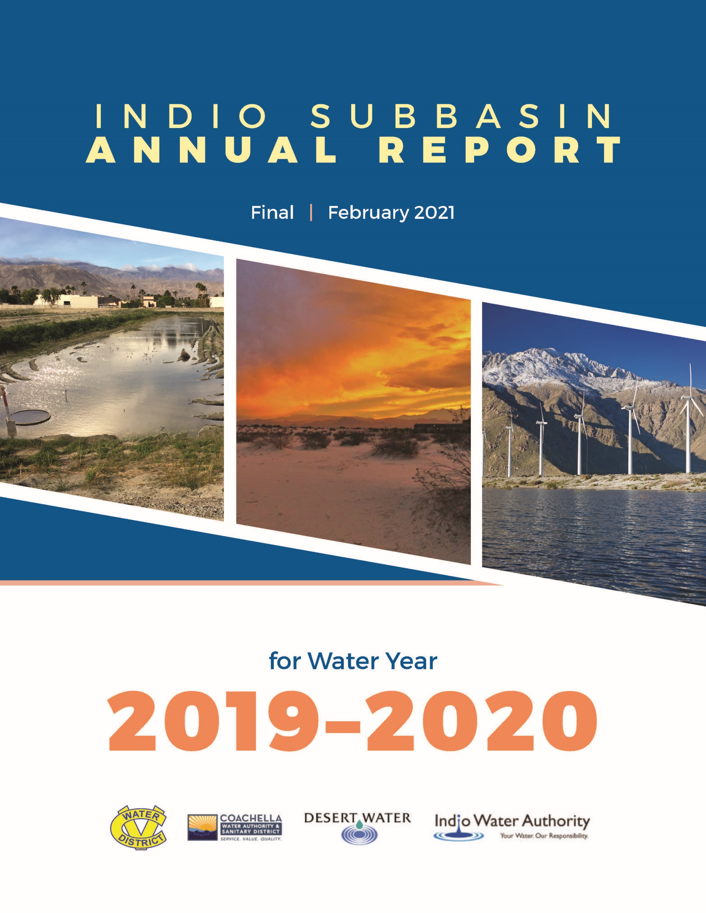
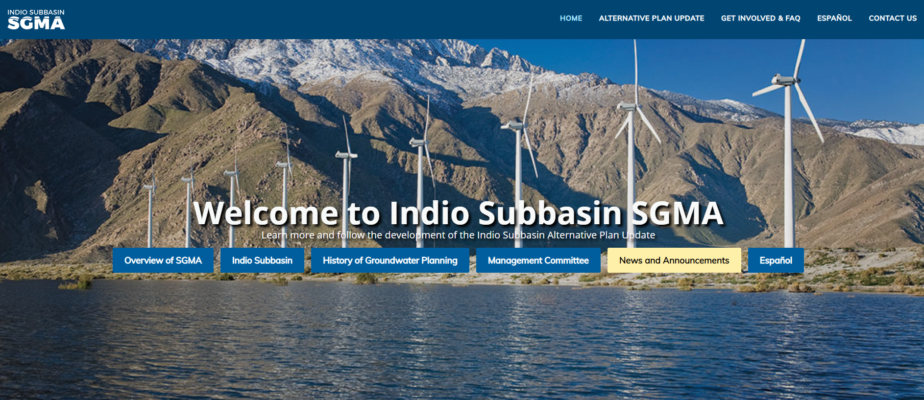
How Do We Know?
Ongoing monitoring, data analysis, reporting, and outreach:
Annual Reports
  Groundwater elevations
  Groundwater pumping
  Water use and demand
  Water budget
  Summary of progress
Five-Year Updates
Website
Notes:
How do we know how the plan is working?
Through the ongoing monitoring, data analysis, reporting, and outreach:
Annual Reports that you see two examples here and these report on
Groundwater elevations
Groundwater pumping
Water use and demand
Water budget
Summary of progress
Five-Year Updates of which this is the first and the Website

Slide 17
Questions?

Slide 18
Agenda
Welcome and Introductions
2022 Water Management Plan Update (Alternative Plan Update)
Groundwater Conditions and Sustainable Management
Water Demands and Supplies
Numerical Model, Plan Scenarios, and Projects & Management Actions (PMAs)
Plan Evaluation and Implementation
Public Comment
Get Involved
Notes:
Let me turn to Groundwater Conditions and Sustainable Management.
In brief,

Slide 19
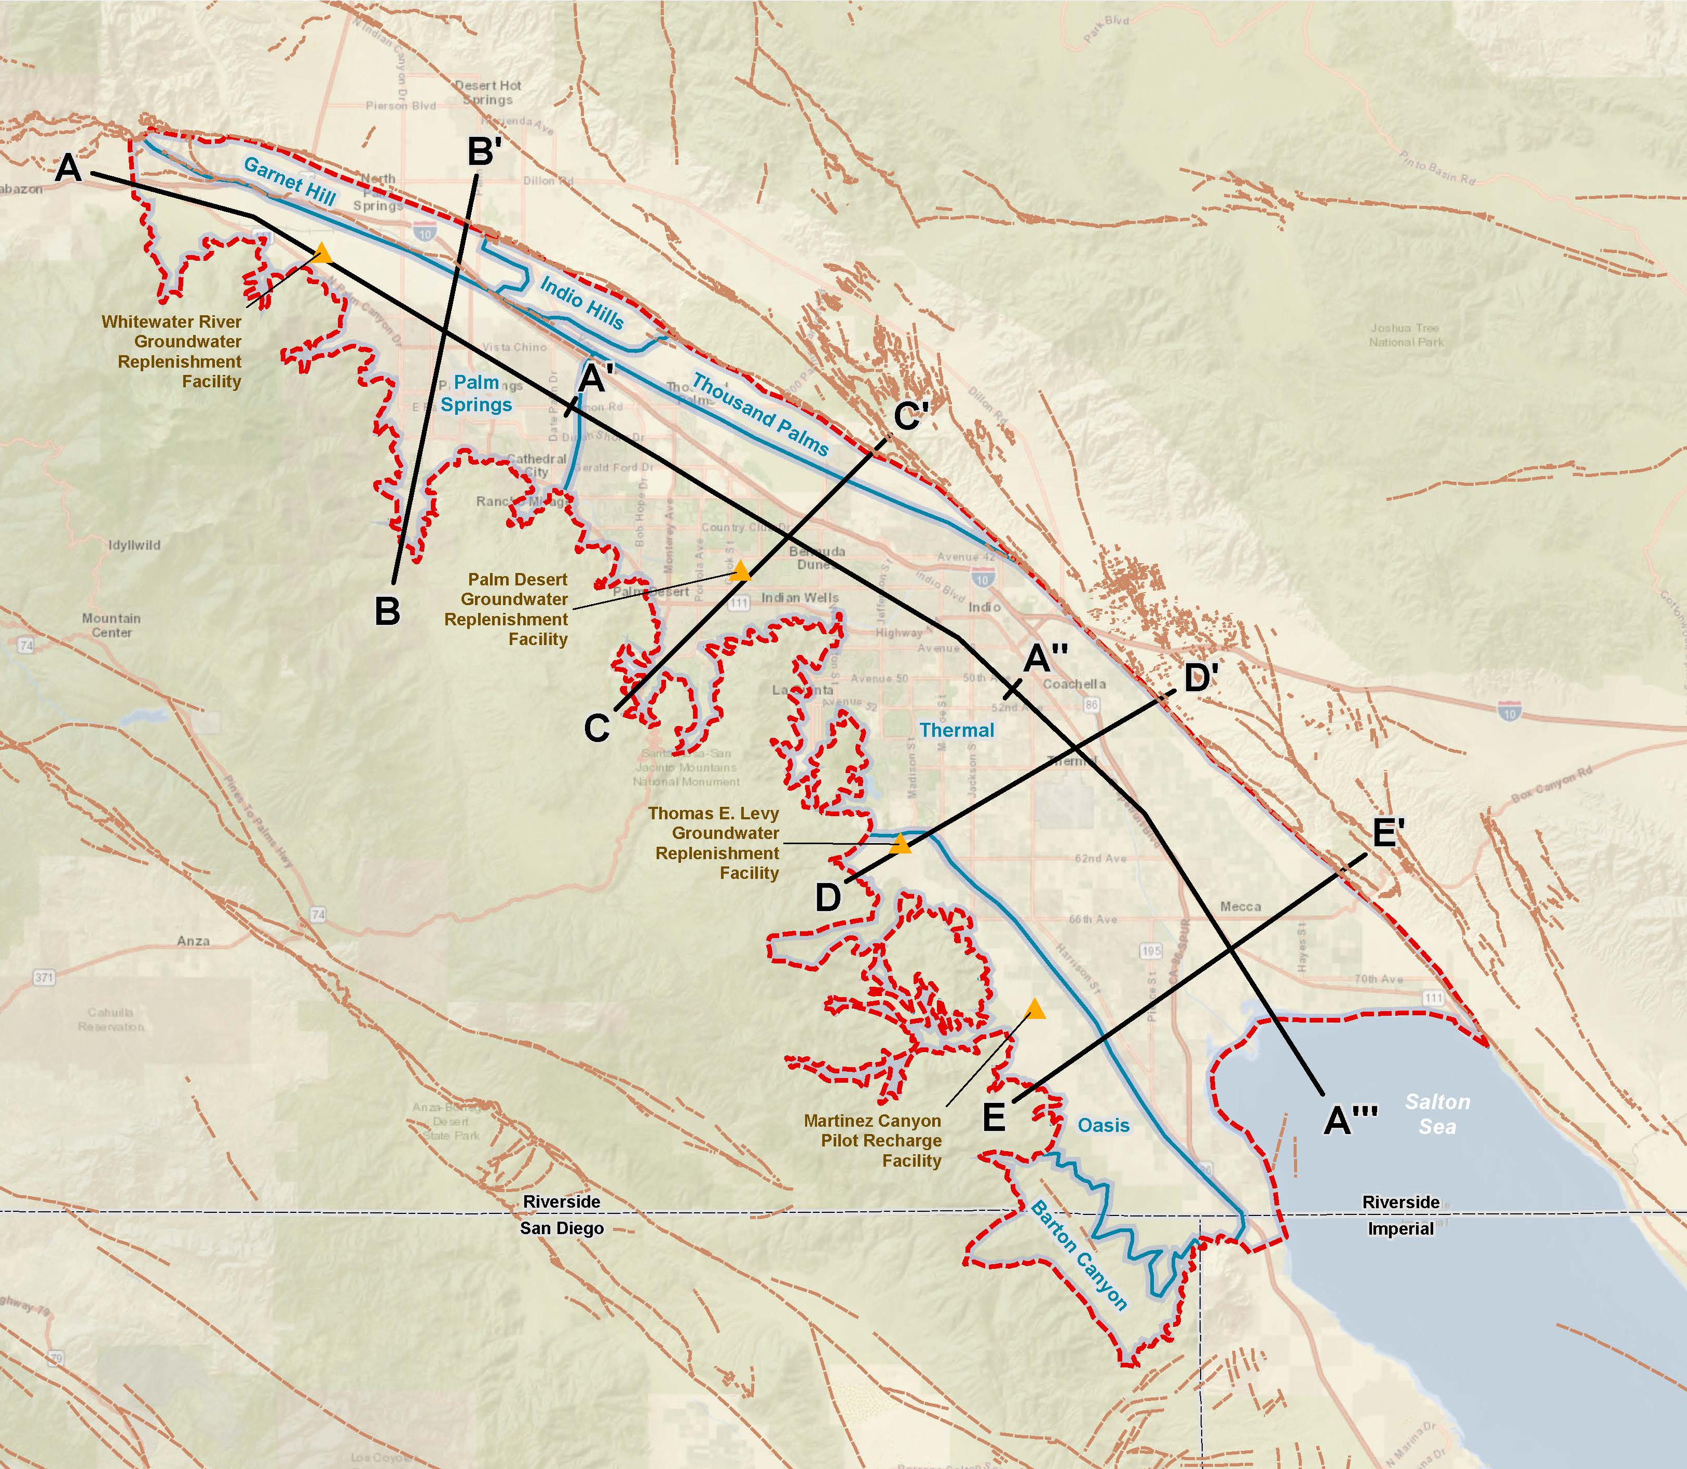
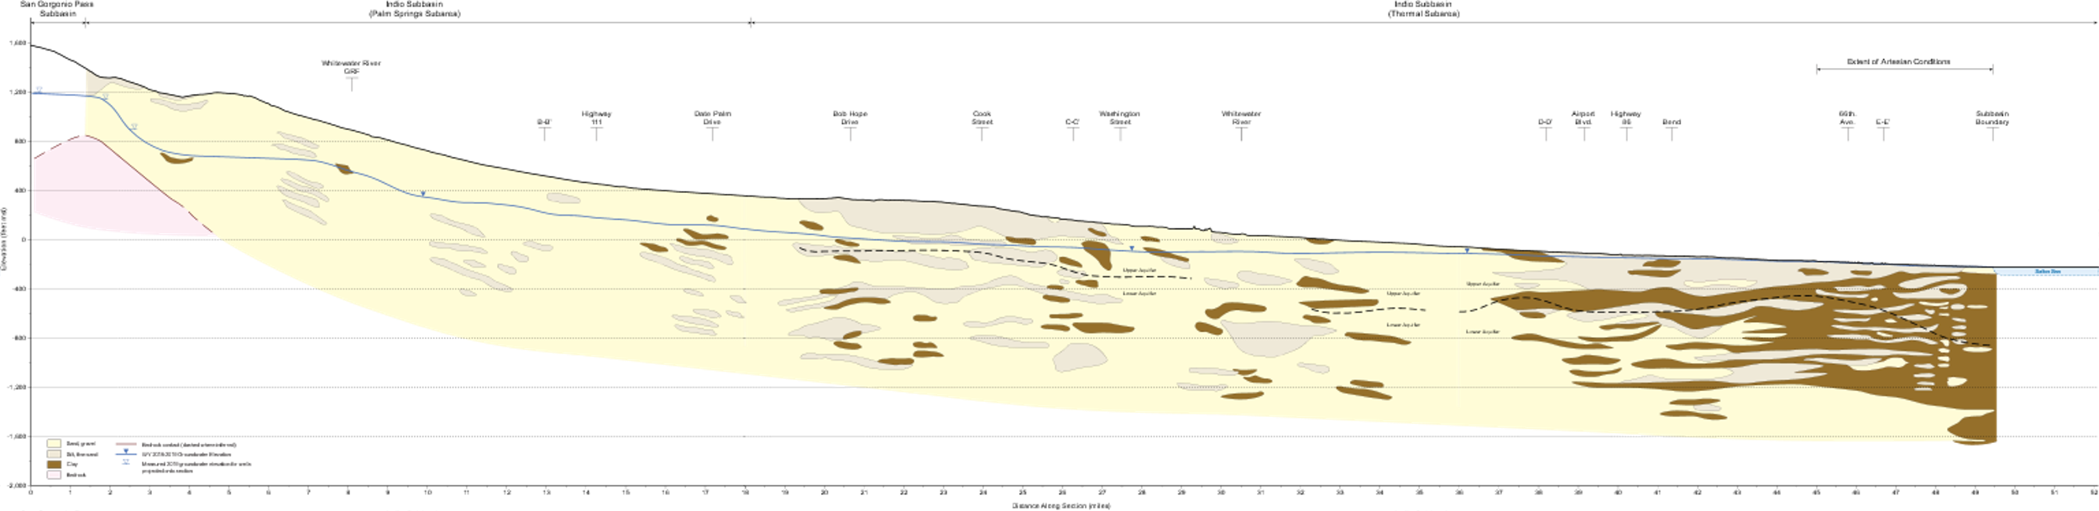
Plan Update describes the Indio Subbasin and How Groundwater Flows through It
A
A’
A’’
A’’’
San Gorgonio
Pass Subbasin
Indio Subbasin
(Palm Springs Subarea)
Indio Subbasin
(Thermal Subarea)
1,600
Whitewater
River GRF
Extent of
Artesian Conditions
Highway 111
Date Palm Drive
Bob Hope Drive
Washington St
Whitewater River
Airport Blvd.
Subbasin
Boundary
1,200
Cook Street
Highway 86
66th Ave
Bend
800
400
Upper Aquifer
0
Elevation
Salton
Sea
Lower Aquifer
Upper Aquifer
Upper Aquifer
-400
Lower Aquifer
-800
Lower Aquifer
-1,200
-1,600
Sand
Clay
WY 2018-2019 groundwater elevation
Measured 2019 groundwater elevation for wells projected onto section
Silt, fine sand
Bedrock
Bedrock contact (dashed where inferred)
General direction of groundwater flow
-2,000
0
1
2
3
4
5
6
7
8
9
10
11
12
13
14
15
16
17
18
19
20
21
22
23
24
25
26
27
28
29
30
31
32
33
34
35
36
37
38
39
40
41
42
43
44
45
46
47
48
49
Distance Along Section (miles)
Notes:
The Plan Update describes the Indio Subbasin and How Groundwater Flows through It. This is a hydrogeologic cross section slicing down the long axis of Coachella Valley from San Gorgonio Pass to the Salton Sea; you can see the inset map there and the cross section goes from 1,600 feet above MSL to more that 1,600 feet below MSL. The light colors indicate permeable sediments—sand and gravel and the darker colors indicate less permeable sediments—clay—especially down by the Salton Sea. Groundwater is recharge from multiple sources—replenishment facilities and streams and return flows and then generally flows downvalley and discharges mostly to wells and then to the Salton Sea

Slide 20






All Six Potential Undesirable Results are Addressed for Indio Subbasin
Chronic lowering of groundwater levels
Reduction of groundwater storage
Land subsidence
Degraded water quality
Seawater intrusion
Depletions of connected surface water with impacts on beneficial uses including Groundwater Dependent Ecosystems (GDEs)
Notes:
To define sustainability, SGMA defines what it is not and that is the significant and unreasonable occurrence of six undesirable results that potentially can occur in a groundwater basin.
All six are addressed in this Plan for Indio subbasin:
Let me walk through these and summarize the information provided on each, beginning with chronic lowering of groundwater levels

Slide 21
Identifying Undesirable Results and Minimum Thresholds for Groundwater Levels
What undesirable results do we want to avoid?
  Significant and unreasonable reduction in the long-term viability of domestic, agricultural, municipal, or environmental uses
  Impacts to relatively shallow wells, including small water system and private drinking water supply wells
How are Minimum Thresholds (MT) defined?
  MT is a numeric value used to define undesirable results
  Defined here as the historical low groundwater level at a key well
Notes:
We started with a question
What undesirable results do we want to avoid?
And working with GSAs and stakeholders, we identified:
Significant and unreasonable reduction in the long-term viability of domestic, agricultural, municipal, or environmental uses
Impacts to relatively shallow wells, including small water system and private drinking water supply wells
The next question was
How are Minimum Thresholds (MT) defined?
According to SGMA, MT is a numeric value below which undesirable results are defined to happen
And for this basin, it is
Defined here as the historical low groundwater level as measured at a key or representative well
This definition was based on examination of many hydrographs

Slide 22
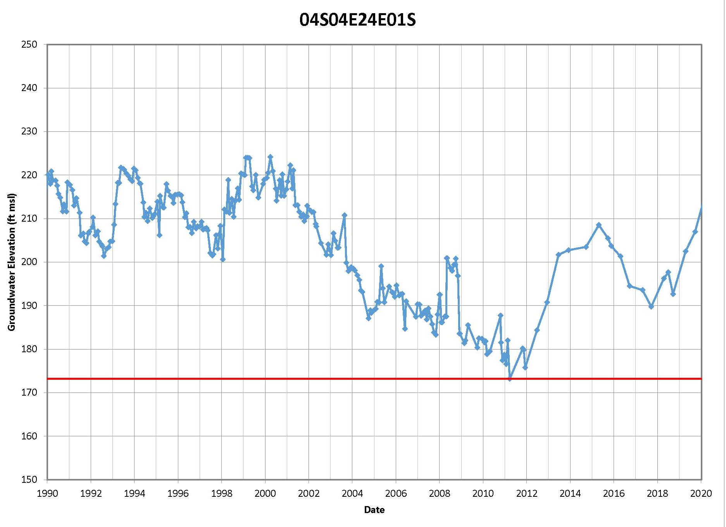
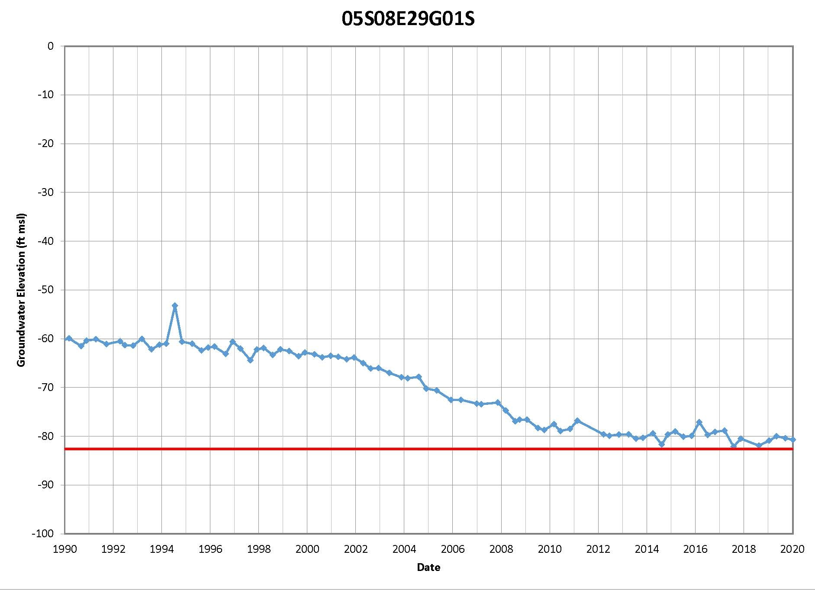
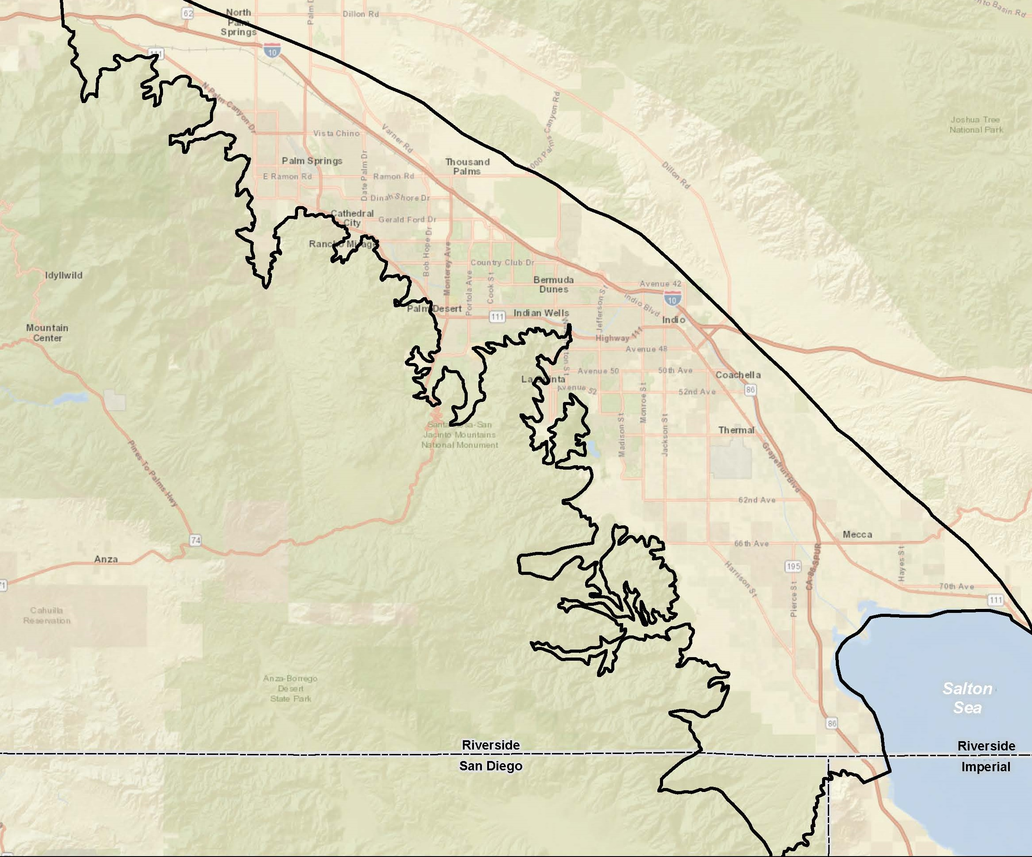
MTs as Historical Lows Measured at Key Wells
  Historical lows occurred in about 2009 with no reported shortages
  MTs compared favorably with well depths in small water system wells
Notes:
These are just two hydrographs, you can see the general locations on the inset maps
One is in the West Valley and it has lots of variability over the years from 1990 to 2020 from 220 feet down to about 170 feet MSL, but you can see the long decline from the 1990s down to about 2010 ---That’s overdraft
And then the increases in groundwater levels
The other hydrograph in the East Valley is less variable, but it shows the long decline to about 2012 and then stabilization
Looking at all the wells with long hydrographs, we saw that Historical lows occurred in about 2009 and most important there were no reported shortages
So we defined the Minimum Threshold—the red line—at the historical low
To check that, we then looked at the MTs relative to well depths in small water system wells—those where we had data– and the results were favorable. No shortages at these levels.

Slide 23
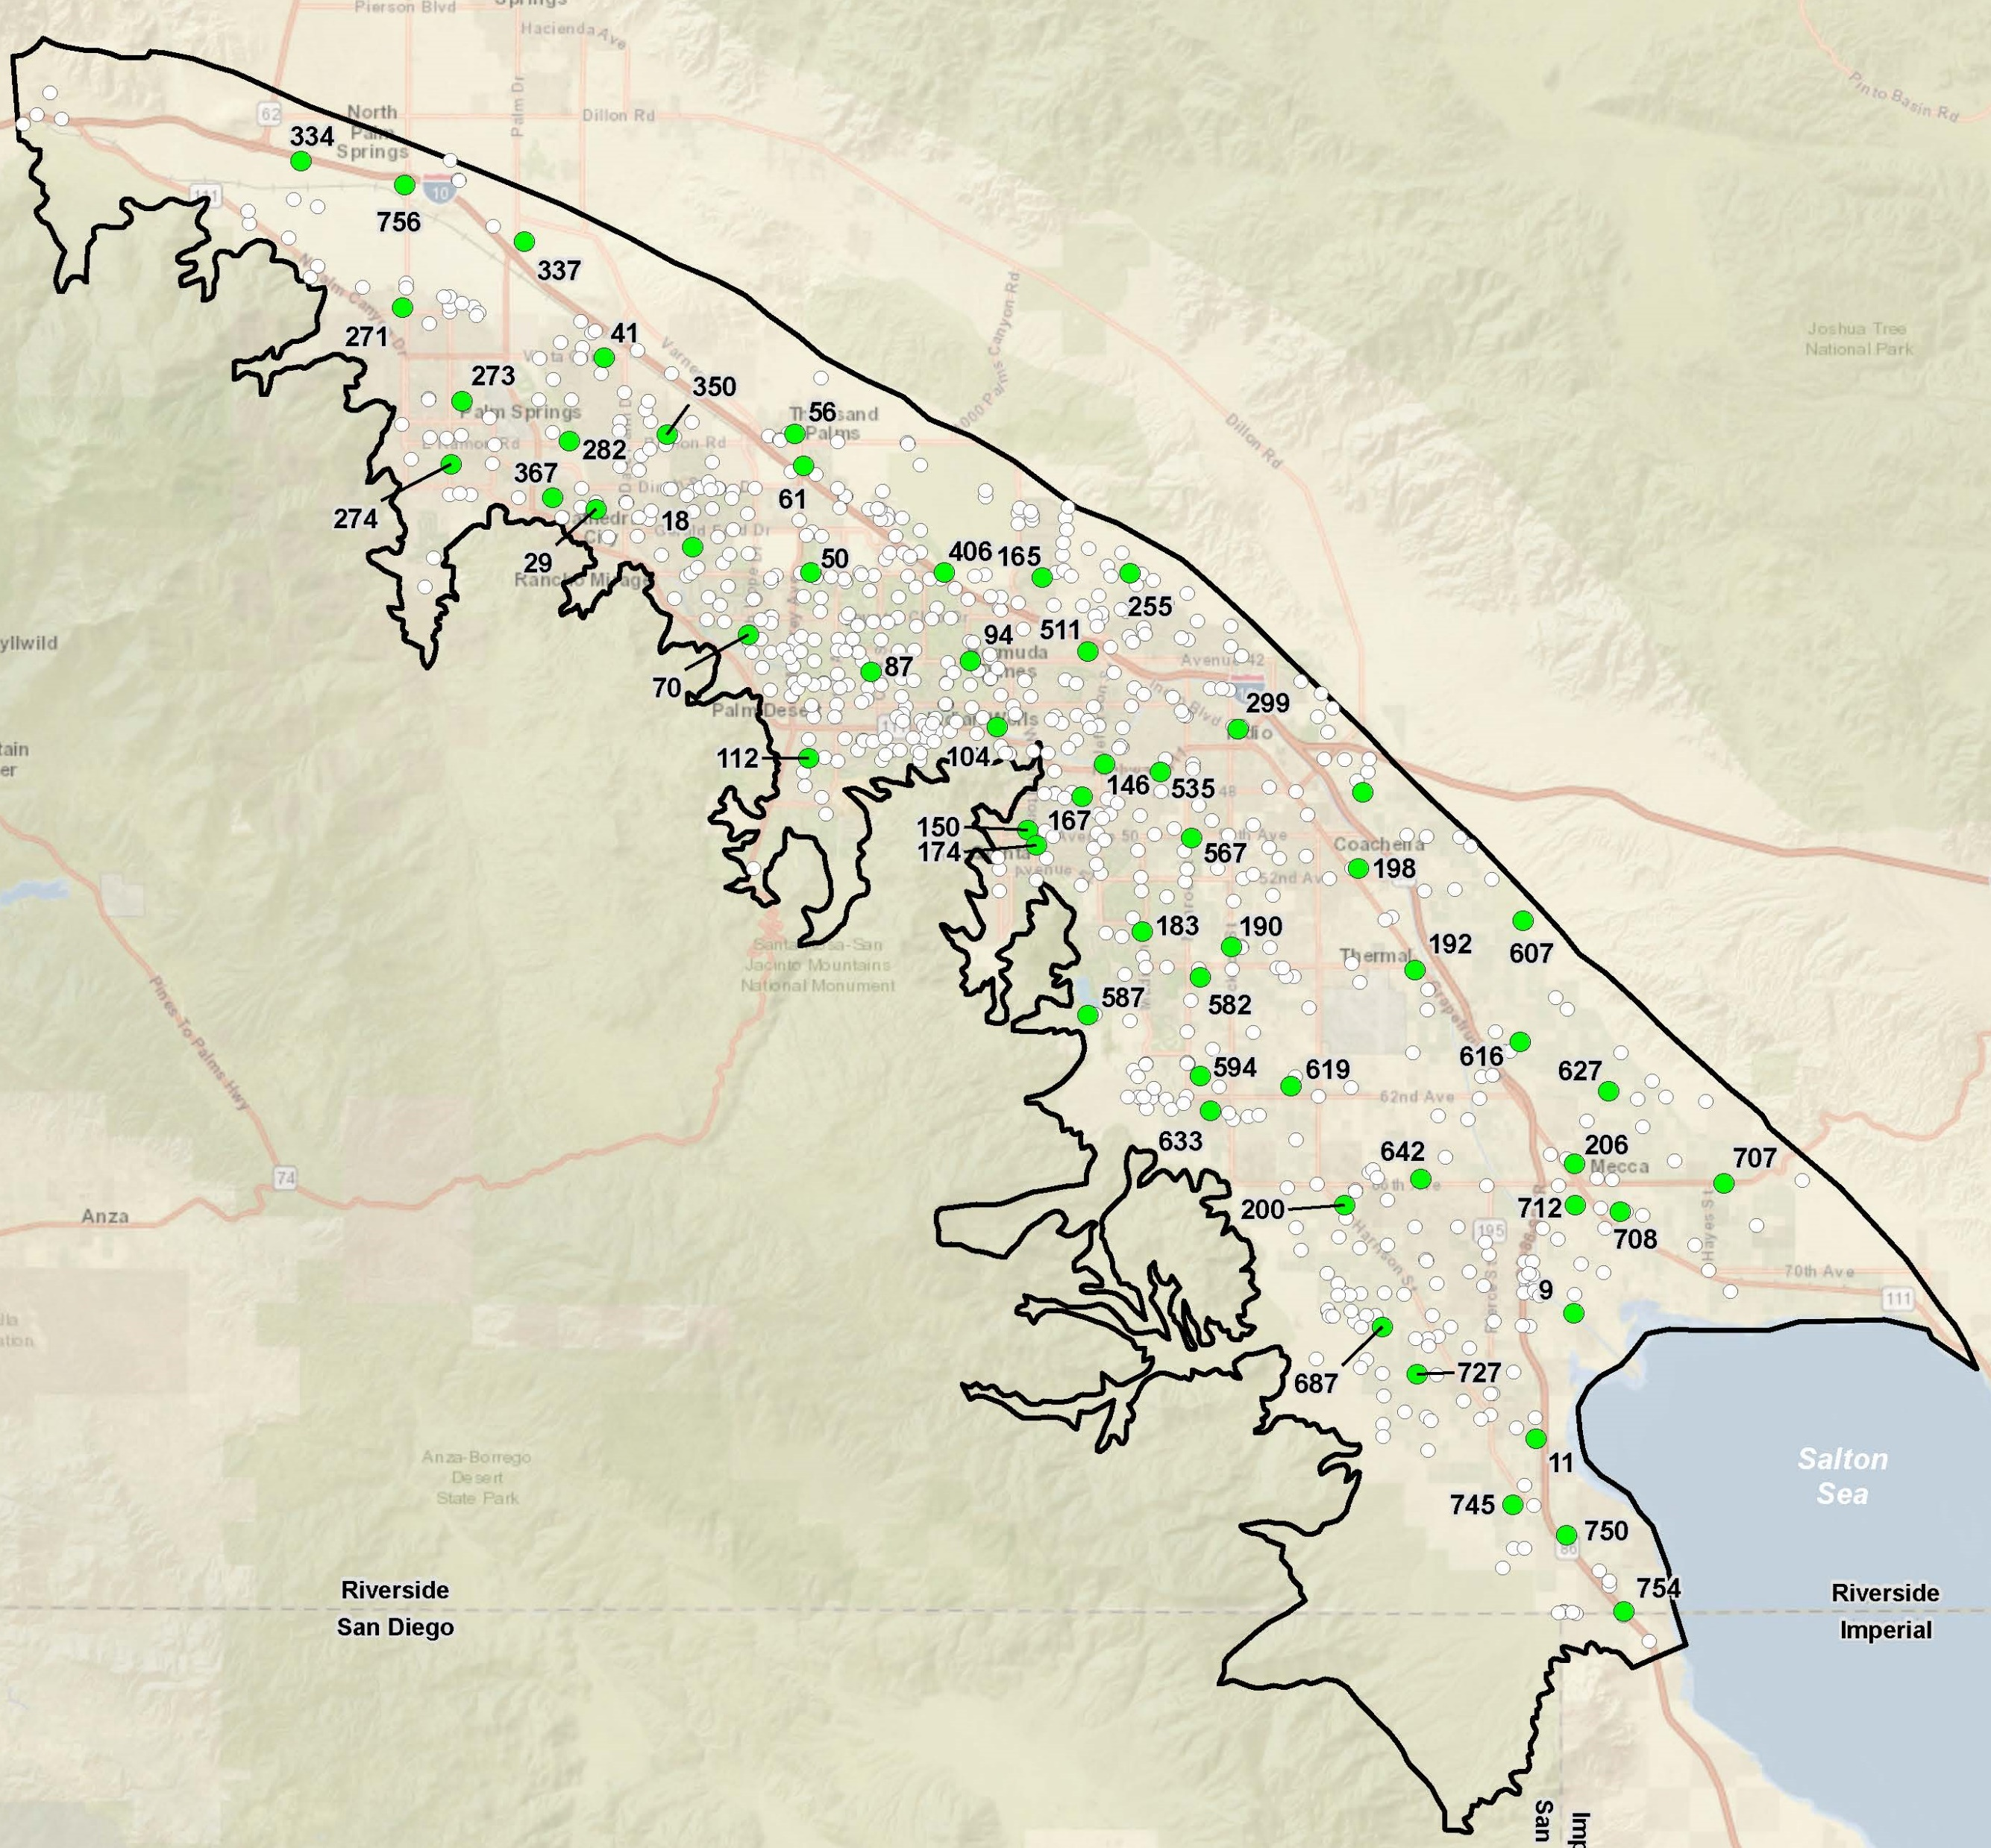
Groundwater Level MTs are set at Key Wells
Key Well selection factors include:
Well construction data available
Current monitoring
Long, reliable record
Areal distribution
Location among production wells
Proximity to small water systems
All GSAs represented
57 wells selected
Notes:
Minimum threshholds can’t be measured at every well, and so we selected 57 Key Well to set the Groundwater Level MTs and to represent nearby wells.
Key Well selection factors include:
Well construction data available
Current monitoring
Long, reliable record
Areal distribution
Location among production wells
Proximity to small water systems
All GSAs represented

Slide 24

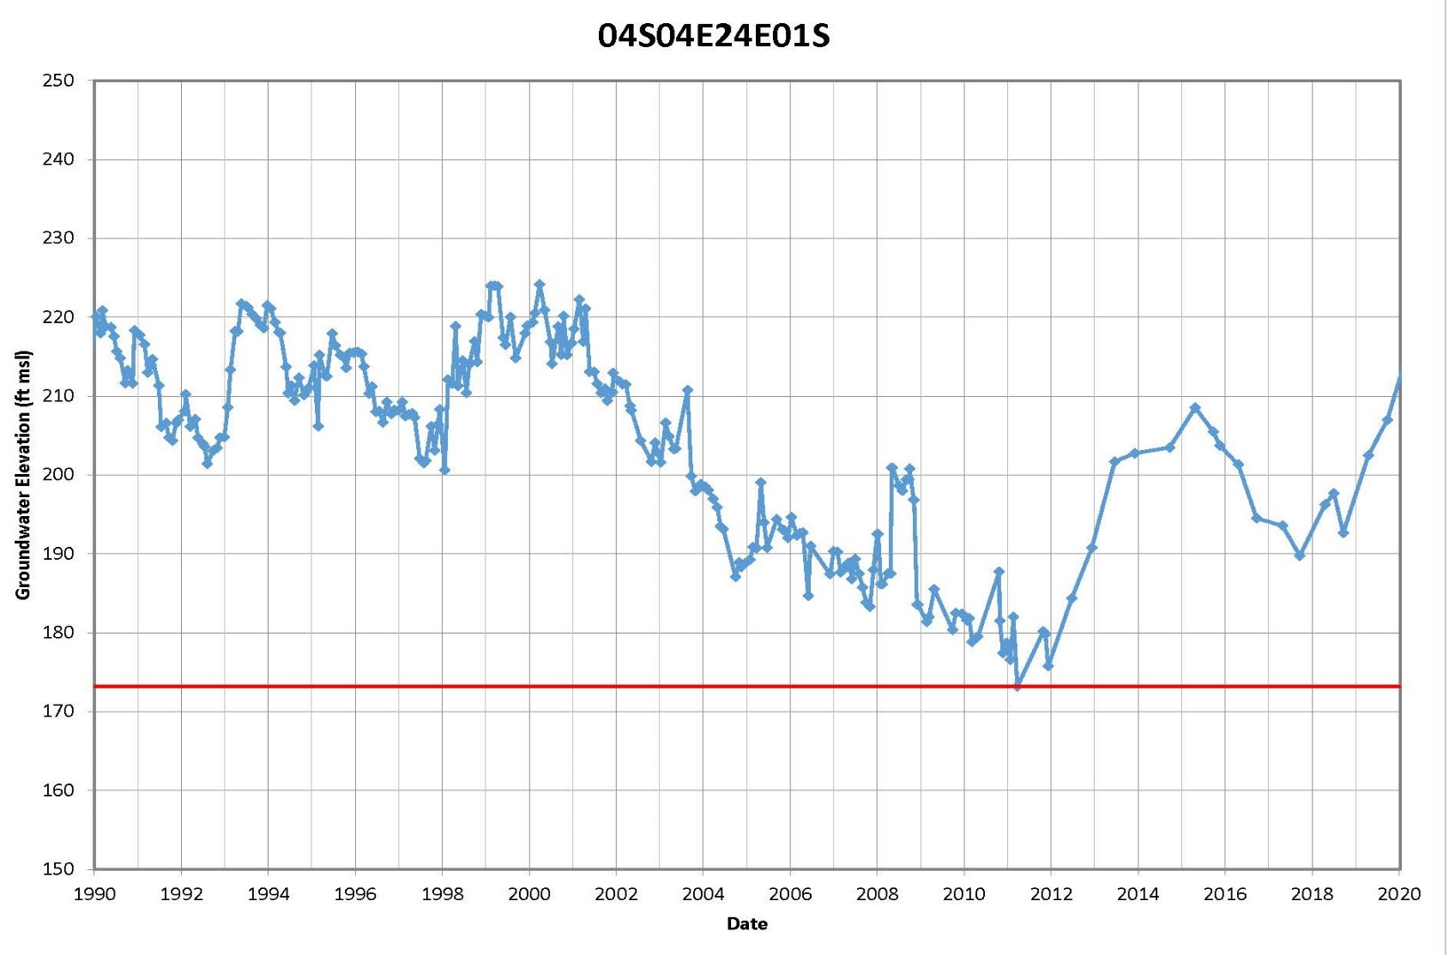
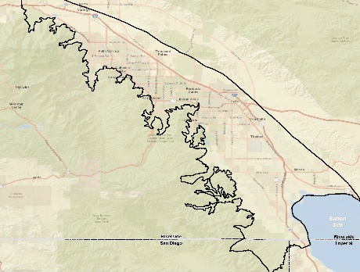
MTs for Groundwater Levels
Historical lows as measured at Key Wells:
An undesirable result occurs when the MT is crossed in five consecutive low-season monitoring events in 25% of wells across the subbasin
GSAs will monitor levels, respond as needed, and provide annual reporting
Notes:
So, to summarize, Historical lows as measured at Key Wells.
But the MT is more than just the level, it also defines how ofter the red line is crossed, for how long, and in how many wells:
Thus we defined:
An undesirable result occurs when the MT is crossed in five consecutive low-season monitoring events in 25% of wells across the subbasin
This means that the undesirable result is significant, unreasonable, and occurs throughout the basin
Be assured that the GSAs will continue to monitor levels, respond as needed, and provide annual reporting so you know what the situation is.
This is an important metric for sustainability, and there’s more.

Slide 25
Groundwater Level MTs are Suitable Proxies for Groundwater Storage and for Subsidence
Groundwater levels, storage, and subsidence are correlated.
The groundwater level MTs are defined to avoid undesirable results of significant & unreasonable:
  Loss of yield from existing production wells due to chronic level decline
  Reduction of groundwater storage
  Reduction in the viability of water conveyance, flood control and other infrastructure due to land subsidence
Notes:
Groundwater Level MTs are Suitable Proxies for Groundwater Storage and for Subsidence
Use of proxies is allowed by SGMA when there is a good demonstrated correlation between the levels and the other criterion.
Here in Indio Subbasin, we can demonstrate that troundwater levels, storage, and subsidence are correlated.
And thus we can use the Groundwater level MTs to track three potential undesirable results:
Allow me to show you:

Slide 26
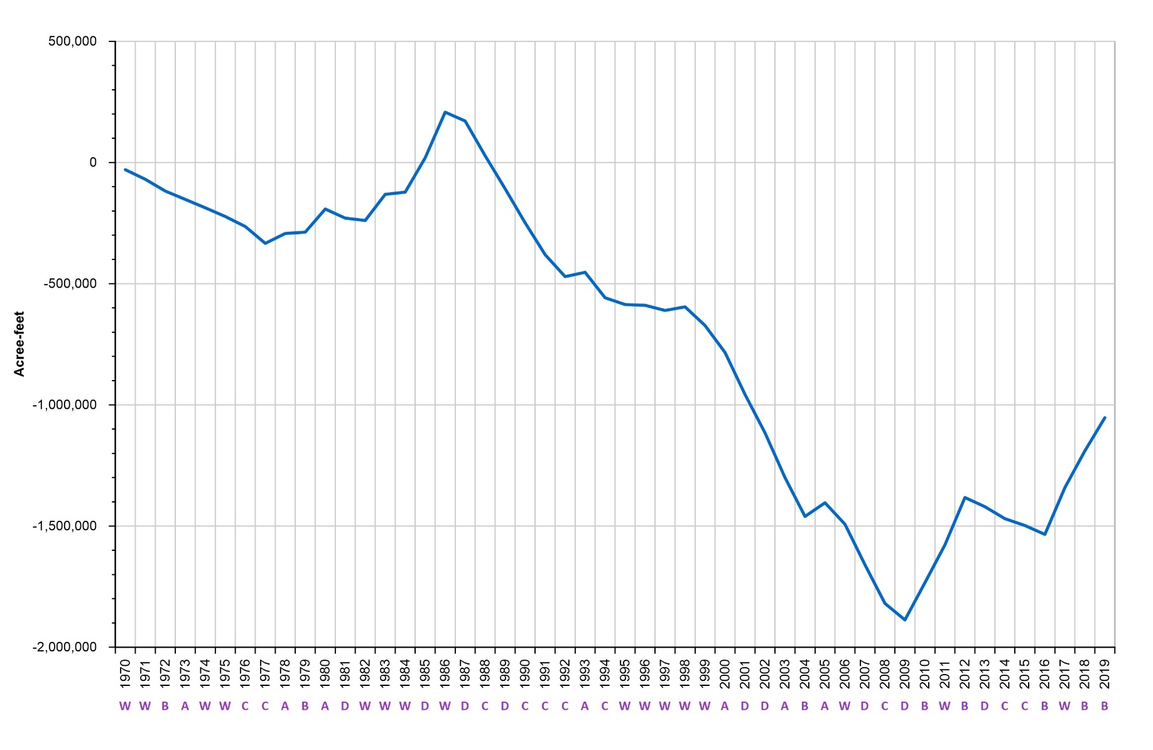
Change in Groundwater Storage
The “running total” from 1970 to 2019
Shows overdraft from 1987-2009
Reversal of historical overdraft since 2009
An increase of about 840,000 AF stored water for use if/when shortages occur, e.g., statewide drought
Historical low groundwater in storage - 2009
26
Notes:
This is a change in storage graph that shows groundwater in storage in AF from 1970 to 2019, essentially as a “running total” starting at zero on the left with the downslopes indicating storage depletion and the rising slopes indicating increasing storage..
You can clearly see the declines and overdraft from about 1987 to 2009
And then the reversal of overdraft and increase of storage since 2009—which is when many hydrographs show the historical low groundwater levels.
Groundwater levels and storage are directly related and groundwater level MTs—based on historical lows—can be a proxy and protective of groundwater storage
And there’s more

Slide 27
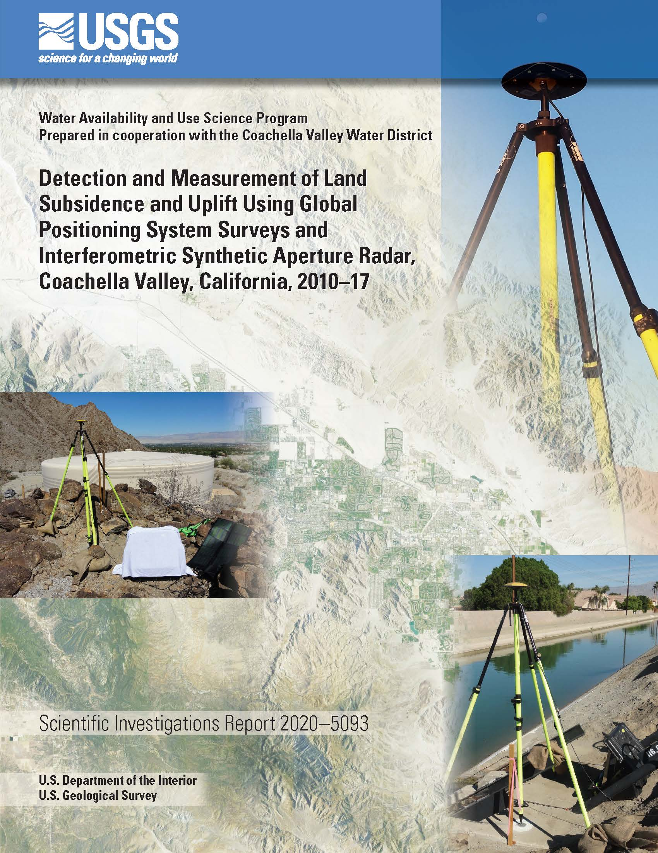
Land Subsidence
Indio Subbasin is susceptible to subsidence due to compaction of basin sediments with groundwater level declines
Subsidence as much as 2 feet, 1995 to 2010, correlated to groundwater declines due to pumping
Stabilization and uplift documented since 2010 with higher groundwater levels
Notes:
Land Subsidence
The Indio Subbasin is susceptible to subsidence due to compaction of basin sediments with groundwater level declines
Subsidence as much as 2 feet, 1995 to 2010,--which is small relative to other basins in CA—but most importantly here, subsidence is correlated to groundwater declines due to pumping
In general, subsidence occurs with groundwater level declines and then stabilization and uplift has been documented since 2010 with higher groundwater levels
Again, there is good correlation and groundwater level MTs can be used as a proxy and can serve to warn against potential subsidence
At this point, we have addressed three of six potential undesirable results. Now let me turn to groundwater quality.

Slide 28
Groundwater Conditions: Water Quality
Numerous water quality constituents are being tracked by GSAs
Water from large water systems meets all drinking water standards
Small water systems and domestic wells may be affected by some constituents
  Nitrate (multiple sources)
  Naturally occurring Cr-6
  Naturally occurring Arsenic
GSAs are working with community representatives and non-profits on domestic system consolidations
Notes:
By way of background:
Numerous water quality constituents are being tracked by GSAs
Water from large water systems meets all drinking water standards
Small water systems and domestic wells may be affected by some constituents
Nitrate (multiple sources)
Naturally occurring Cr-6
Naturally occurring Arsenic
GSAs are working with community representatives and non-profits on domestic system consolidations

Slide 29
Groundwater Conditions: Water Quality
Constituents of Concern Included
Salinity (TDS)
Nitrate
Arsenic
Hexavalent chromium (Cr-6)
Fluoride
Perchlorate
Uranium
DBCP
Plan Update provides comprehensive assessment of groundwater quality
Maps for eight constituents
Cross-sections for TDS, NO3, Arsenic, Cr-6 to show vertical variation
Time concentration plots for TDS and nitrate
Discussion of significance, source(s), distribution factors
29
Notes:
And the Plan Update provides comprehensive assessment of groundwater quality
Maps for eight constituents listed here on the right
Cross-sections for TDS, NO3, Arsenic, Cr-6 to show vertical variation
Time concentration plots for TDS and nitrate
Discussion of significance, source(s), distribution factors

Slide 30
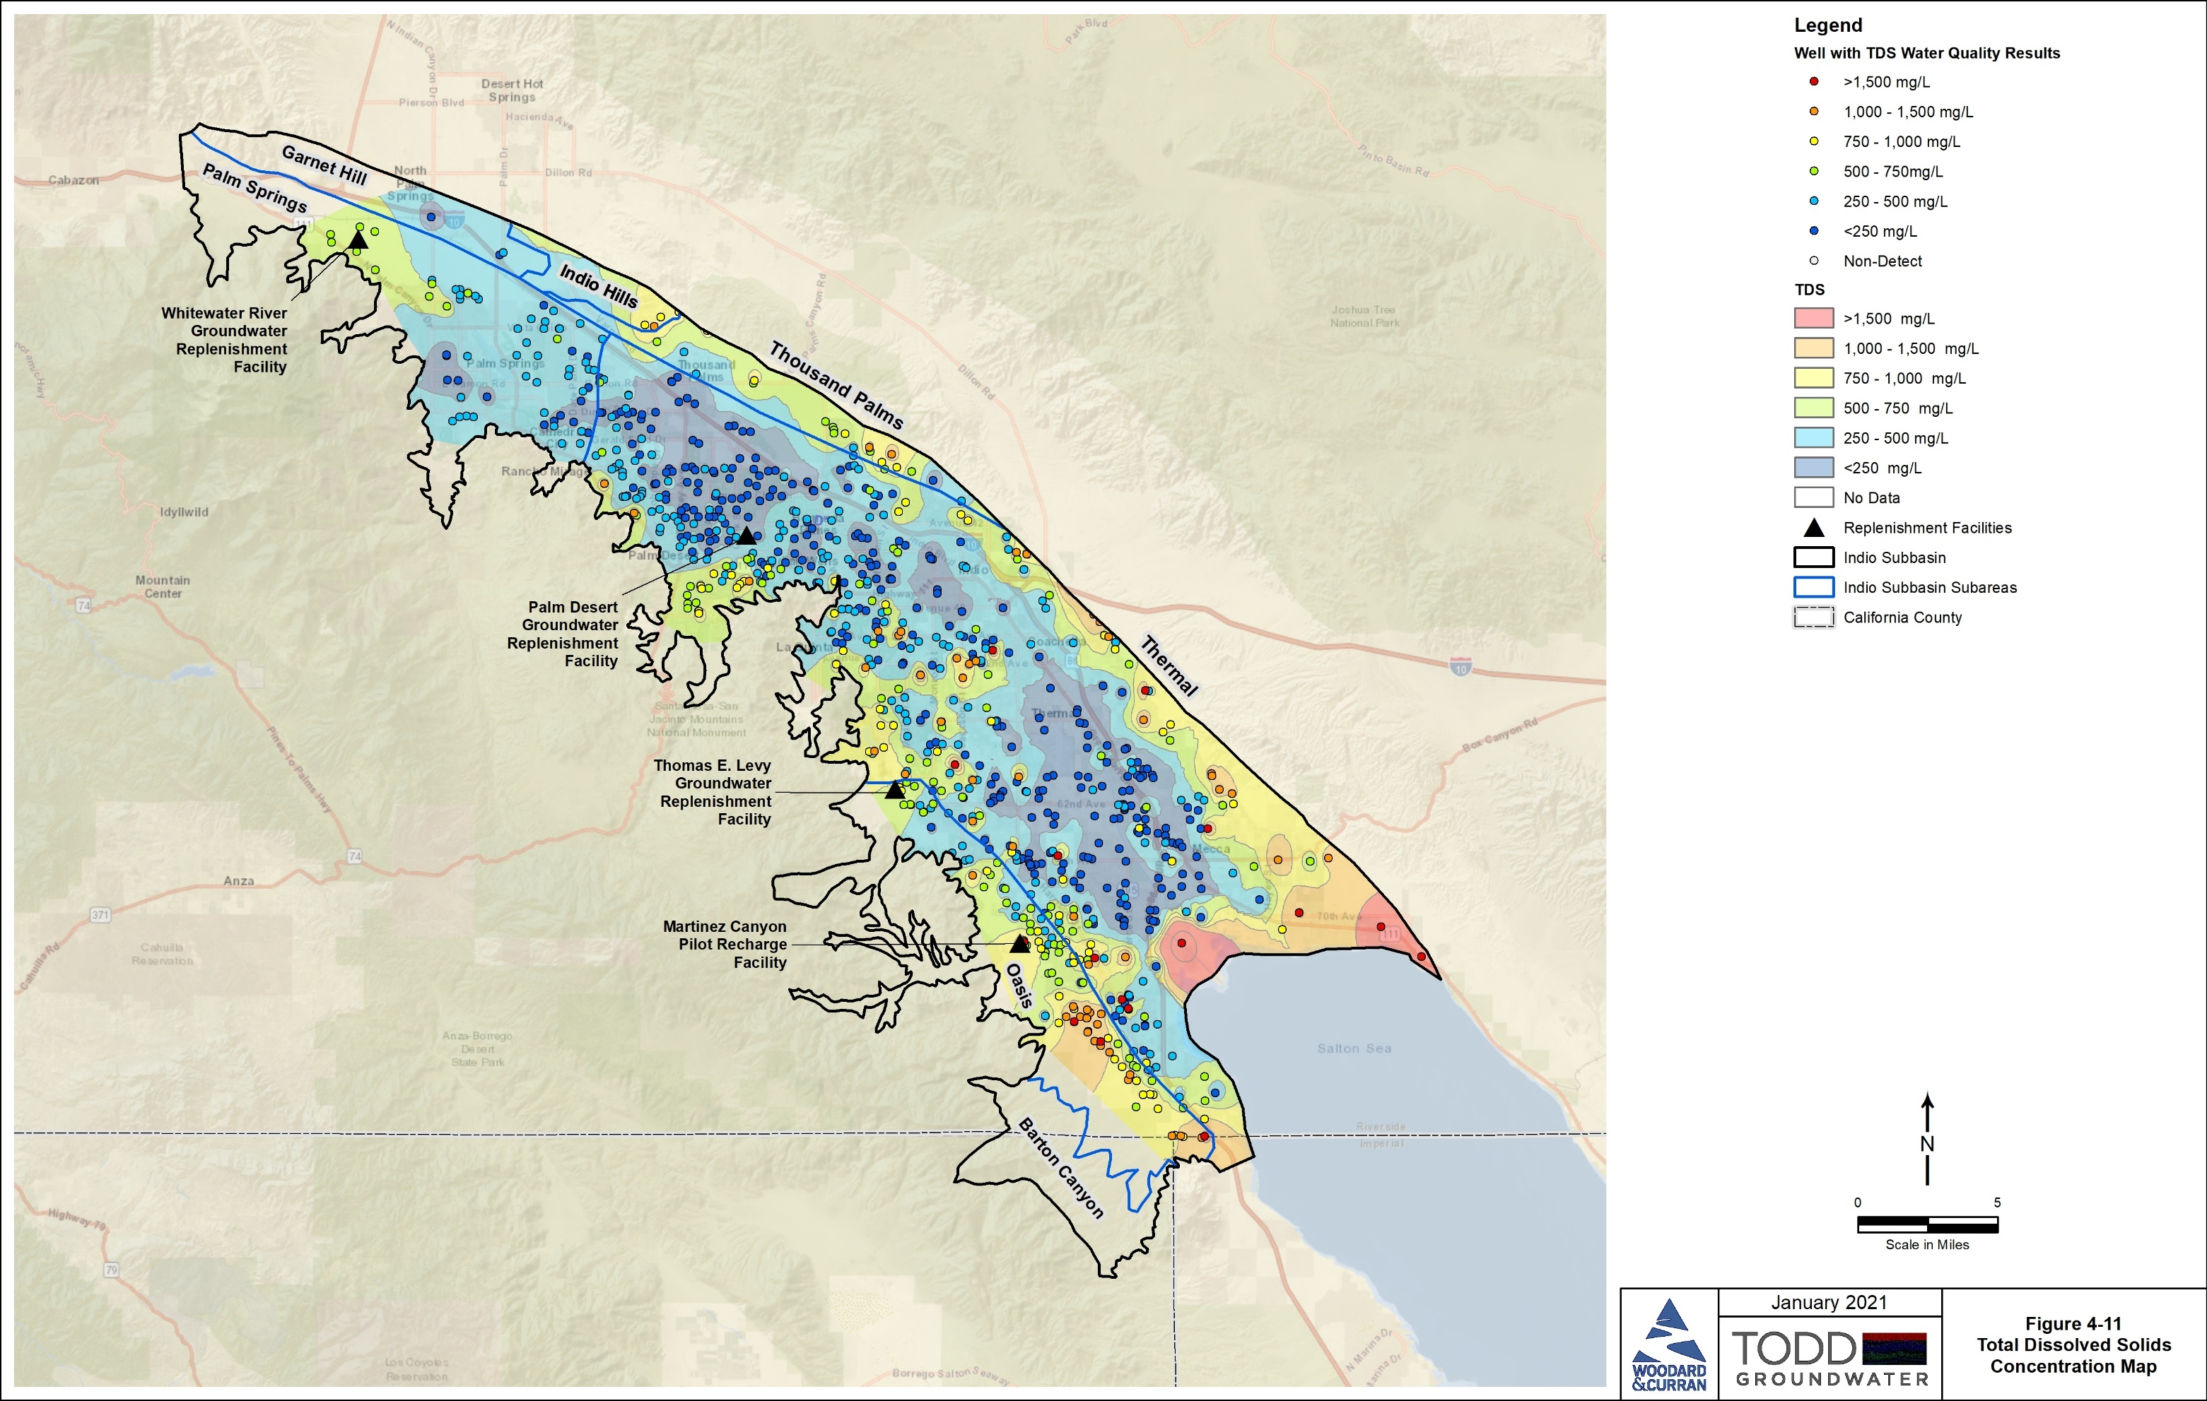
Groundwater Quality Maps: e.g., TDS
SWRCB Consumer Acceptance Levels
  recommended 500 mg/L
  upper 1,000 mg/L
  short-term 1,500 mg/L
From natural sources, return flows, imported water recharge, septic and wastewater disposal, subsurface inflow, and historical seawater inflow
Large areas are <500 mg/L with highest concentrations near Salton Sea and along basin margins
  Most recent samples from 1990-2019
  Relatively deep wells (>300 feet) in production zones
30
Notes:
As one example, here is the groundwater quality map for TDS
The values used to create this map
are from Relatively deep wells (>300 feet) in production zones
And are the Most recent samples from 1990-2019
You can’t read the legend, but the warm colors are higher concentrations, and the cool colors are relatively low concentrations
The scale reflects the State Water Resources Control Board Consumer Acceptance Levels
recommended 500 mg/L
upper 1,000 mg/L
short-term 1,500 mg/L
The Plan provides information on sources, in this case:
From natural sources, return flows, imported water recharge, septic and wastewater disposal, subsurface inflow, and historical seawater inflow
The map indicates that large are less than 500 mg/L, the blue shades on the map
Higher concentrations are along the Salton Sea

Slide 31
Salinity Studies/SNMP
Plan Update has provided:
Improved basis to study the rate and level of increased salt in groundwater from all sources (e.g., return flows, recharge, wastewater, subsurface inflow, seawater intrusion)
Groundwater quality database compilation and assessment
Planning for installation of additional monitoring wells
Update and improvement of numerical flow model that can be basis for salt and nutrient balance studies
Planning for study of relationships among groundwater levels, groundwater quality, and drain flows
Coordination with the CV-SNMP update beginning in 2022
Notes:
With regard to salinity studies and the Salt Nutrient Management Plan, The Plan Update has provided:
Improved basis to study the rate and level of increased salt in groundwater from all sources (e.g., return flows, recharge, wastewater, subsurface inflow, seawater intrusion)
Groundwater quality database compilation and assessment
Planning for installation of additional monitoring wells
Update and improvement of numerical flow model that can be basis for salt and nutrient balance studies
Planning for study of relationships among groundwater levels, groundwater quality, and drain flows
Coordination with the CV-SNMP update beginning in 2022

Slide 32

Seawater Intrusion and the Salton Sea
The Salton Sea is distinguished by:
salinity about twice that of the ocean and gradually increasing
surface water levels decreasing and a shoreline that is retreating
Seawater intrusion is an important consequence of overdraft
Tracked closely by the GSAs:
Dedicated monitoring wells for sampling and level measurements
Subbasin groundwater level monitoring and water budget modeling to assess groundwater flow
Notes:
Salt water intrusion also is a potential undesirable result typically associated with the ocean. But here the Indio Subbasin is bounded by the Salton Sea, which is different.
The Salton Sea is distinguished by:
salinity about twice that of the ocean and gradually increasing
surface water levels decreasing and a shoreline that is retreating
Although different, Seawater intrusion from the Salton Sea has been an undesirable consequence of overdraft
Accordingly, it is Tracked closely by the GSAs:
Dedicated monitoring wells for sampling and level measurements
Subbasin groundwater level monitoring and water budget modeling to assess groundwater flow

Slide 33
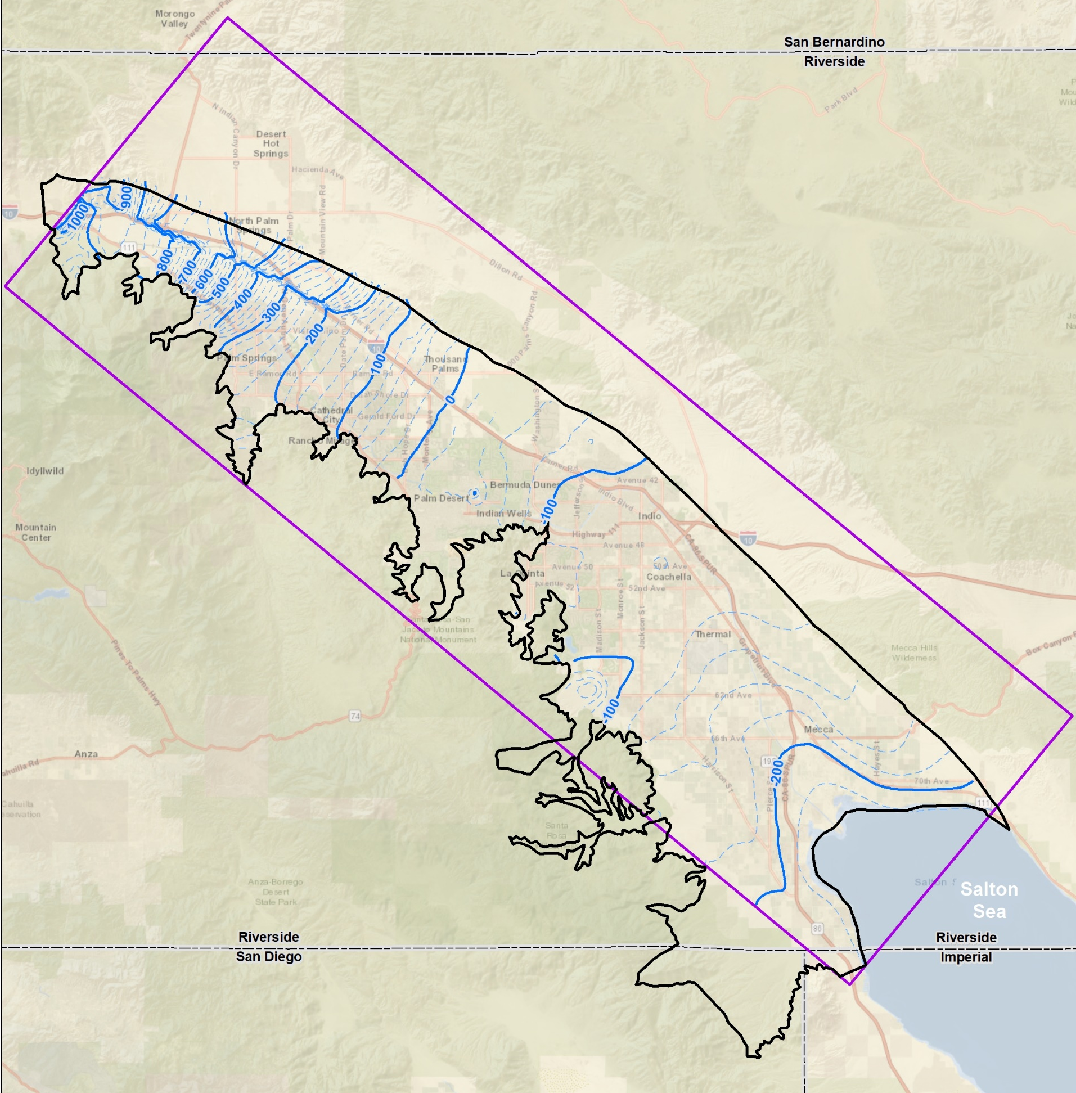
Seawater Intrusion
Numerical modeling indicates:
  Net inflow from Sea 1997-2014
  Net outflow to Sea, 3,000 AFY, 2015 on
Simulated 2020 shallow groundwater levels (-220 feet) are higher than Sea
Simulated 2020 deep groundwater contour (-200 feet) is even higher (groundwater flowing upward)
Seawater intrusion has been reversed (but will continue to be monitored)
Simulated Levels in Shallow Aquifer, 2020
-220 ft
Salton Sea currently is about -238 ft
Notes:
The Plan—through use of the numerical models indicates that there was seawater intrusion
A Net inflow from Sea 1997-2014 but then a
Net outflow to Sea, 3,000 AFY, 2015 on
In addition, the model was used to simulate shallow groundwater levels in 2020 and indicated that at (-220 feet), they are higher than Sea (at -238 feet)
And simulated deep groundwater contours for 2020 are at (-200 feet) even higher and indicating that groundwater is flowing upward from the deep aquifer to the Salton Sea
So that Seawater intrusion has been reversed
(but will continue to be monitored)

Slide 34
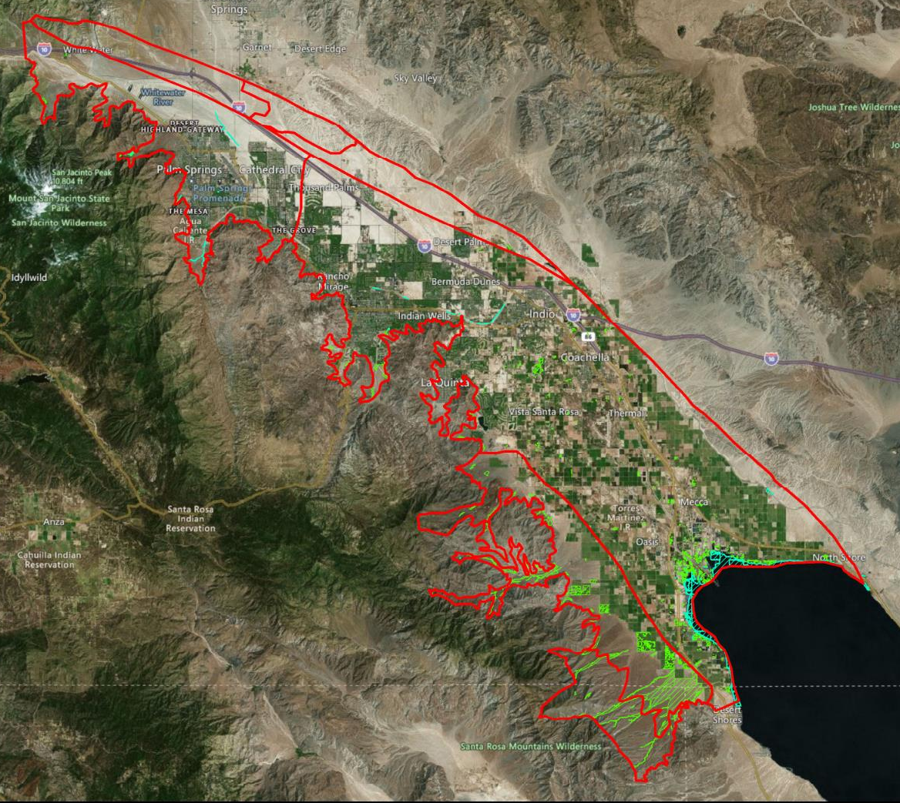
Interconnected Surface Water and
Groundwater Dependent Ecosystems (GDEs)
Plan Update assesses potential GDEs:
Review of Coachella Valley Multiple Species Habitat Conservation Plan and protected species
Desktop analysis of mapped
NCCAG polygons
Field survey of 13 sites
Mapping of potential GDEs
34
34
Notes:
Lastly, the Plan Update addresses interconnected surface water and particularly Groundwater Dependent Ecosystems (GDEs)
The Plan Update assesses potential GDEs through:
Review of Coachella Valley Multiple Species Habitat Conservation Plan and protected species
Desktop analysis of mapped NCCAG polygons
Field survey of 13 sites
Mapping of potential GDEs, as shown on the next slide

Slide 35
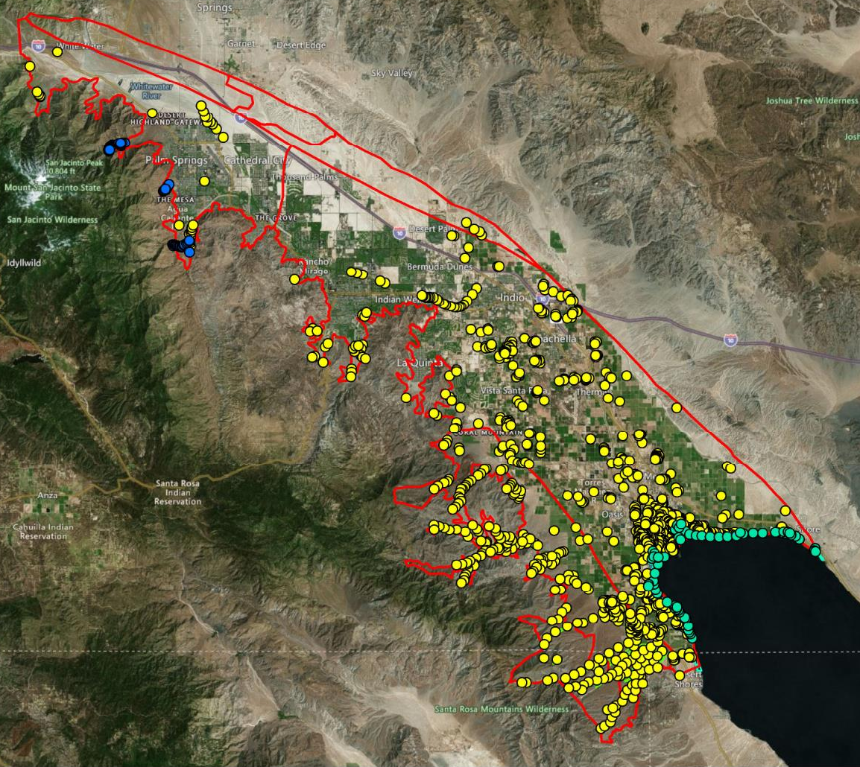
Assessment and Mapping of Potential GDEs
Probable GDEs (5%) occur in canyons and may rely partially on surface water or snowmelt
Probable Non-GDEs (89%) include agricultural fields and drainages, uplands, and dry washes
Playa Wetlands (6%) are dependent on agricultural drain flows and occur along Salton Sea exposed seabed
35
35
Notes:
The GDE assessment and mapping indicated that, of the hundreds of sites assessed,
Probable GDEs (5%) occur in canyons and may rely partially on surface water or snowmelt
Probable Non-GDEs (89%) include agricultural fields and drainages, uplands, and dry washes
Playa Wetlands (6%) are dependent on agricultural drain flows that used to flow directly into the Salton Sea and now discharge to the Salton Sea playa that has been exposed with Salton Sea retreat.
That has been a rapid review of groundwater conditions and work on sustainability criteria…are there any questions?

Slide 36
Questions?

Slide 37
Agenda
Welcome and Introductions
2022 Water Management Plan Update (Alternative Plan Update)
Groundwater Conditions and Sustainable Management
Water Demands and Supplies
Numerical Model, Plan Scenarios, and Projects & Management Actions (PMAs)
Plan Evaluation and Implementation
Public Comment
Get Involved

Slide 38
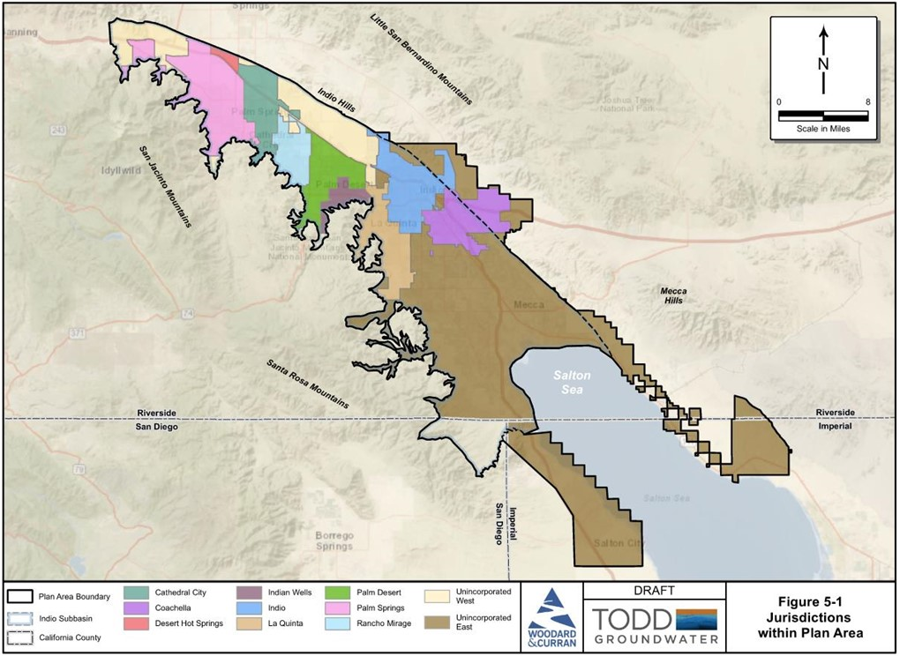
Demand Forecast – 2020-2045
Forecast is based on 11 geographic units
Considers:
  Projected land uses
  Conversion of agricultural lands
  Historical water use
  Conservation trends
Coordination and data sharing with Mission Creek Planning Team
38

Slide 39
Municipal Demands – Forecast Process
1.
Regional Growth
Forecast
2.
Land Use Inventories
3.
Unit Demand Factors
4.
Projected Water Loss
5.
Adjustment Factors
Using SCAG
2020 growth projections for households, population, and employment
Allocating growth to residential and non-residential based on SCAG land use mapping
Using 5-year (2015-2019) averages from customer billing data to develop unit demand factors
Developing water loss estimates based on validated Water Loss Audit reports
Developing conservation savings estimates for indoor and outdoor (new development only) water use

Slide 40
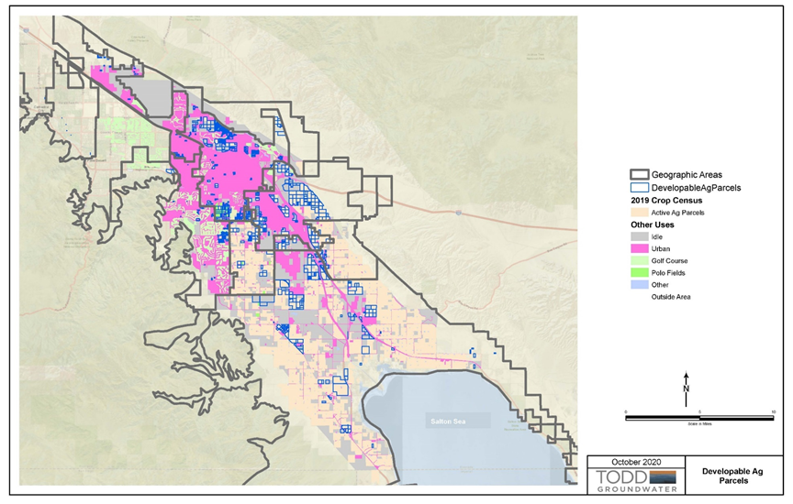
Agricultural, Golf, and Other Demands
Agricultural demand forecast is based on current agricultural use and expected conversion of idle and agricultural lands
Golf demand forecast considers market trends and currently proposed golf courses within the Plan Area
Other demand forecast includes fish farms, duck clubs, polo/turf, and potential surf parks

Slide 41
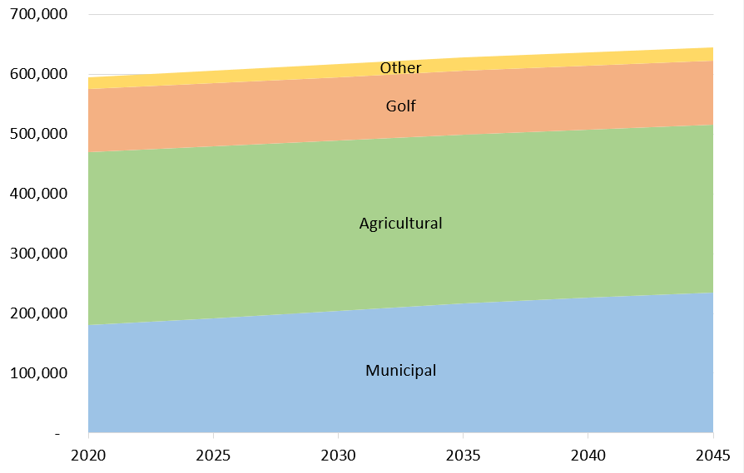
Total Projected Demand (AFY)
644,610
+8%
594,823

Slide 42
Supply Portfolio for Indio Subbasin
QSA Base Entitlement
Surface Water
Based on Municipal Wastewater Flow Projections
Recycled Water
Minus Conveyance Losses
MWD SWP Transfer
IID/CVWD Transfers
Other Supplies
Rosedale Rio-Bravo
Snow, Falls & Chino Creek
Whitewater River
Groundwater
Table A Amount
Lake Perris Seepage
Colorado River Water
Natural Infiltration
Net Groundwater Inflow
SWP Exchange Water
Delta Conveyance Facility
Sites Reservoir
Yuba Accord

Slide 43
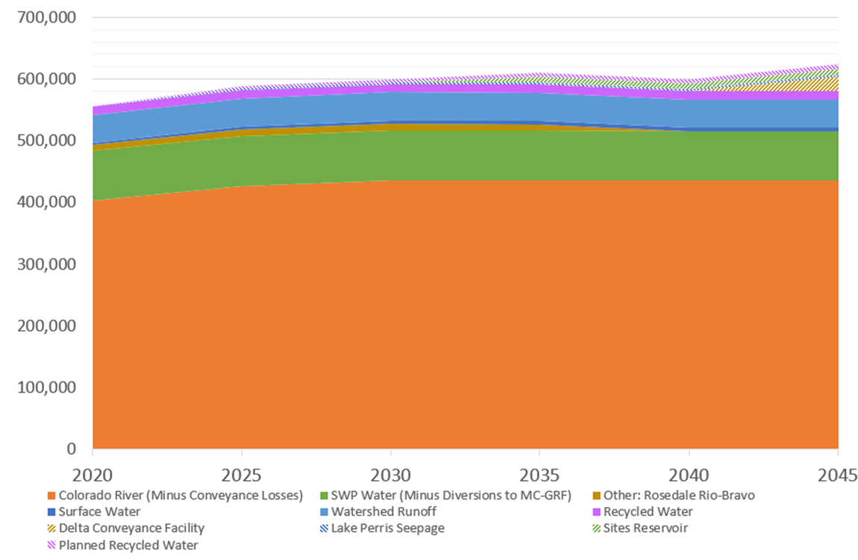
Supply Forecast – Projected Future Supplies with Climate Change (AFY)
581,683
+10%
528,064
Climate change conditions are projected to reduce available water supplies by up to 40,000 AFY

Slide 44
Questions?

Slide 45
Agenda
Welcome and Introductions
2022 Water Management Plan Update (Alternative Plan)
Groundwater Conditions and Sustainable Management
Water Demands and Supplies
Numerical Model, Plan Scenarios, and Projects & Management Actions (PMAs)
Plan Evaluation and Implementation
Public Comment
Get Involved

Slide 46
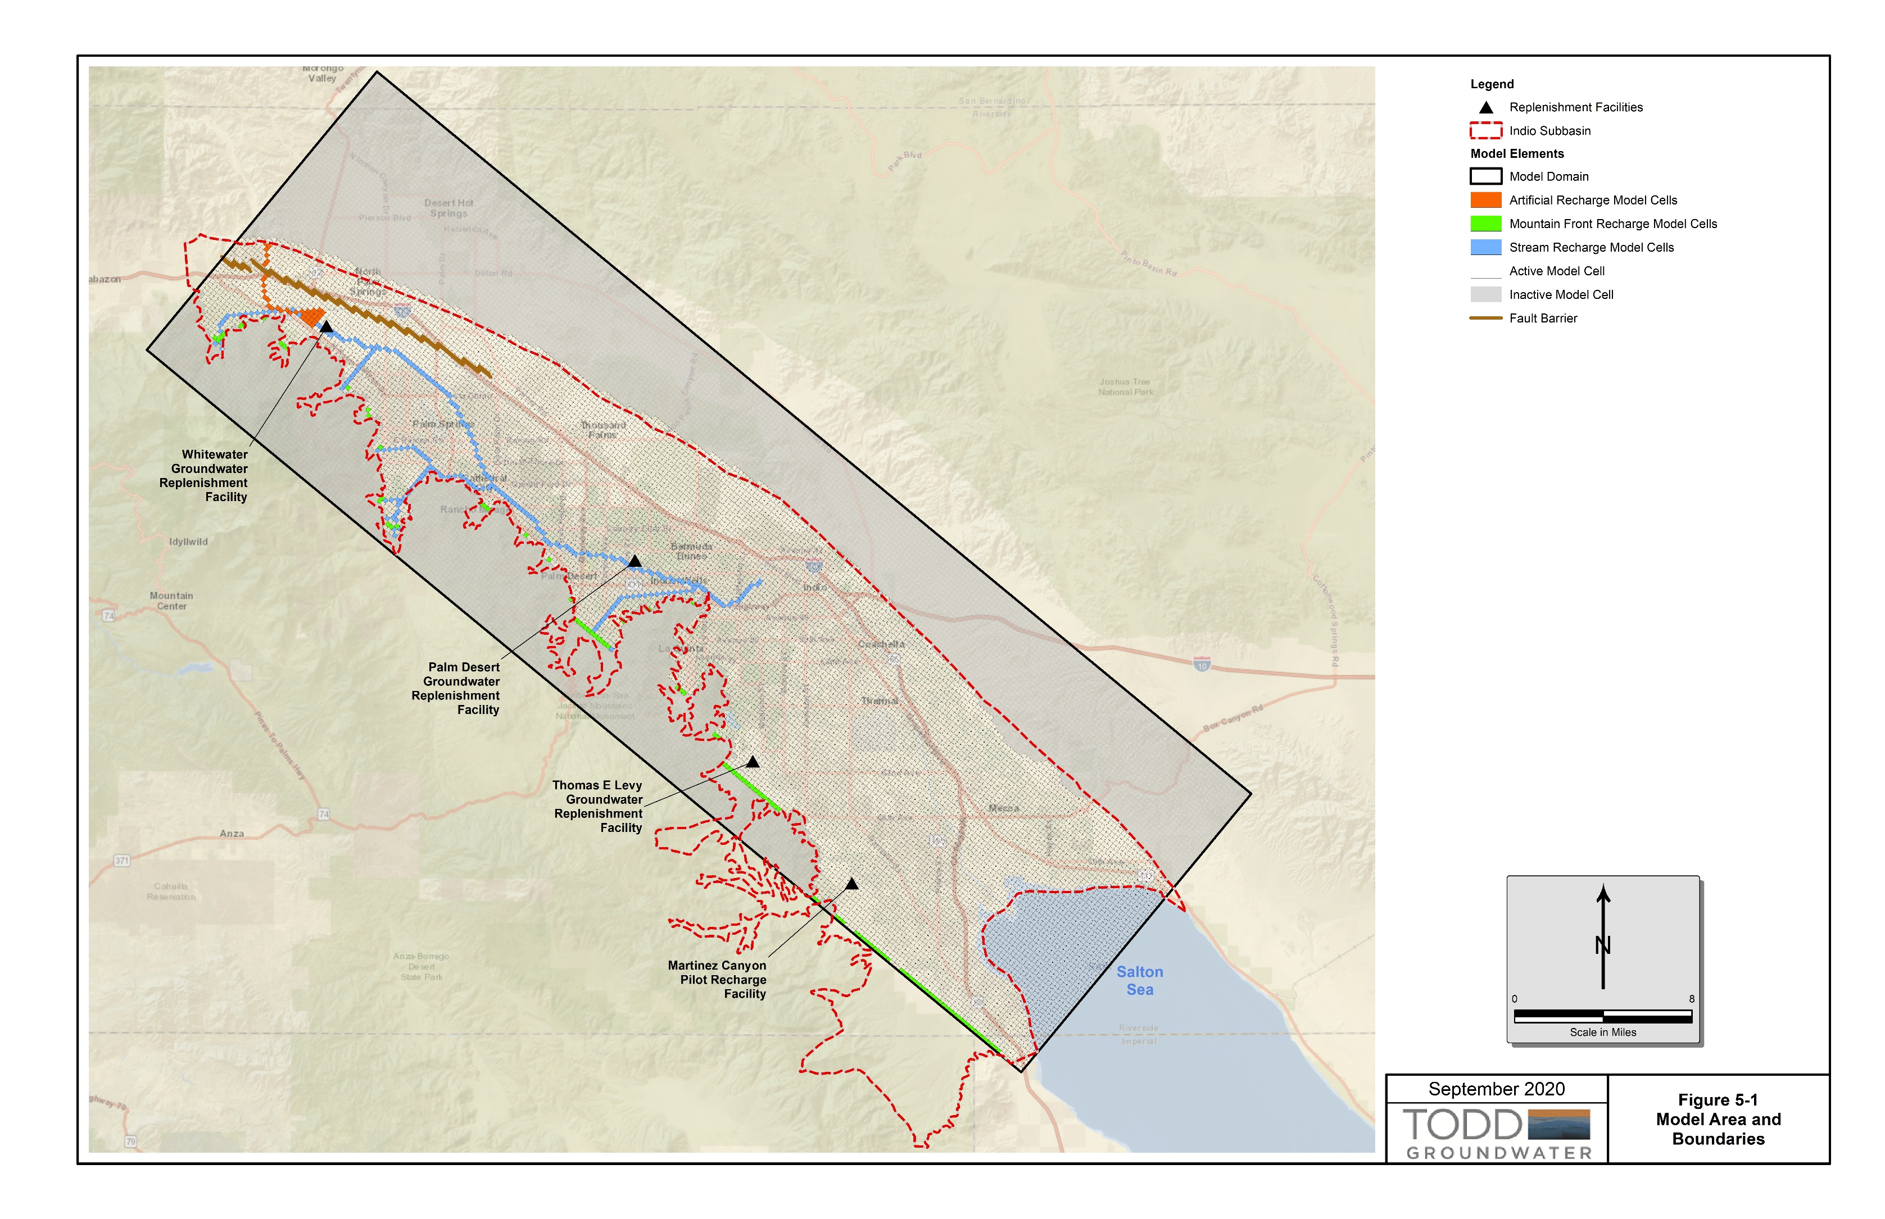
Indio Subbasin Groundwater Model
Extended modeling through 2019
Updated 2009-2019 recharge and pumping
Updated Salton Sea elevations (1997-2019)
Used more-accurate land surface elevations and sea bathymetry
Improved 1997-2008 inputs in Garnet Hill Subarea
Updated subsurface inflow boundary conditions from adjacent subbasins

Slide 47
Model Update Summary
Historical model accurately simulates shallow and deep groundwater levels in all areas of the subbasin
Can be used to predict future water level and storage changes under different inflow and outflow scenarios for 50 years into the future
Model provides forecasts of future drain flows, Salton Sea interactions, and other water budget conditions
1
47

Slide 48
Plan Scenarios – Assumptions
No New Projects = Baseline
Baseline w/ Climate Change
Five-Year w/Climate Change
Future Projects w/Climate Change
Expanded Ag w/Climate Change
Baseline assumes no new projects
Not realistic because additional projects already planned
Provides a comparison of future conditions with and without climate change/drought

Slide 49
Plan Scenarios – Assumptions
No New Projects = Baseline
Baseline w/ Climate Change
Five-Year w/Climate Change
Future Projects w/Climate Change
Expanded Ag w/Climate Change
Simulations of additional scenarios with 5-year (near-term) projects, future projects, and expanded agriculture
Additional scenarios include climate change/drought

Slide 50
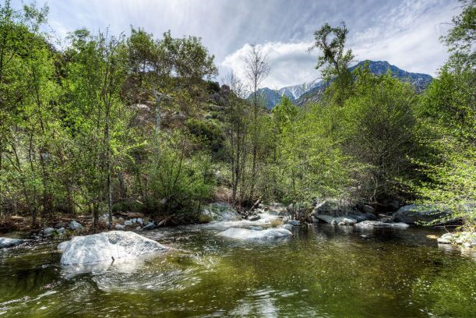
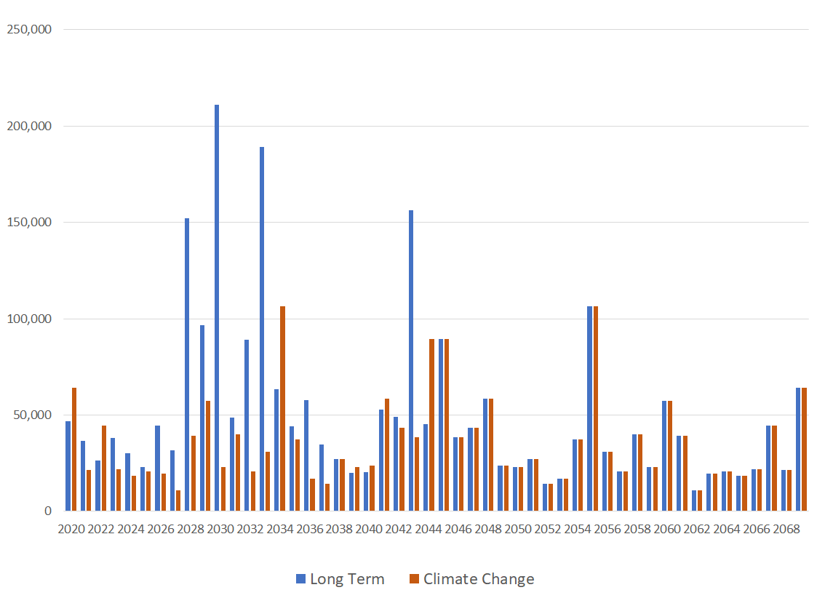
Climate Change – Assumptions
Scenarios use recent (drier) patterns
For local inflow:
  Baseline uses long term-hydrology – modeling repeats historical conditions (1970-2019) for future 50-years
    Estimated natural infiltration 43,000 AFY
  Climate change scenarios use recent 25-year period (1995-2019) which includes multiple droughts – modeling repeats drier pattern twice for 50-years
    Estimated natural infiltration 29,200 AFY
Snow Creek
Local Hydrology
Long Term
Observed 1970-2019
Climate Change
Observed 1995-2019
Repeated Twice

Slide 51
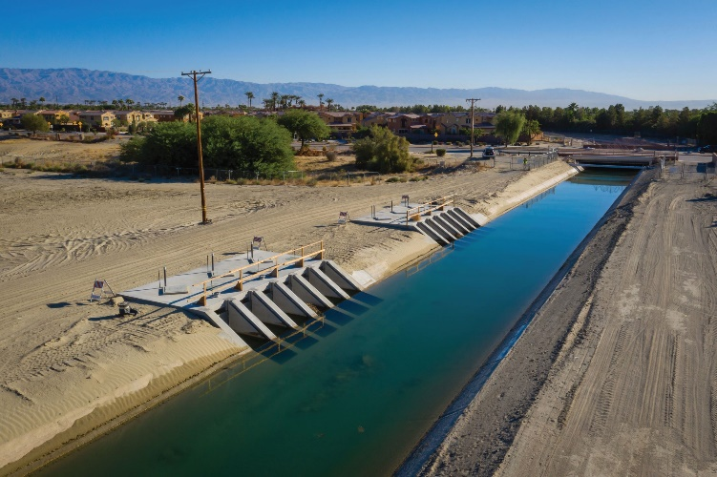
Climate Change – Assumptions
Scenarios use recent (drier) patterns
For imported water:
  State Water Project:
    Deliveries of SWP water have been impacted by legal, environmental, and drought conditions
    SWP deliveries = 45% over last 14 years
    Under future climate, DWR projects SWP deliveries will be reduced by additional 1.5%
  Colorado River:
    CVWD has agreed to 7% of California’s contribution of water to Lake Mead
    Availability of QSA water for direct delivery and replenishment will be reduced by 14,000 – 24,000 AFY
Thomas E. Levy GRF
Coachella Canal

Slide 52
Projects & Management Actions – Selected
Water Conservation
Source Substitution & Replenishment
Water Quality Protection
1: Urban Water Conservation
10: Mid-Valley Pipeline Direct Customers
22: Eliminate Wastewater Percolation
2: Golf Water Conservation
11: East Golf Expansion
23: Wellhead Treatment
3: Agricultural Water Conservation
12: Oasis Distribution System
24: Small Water System Consolidations
13: WRP-10 Recycled Water Delivery
25: Septic to Sewer Conversions
Water Supply Development
14: WRP-10 Tertiary Expansion
26: CV-SNMP GW Monitoring Program Workplan
15: Canal Water Pump Station Upgrade
27: CV-SNMP Development Workplan
4: Increased Surface Water Diversion
16: WRP-7 Recycled Water Delivery
28: Colorado River Salinity Forum
5: Delta Conveyance Facility
17: WRP-4 Tertiary Expansion & Delivery
29: Source Water Protection
6: Lake Perris Seepage
18: DWA WRP Recycled Water Delivery
7: Sites Reservoir
19: PD-GRF Phase 2 Expansion
8: Future Supplemental Water Acquisitions
20: TEL-GRF Expansion
9: EVRA Potable Reuse
21: WWR-GRF Operation

Slide 53
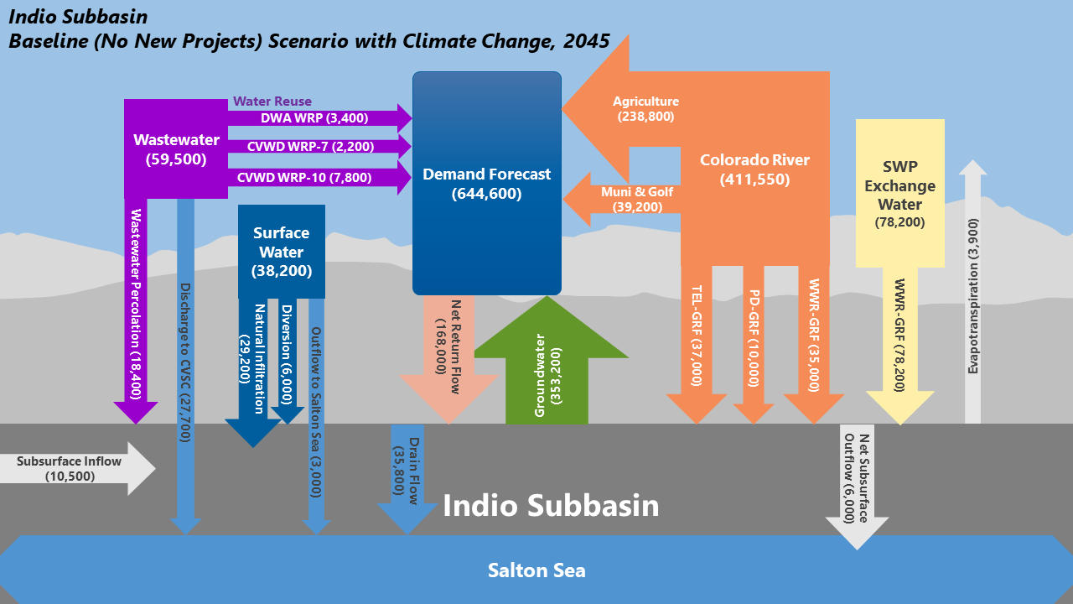
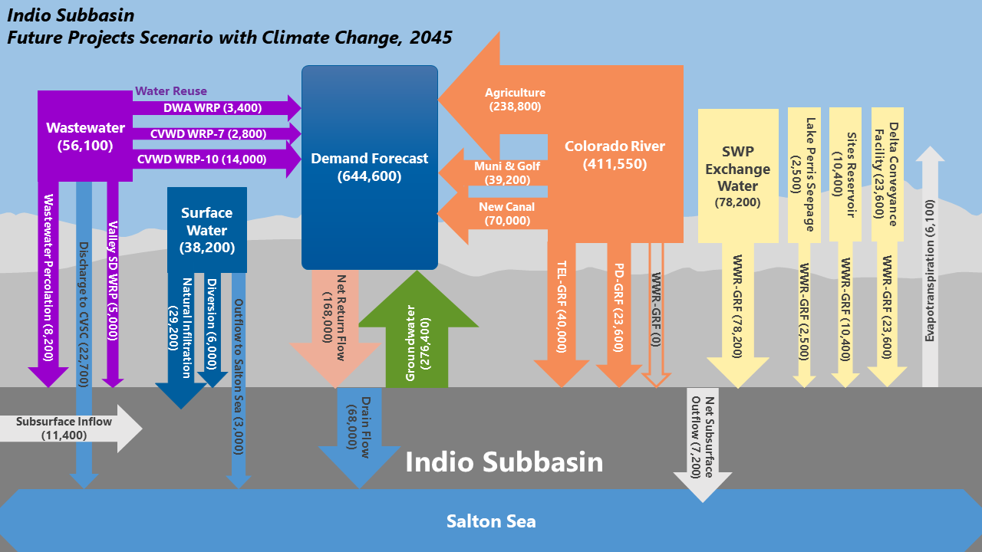
Plan Scenarios Reflect Varying Water Supplies and PMAs

Slide 54
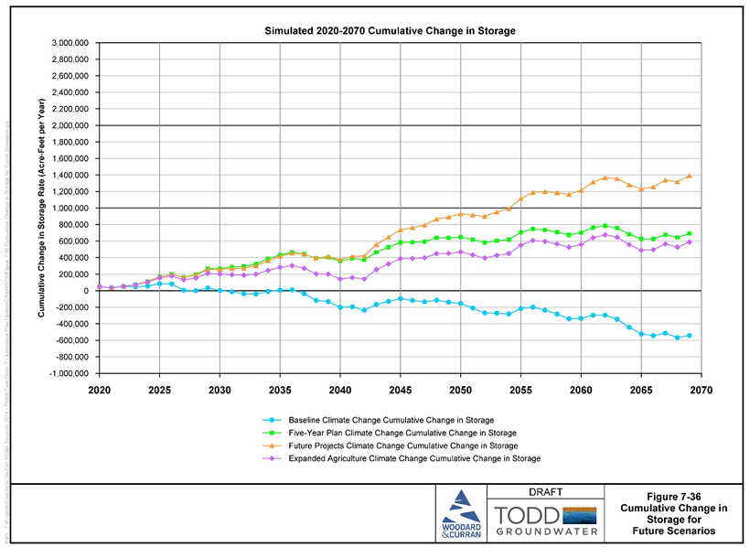
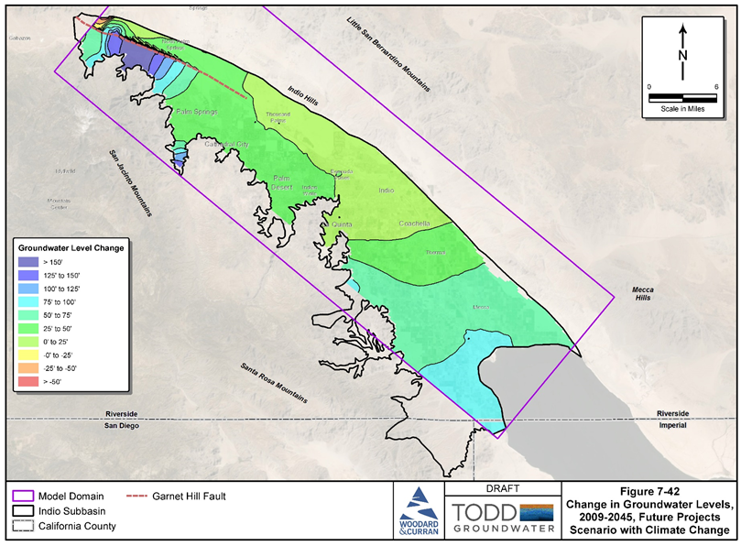
Simulation Results are Positive with Implementation of PMAs
Simulated 2020-2070 Cumulative Change in Storage
Simulated 2009-2045 Change in Groundwater Levels
Baseline w/Climate Change
Five-Year Plan w/Climate change
Future Projects w/Climate Change
Expanded Agriculture w/Climate Change

Slide 55
Simulation Results – Take Aways
Baseline scenario is not realistic and does not achieve basin sustainability
“With Project” scenarios show gradual increases in groundwater levels and cumulative increases in storage
Five-Year Plan PMAs are needed for supply-demand balance
Additional Future PMAs are needed for reliability in the face of climate change and uncertain future water demands

Slide 56
Questions?

Slide 57
Agenda
Welcome and Introductions
2022 Water Management Plan Update (Alternative Plan Update)
Groundwater Conditions and Sustainable Management
Water Demands and Supplies
Numerical Model, Plan Scenarios, and Projects & Management Actions (PMAs)
Plan Evaluation and Implementation
Public Comment
Get Involved

Slide 58
Plan Implementation Activities
GSA Program Management
Monitoring Programs
Tribal Coordination
Stakeholder Outreach
Annual Reports
5-year Plan Update
Monitoring Network Improvements
Refine Subbasin Characterization
Pursue Funding Opportunities
Implement Projects & Management Actions

Slide 59
GSA Priorities in PMA Implementation
GSAs established the following priorities:
  Fully use available Colorado River water supplies
  Support improvement of the long-term reliability of SWP supplies, including participation in the Delta Conveyance Facility
  Continue developing recycled water as a reliable local water supply
  Implement source substitution and replenishment for resilience in response to changing conditions and for maintenance of long-term groundwater supply reliability
  Increase water-use efficiency across all sectors
  Participate in development of the CV-SNMP to address salt and nutrient management in the Indio Subbasin

Slide 60
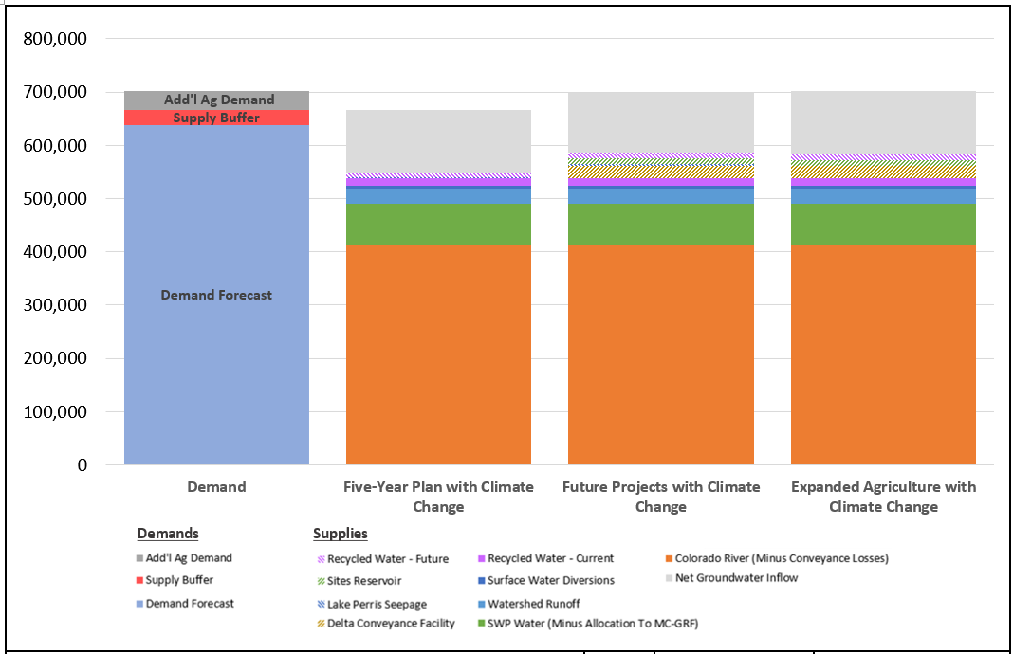
All “With Project” Scenarios have Adequate Supply to Meet Projected Demands

Slide 61
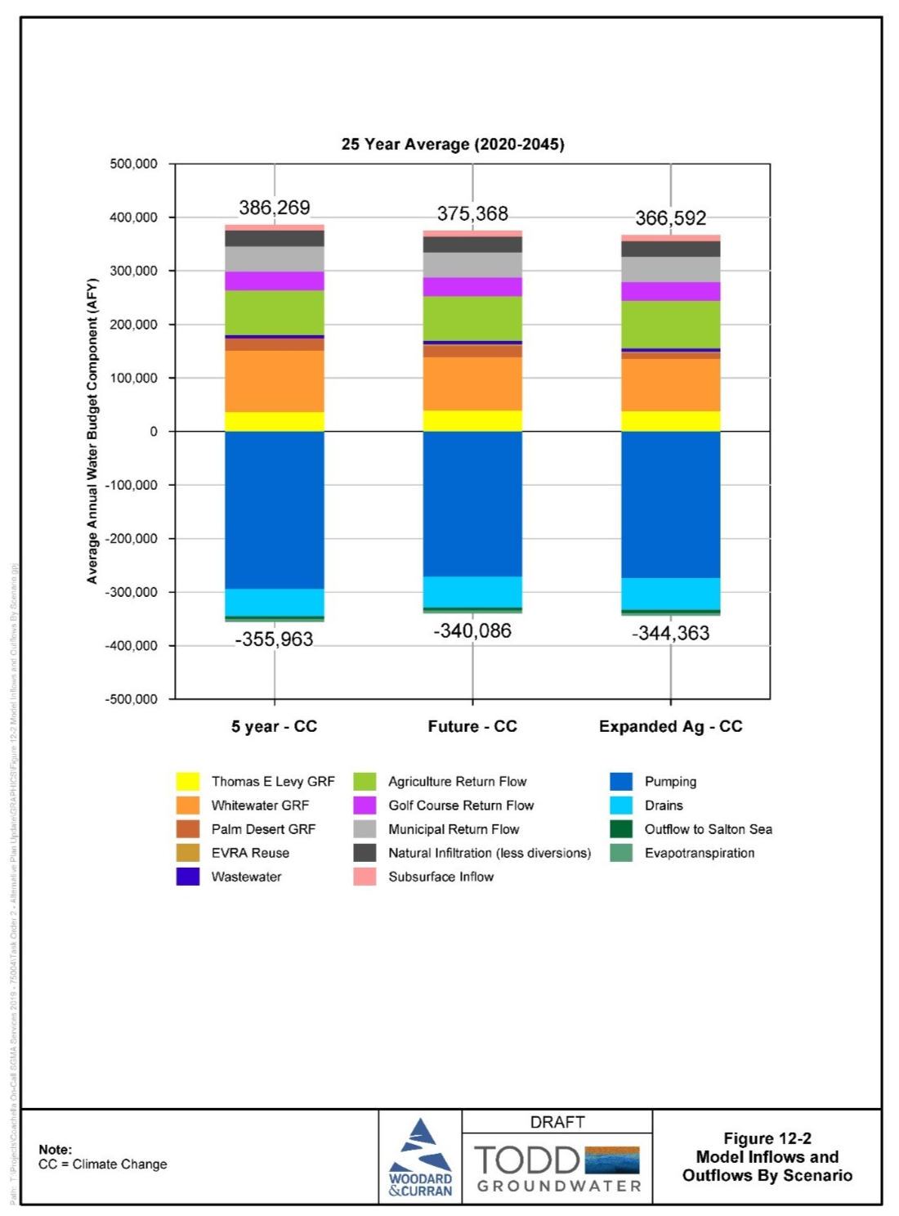
Simulated Water Balance Includes More Inflows than Outflows
30,306
35,282
22,229

Slide 62
The Plan Update demonstrates that the GSAs can meet the established Plan goal “to reliably meet current and future water demands in a cost-effective and sustainable manner”.
As they have been doing over the last 20 years, GSAs will monitor trends in demand and supply availability and implement PMAs as needed.

Slide 63
Questions?

Slide 64
Public Comment
Input and feedback are welcomed
For Callers – you may need to press *6 to unmute

Slide 65
Next Steps – Review the Plan!
Plan Update can be downloaded:
Please review the draft Plan and share your feedback with us!
  Comments are due on October 29, 2021
  Please send comments to:
  IndioSubbasinSGMA@woodardcurran.com
www.IndioSubbasinSGMA.org

Slide 66
Next Steps – Plan Adoption & Submittal
GSAs will review all comments submitted on the Plan Update and incorporate revisions as appropriate
Final Plan Update will be prepared
GSAs will each host a public hearing and consider adopting the Plan Update
  Tentative dates are below:
    Coachella Valley Water District – December 7
    Coachella Water Authority – December 8
    Desert Water Agency – December 7
    Indio Water Authority – December 15
GSAs will submit Plan Update to DWR for review and approval before January 1, 2022

Slide 67
Stay Involved – Visit our Website
www.IndioSubbasinSGMA.org

