Slide 1




2022 Indio Subbasin Alternative Plan Update
Workshop #6
August 26, 2021

Slide 2
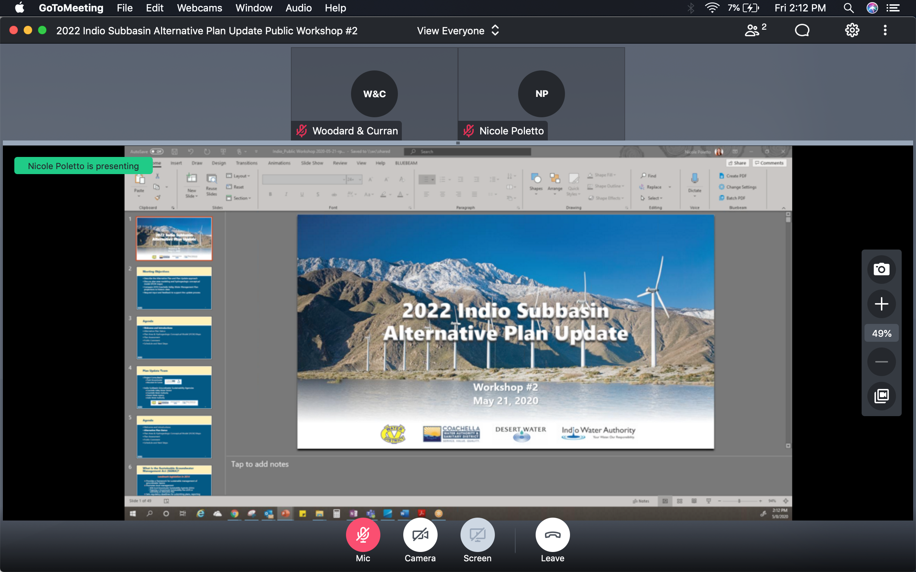
GoToMeeting – Quick How To
Your screen should look like this:
Turn on/off your Mic (mute) and Camera (video) using the controls along the bottom
During the meeting, you may need to wiggle your mouse to make the controls appear
For Callers: use *6 to unmute on the phone

Slide 3
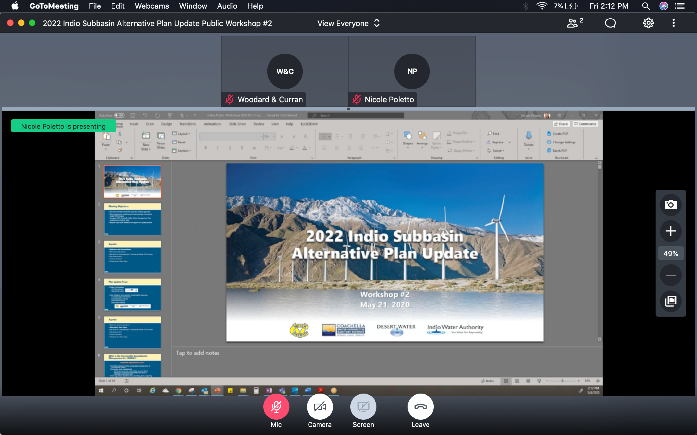
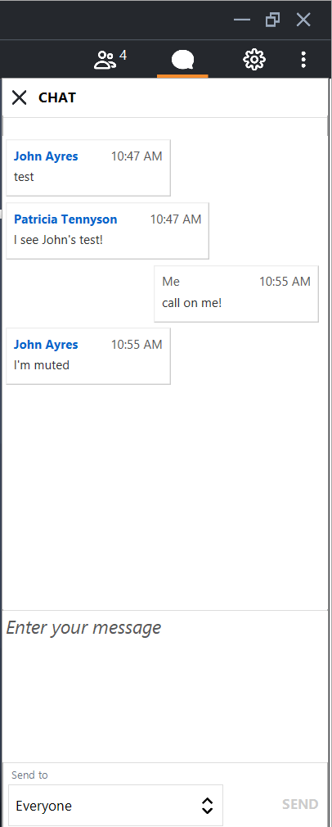
GoToMeeting – How to Ask a Question
Our organizer will mute everyone at the beginning of the meeting
Let us know you have a question by clicking the Chat icon in the top right
  Click on Enter your message, type your message and hit SEND
Once we receive your Chat, we will call on you and answer your question
For Callers: when ask for your questions or comments, use *6 to unmute

Slide 4
GoToMeeting – How to Ask a Question
Our organizer will mute everyone at the beginning of the meeting
Let us know you have a question by clicking the Chat icon in the top right
  Click on Enter your message, type your message and hit SEND
Once we receive your Chat, we will call on you and answer your question
For Callers: when ask for your questions or comments, use *6 to unmute

Slide 5
Meeting Objectives
Provide overview and status of the Alternative Plan Update
Discuss proposed Projects and Management Actions included
in the Plan scenarios
Present on groundwater modeling for Plan Scenarios and simulation results
Request input and feedback to support the Plan Update

Slide 6
Agenda
Welcome and Introductions
Alternative Plan Status
Groundwater Model
Plan Scenarios & Projects and Management Actions
Simulation Results
Public Comment
Get Involved
Notes:
Our goals are to:
Enhance public understanding about water resources in the basin
Keep you—the public and stakeholders—informed about the GSP
Engage diverse interested parties and stakeholders
Respond to your concerns

Slide 7

Plan Update Team
Project Consultants
  Todd Groundwater
  Woodard & Curran
Indio Subbasin Groundwater Sustainability Agencies
  Coachella Valley Water District
  Coachella Water Authority
  Desert Water Agency
  Indio Water Authority
`

Slide 8
Agenda
Welcome and Introductions
Alternative Plan Status
Groundwater Model
Plan Scenarios & Projects and Management Actions
Simulation Results
Public Comment
Get Involved
Notes:
Our goals are to:
Enhance public understanding about water resources in the basin
Keep you—the public and stakeholders—informed about the GSP
Engage diverse interested parties and stakeholders
Respond to your concerns

Slide 9
Status of Alternative Plan Update
Outreach
Assess existing Plan
Document groundwater conditions
Evaluate water demand and supply
Update numerical model
Consider emerging issues
Establish sustainability goals + criteria
Evaluate management actions
Assess monitoring programs
Update implementation plan

Slide 10
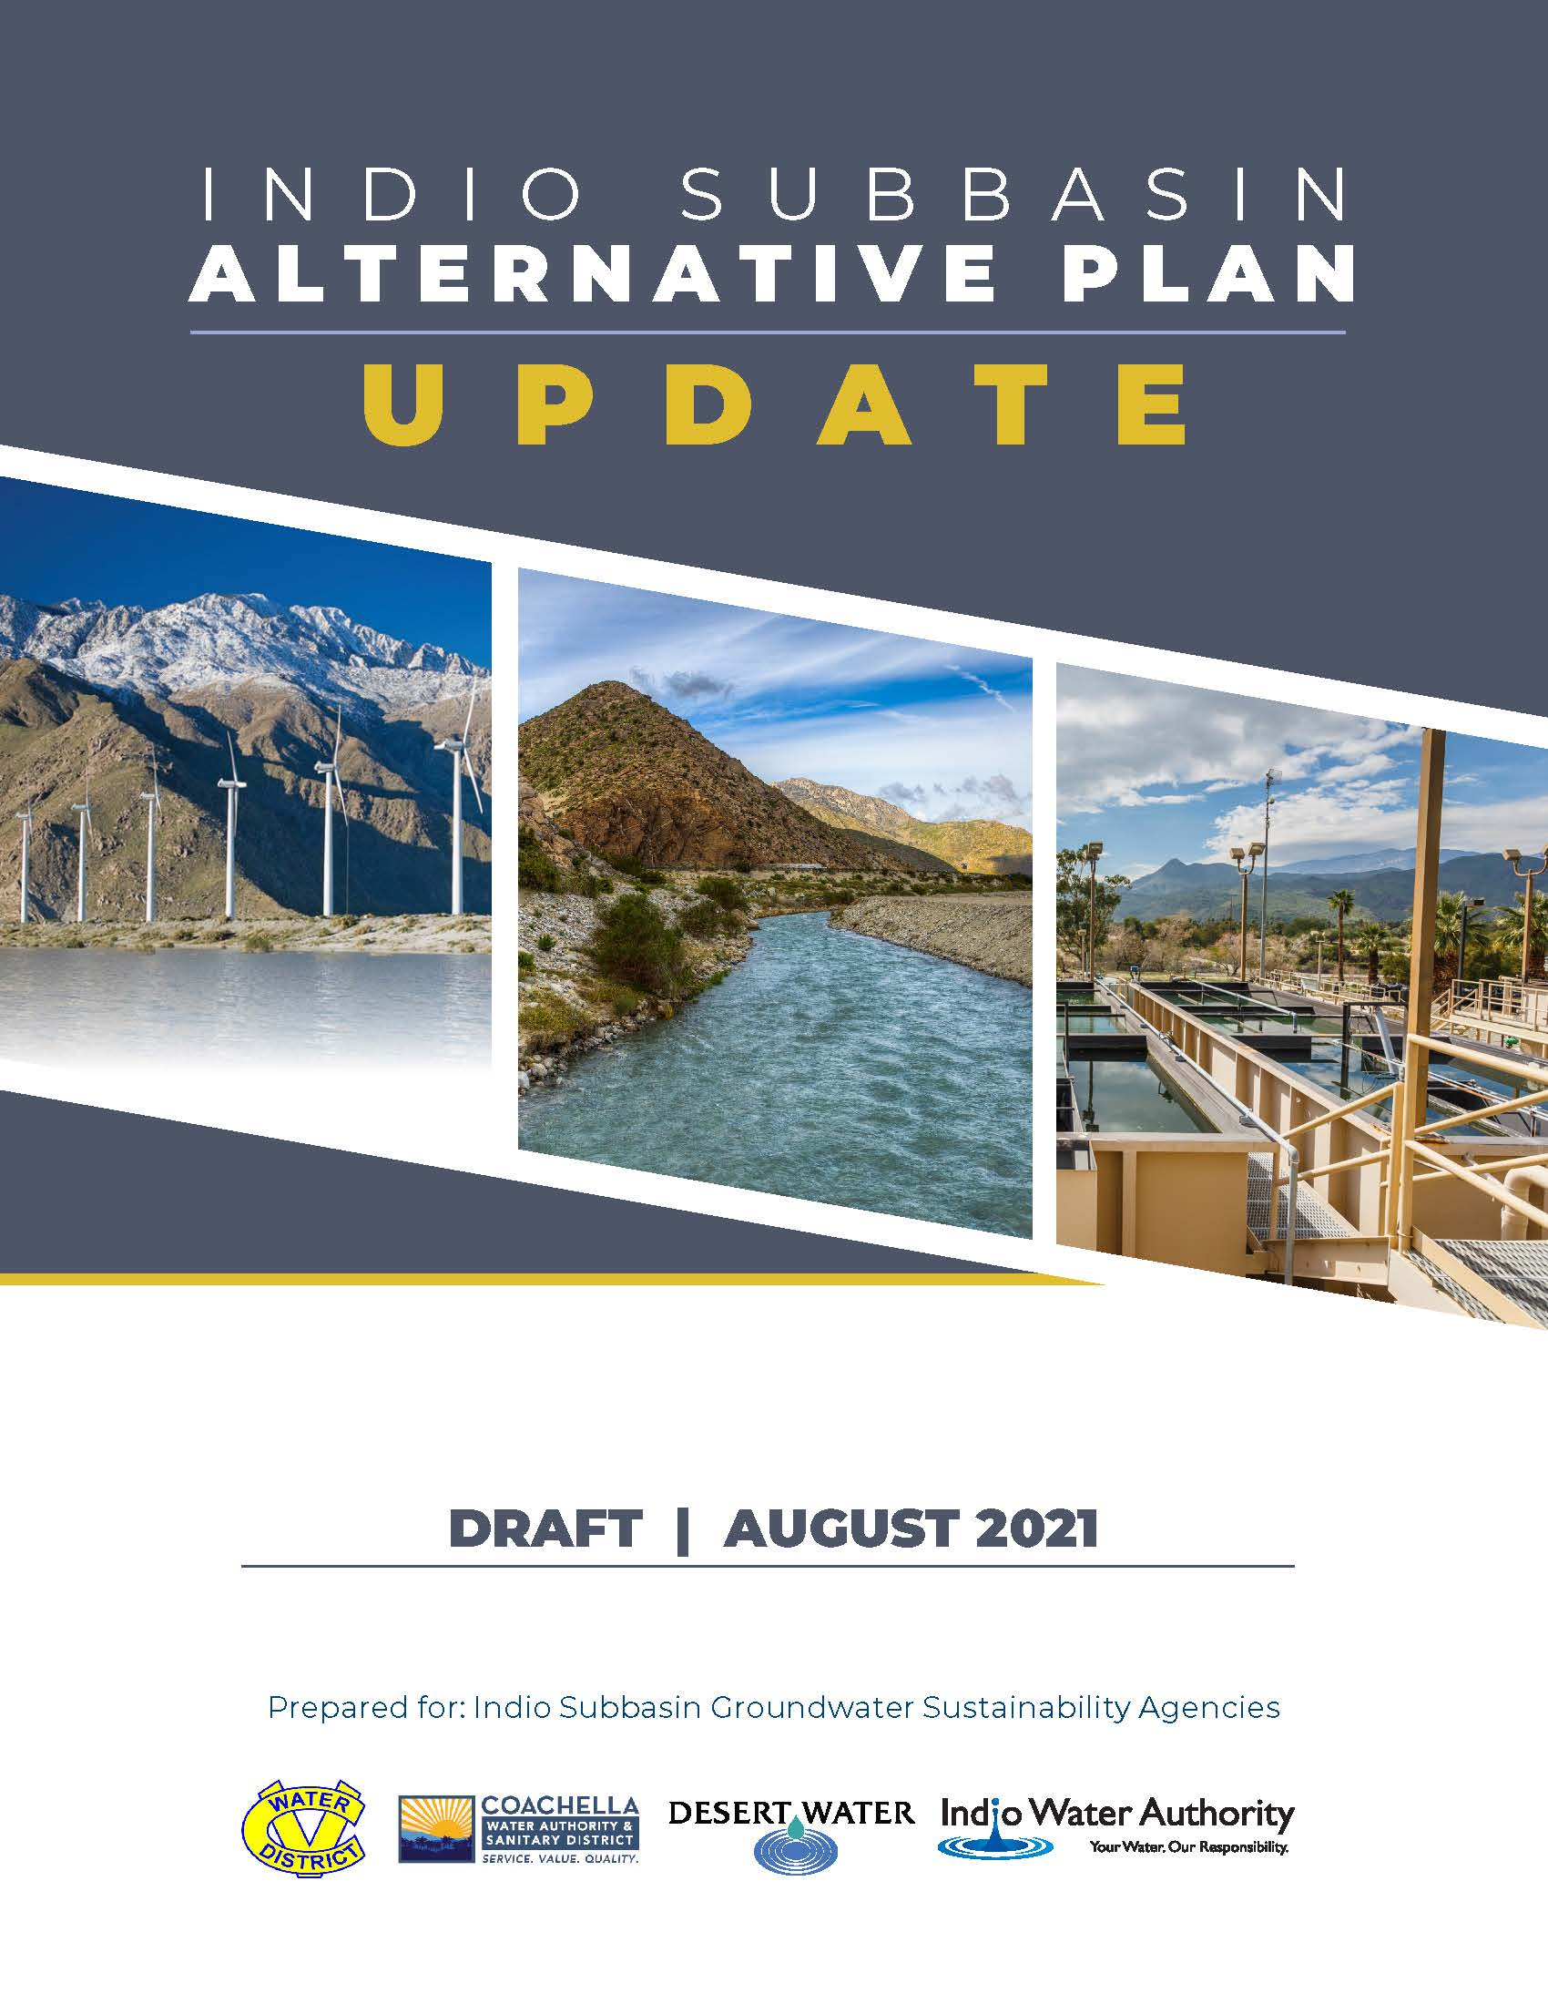
Status of Alternative Plan Update
Outline of 2022 Alternative Plan Update presents a progression of work
Introduction
Plan Area
Hydrogeologic Conceptual Model
Groundwater Conditions
Demand Projections
Water Supply
Numerical Model and Plan Scenarios
Regulatory and Policy Issues
Sustainable Management
Monitoring Program
Projects and Management Actions
Plan Evaluation and Implementation

Slide 11
Plan Goals and Objectives
Plan Goal:
to reliably meet current and future water demands in a cost-effective and sustainable manner
Sustainability Goal:
to maintain a locally managed, economically viable, sustainable groundwater resource for existing and future beneficial uses in the Indio Subbasin by managing groundwater to avoid the occurrence of undesirable results

Slide 12
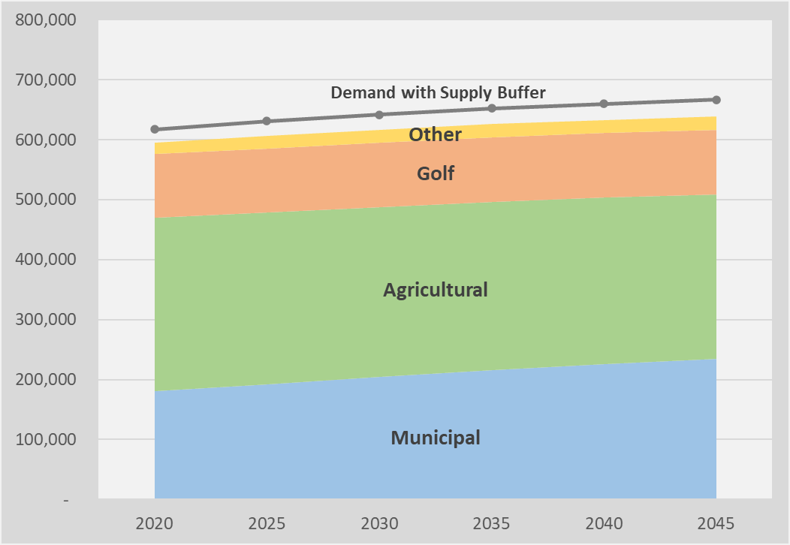
Plan Goals and Objectives
Objectives:
Meet current and future water demands
with 10 percent supply buffer
Avoid chronic groundwater overdraft
Manage and protect water quality
Collaborate with tribes, state and
federal agencies on shared objectives
Manage future costs
Minimize adverse environmental impacts
Reduce vulnerability to climate change and drought impacts
Total Projected Water Demands

Slide 13
Agenda
Welcome and Introductions
Alternative Plan Status
Groundwater Model
Plan Scenarios & Projects and Management Actions
Simulation Results
Public Comment
Get Involved
Notes:
Our goals are to:
Enhance public understanding about water resources in the basin
Keep you—the public and stakeholders—informed about the GSP
Engage diverse interested parties and stakeholders
Respond to your concerns

Slide 14
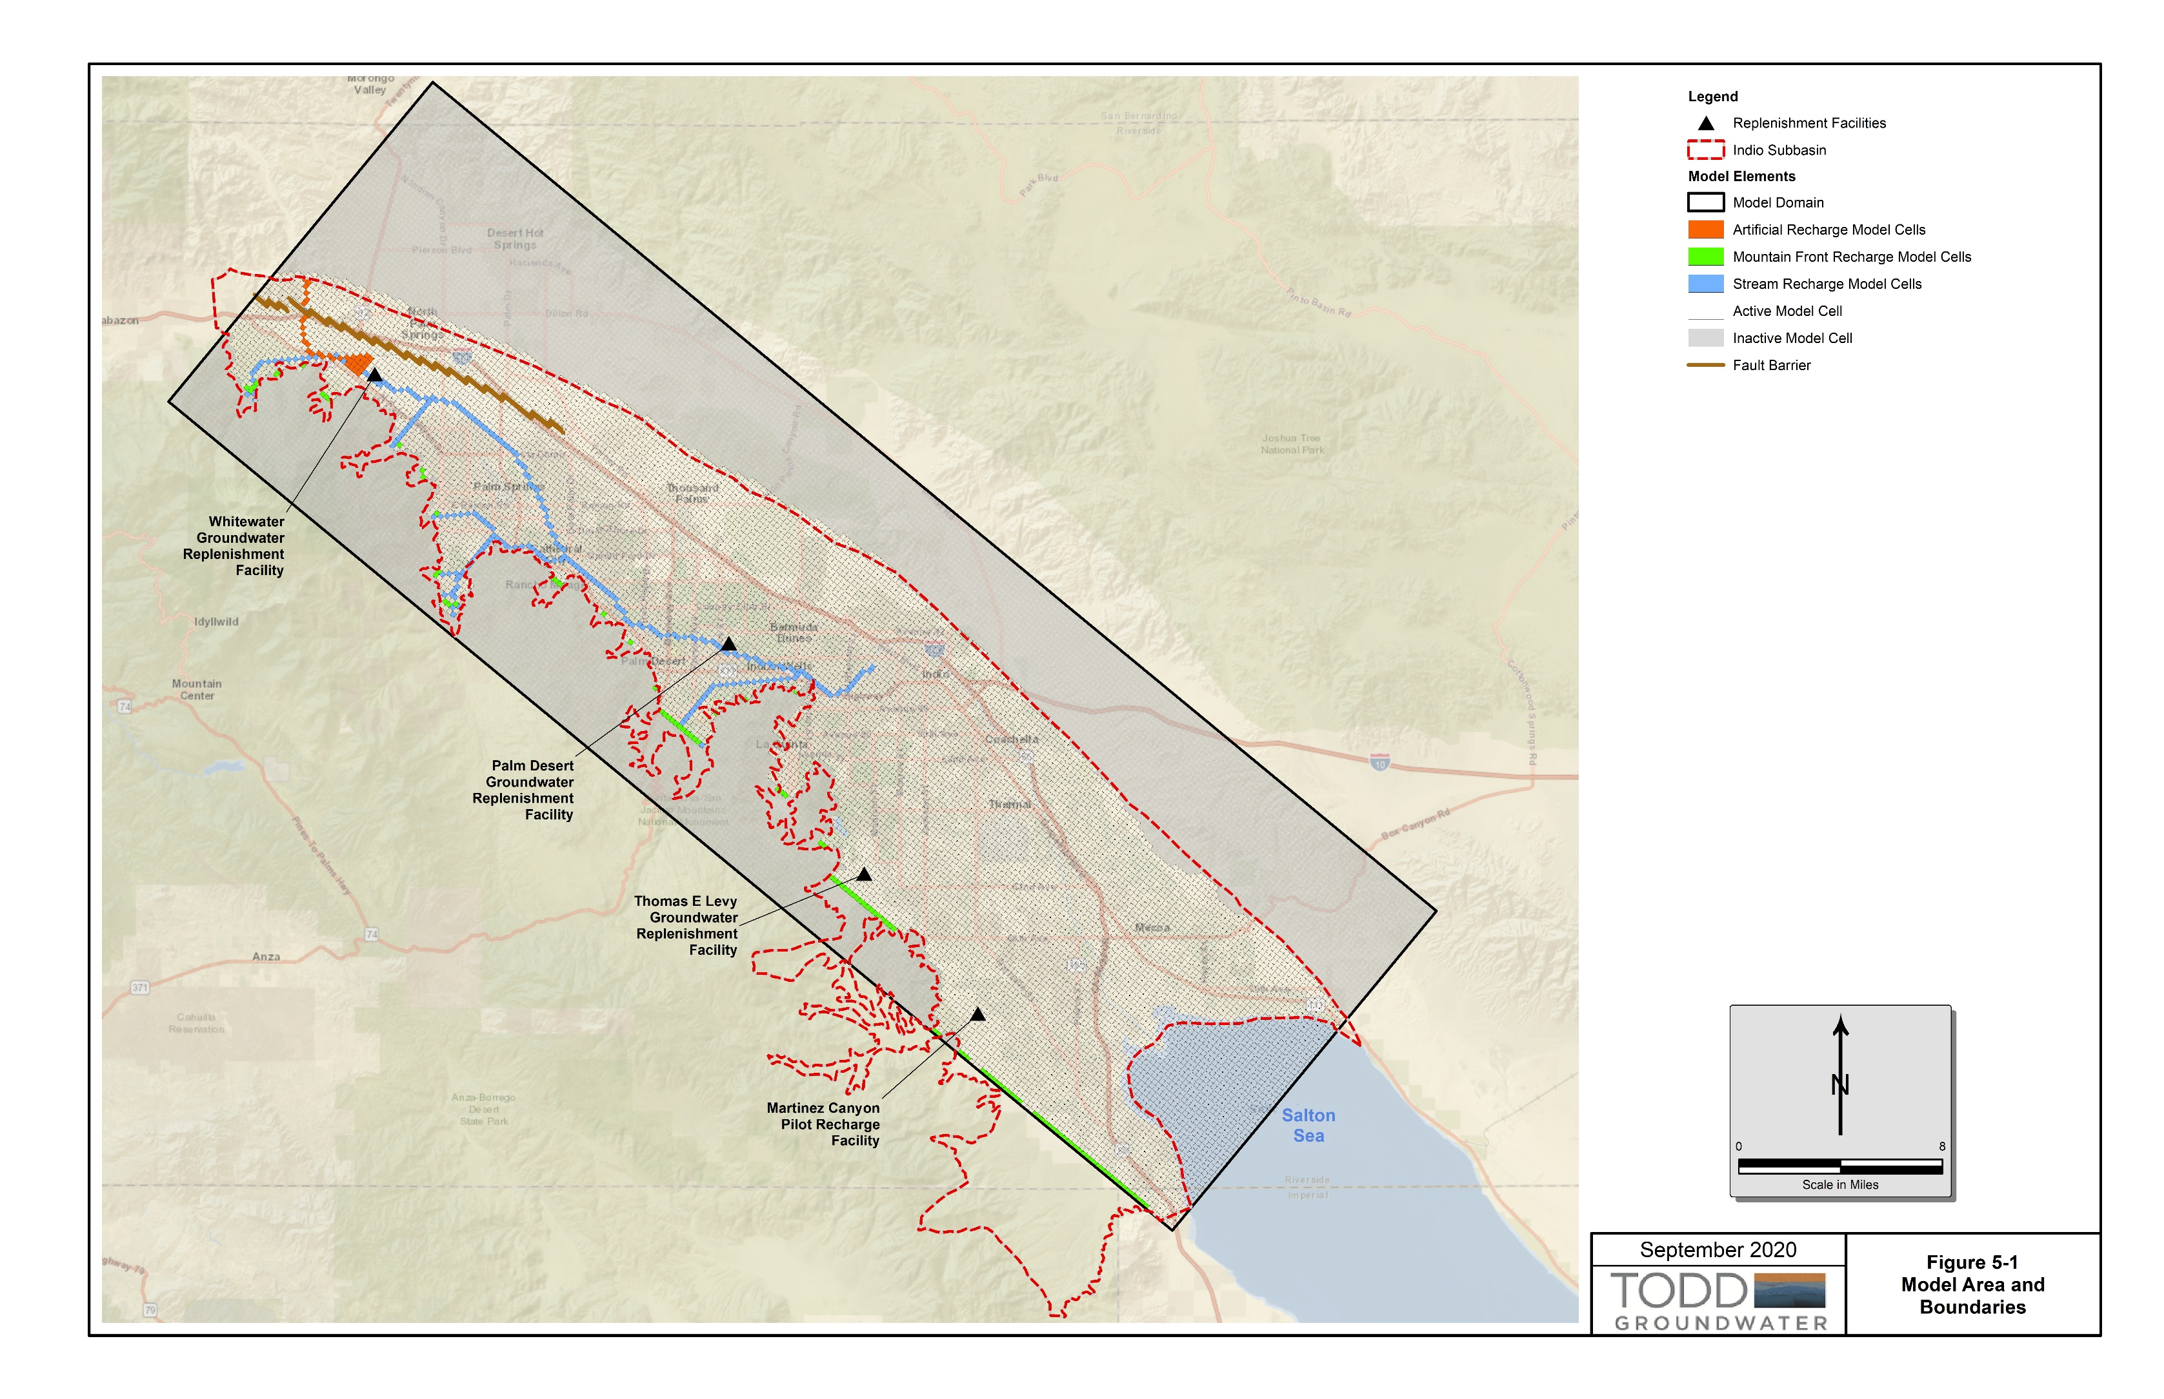
Indio Subbasin Groundwater Model
Model originally developed in the 1990’s
Historical Simulation Period of 1936-1996
Updated for 2010 CVWMP to simulate1997-2008
14

Slide 15
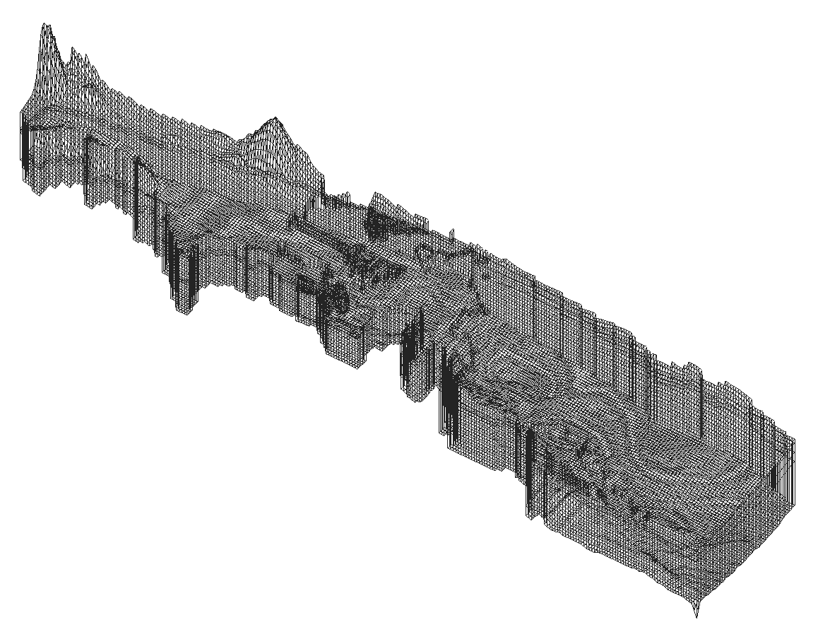
Indio Subbasin Groundwater Model
Uses USGS MODFLOW program
3-Dimensional grid of 1,000 ft x 1,000 ft model cells
270 rows, 86 columns, and 4 layers
Groundwater elevation and flow amounts over time calculated at each cell
15

Slide 16
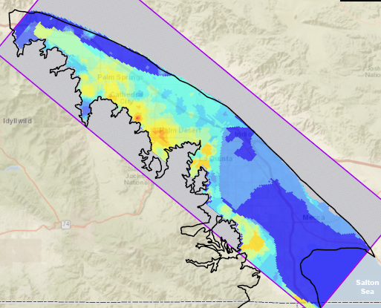
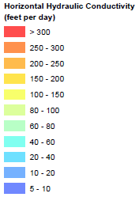
Model Features
Shallow and Deep Aquifers
Variable Aquifer Properties
Inflow from Mission Creek and San Gorgonio Pass Subbasins
Simulates Fault Barriers, Drains, Evapotranspiration, and Salton Sea

Slide 17
Alternative Plan Model Updates
Extended simulation period through 2019
Updated 2009-2019 Recharge and Pumping
  Mountain Front and Stream Channel Recharge
  Artificial Recharge
  Wastewater Discharges
  Return Flows (Municipal, Agricultural, Golf)
  Groundwater Pumping
Updated Salton Sea Elevations (1997-2019)
Used more-accurate Land Surface Elevations and Sea Bathymetry
Corrected 1997-2008 Inputs in Garnet Hill Subarea
Updated Subsurface Inflow Boundary Conditions from Adjacent Subbasins

Slide 18
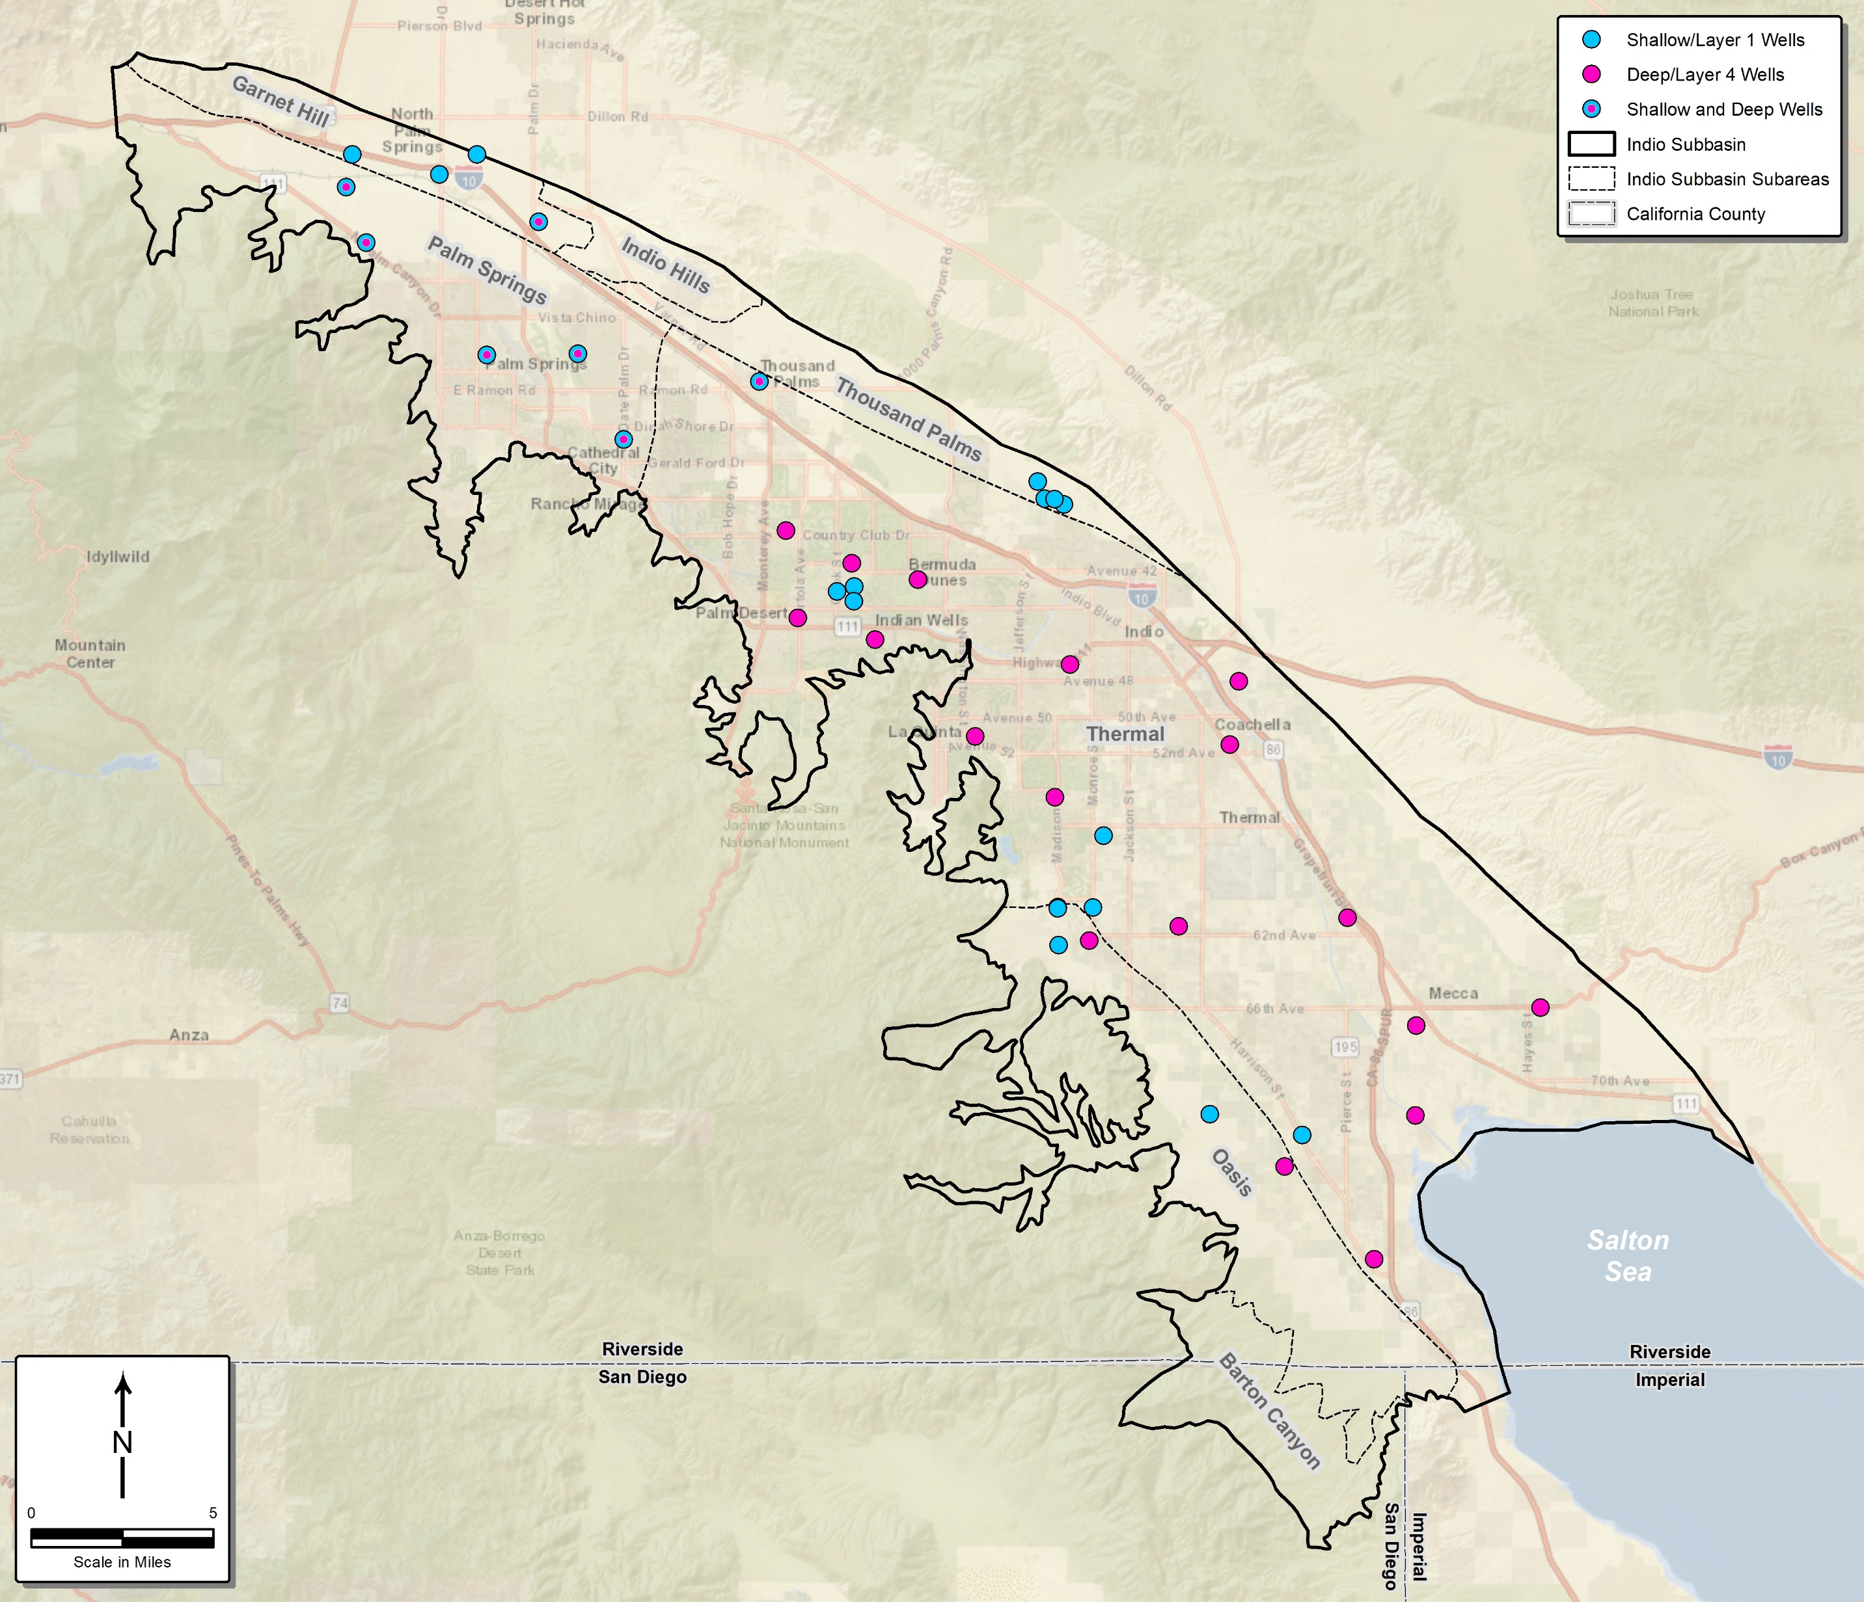
Numerical Model Assessment
Evaluated match between measured vs. simulated groundwater level in 20 shallow and 26 deep wells
Measured vs. simulated drain flow rates also used to assess calibration

Slide 19
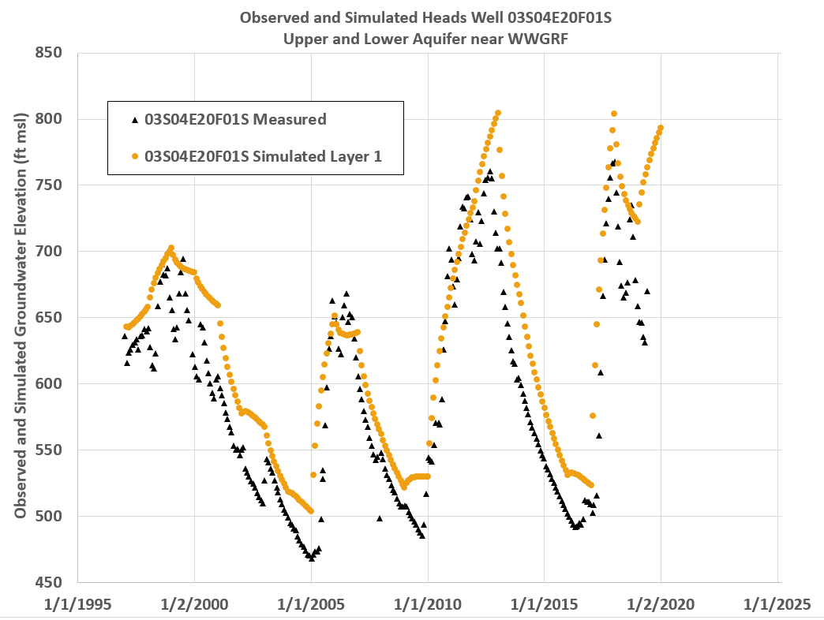
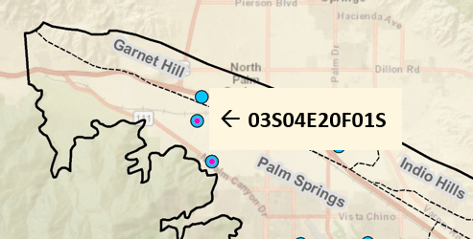
Measured vs. Simulated – Well 03S04E20F01S

Slide 22
Model Update Summary
Historical model accurately simulates shallow and deep groundwater levels in all areas of the Subbasin
Can be used to predict future water level and storage changes under different inflow and outflow scenarios
Model provides forecasts of future drain flows, Salton Sea interactions, and other water budget conditions
Notes:
Our goals are to:
Enhance public understanding about water resources in the basin
Keep you—the public and stakeholders—informed about the GSP
Engage diverse interested parties and stakeholders
Respond to your concerns

Slide 23
Questions?

Slide 24
Agenda
Welcome and Introductions
Alternative Plan Status
Groundwater Model
Plan Scenarios & Projects and Management Actions
Simulation Results
Public Comment
Get Involved
Notes:
Our goals are to:
Enhance public understanding about water resources in the basin
Keep you—the public and stakeholders—informed about the GSP
Engage diverse interested parties and stakeholders
Respond to your concerns

Slide 25
Plan Scenarios
No New Projects = Baseline
Baseline w/Climate Change
Five-Year Plan w/Climate Change
Future Projects w/Climate Change
Expanded Agriculture w/Climate Change
Existing supplies & facilities, no new projects
Existing supplies & facilities limited by climate changes
5-Yr CIP supplies and facilities limited by climate changes
All planned supplies & facilities limited by climate changes
Expanded agricultural demands and all future supplies & facilities, limited by climate changes

Slide 26
Climate Change Assumptions
Model simulates 50-year future period
The future scenarios incorporate recent (drier) patterns
For local inflow (Mountain Front and Stream Flow)
  Baseline uses long term-hydrology and previously estimated annual recharge volumes (repeated historical conditions 1970-2019)
  Climate change scenarios use repeated historical conditions only for period 1995-2019 that include multiple droughts
    Drought period repeated twice, first in reverse and then forward
Availability of imported water for direct delivery and groundwater replenishment also reduced

Slide 27
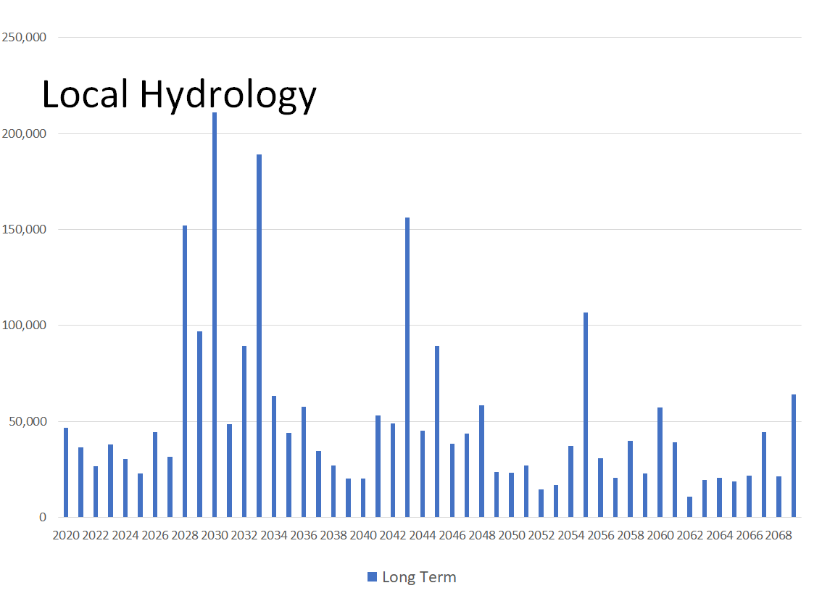
Long Term
Observed 1970-2019
Climate Change Observed 1995-2019

Slide 28
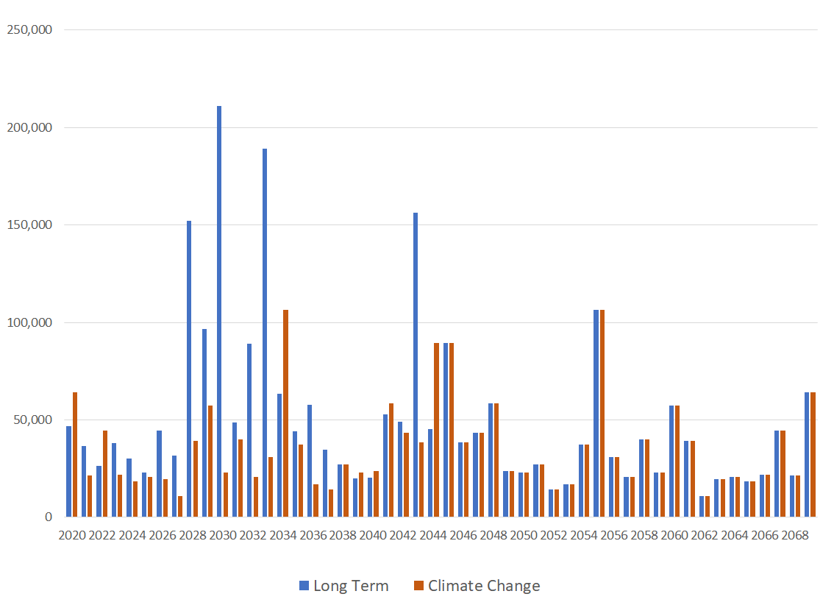
Local Hydrology
Long Term
Observed 1970-2019
Climate Change Observed 1995-2019 Repeated Twice

Slide 29
Projects and Management Actions - Priorities
GSAs established the following priorities in selection of PMAs:
  Fully use available Colorado River water supplies
  Support improvement of the long-term reliability of SWP supplies, including participation in the Delta Conveyance Facility (DCF)
  Develop recycled water as a reliable local water supply
  Secure supplemental supplies
  Manage groundwater storage and surface water conjunctively to provide storage reserves for resilient response to drought and for supply reliability
  Increase water-use efficiency across all sectors
  Participate in development of CV-SNMP to address salt and nutrient management in the Subbasin

Slide 30
Projects and Management Actions
Water Conservation
Source Substitution & Replenishment
Water Quality Protection
1: Urban Water Conservation
10: Mid-Valley Pipeline Direct Customers
22: Eliminate Wastewater Percolation
2: Golf Water Conservation
11: East Golf Expansion
23: Wellhead Treatment
3: Agricultural Water Conservation
12: Oasis Distribution System
24: Small Water System Consolidations
13: WRP-10 Recycled Water Delivery
25: Septic to Sewer Conversions
Water Supply Development
14: WRP-10 Tertiary Expansion
26: CV-SNMP GW Monitoring Program Workplan
15: Canal Water Pump Station Upgrade
27: CV-SNMP Development Workplan
4: Increased Surface Water Diversion
16: WRP-7 Recycled Water Delivery
28: Colorado River Salinity Forum
5: Delta Conveyance Facility
17: WRP-4 Tertiary Expansion & Delivery
29: Source Water Protection
6: Lake Perris Seepage
18: DWA WRP Recycled Water Delivery
7: Sites Reservoir
19: PD-GRF Phase 2 Expansion
8: Future Supplemental Water Acquisitions
20: TEL-GRF Expansion
9: EVRA Potable Reuse
21: WWR-GRF Operation

Slide 31
Baseline (No New Projects) &
Baseline w/Climate Change
Water Conservation
Water Supply Development
Source Substitution & Replenishment
Water Quality Protection
1: Urban Water Conservation
22: Eliminate Wastewater Percolation
2: Golf Water Conservation
23: Wellhead Treatment
3: Agricultural Water Conservation
24: Small Water System Consolidations
4: Increased Surface Water Diversion
25: Septic to Sewer Conversions
21: WWR-GRF Operation
26: CV-SNMP GW Monitoring Program Workplan
27: CV-SNMP Development Workplan
28: Colorado River Salinity Forum
29: Source Water Protection

Slide 32
Indio Subbasin
Baseline (No New Projects) Scenario, 2045
Baseline with Climate Change, 2045
Agriculture
Demand
Forecast
Colorado River
Wastewater
Water Reuse
DWA WRP
SWP Exchange Water
CVWD WRP-7
CVWD WRP-10
Muni & Golf
Wastewater Percolation
Surface Water
TEL-GRF
PD-GRF
WWR-GRF
WWR-GRF
Evapotranspiration
Watershed Runoff
Net Return Flow
Groundwater
Diversion
Discharge to CVSC
Outflow to Salton Sea
Subsurface Inflow
Drain Flow
Subsurface Outflow
Indio Subbasin
Salton Sea

Slide 33
Five-Year Plan with Climate Change
Water Conservation
Water Supply Development
Source Substitution & Replenishment
Water Quality Protection
1: Urban Water Conservation
22: Eliminate Wastewater Percolation
2: Golf Water Conservation
23: Wellhead Treatment
3: Agricultural Water Conservation
24: Small Water System Consolidations
4: Increased Surface Water Diversion
25: Septic to Sewer Conversions
11: East Golf Expansion
26: CV-SNMP GW Monitoring Program Workplan
12: Oasis Distribution System
27: CV-SNMP Development Workplan
21: WWR-GRF Operation
28: Colorado River Salinity Forum
10: Mid-Valley Pipeline Direct Customers
29: Source Water Protection
13: WRP-10 Recycled Water Delivery
15: Canal Water Pump Station Upgrade
16: WRP-7 Recycled Water Delivery
19: PD-GRF Phase 2 Expansion

Slide 34
Indio Subbasin
Five-Year Plan Scenario with Climate Change, 2045
Agriculture
Demand
Forecast
Colorado River
Wastewater
Water Reuse
DWA WRP
SWP Exchange Water
CVWD WRP-7
CVWD WRP-10
Muni & Golf
Wastewater Percolation
Surface Water
New Canal
TEL-GRF
PD-GRF
WWR-GRF
WWR-GRF
Evapotranspiration
Watershed Runoff
Net Return Flow
Groundwater
Diversion
Discharge to CVSC
Outflow to Salton Sea
Subsurface Inflow
Drain Flow
Subsurface Outflow
Indio Subbasin
Salton Sea

Slide 35
Future Projects with Climate Change &
Expanded Agriculture with Climate Change
Water Conservation
Water Supply Development
Source Substitution & Replenishment
Water Quality Protection
1: Urban Water Conservation
10: Mid-Valley Pipeline Direct Customers
22: Eliminate Wastewater Percolation
2: Golf Water Conservation
11: East Golf Expansion
23: Wellhead Treatment
3: Agricultural Water Conservation
12: Oasis Distribution System
24: Small Water System Consolidations
4: Increased Surface Water Diversion
13: WRP-10 Recycled Water Delivery
25: Septic to Sewer Conversions
5: Delta Conveyance Facility
15: Canal Water Pump Station Upgrade
26: CV-SNMP GW Monitoring Program Workplan
6: Lake Perris Seepage
16: WRP-7 Recycled Water Delivery
27: CV-SNMP Development Workplan
7: Sites Reservoir
19: PD-GRF Phase 2 Expansion
28: Colorado River Salinity Forum
9: EVRA Potable Reuse
20: TEL-GRF Expansion
29: Source Water Protection
21: WWR-GRF Operation

Slide 36
Indio Subbasin
Future Scenario with Climate Change, 2045
Agriculture
Demand
Forecast
Colorado River
Water Reuse
Wastewater
DWA WRP
CVWD WRP-7
SWP Exchange Water
CVWD WRP-10
Muni & Golf
Delta Conveyance
Facility
Sites Reservoir
Valley SD WRP
Lake Perris Seepage
Wastewater Percolation
Surface Water
New Canal
TEL-GRF
PD-GRF
WWR-GRF
WWR-GRF
WWR-GRF
WWR-GRF
WWR-GRF
Evapotranspiration
Watershed Runoff
Net Return Flow
Groundwater
Diversion
Discharge to CVSC
Outflow to Salton Sea
Subsurface Inflow
Drain Flow
Subsurface Outflow
Indio Subbasin
Salton Sea

Slide 37
Indio Subbasin
Future Scenario with Expanded Agriculture and Climate Change, 2045
Agriculture
Demand
Forecast
Colorado River
Water Reuse
Wastewater
DWA WRP
CVWD WRP-7
SWP Exchange Water
CVWD WRP-10
Expanded Ag
Delta Conveyance
Facility
Sites Reservoir
Valley SD WRP
Muni & Golf
Lake Perris Seepage
Wastewater Percolation
Surface Water
New Canal
TEL-GRF
PD-GRF
WWR-GRF
WWR-GRF
WWR-GRF
WWR-GRF
WWR-GRF
Evapotranspiration
Watershed Runoff
Net Return Flow
Groundwater
Diversion
Discharge to CVSC
Outflow to Salton Sea
Subsurface Inflow
Drain Flow
Subsurface Outflow
Indio Subbasin
Salton Sea

Slide 38
Questions?

Slide 39
Agenda
Welcome and Introductions
Alternative Plan Status
Groundwater Model
Plan Scenarios & Projects and Management Actions
Simulation Results
Public Comment
Get Involved
Notes:
Our goals are to:
Enhance public understanding about water resources in the basin
Keep you—the public and stakeholders—informed about the GSP
Engage diverse interested parties and stakeholders
Respond to your concerns

Slide 40
Simulation Results
No New Projects = Baseline
Baseline w/Climate Change
Five-Year Plan w/Climate Change
Future Projects w/Climate Change
Expanded Agriculture w/Climate Change
Baseline assumes no new projects
Not realistic because additional projects already planned
Provides a comparison of future conditions with and without climate change/drought

Slide 41

Future Scenario Water Budgets
Baseline and Baseline with Climate Change
408,500
379,500
-369,300
-367,000
Baseline Baseline w/CC
+39,200
+12,500

Slide 42
Future Water Budgets
Baseline with and without Climate Change

Slide 43
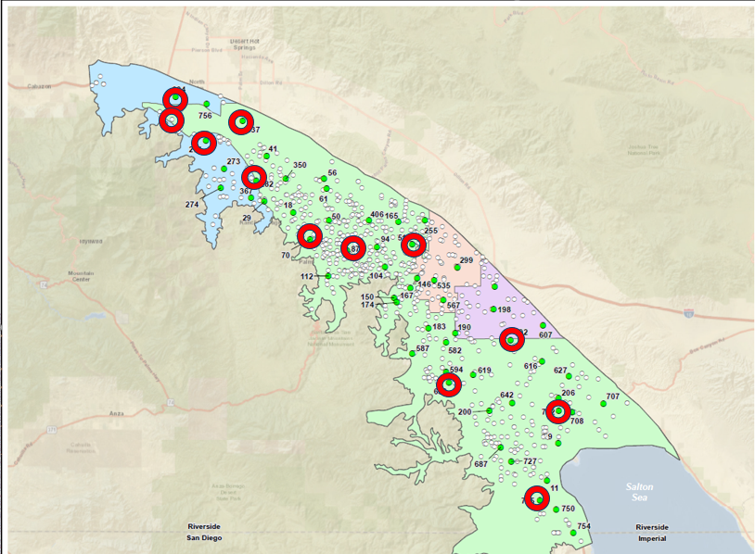
Future Groundwater Levels
Hydrograph Wells

Slide 44
Future Groundwater Levels

Slide 45
Future Groundwater Levels

Slide 46
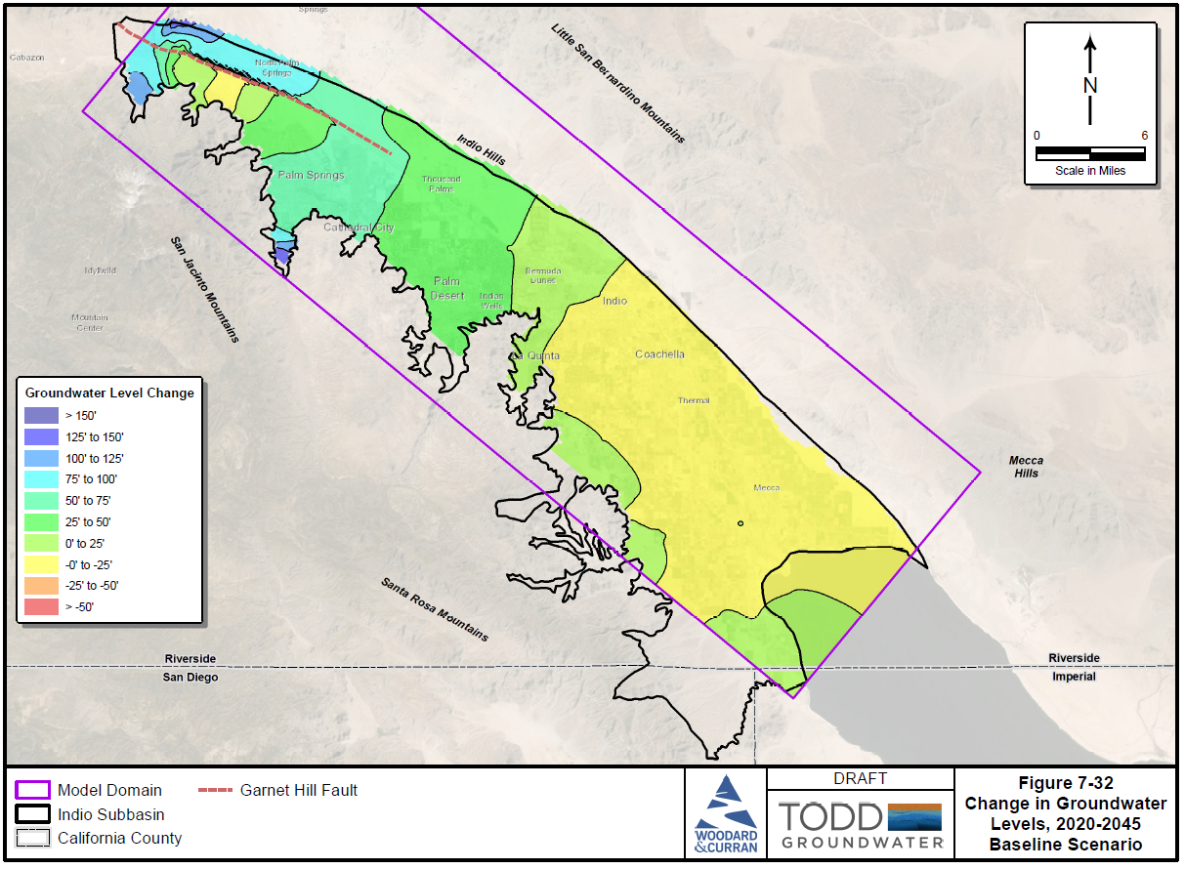
Future Change in Groundwater Levels
2020-2045, Baseline Scenario

Slide 47
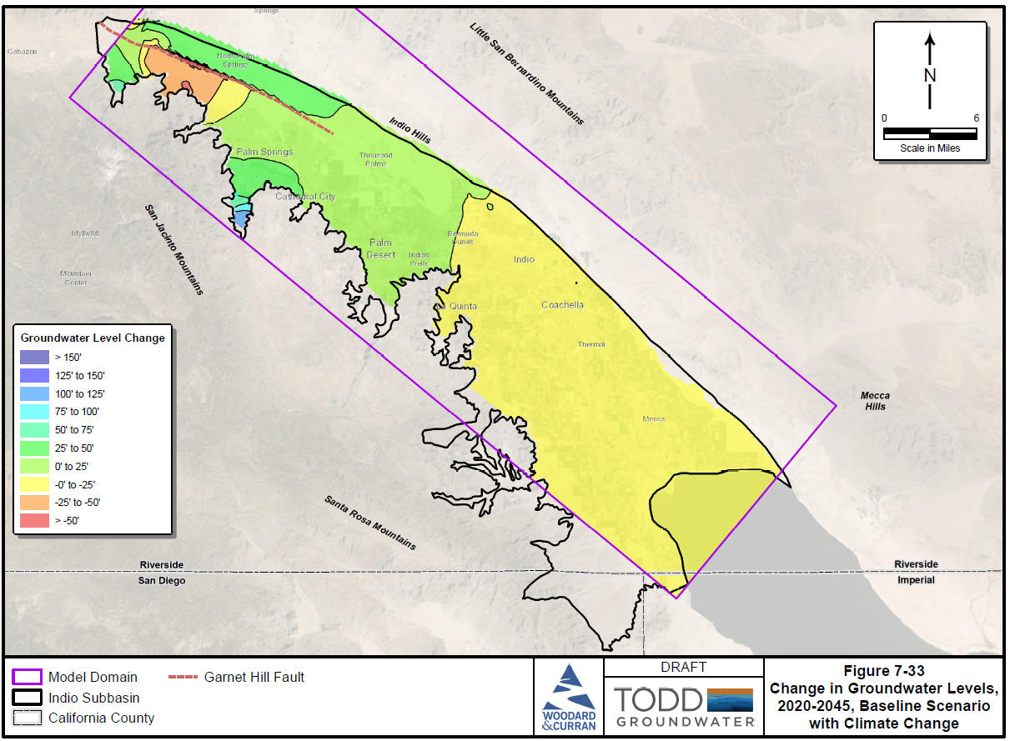
Future Change in Groundwater Levels
2020-2045, Baseline with Climate Change Scenario

Slide 48
Effects of Climate Change on Baseline
Baseline (No New Projects) could be sustainable except for climate change
Only change here is climate change-uncertain and beyond local control
Baseline with Climate Change scenario indicates depletion of storage
Local simulated declines in groundwater levels

Slide 49
Questions?

Slide 50
Simulation Results
No New Projects = Baseline
Baseline w/Climate Change
Five-Year Plan w/Climate Change
Future Projects w/Climate Change
Expanded Agriculture w/Climate Change
Simulations of additional scenarios with five-year CIP projects, future projects, and expanded agriculture
Additional scenarios include climate change/drought

Slide 51
Future Scenario Water Budgets
Baseline and 4 Climate Change Scenarios
408,500
379,500
375,000
364,100
355,300
-369,300
-367,000
-347,800
-331,800
-333,100
+39,200
+12,500
+27,200
+32,300
+22,200

Slide 52
Future Pumping
4 Climate Change Scenarios

Slide 53
Future Inflows
4 Climate Change Scenarios

Slide 54
Future Groundwater Levels

Slide 55
Future Groundwater Levels

Slide 56
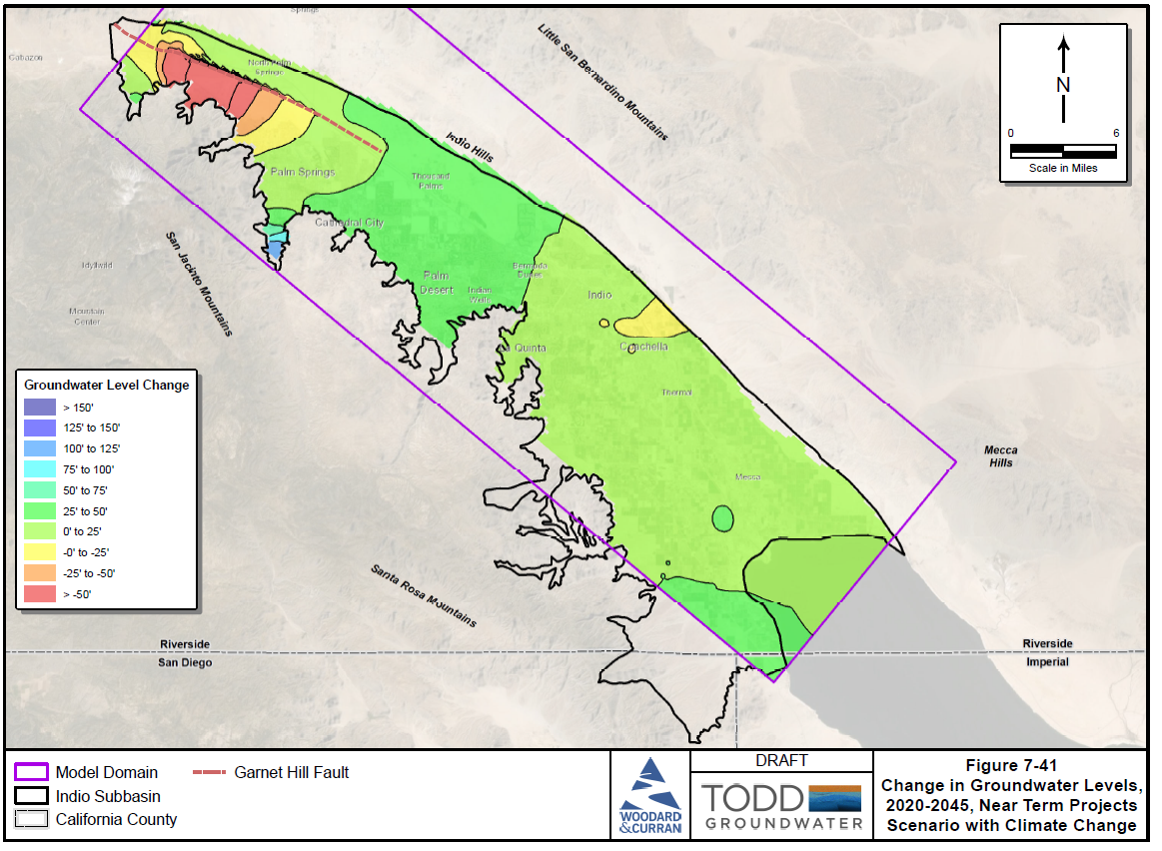
Future Change in Groundwater Levels
2020-2045, 5-Year Projects with Climate Change

Slide 57
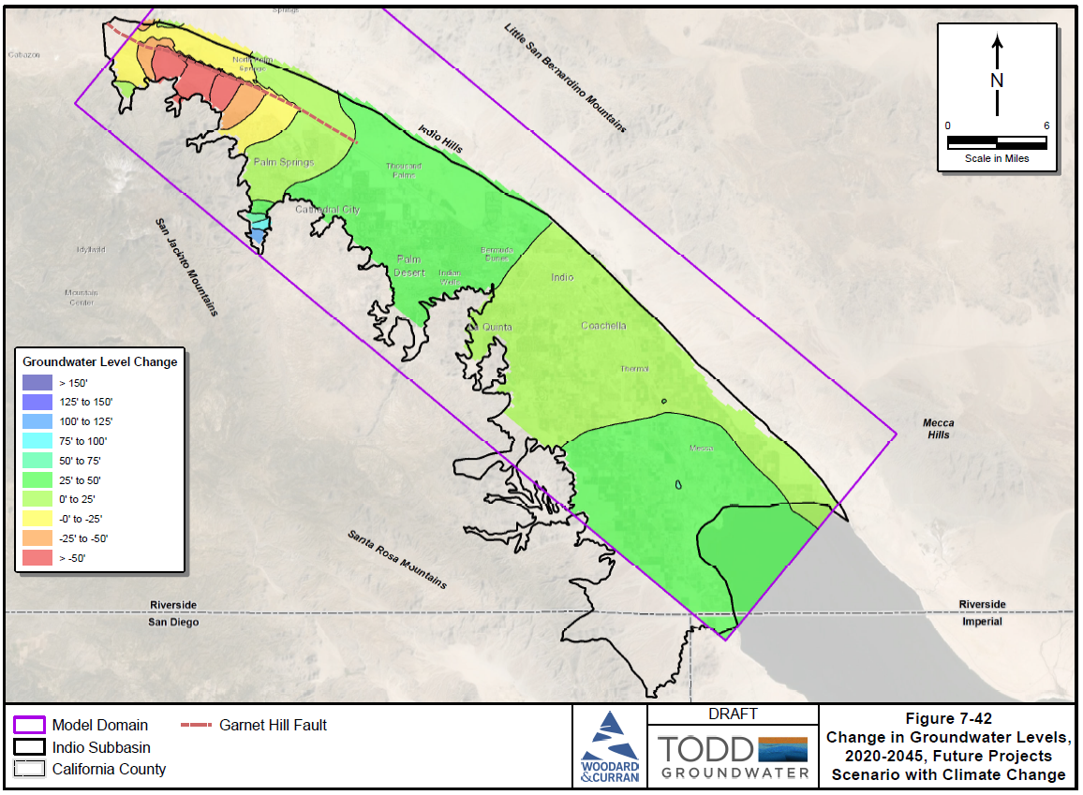
Future Change in Groundwater Levels
2020-2045, Future Projects with Climate Change

Slide 58
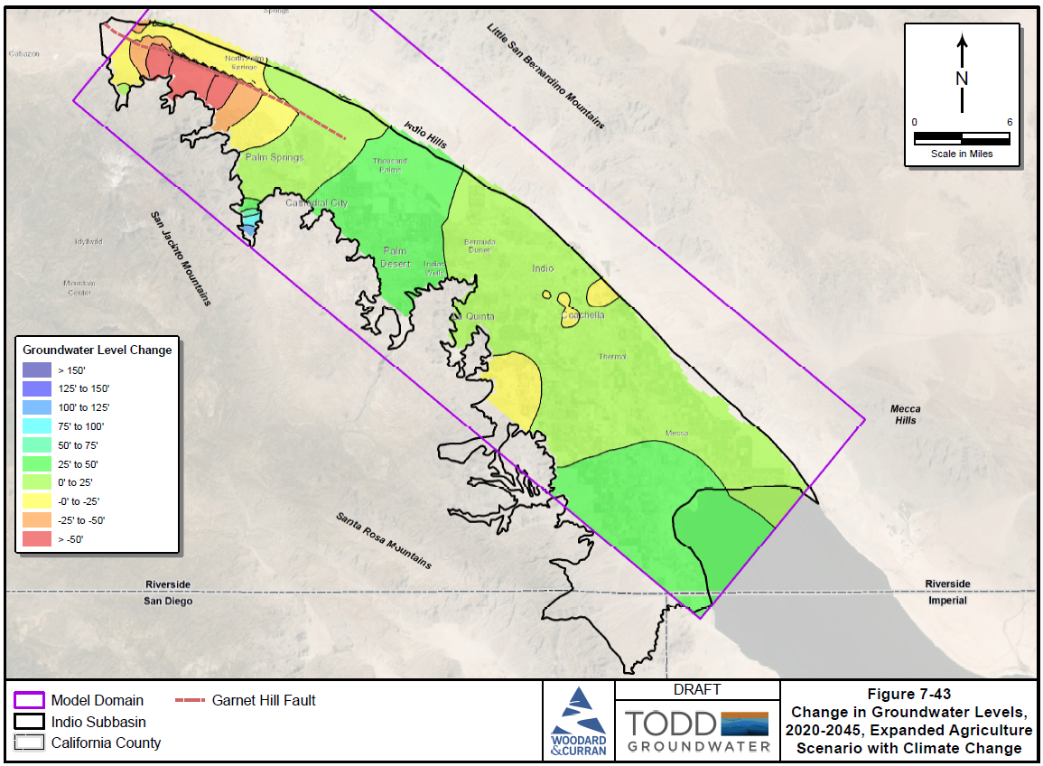
Future Change in Groundwater Levels
2020-2045, Expanded Agriculture with Climate Change

Slide 59
Cumulative Change in Storage
4 Climate Change Scenarios
Storage -
Storage -
Storage -
Storage -

Slide 60
Future Drain Flows
4 Climate Change Scenarios

Slide 61
Future Groundwater Outflow to Salton Sea
4 Climate Change Scenarios

Slide 62
Future Scenario Simulation Results
Scenarios indicate:
  Cumulative decline in storage for Baseline with Climate Change
  Cumulative increases in storage for all others
  Drain flows decline for Baseline with Climate Change and increase for others
  Seawater intrusion is not a problem in any scenario
New Five-Year Plan PMAs are needed for supply-demand balance
Future PMAs are needed for reliability in face of climate change and uncertainties in demand past 25-year planning horizon

Slide 63
Agenda
Welcome and Introductions
Alternative Plan Status
Groundwater Model
Plan Scenarios & Projects and Management Actions
Simulation Results
Public Comment
Get Involved
Notes:
Our goals are to:
Enhance public understanding about water resources in the basin
Keep you—the public and stakeholders—informed about the GSP
Engage diverse interested parties and stakeholders
Respond to your concerns

Slide 64
Public Comment
Input and feedback are welcomed
For Callers – you may need to press *6 to unmute

Slide 65
Agenda
Welcome and Introductions
Alternative Plan Status
Groundwater Model
Plan Scenarios & Projects and Management Actions
Simulation Results
Public Comment
Get Involved
Notes:
Our goals are to:
Enhance public understanding about water resources in the basin
Keep you—the public and stakeholders—informed about the GSP
Engage diverse interested parties and stakeholders
Respond to your concerns

Slide 66
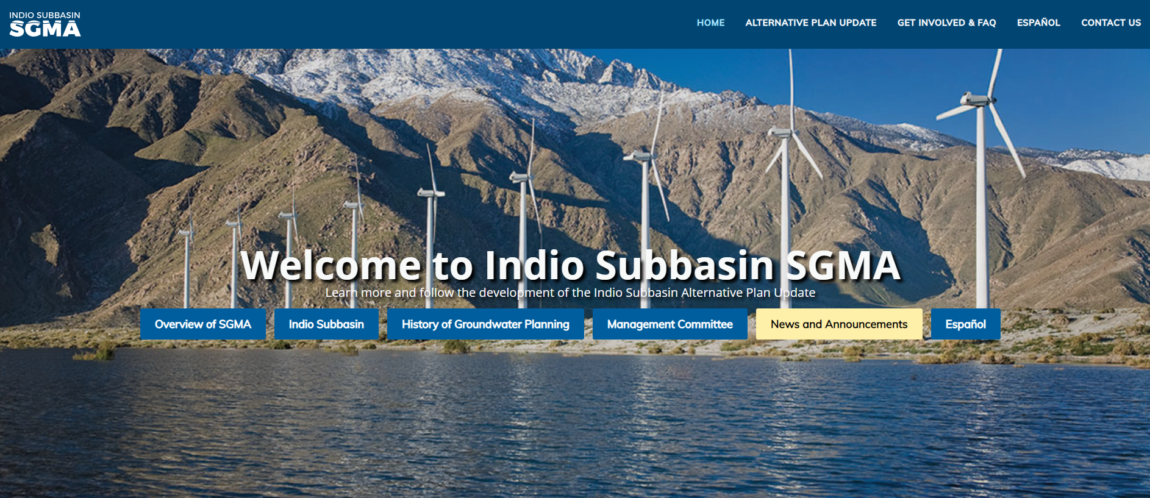

Get Involved – Visit our Website
www.IndioSubbasinSGMA.org

Slide 67
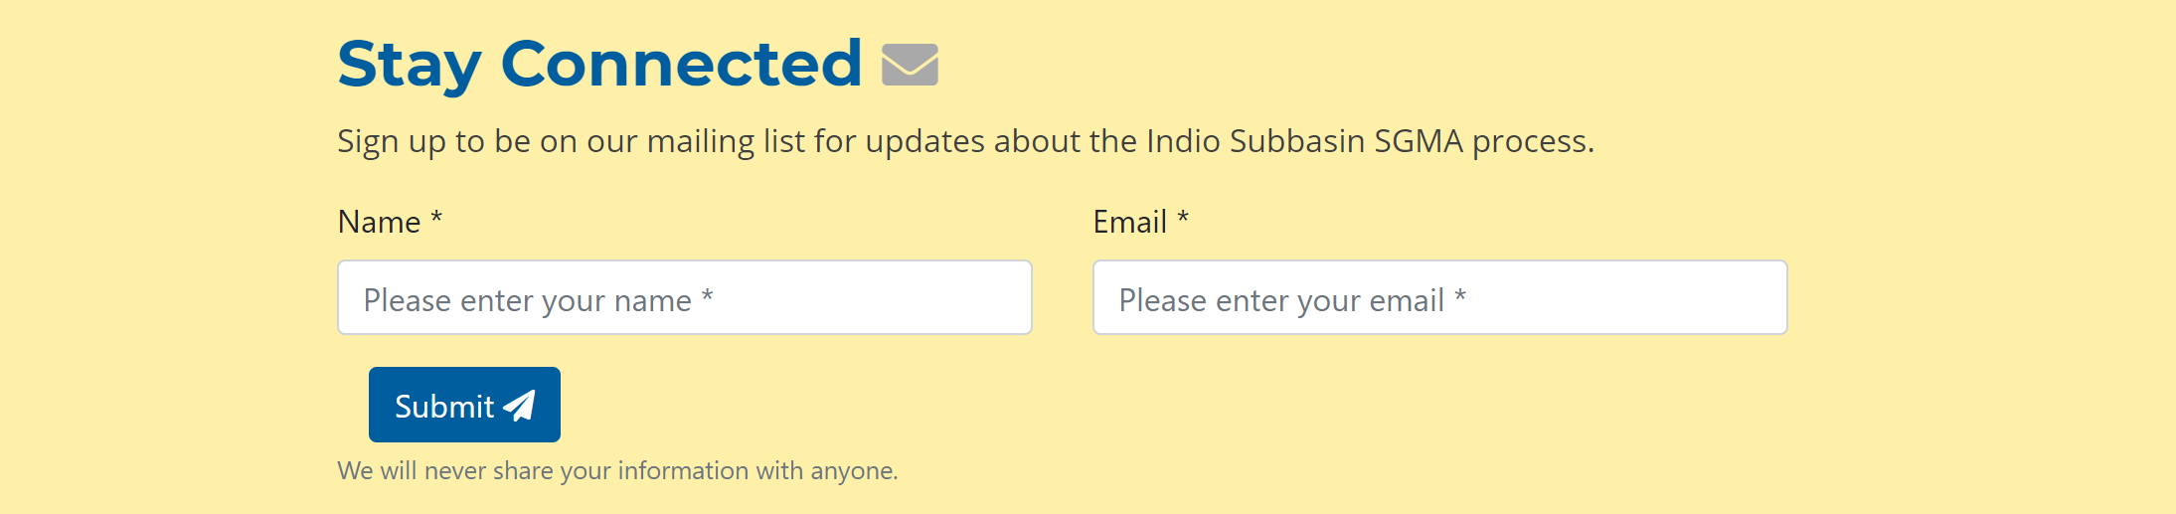
Get Involved – Visit our Website
Sign up for email invites, updates, and data/report releases at
www.IndioSubbasinSGMA.org

Slide 68




Get Involved – Final Workshop
Wednesday
October 13, 2021
2:00 – 4:00 PM
Location: TBD
For additional information, please contact:
Rosalyn Prickett
IndioSubbasinSGMA@woodardcurran.com
(858) 875-7420

