Slide 1




2022 Indio Subbasin Alternative Plan Update
Workshop #4
March 3, 2021

Slide 2
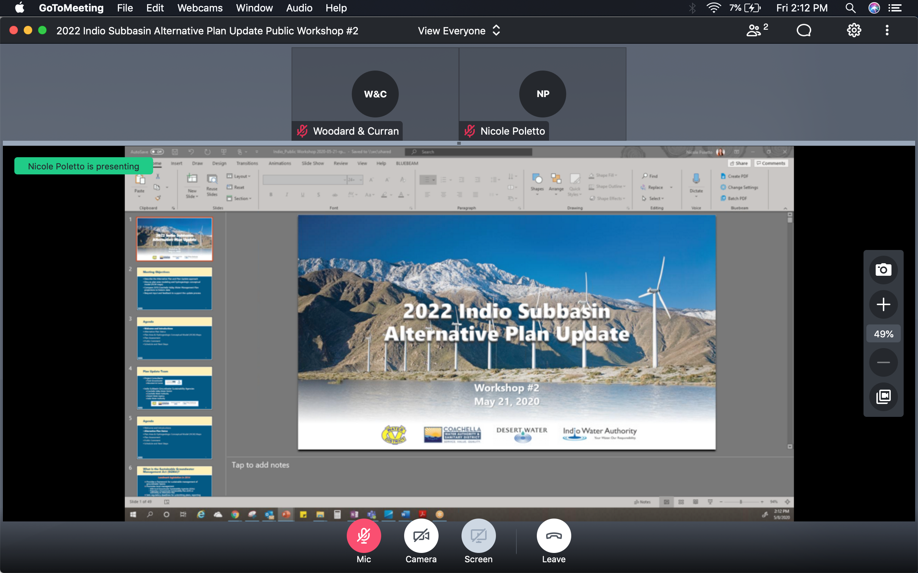
GoToMeeting – Quick How To
Your screen should look like this:
Turn on/off your Mic (mute) and Camera (video) using the controls along the bottom
During the meeting, you may need to wiggle your mouse to make the controls appear
For Callers: use *6 to unmute on the phone

Slide 3
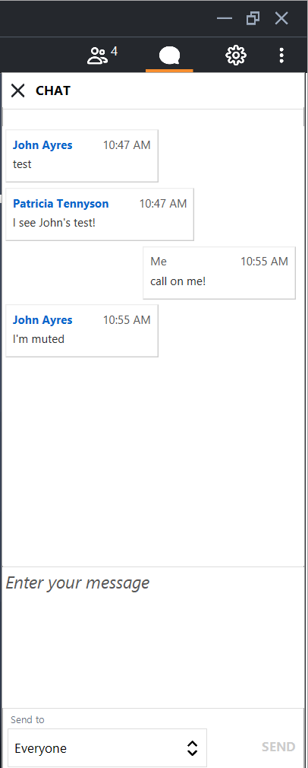
GoToMeeting – How to Ask a Question
Our organizer will mute everyone at the beginning of the meeting
Let us know you have a question by clicking the Chat icon in the top right
  Click on Enter your message, type your message and hit SEND
Once we receive your Chat, we will call on you and answer your question
For Callers: when ask for your questions or comments, use *6 to unmute

Slide 4
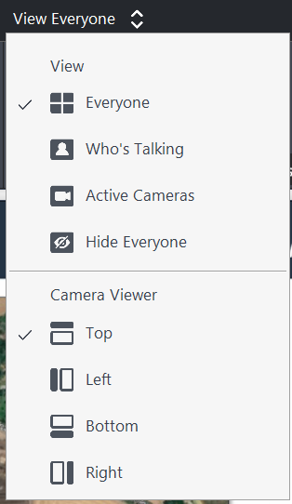
GoToMeeting – How to See Everyone
To change your display options, select the View menu in the top center
  Select View-Everyone to display all attendees in the meetings
  Select Camera Viewer-Top to display participant images along the top of your screen
The grey divider can be raised or lowered, which will change the screen size

Slide 5
Meeting Objectives
Provide overview and status of the Alternative Plan Update
Discuss the Groundwater Conditions
Present an overview of Sustainable Management Criteria
Discuss potential Projects & Management Actions identified for the modeling Scenarios
Request input and feedback to support the Plan Update

Slide 6
Agenda
Welcome and Introductions
Alternative Plan Status
Groundwater Conditions
Sustainable Management Criteria
Groundwater Model Status
Projects and Management Actions
Public Comment
Get Involved
Notes:
Our goals are to:
Enhance public understanding about water resources in the basin
Keep you—the public and stakeholders—informed about the GSP
Engage diverse interested parties and stakeholders
Respond to your concerns

Slide 7

Plan Update Team
Project Consultants
  Todd Groundwater
  Woodard & Curran
Indio Subbasin Groundwater Sustainability Agencies
  Coachella Valley Water District
  Coachella Water Authority
  Desert Water Agency
  Indio Water Authority
`

Slide 8
Agenda
Welcome and Introductions
Alternative Plan Status
Groundwater Conditions
Sustainable Management Criteria
Groundwater Model Status
Projects and Management Actions
Public Comment
Get Involved
Notes:
Our goals are to:
Enhance public understanding about water resources in the basin
Keep you—the public and stakeholders—informed about the GSP
Engage diverse interested parties and stakeholders
Respond to your concerns

Slide 9
Status of Alternative Plan Update
Outreach
Assess existing Plan
Document groundwater conditions
Evaluate water demand and supply
Update numerical model
Consider emerging issues
Establish sustainability goals + criteria
Evaluate management actions
Assess monitoring programs
Update implementation plan

Slide 10
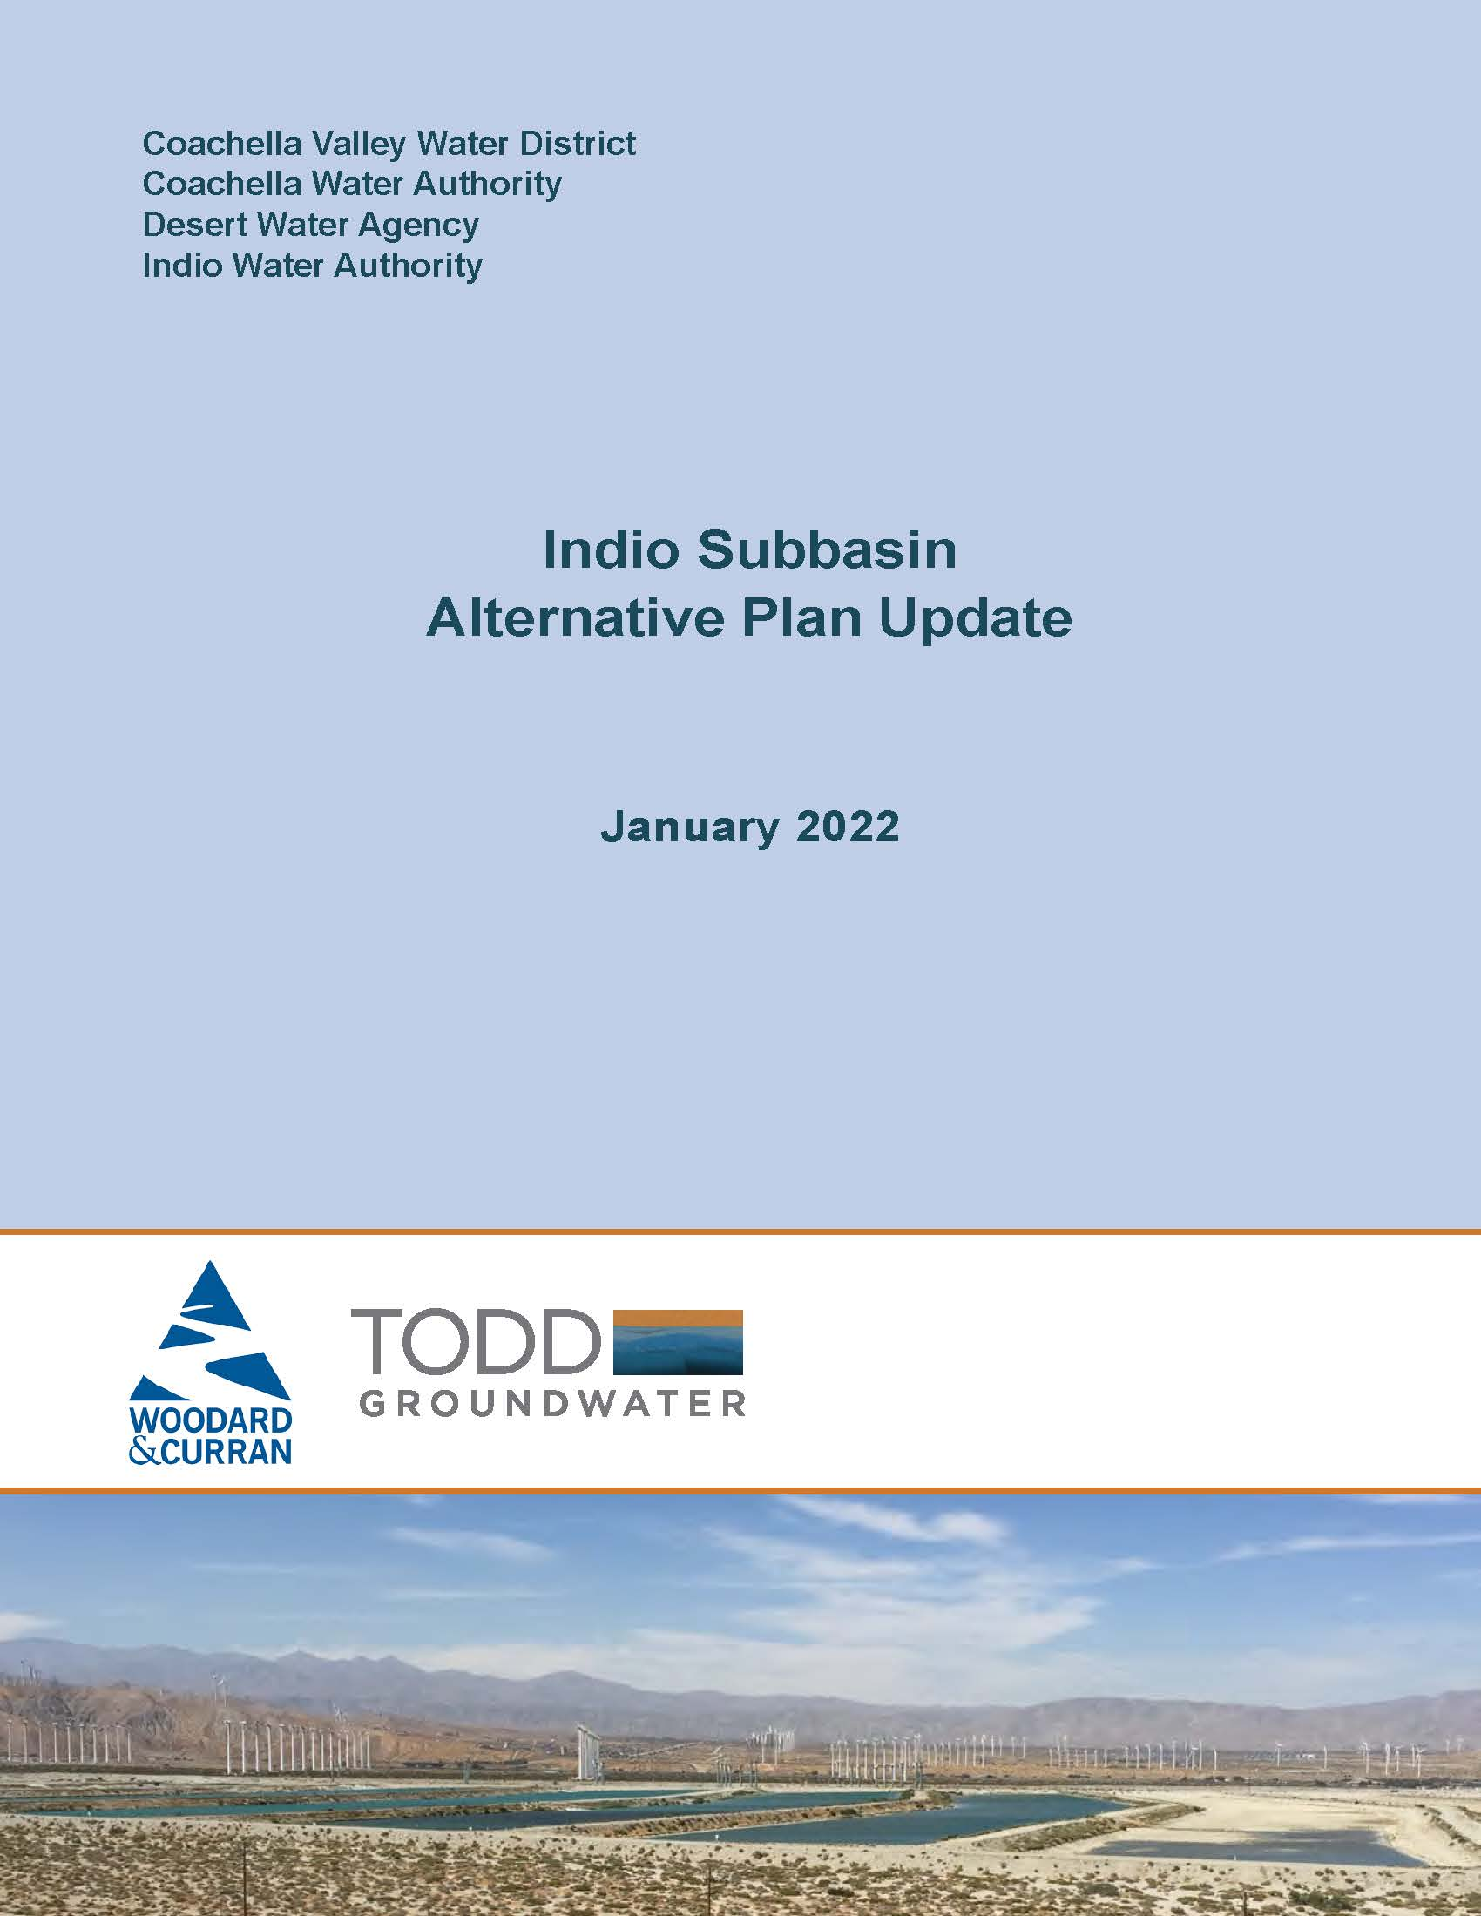
Status of Alternative Plan Update
Outline of 2022 Alternative Plan Update presents a progression of work
Introduction
Plan Area
Hydrogeologic Conceptual Model
Groundwater Conditions
Water Demand Projections
Existing Water Supplies
Water Budgets and Plan Scenarios
Emerging Issues
Sustainable Management Criteria
Monitoring Program
Projects and Management Actions
Implementation Plan
Notes:
Task 1 - Compare water demand projections to actual water use
Evaluate existing management actions
Assess groundwater flow model update needs
Task 2 - Land use change / growth projections
Groundwater monitoring data
Water deliveries/use
Task 3 - Hydrogeologic cross sections
Groundwater occurrence, levels, and flow
Groundwater quality mapping
Groundwater production
Land subsidence
Groundwater dependent ecosystems (GDEs)
Task 4 - Update future land use and water demand projections
Update water supply projections
Incorporate water conservation goals
Identify potential future shortfalls in supply
Task 5 - Build on existing projects and management actions
Identify new projects
Prioritize based on cost, schedule, and benefits
Develop Implementation schedule, costs, and funding
Task 6 – NEXT SLIDE
Task 7 - Manage and use groundwater without causing undesirable results
Task 9 - Eight quarterly public workshops planned in 2020/2021 February, May, August, Nov
This is the second public workshop
Report on progress
Share results and findings
Request input and feedback

Slide 11
Agenda
Welcome and Introductions
Alternative Plan Status
Groundwater Conditions: Levels, Storage, Subsidence
Sustainable Management Criteria
Groundwater Model Status
Projects and Management Actions
Public Comment
Get Involved
Notes:
Our goals are to:
Enhance public understanding about water resources in the basin
Keep you—the public and stakeholders—informed about the GSP
Engage diverse interested parties and stakeholders
Respond to your concerns

Slide 12
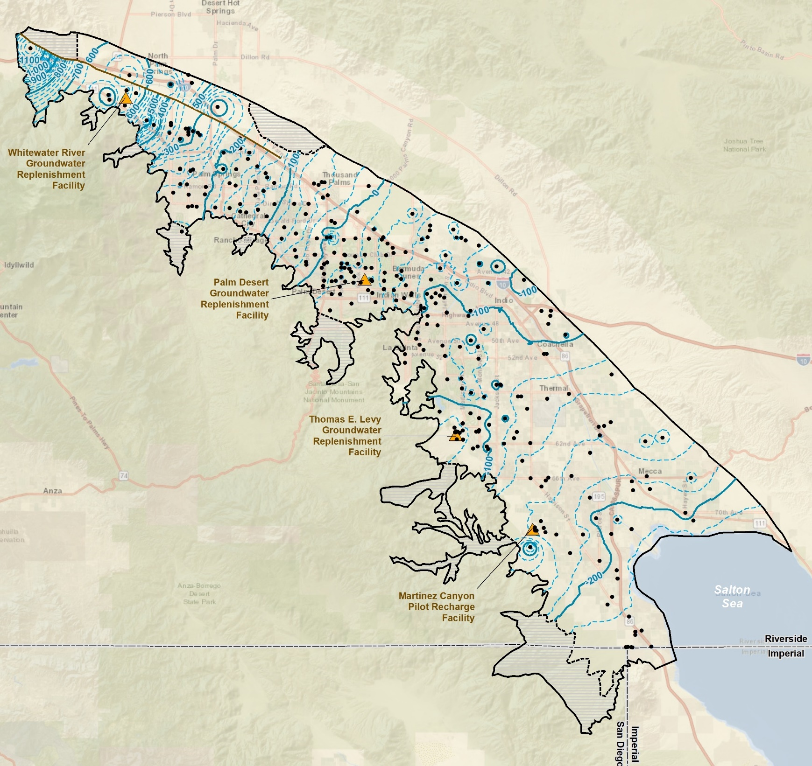
Groundwater Conditions: Levels
Indio Subbasin has a robust monitoring program, 345 wells measured
Elevations range from 1,100 feet above mean sea level to 200 feet below msl
Groundwater flow is from northwest to southeast
Groundwater elevation contours, WY 2018-2019
12

Slide 13
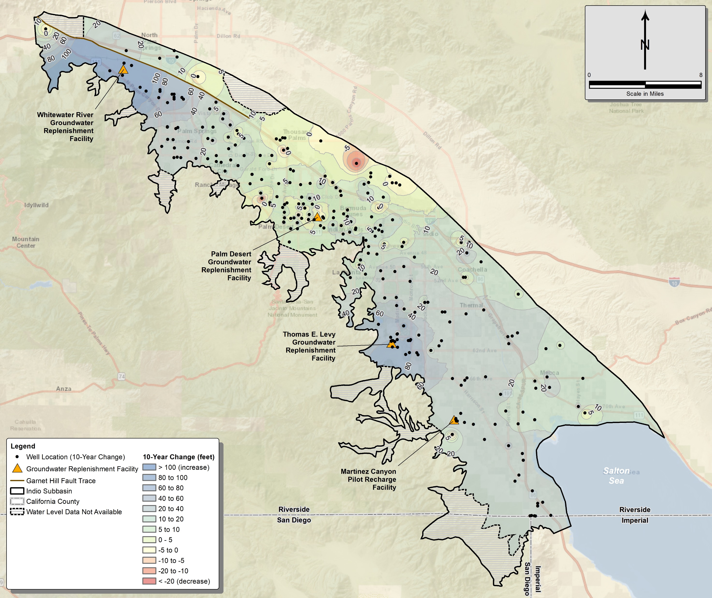
Change in Groundwater Levels 2009-2019
Groundwater levels have increased over most areas, with some localized decreases
Largest increases near GRFs
Increases in mid-valley of
7-15 feet and in southeast of 10-40 feet
Increases are due to GRF recharge, source substitution, and conservation programs
Figure 4-7
13

Slide 14
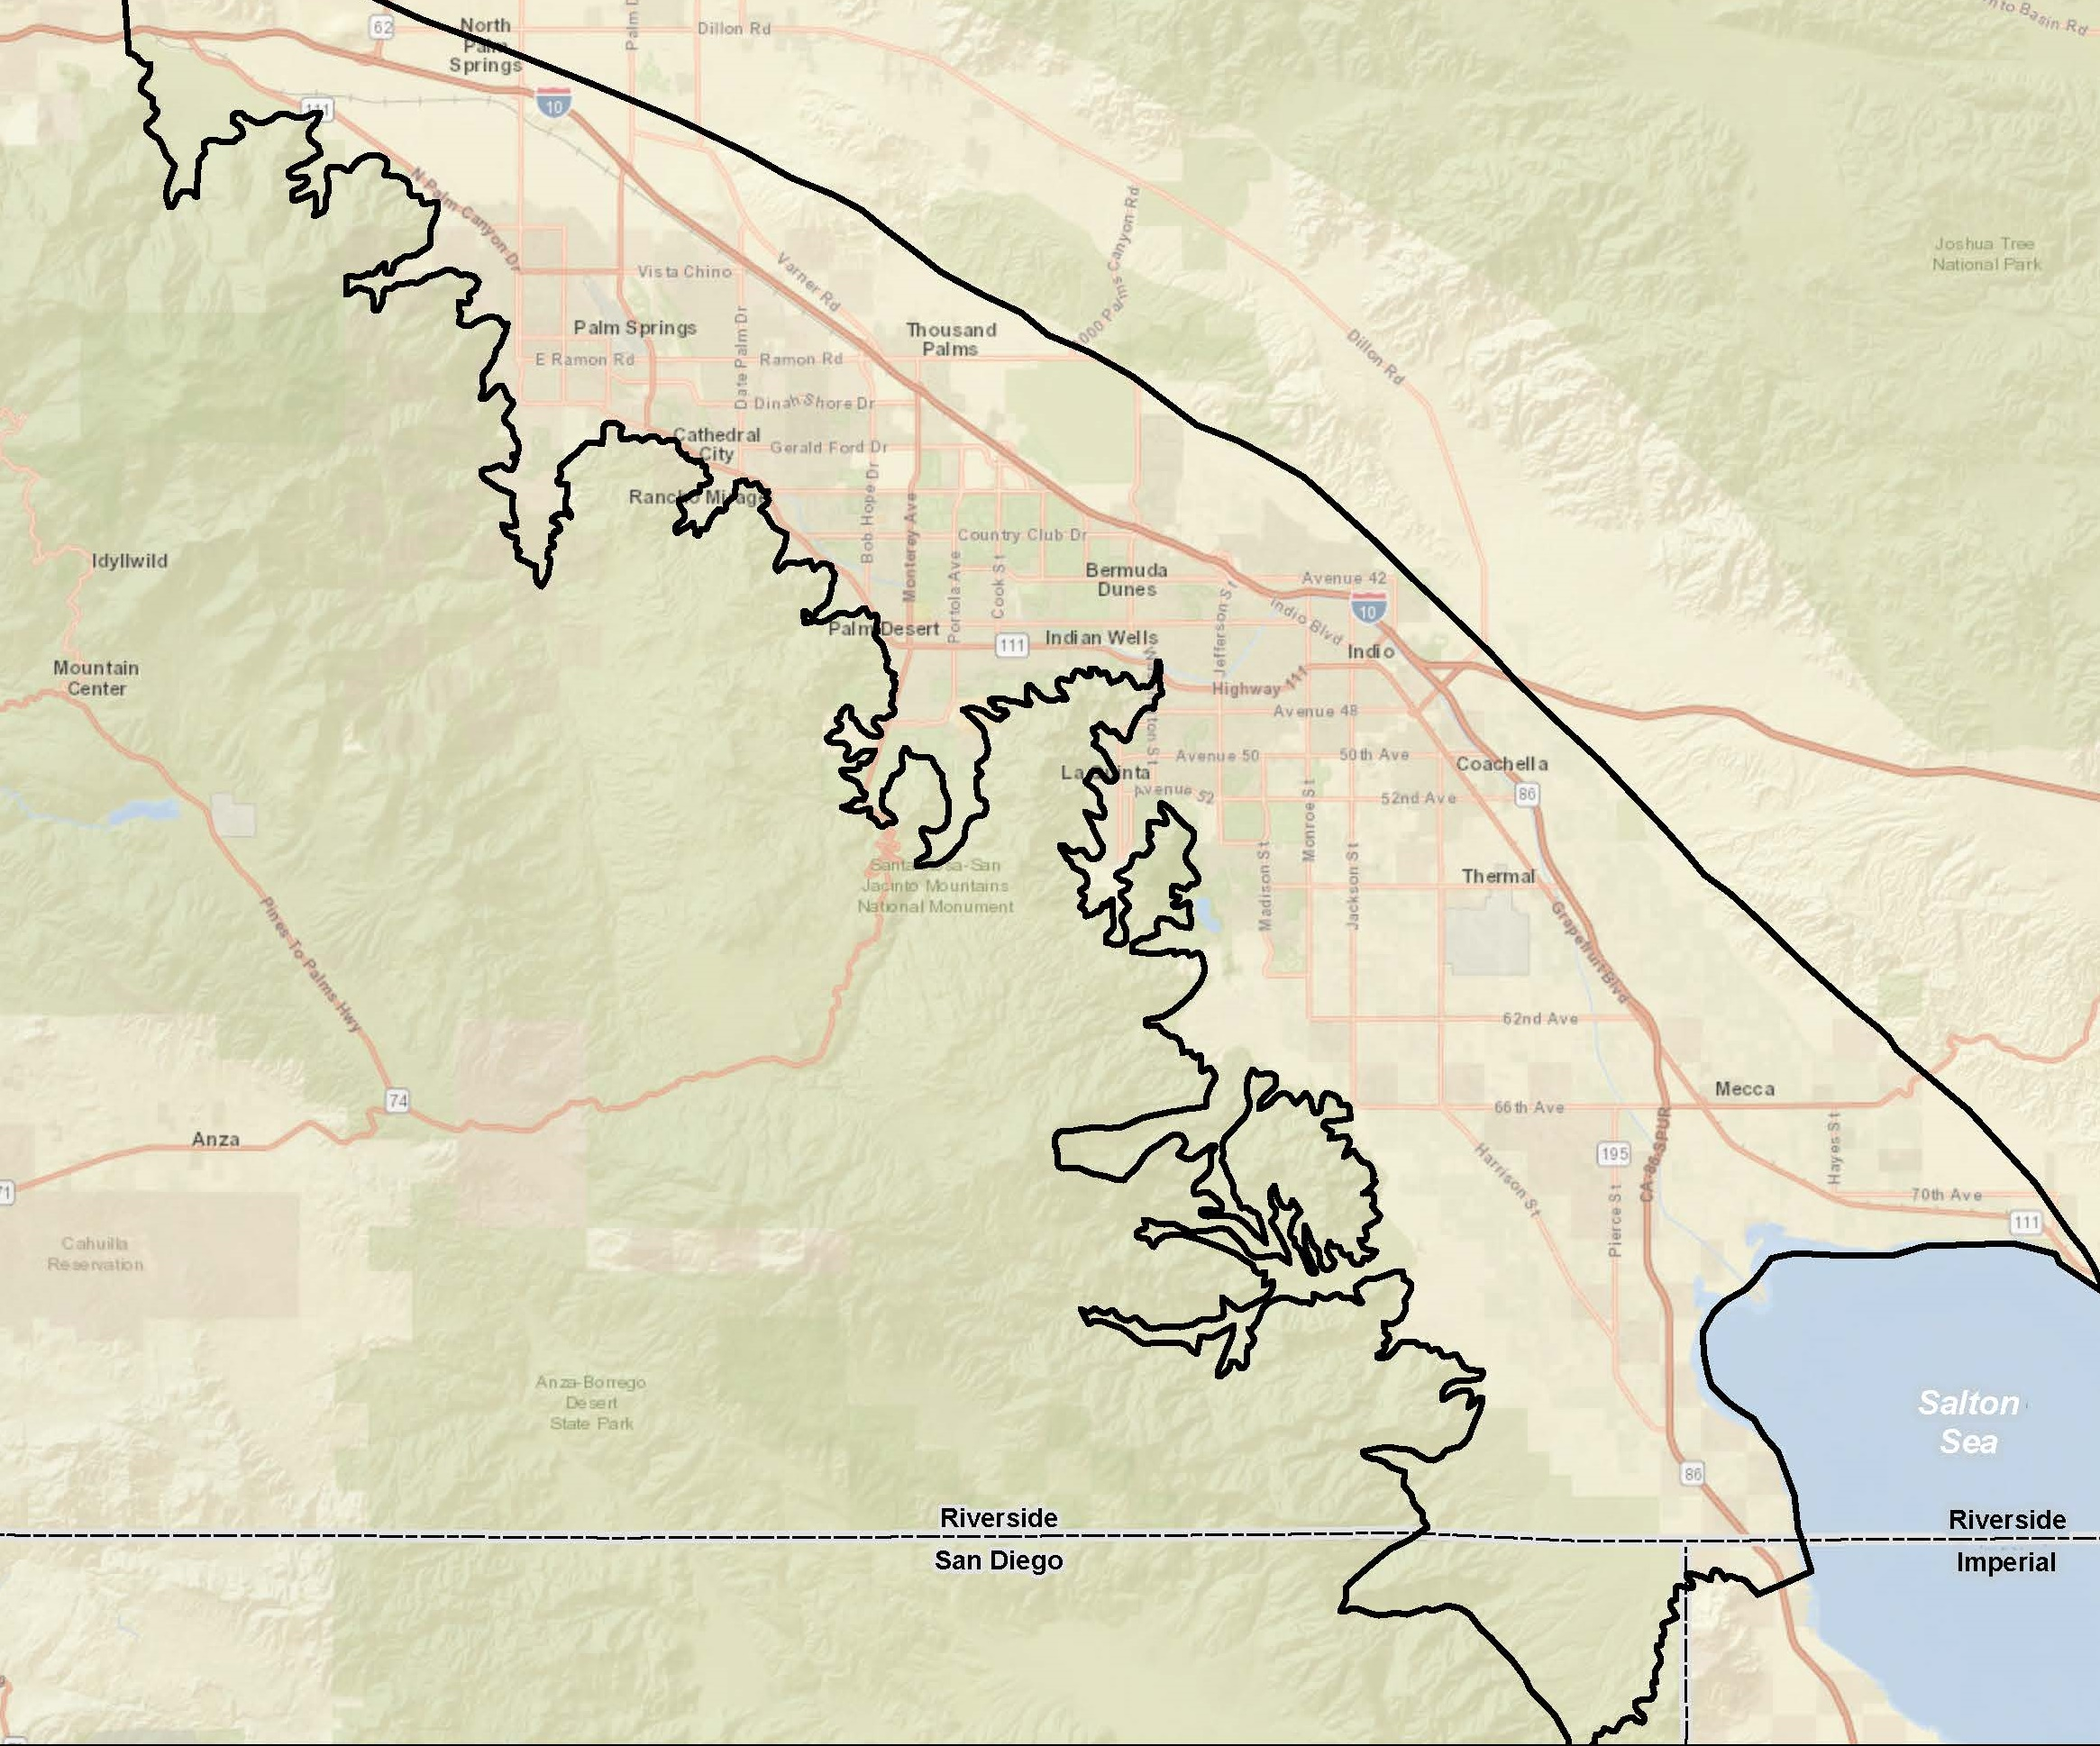
Groundwater Level
Hydrographs
Numerous hydrographs are available
Hydrographs show:
  Overall increases 2009-2020
  Large increases due to recharge at GRFs
  Smaller, later increases with distance from GRFs
  Recovery from overdraft with recharge, source substitution, and conservation

Slide 15
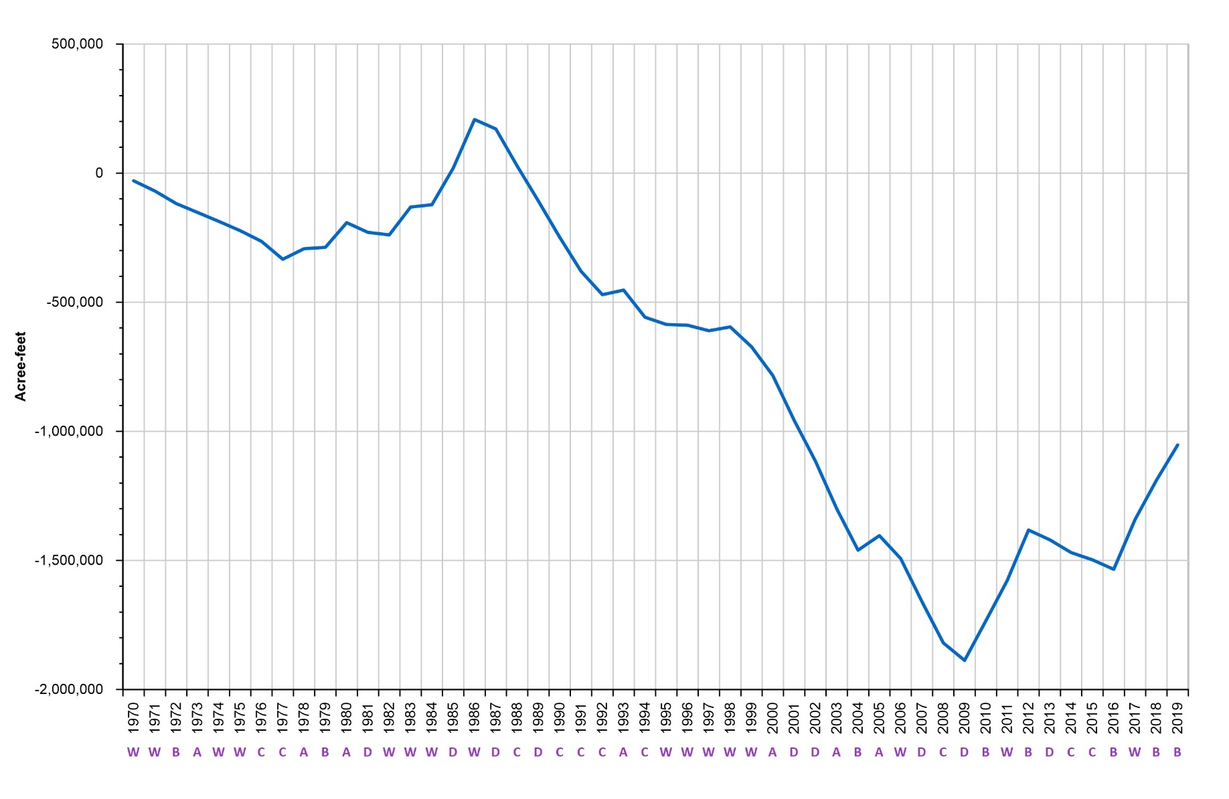
Change in Groundwater Storage
“Running total” from 1970 to 2019 shows overdraft 1987-2009
Reversal of historical overdraft since 2009
An increase of about 840,000 AF stored water for use if/when shortages occur, e.g., recent drought
Historical low groundwater in storage - 2009
15

Slide 16
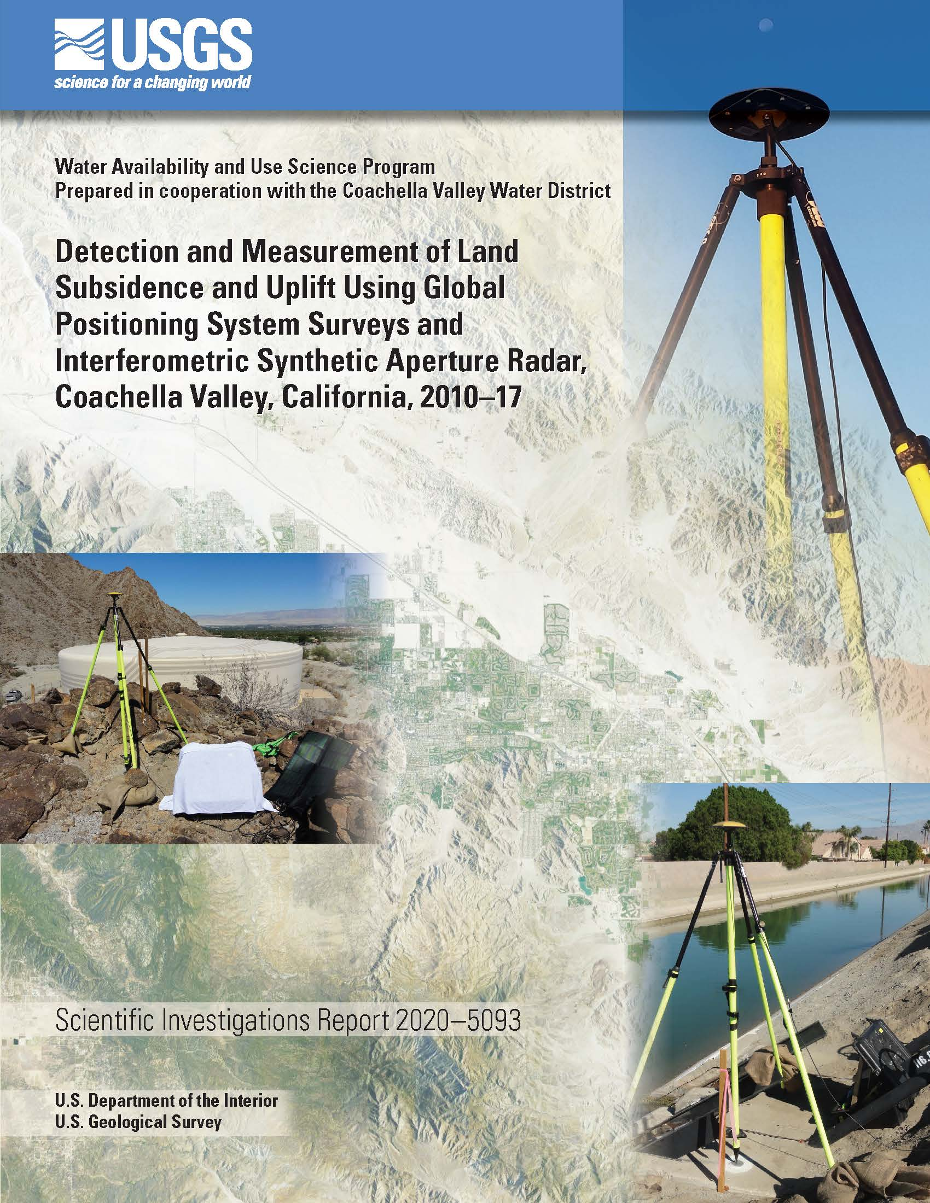
Land Subsidence
Subbasin is susceptible to subsidence due to compaction of basin sediments with groundwater level declines
Investigated by USGS and CVWD since 1995
Up to 2 feet, 1995 to 2010, correlated to groundwater declines due to pumping
Stabilization and uplift documented since 2010 with higher groundwater levels

Slide 17
Agenda
Welcome and Introductions
Alternative Plan Status
Groundwater Conditions
Sustainable Management Criteria
Groundwater Model Status
Projects and Management Actions
Public Comment
Get Involved
Notes:
Our goals are to:
Enhance public understanding about water resources in the basin
Keep you—the public and stakeholders—informed about the GSP
Engage diverse interested parties and stakeholders
Respond to your concerns

Slide 18
Sustainable Management Criteria:
Levels, Storage, Subsidence
DWR Recommendations:
  Set groundwater levels thresholds
  Consider using levels as a proxy for storage and subsidence
GSA objective:
To avoid undesirable results of significant and unreasonable loss of yield from existing production wells
  Due to chronic groundwater level decline
  Throughout the basin; not every well
  As a result of GSA basin management

Slide 19
Sustainability Criteria – Terms
Sustainability Goals – Conditions in the absence of undesirable results within
20 years.​
Undesirable Results – Conditions that we want to avoid.​
Qualitative
Measurable Objectives (MO) – Specific, quantifiable goals for the maintenance or improvement of specified groundwater conditions to achieve the sustainability goal.​
Minimum Thresholds (MT) – Numeric value for each sustainability indicator used to define undesirable results.​
Interim Milestones (IM) – Target value representing measurable groundwater conditions, in increments of five years.​
Quantitative

Slide 20
Alternative Plan Goal vs Sustainability Goal
CVWMP / Alternative Plan Goal:
To reliably meet current and future water demands in a cost effective and sustainable manner
SGMA Sustainability Goal:
To maintain a locally managed, economically viable, sustainable groundwater resource for existing and future beneficial use in the Indio Subbasin by managing groundwater to avoid undesirable results
DRAFT

Slide 21
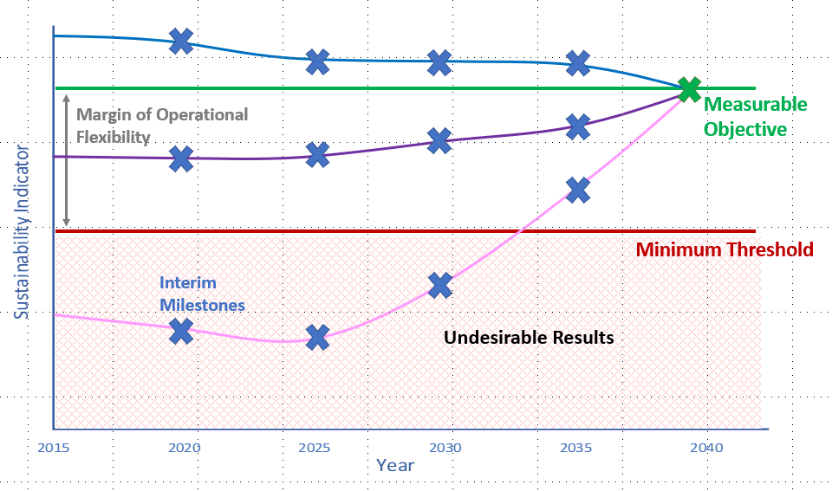

Slide 22






Sustainability Criteria – Sustainability Indicators
Chronic lowering of groundwater levels
Reduction of groundwater storage
Land subsidence
Degraded water quality
Seawater intrusion
Depletions of connected surface water with impacts on beneficial uses including groundwater dependent ecosystems

Slide 23
Defining Undesirable Result Statements
Statements that describe what ‘bad’ looks like – what we want to prevent from happening
Phrased broadly to meet regulations “significant and unreasonable effects…caused by groundwater conditions”
Drives monitoring networks and thresholds, which must detect conditions before they are significant and unreasonably undesirable
“Significant and Unreasonable” – provides flexibility within SGMA for *local control* because locals determine what is significant and unreasonable

Slide 24
Undesirable Results in Indio Subbasin
Chronic Lowering of Groundwater Levels
Significant and unreasonable reduction in the long-term viability of domestic, agricultural, municipal, or environmental uses over the planning and implementation horizon of this Alternative Plan.
Reduction in Groundwater Storage
Significant and unreasonable reduction in the viability of domestic, agricultural, municipal, or environmental uses over the planning and implementation horizon of this Alternative Plan.
Land Subsidence
Significant and unreasonable reduction in the viability of the use of water conveyance and flood control infrastructure over the planning and implementation horizon of this Alternative Plan.

Slide 25
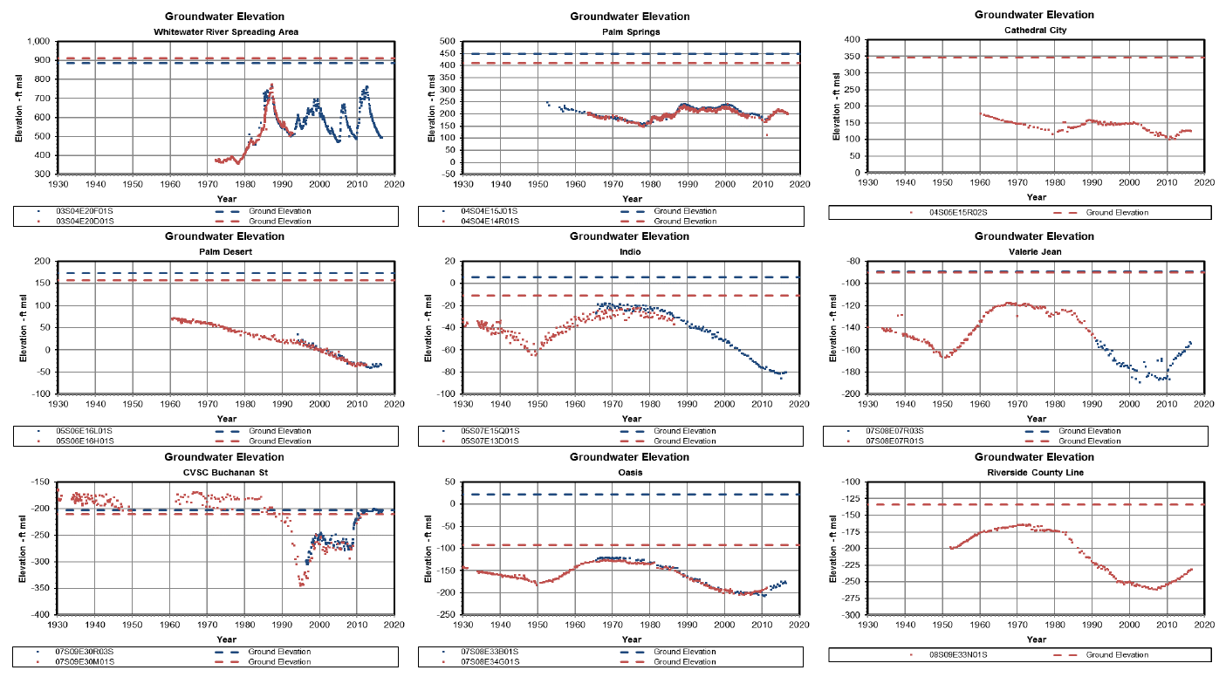

Undesirable Results in Indio Subbasin:
Groundwater Levels
Questions:
What undesirable results do we want to avoid?
  Impacts to shallow wells?
  Maintenance of municipal and industrial water supply?
  Other?

Slide 26
Setting Minimum Thresholds (MTs) for Levels
SGMA definition for groundwater level Minimum Threshold (MT):
A groundwater elevation measured at a representative monitoring site.
How to define the MT elevation? Two options considered:
  Use historical low groundwater levels
  Occurred recently without reported significant problems
  Probably conservative, but certainly protective
  Document construction of all production wells, select criteria per diverse well characteristics, relate private wells to representative “Key Wells”
  Consider this in the future as a mean to refine MTs

Slide 27
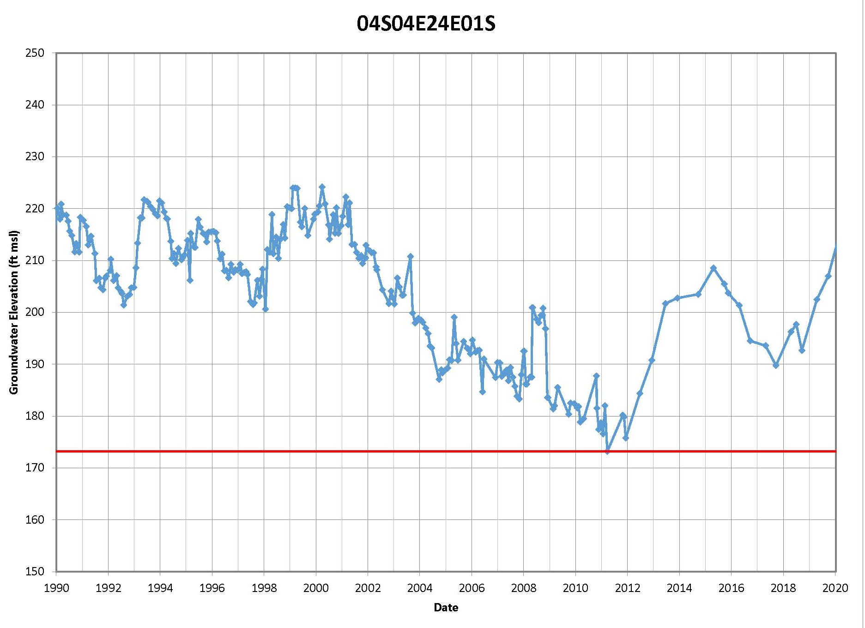
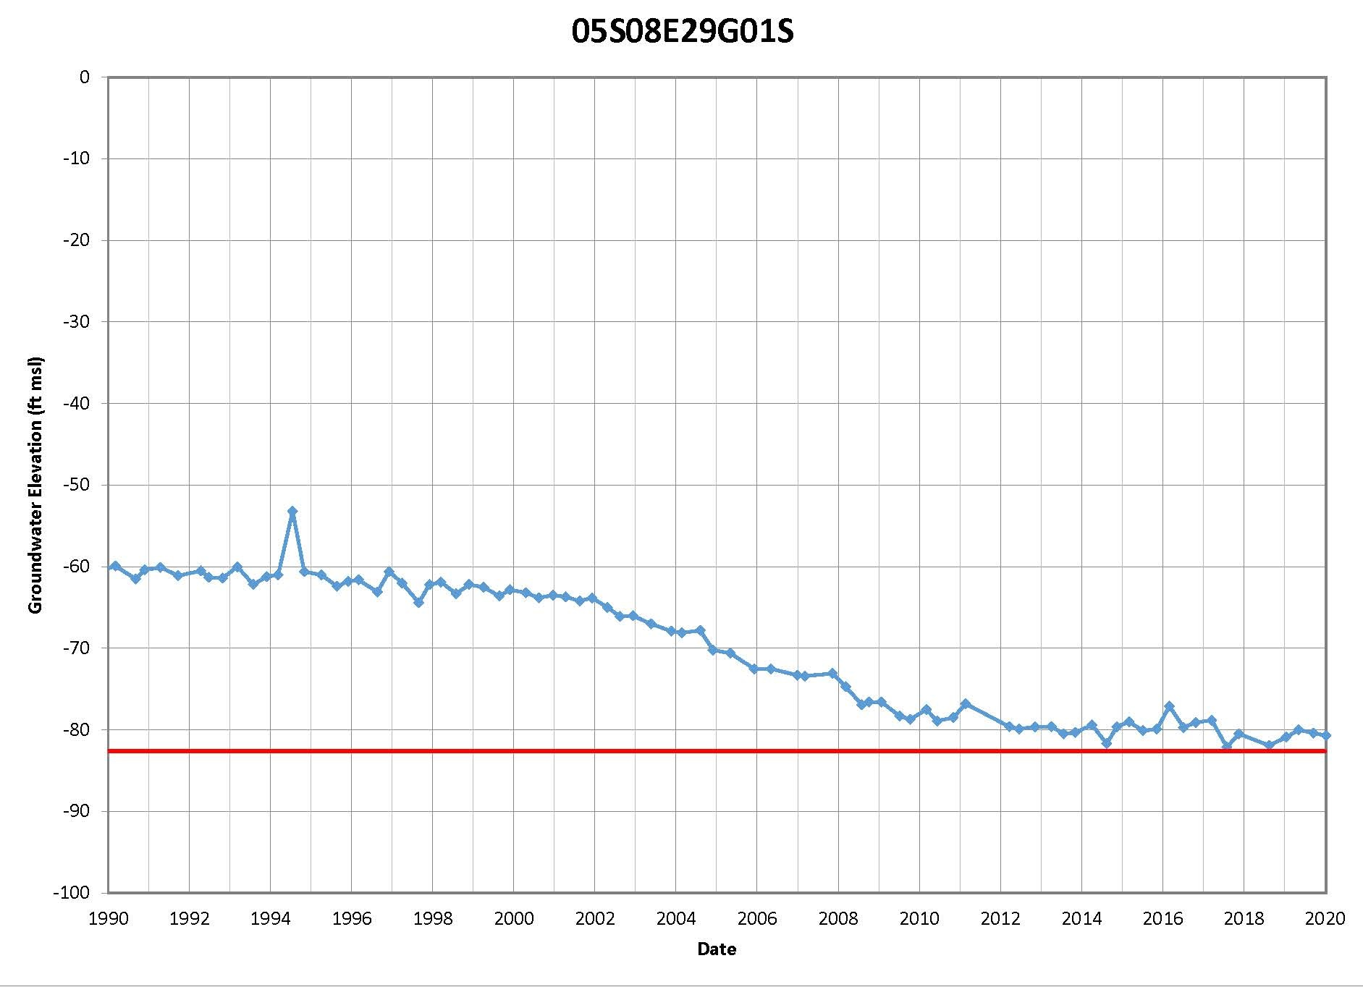
MTs as Historical Lows Measured at Key Wells

Slide 28
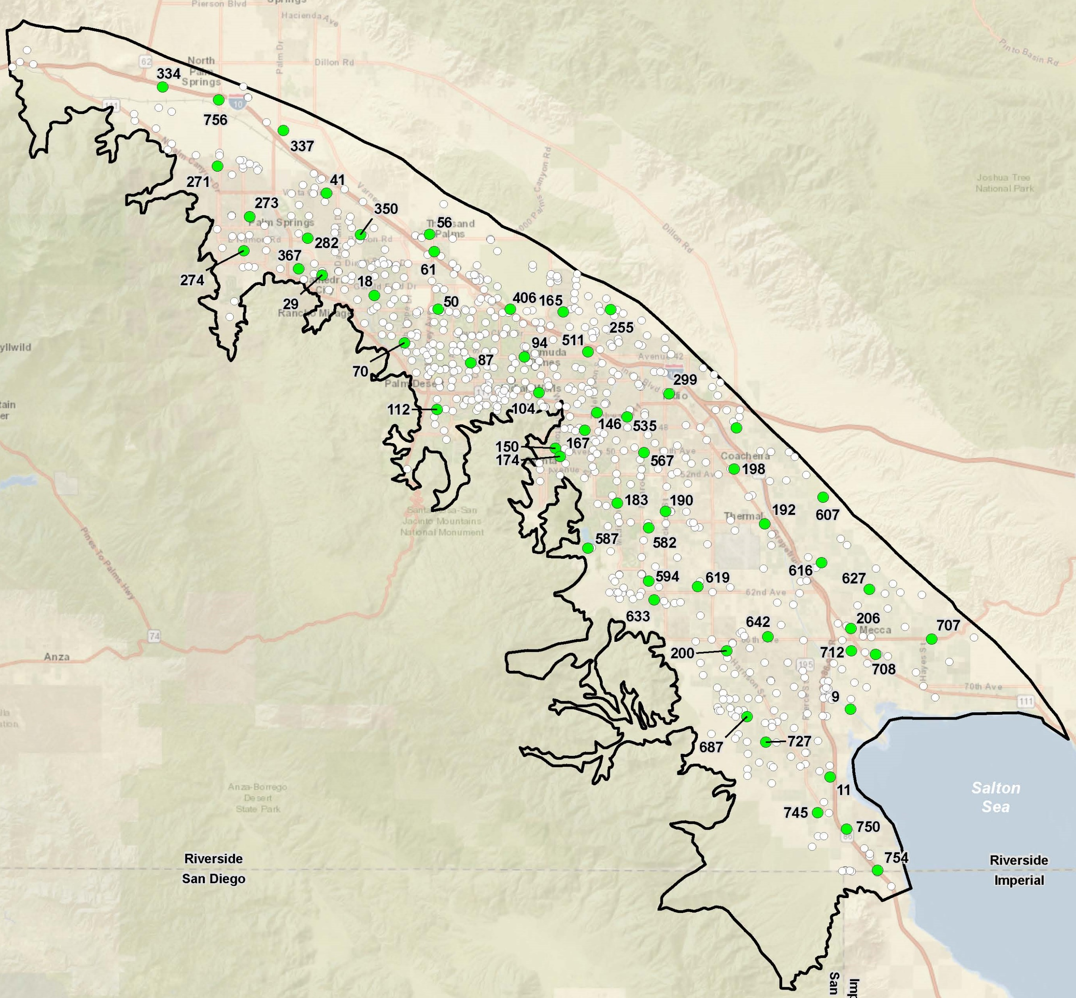
Key Well Network for Groundwater Levels
Key Well selection factors include:
Well construction data available
Current monitoring
Long, reliable record
Areal distribution
Location among production wells
Proximity to small water systems
All GSAs represented
757 wells considered
57 wells selected

Slide 29

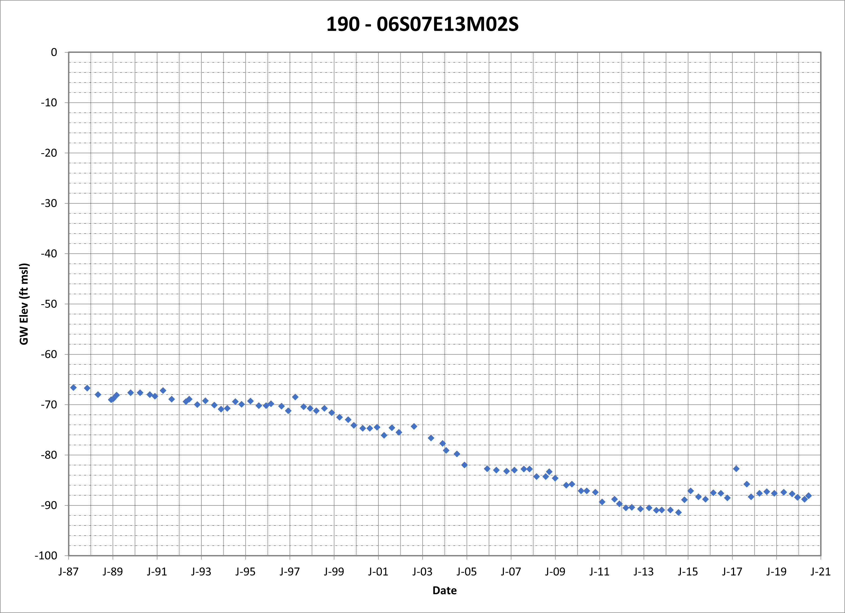
Undesirable Results for Chronic Groundwater Level Decline
Crossing the MT infrequently or briefly may not be undesirable
Local problems may be undesirable, but do not represent overdraft
GSAs will be monitoring and responding to water levels near
the MTs
An undesirable result occurs when the MT is crossed in five consecutive low-season monitoring events in 25% of wells across the subbasin
Annual reporting will include MT hydrographs and management actions
29

Slide 30
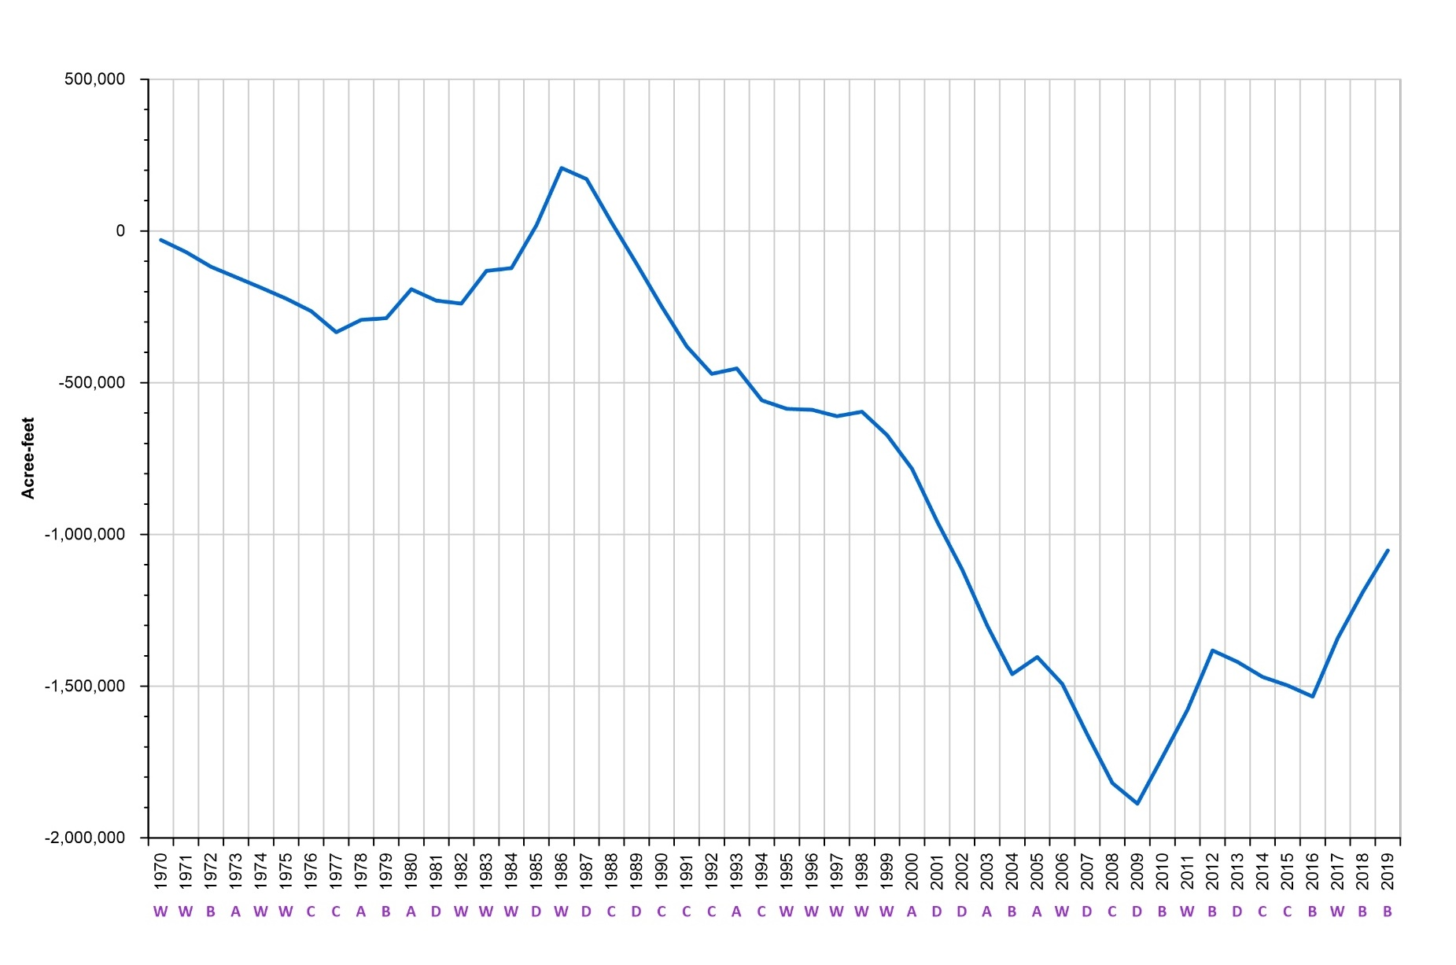
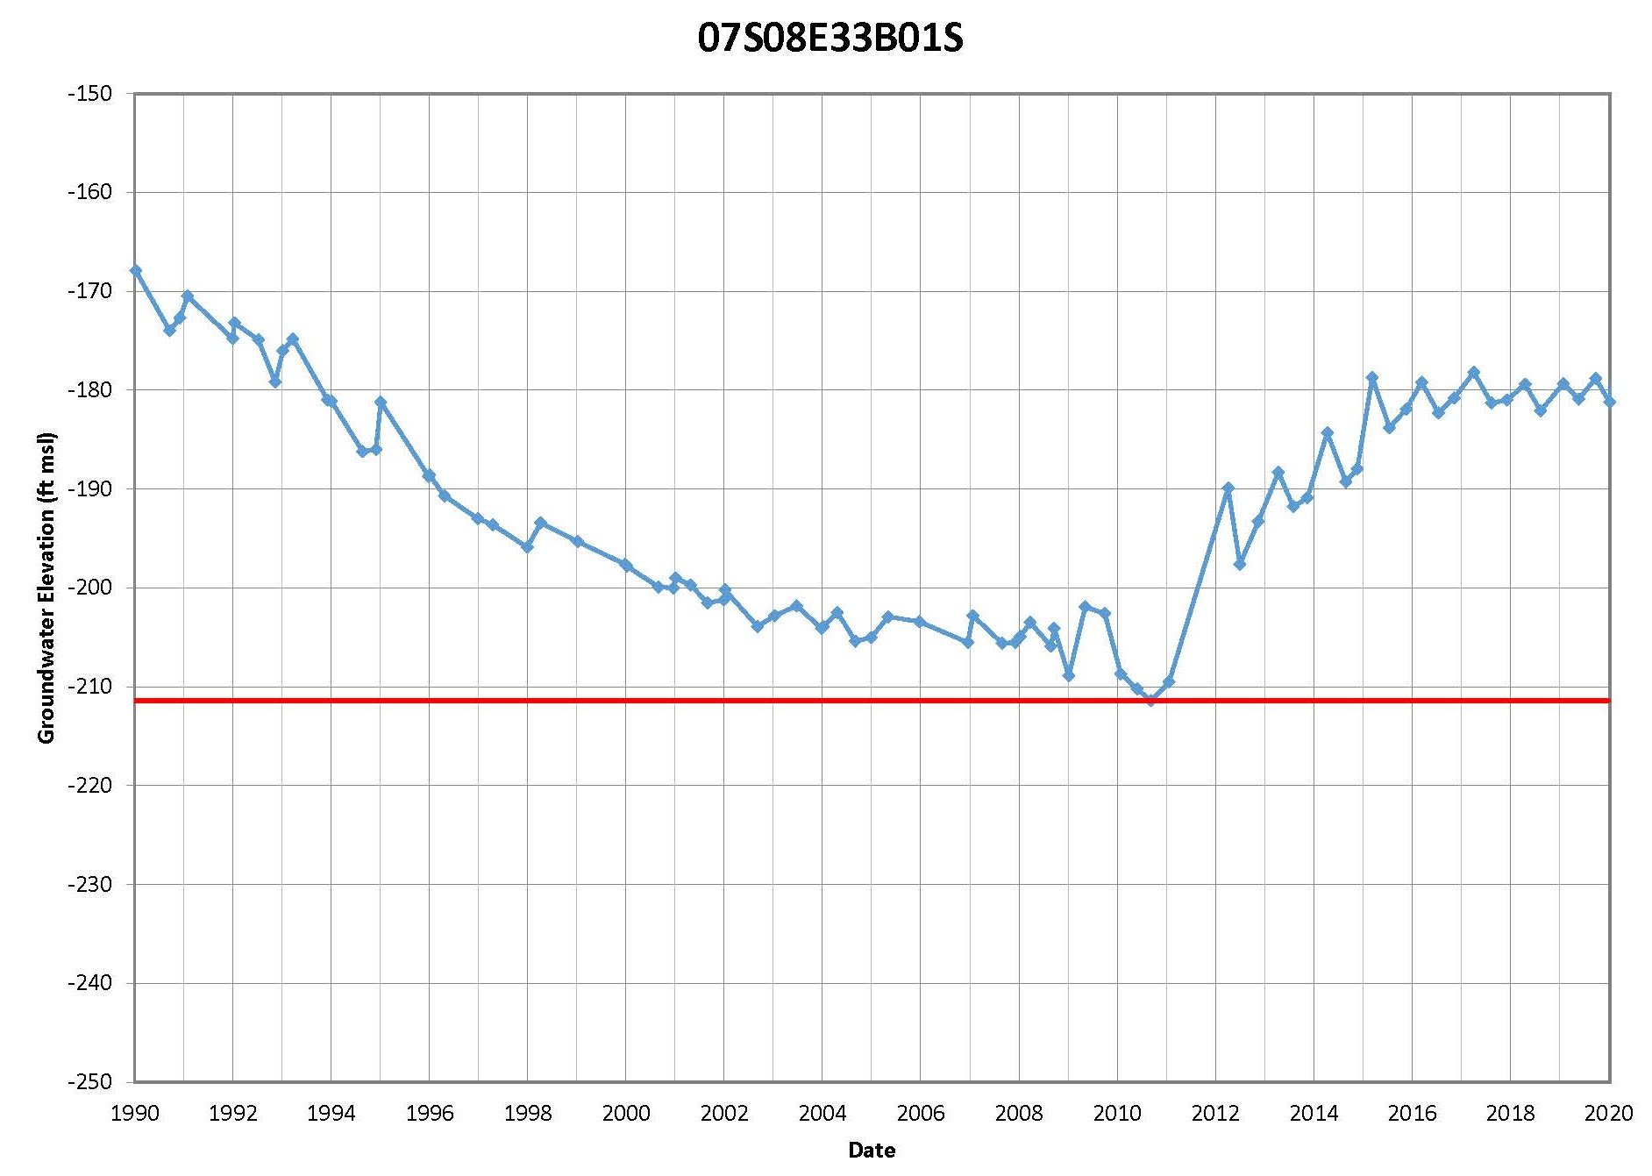
Using Levels as a Proxy for Storage
Levels monitoring generally matches the long-term change in storage
With groundwater level MTs as historical lows, then storage cannot reach a significant and unreasonable condition
We recommend using levels as a proxy for storage
30

Slide 31
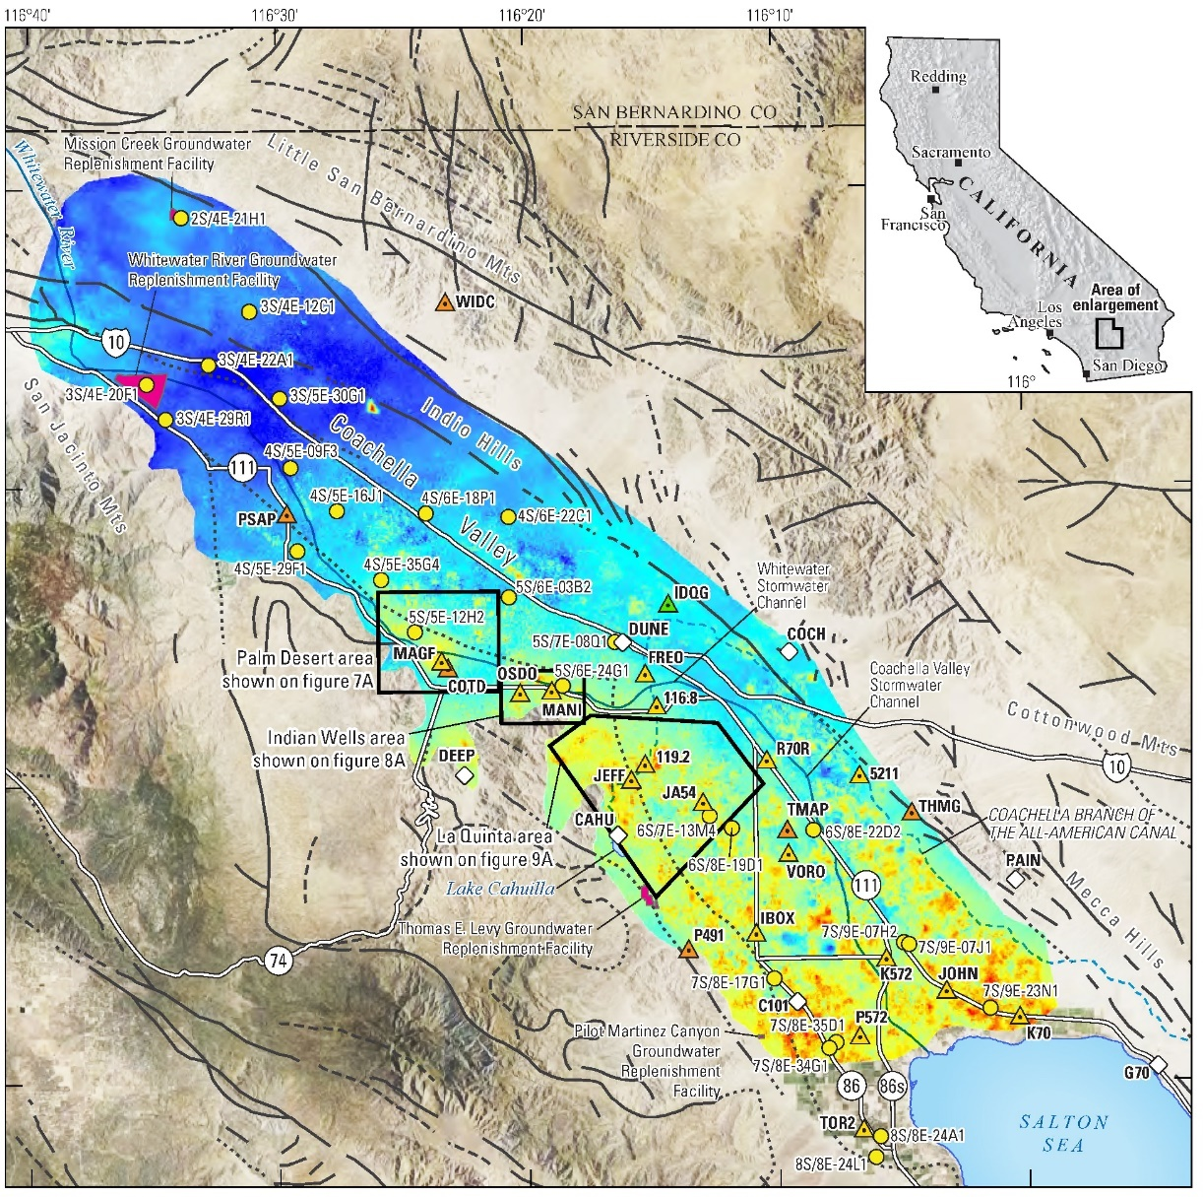
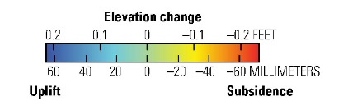
Using Levels as a
Proxy for Subsidence
Undesirable results include
  Disruption of surface drainage, water supply conveyance, and flood control
  Damage to infrastructure
  Earth fissures
Maintaining groundwater levels above historical lows would be protective against subsidence
We recommend using levels as a proxy for subsidence
2014-2017

Slide 32
Agenda
Welcome and Introductions
Alternative Plan Status
Groundwater Conditions
Sustainable Management Criteria
Groundwater Model Status
Projects and Management Actions
Public Comment
Get Involved
Notes:
Our goals are to:
Enhance public understanding about water resources in the basin
Keep you—the public and stakeholders—informed about the GSP
Engage diverse interested parties and stakeholders
Respond to your concerns

Slide 33
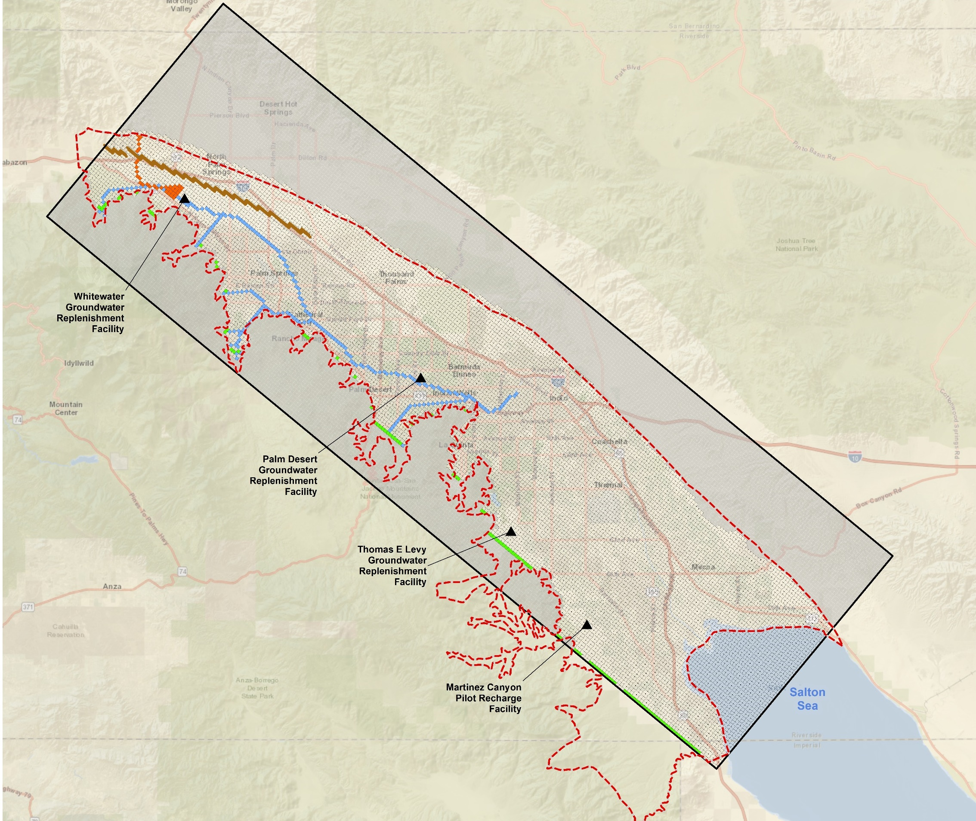
Groundwater Model Status
Provides numerical simulation of the Subbasin
Updated with recent data on inflows and outflows
Coordinated with models for adjacent basins
In final calibration and chapter preparation
Continues to provides a reliable tool to simulate future conditions and scenarios

Slide 34
Agenda
Welcome and Introductions
Alternative Plan Status
Groundwater Conditions
Sustainable Management Criteria
Groundwater Model Status
Projects and Management Actions
Public Comment
Get Involved
Notes:
Our goals are to:
Enhance public understanding about water resources in the basin
Keep you—the public and stakeholders—informed about the GSP
Engage diverse interested parties and stakeholders
Respond to your concerns

Slide 35
Projects & Management Actions (PMAs)
Alternative Plan Update to include “a description of the projects and management actions the GSA has determined will achieve the sustainability goal for the basin, including projects and management actions to respond to changing conditions in the basin.”
Coordinated across several chapters:
Water Supply ←→ Scenarios ←→ Projects & Management Actions

Slide 36
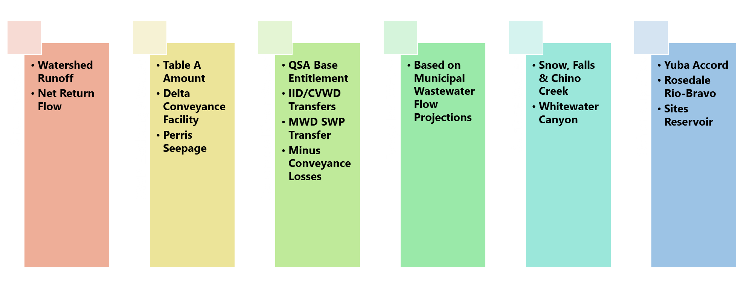
Two Major Groupings of PMAs
SGMA Implementation
Projects & Management Actions
These are different from, but support, the water supplies that we discussed last workshop. Many PMAs help to convey, deliver, and recharge our regional supplies.

Slide 37
SGMA Implementation
Tasks the GSAs may implement to support SGMA compliance
Recommendations:
  Monitoring (Groundwater Levels and Quality)
  GSAs Meetings – Annually
  Annual Reports
  Alternative Plan 5-year Update (incl Groundwater Model Update)
  Pursue Funding Opportunities
  Monitoring Network Improvements
  Stakeholder Outreach and Website Maintenance
  Subbasin Well Inventory
  Expand Pumping Measurements
  Consider SGMA Fee

Slide 38
Projects & Management Actions
Actions the GSAs may implement to support sustainable water management
PMAs organized into 5 categories:
  Water Conservation
  Water Supply Development
  Source Substitution & Replenishment
  Water Quality Improvements
  Other Studies & Programs

Slide 39
Potential PMAs by Category
Water Conservation
Conservation Programs and State Regulations
Agricultural
Source Substitution & Replenishment
MVP Expansion
Golf
TEL-GRF Expansion
PD-GRF Expansion
WRP-7
WRP-10
Increased RW Deliveries
East Golf Expansion
Water Supply Development
Surface Water Diversions
WRP-4 RW Expansion
Delta Conveyance Facility
Lake Perris Seepage
Sites Reservoir
Other Studies & Programs
Monitoring & Reporting
Water Quality Improvement
Recharge Water Quality Improvement
Drainage Control
Flood Control
Colorado River Salinity Forum
Continue Evaluating: CR Treatment and SWP Importation
Domestic Water
& Sewer Consolidations
Continued WWR-GRF Recharge
Supplemental Water Supplies
Implement SNMP
Further GDEs Analysis
Oasis Distribution System
Groundwater Treatment
Stormwater Capture
EVRA Potable Reuse
Well Construction/ Abandonment
Urban

Slide 40
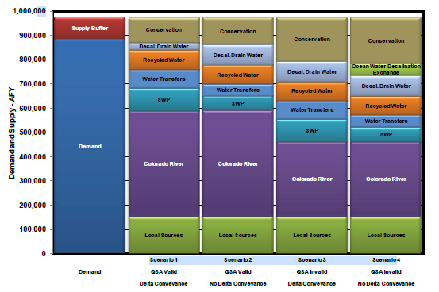
Objectives for Scenario Modeling
What Are We Trying to Achieve?
  Consider how uncertainties may affect the GSAs ability to sustainably manage water resources
  Meet SGMA regulations, including balancing water budget and avoiding groundwater overdraft
Scenario Modeling in 2010 CVWMP

Slide 41
Plan Scenarios – Uncertainties for Demands
Uncertainties:
  Land Use Agencies (Municipal/Tribes) – higher than anticipated growth, large scale developments with higher than anticipated demands
  Agricultural – influx of new farmers with higher than anticipated demands
Recommendation:
  Supply buffer of +10% municipal demands, plus double the acreage of potential new agriculture (+1,000 acres)
    Consider greater agricultural growth in Scenarios

Slide 42
Plan Scenarios – Uncertainties for Supplies
Supply Uncertainties:
  Climate change –
    Local hydrology – reduction in watershed runoff
    Colorado River – cutbacks under Lower Basin DCP
    SWP – additional reductions in delivery reliability; Delta Conveyance Facility not constructed
  Imported water – natural disaster disrupting conveyance, regulatory constraints
  Groundwater – outflows and storage
  Recycled water – regulatory tightening, treatment or connections not constructed
  Sites Reservoir – not constructed or significantly delayed
  Lake Perris Seepage – not constructed or significantly delayed
Recommendation:
  Model up to 5 Scenarios with varying portfolios of supplies and projects

Slide 43

What Might Scenarios Look Like?
No Project
Baseline
Future Projects
Future Projects w/Climate Change
Future Projects w/Drought
Existing supplies & facilities
Supplies & facilities in 5-Yr Capital Improvement Plan
All planned supplies & facilities
Planned supplies & facilities, limited by climate changes
Planned supplies & facilities, limited by reoccurring drought
Notes:
No Project Scenario: Includes only those supplies and facilities currently in place to support basin management. No new projects or water supplies.
Baseline: Includes supplies and facilities currently in place to support basin management, along with new projects or supplies under the control of GSAs.
Future Projects: Includes implementation of additional supplies and facilities that are in the planning phases by GSA agencies, subsequent phases of projects, and/or GSAs are participating agencies.
Future Projects w/Climate Change: Includes supply constraints on future projects scenario associated with anticipated climate changes.
Future Projects w/Drought: Includes supply constraints on future projects scenario associated with 5-year drought (2012-2016) conditions.

Slide 44
What Might Scenarios Look Like?
No Project
Baseline
Future Projects
Future Projects w/Climate Change
Future Projects w/Drought
Questions:
What else should be considered in the Scenario modeling?
Are there other projects that should be added?
Notes:
No Project Scenario: Includes only those supplies and facilities currently in place to support basin management. No new projects or water supplies.
Baseline: Includes supplies and facilities currently in place to support basin management, along with new projects or supplies under the control of GSAs.
Future Projects: Includes implementation of additional supplies and facilities that are in the planning phases by GSA agencies, subsequent phases of projects, and/or GSAs are participating agencies.
Future Projects w/Climate Change: Includes supply constraints on future projects scenario associated with anticipated climate changes.
Future Projects w/Drought: Includes supply constraints on future projects scenario associated with 5-year drought (2012-2016) conditions.

Slide 45
Next Steps
February 2021 – April 2021
  Document groundwater dependent ecosystems
  Finalize projects and management actions
  Finalize proposed sustainability criteria
  Run Scenarios in groundwater model
  Quantify Indio Subbasin water budget

Slide 46
Agenda
Welcome and Introductions
Alternative Plan Status
Groundwater Conditions
Sustainable Management Criteria
Groundwater Model Status
Projects and Management Actions
Public Comment
Get Involved
Notes:
Our goals are to:
Enhance public understanding about water resources in the basin
Keep you—the public and stakeholders—informed about the GSP
Engage diverse interested parties and stakeholders
Respond to your concerns

Slide 47
Public Comment
Input and feedback are welcomed
For Callers – you may need to press *6 to unmute

Slide 48
Agenda
Welcome and Introductions
Alternative Plan Status
Groundwater Conditions
Sustainable Management Criteria
Groundwater Model Status
Projects and Management Actions
Public Comment
Get Involved
Notes:
Our goals are to:
Enhance public understanding about water resources in the basin
Keep you—the public and stakeholders—informed about the GSP
Engage diverse interested parties and stakeholders
Respond to your concerns

Slide 49
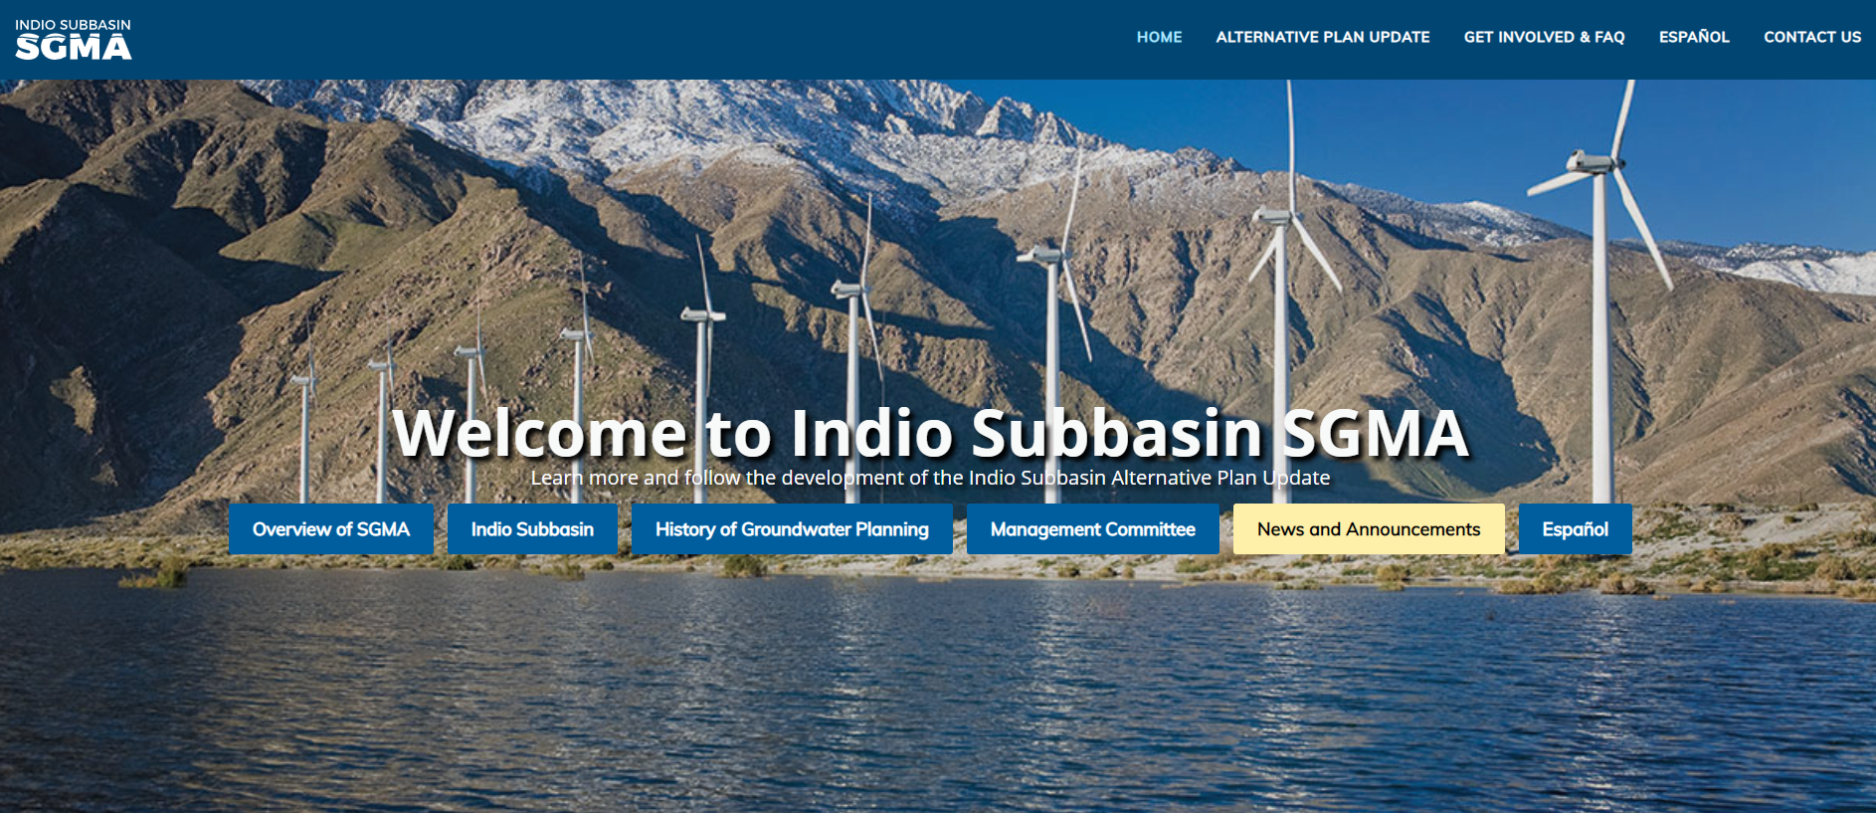

Get Involved – Visit our Website
www.IndioSubbasinSGMA.org

Slide 50
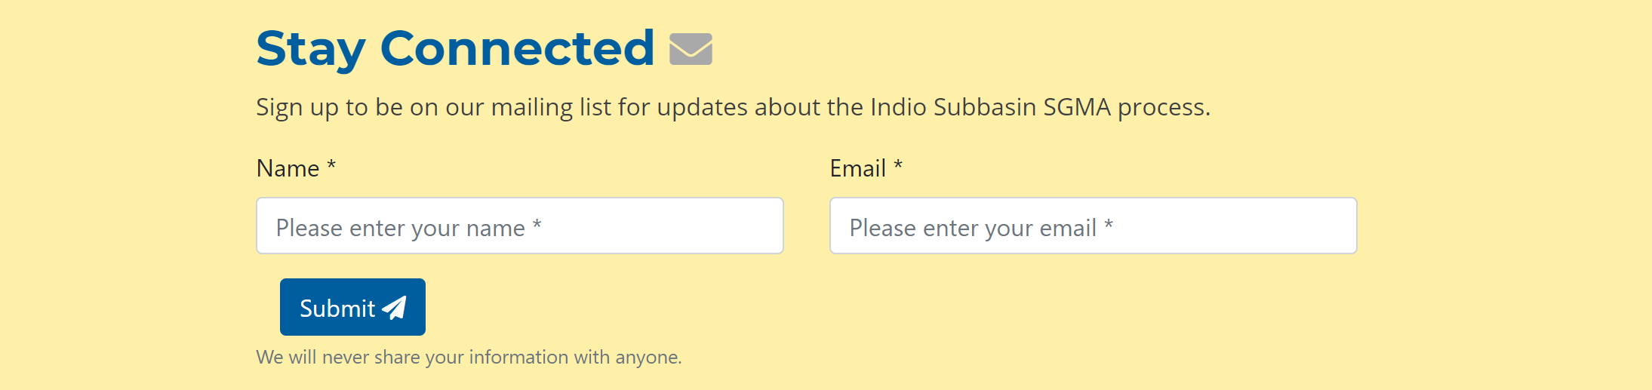
Get Involved – Visit our Website
Sign up for email invites, updates, and data/report releases at
www.IndioSubbasinSGMA.org

Slide 51




Get Involved – Next Workshop
May 19, 2021
2:00 – 4:00 PM
Location: TBD
For additional information, please contact:
Rosalyn Prickett
IndioSubbasinSGMA@woodardcurran.com
(858) 875-7420

