Slide 1




Indio Subbasin Alternative Plan Update Annual Report for Water Year 2024-2025
Public Workshop
March 11, 2026

Slide 2
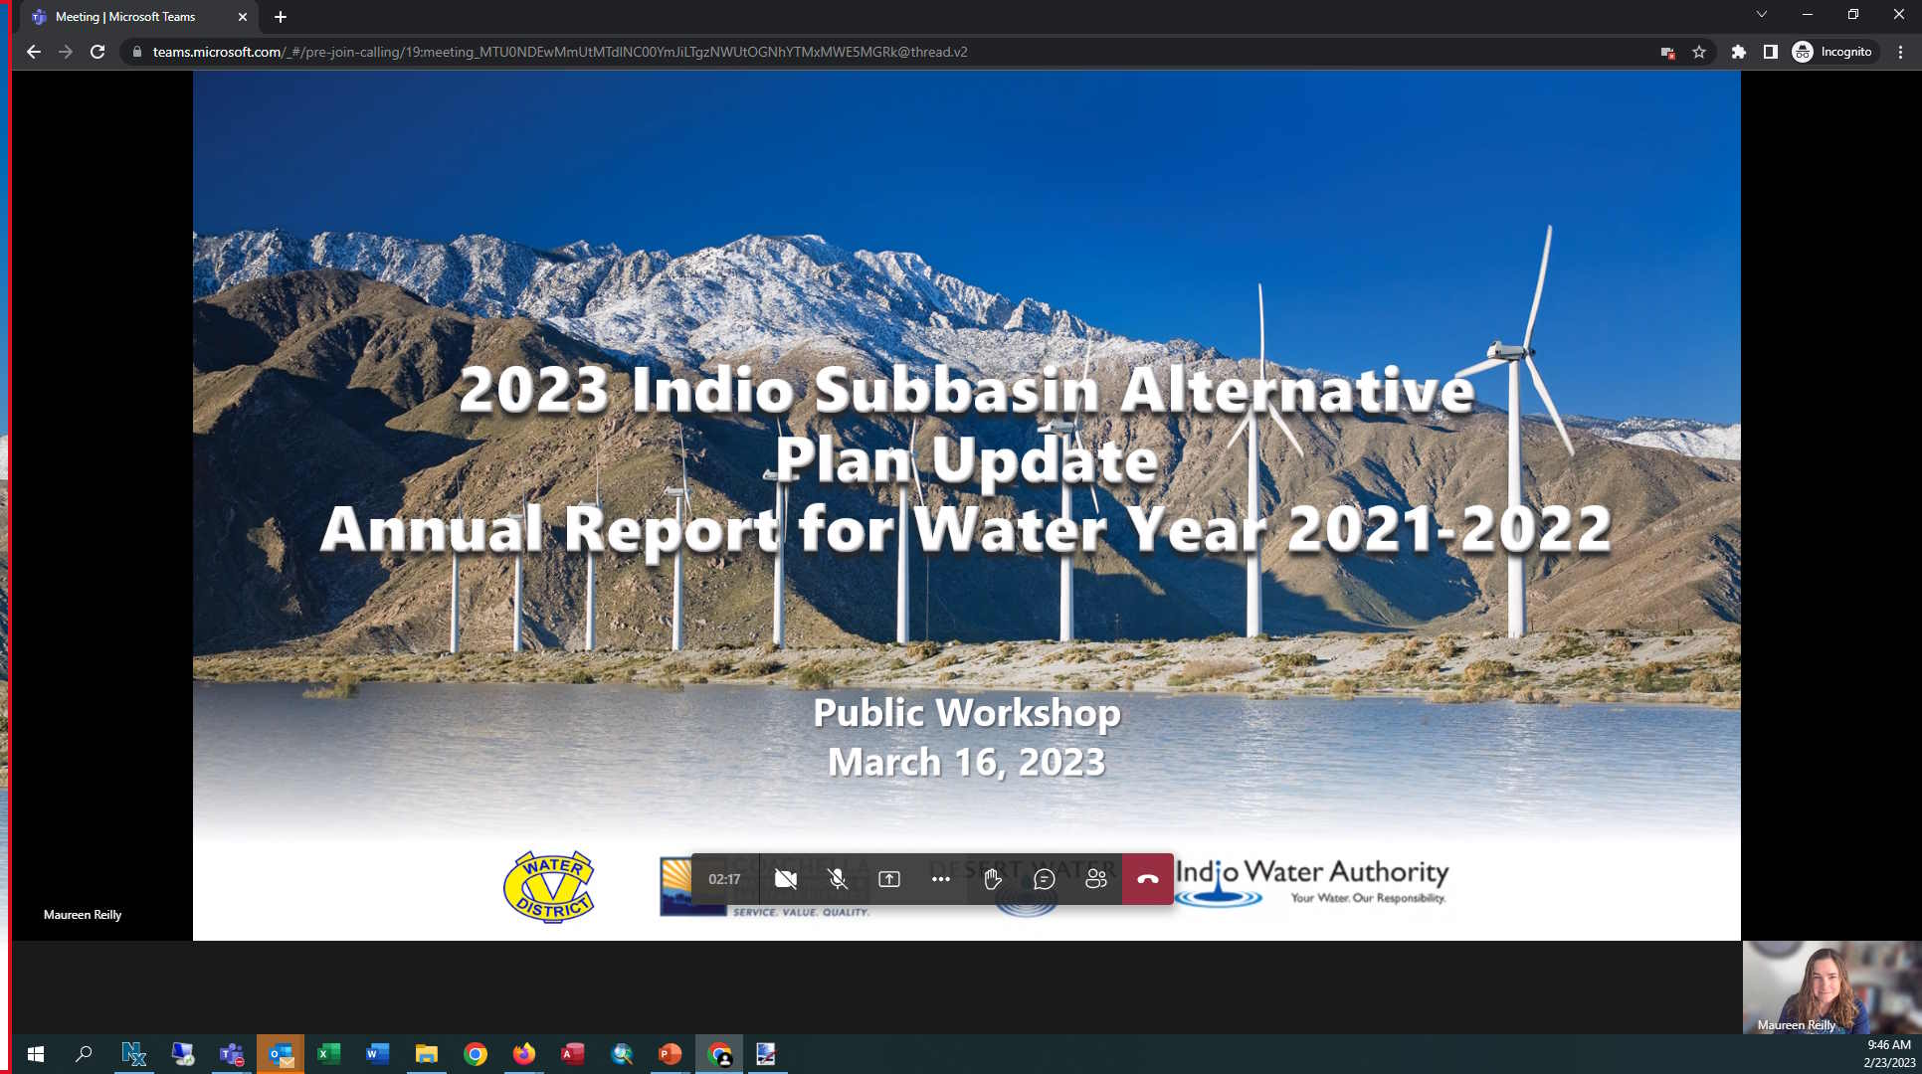
Teams – Quick How To
Your screen should look like this:
Turn on/off your Mic (mute) and Camera (video) using the controls along the bottom
You may need to wiggle your mouse to make the controls appear
For Callers: use *6 to unmute on the phone

Slide 3
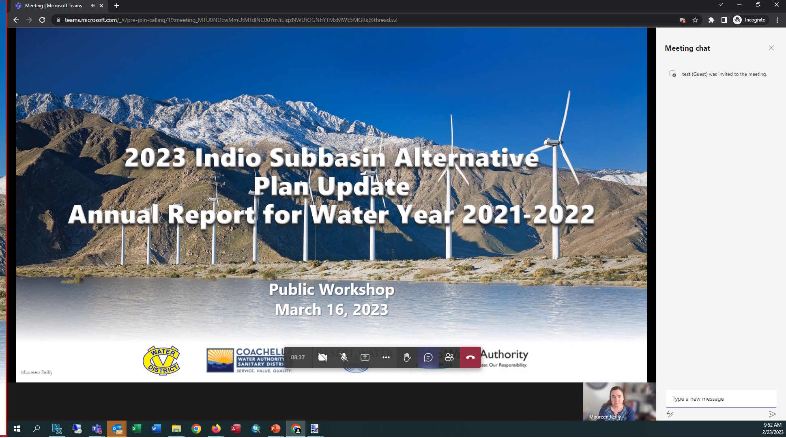
Teams – How to Ask a Question
Our organizer will mute everyone at the beginning of the meeting
Let us know you have a question by
Raising your hand (bottom of screen)
Entering the Chat (bottom of screen)
Click on the right panel, type your message and hit SEND
Once we receive your request, we will call on you and answer your question
For Callers: when asked for questions or comments, use *6 to unmute

Slide 4
Agenda
Welcome and Introductions
Annual Report Status
Groundwater Elevation Data
Groundwater Extractions
Surface Water
Total Water Use
Change in Groundwater Storage
Plan Implementation Progress
Public Comment

Slide 5

Indio Subbasin Team
Project Consultants
Todd Groundwater
Indio Subbasin Groundwater Sustainability Agencies (GSAs)
Coachella Valley Water District
Coachella Water Authority
Desert Water Agency
Indio Water Authority
`

Slide 6
Agenda
Welcome and Introductions
Annual Report Status
Groundwater Elevation Data
Groundwater Extractions
Surface Water
Total Water Use
Change in Groundwater Storage
Plan Implementation Progress
Public Comment

Slide 7
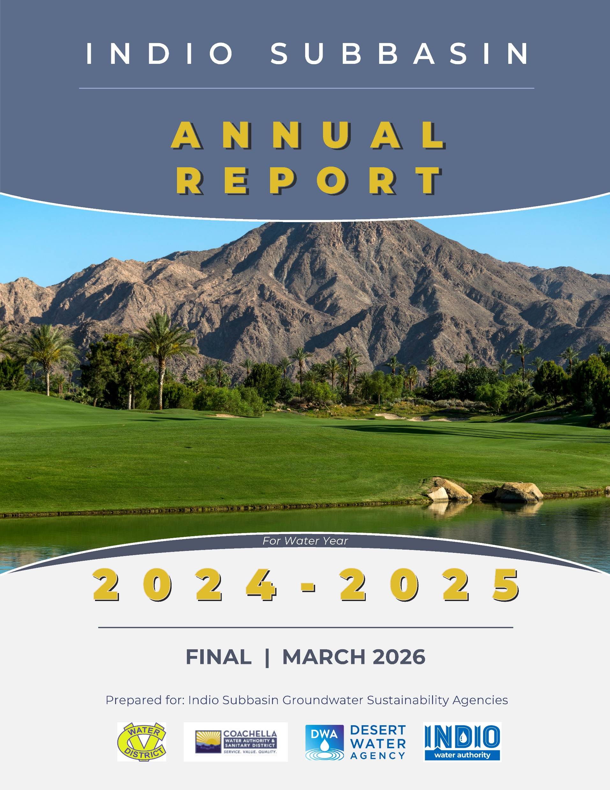
Indio Subbasin Annual Report for WY 2023-2024
Annual Report is required by Sustainable Groundwater Management Act (SGMA)
General information
Subbasin conditions
Implementation progress of projects and management actions (PMAs)
9th Annual Report (5th report following submittal of Indio Subbasin 2022 Alternative Plan Update)
Covers WY 2024-2025 (Oct. 1, 2024 – Sept. 30, 2025)
Will be submitted to DWR by April 1, 2026

Slide 8
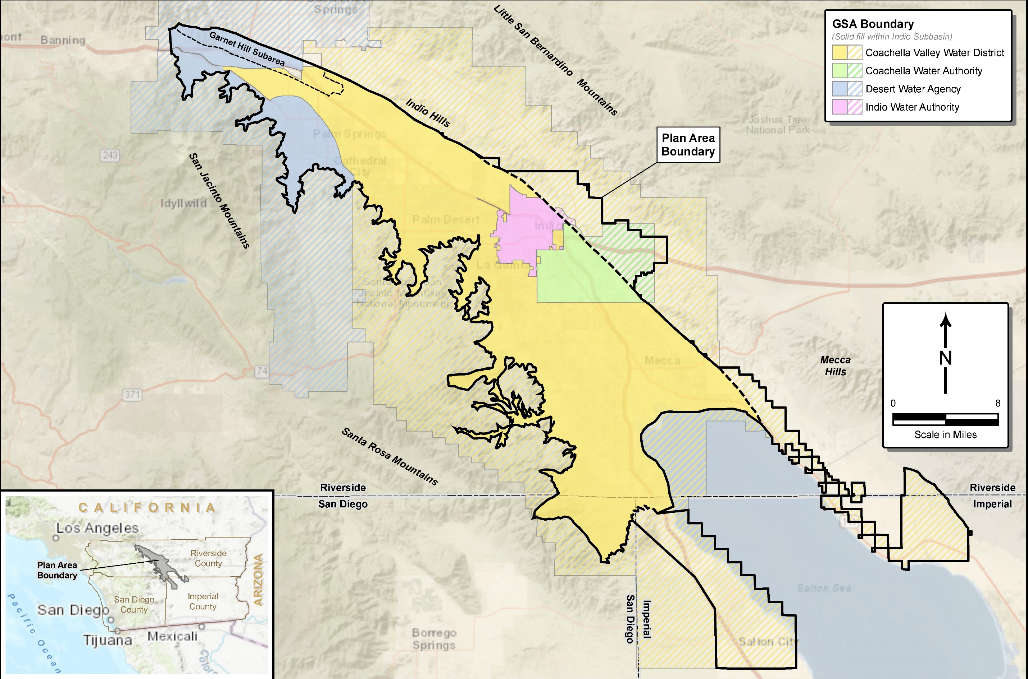

Slide 9
Agenda
Welcome and Introductions
Annual Report Status
Groundwater Elevation Data
Groundwater Extractions
Surface Water
Total Water Use
Change in Groundwater Storage
Plan Implementation Progress
Public Comment

Slide 10
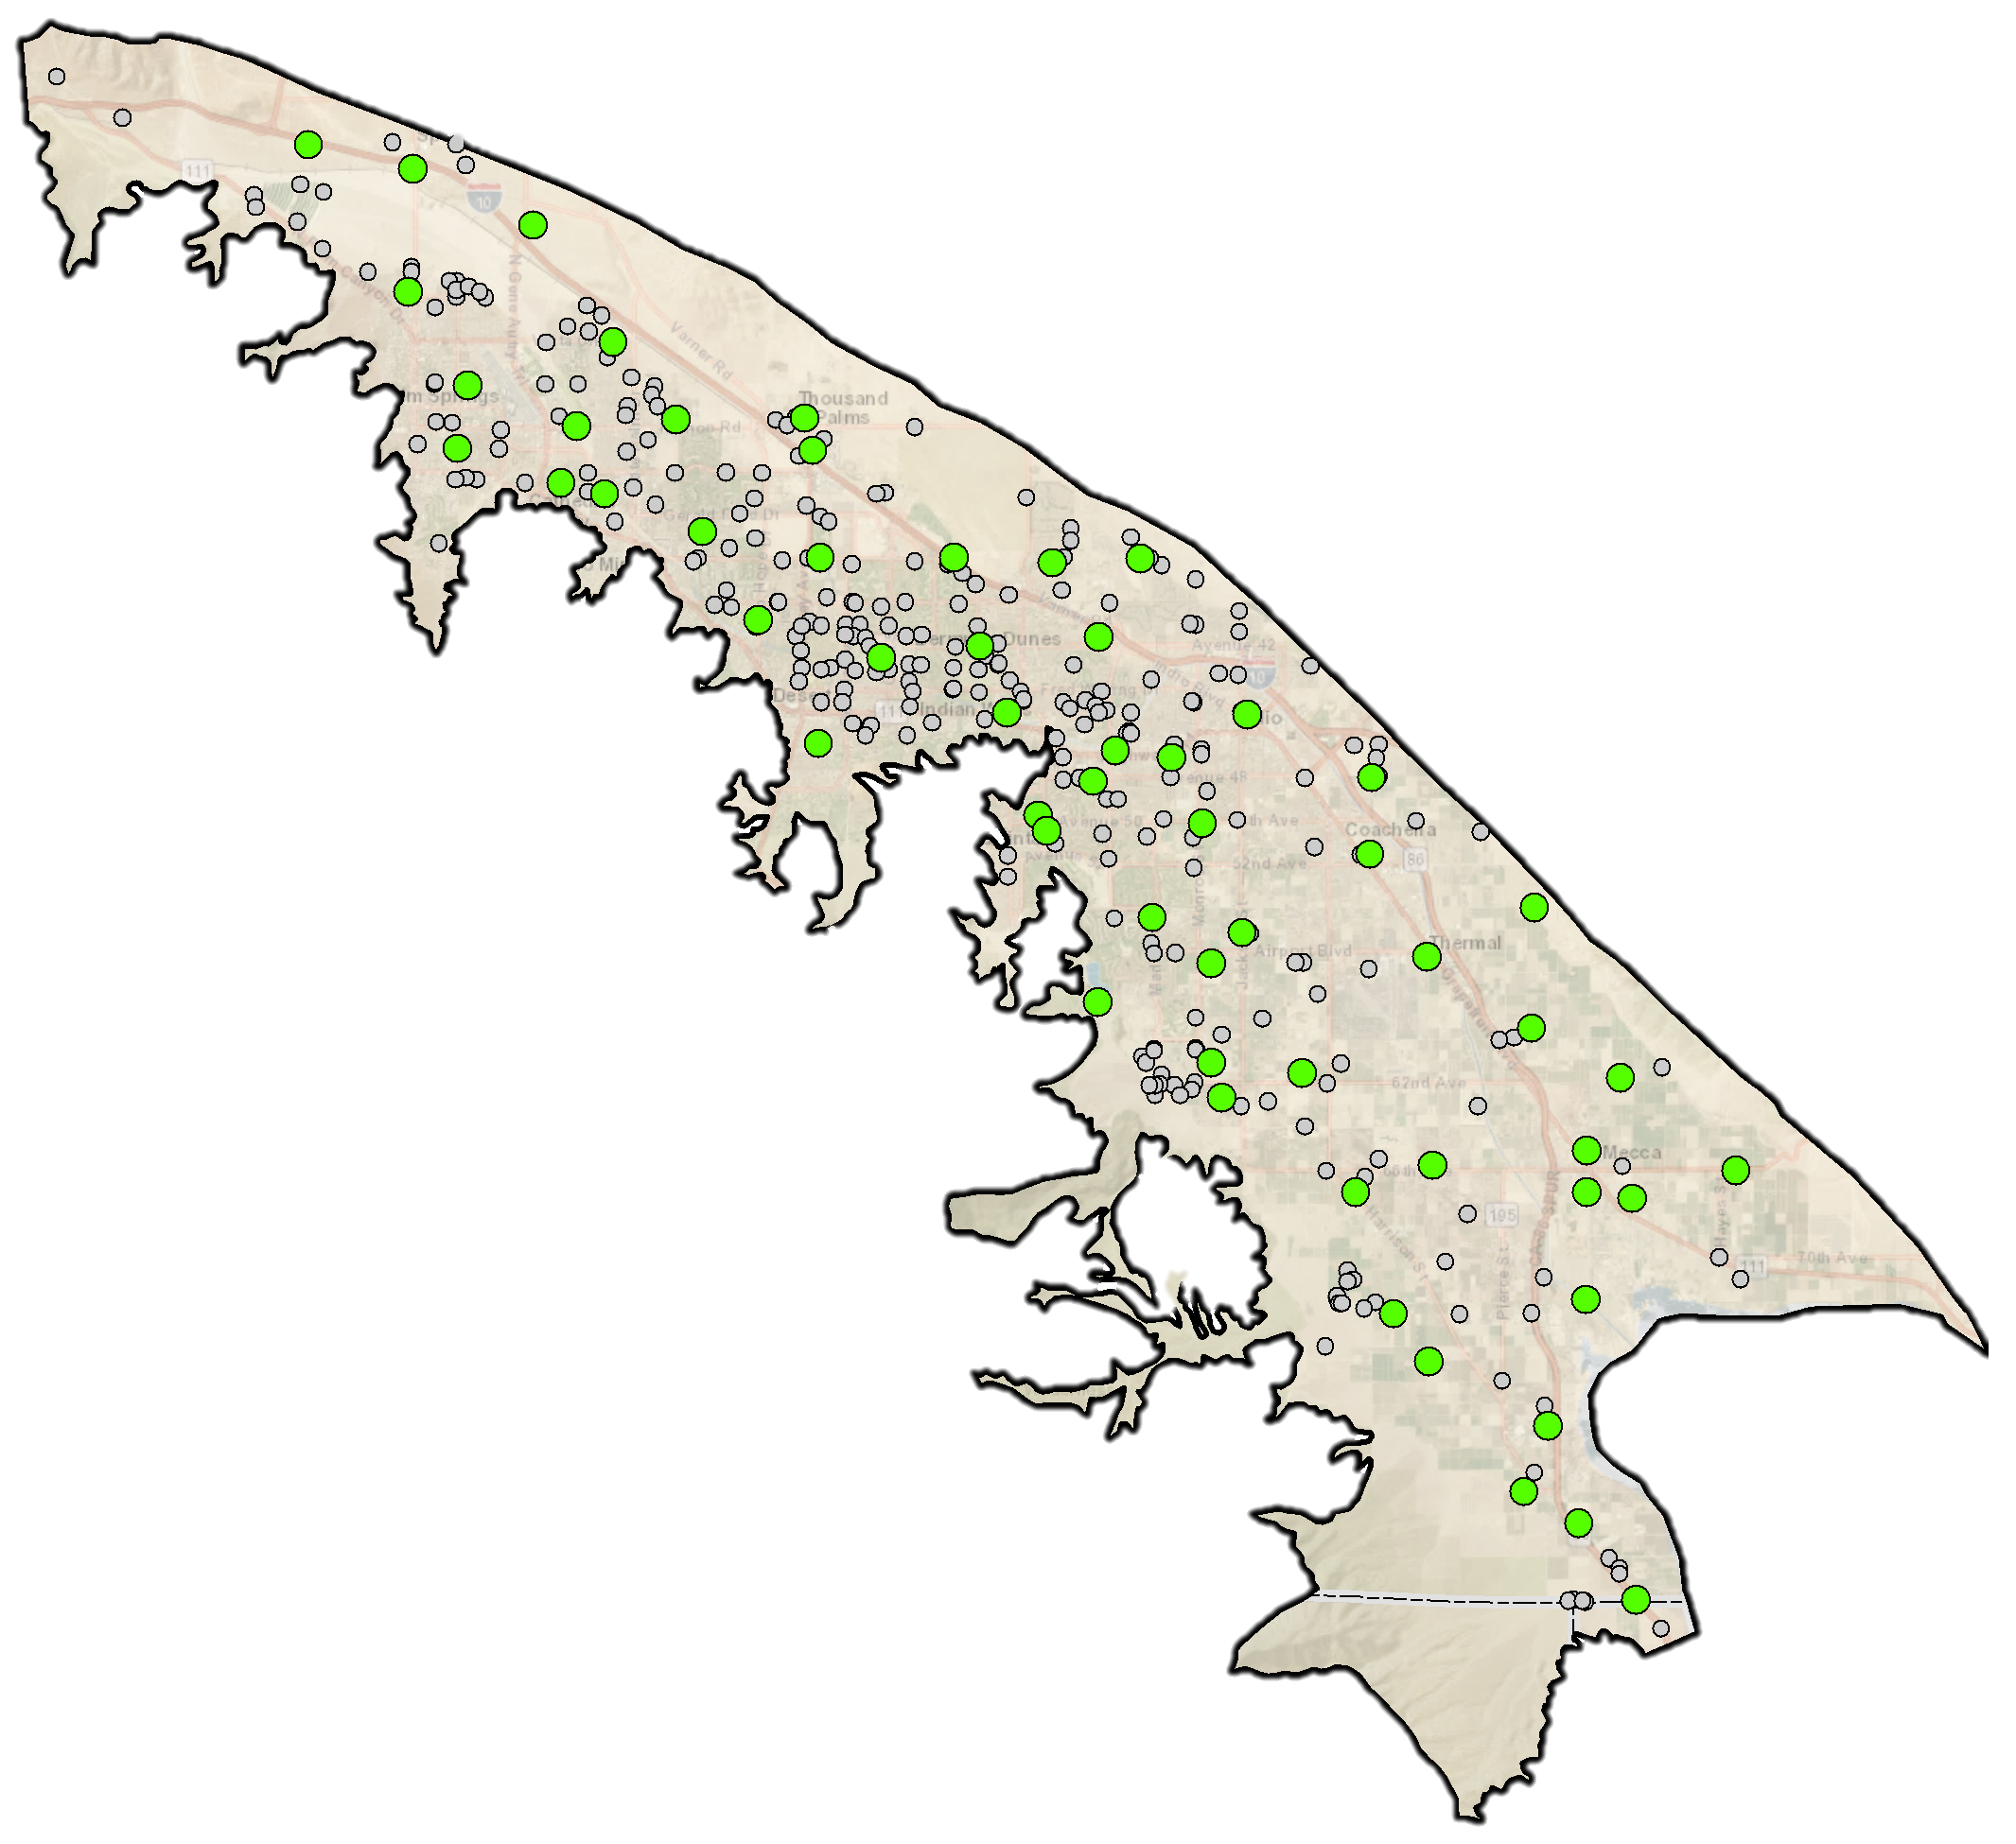
Groundwater Elevation Data
Groundwater elevations from 355 wells were used to develop contour maps and change in storage maps
2022 Plan Update identified 57 Key Wells to track groundwater sustainability
Each well has a minimum threshold (MT—set at recent observed lowest elevation)
Current groundwater elevations were compared to the MTs
Levels in all wells were above the MT
Hydrographs of each of these wells are included in the report as an Appendix

Slide 11
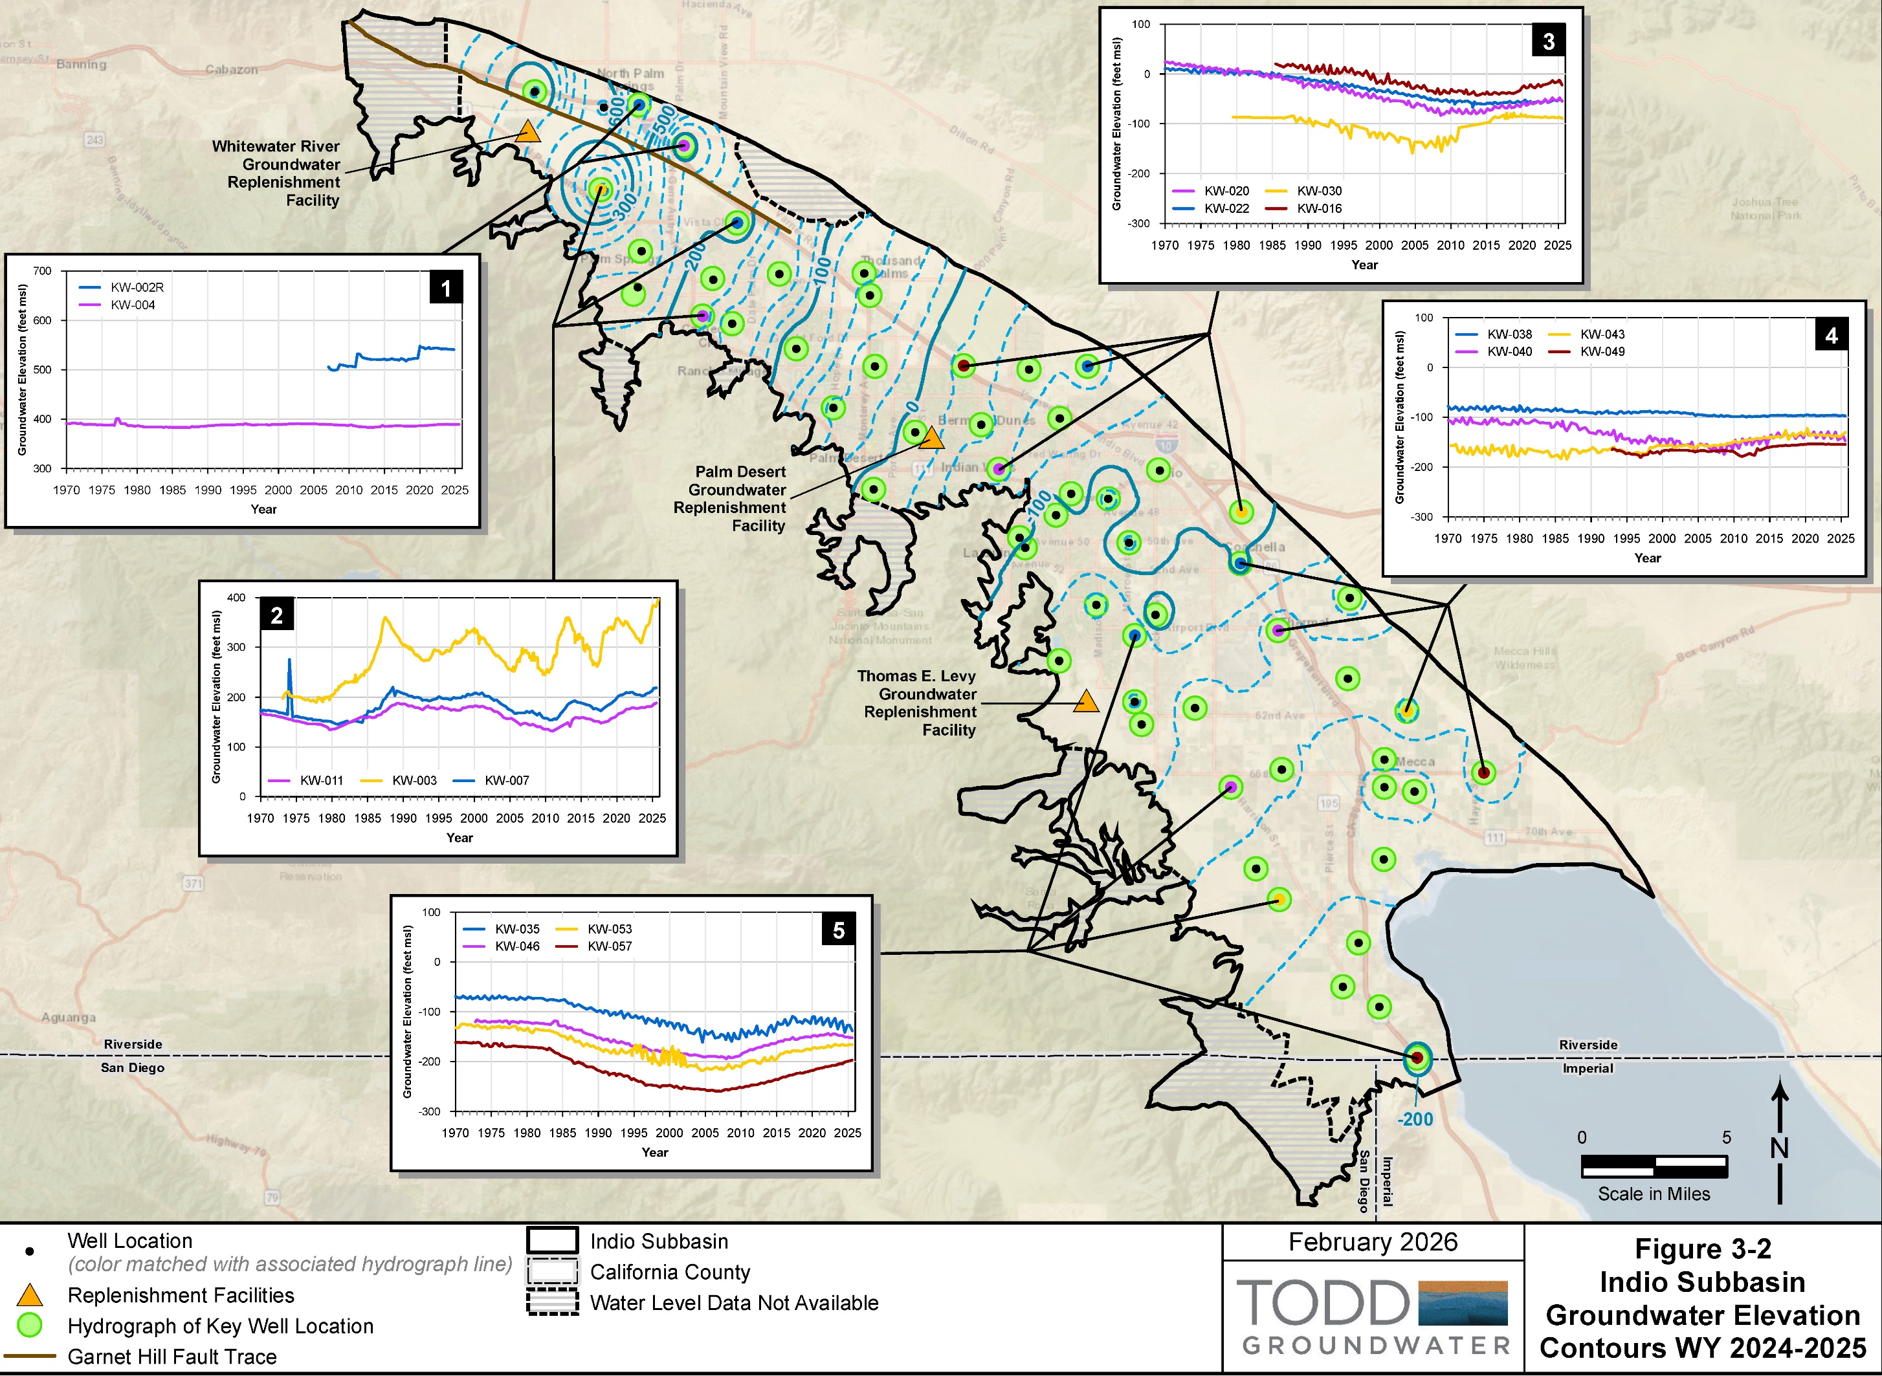

Slide 12
Questions?

Slide 13
Agenda
Welcome and Introductions
Annual Report Status
Groundwater Elevation Data
Groundwater Extractions
Surface Water
Total Water Use
Change in Groundwater Storage
Plan Implementation Progress
Public Comment

Slide 14
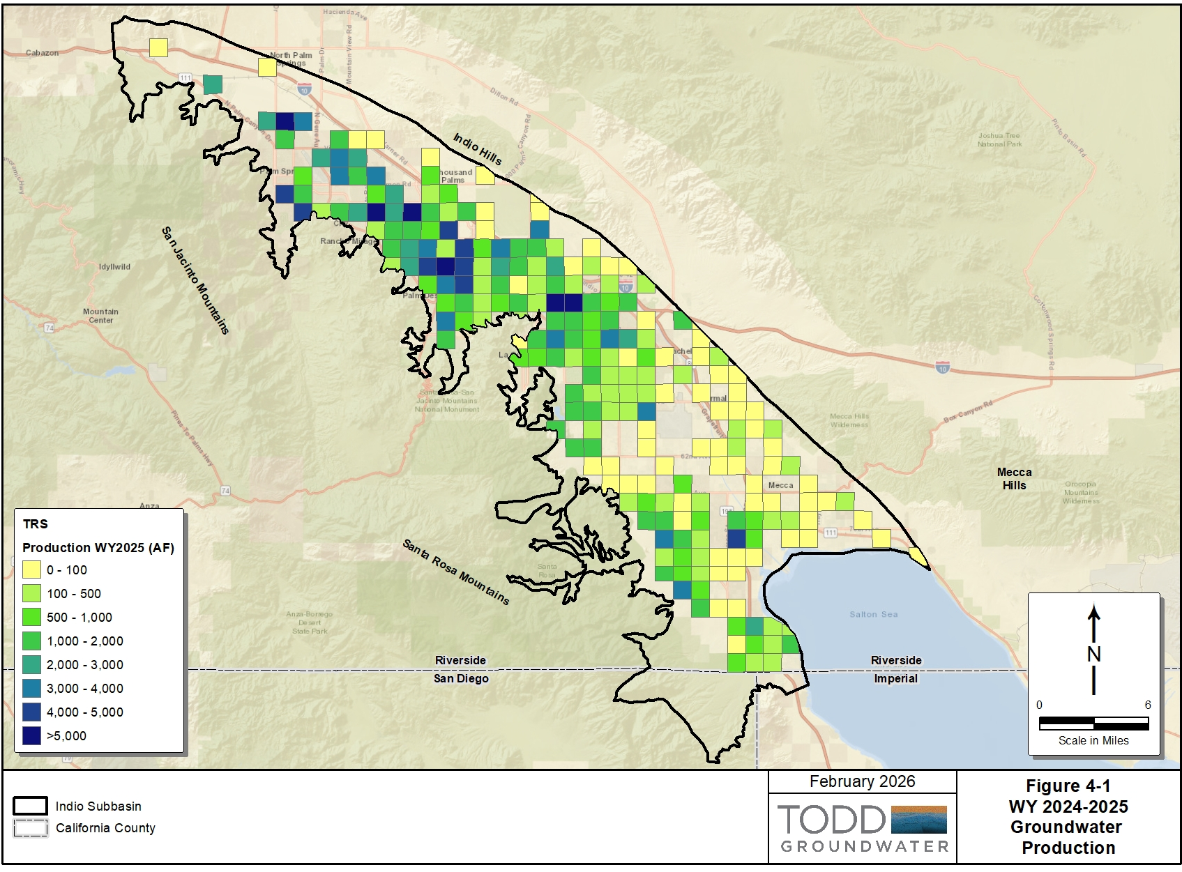
Groundwater Extractions
Water Use Sector | Groundwater Extractions (AF) | Method of Measurement | Accuracy of Measurement
Agriculture¹ | 32,773 | 100% metered | ±2%
Industrial² | 888 | 100% metered | ±2%
 |  | 0% estimated | ±50%
Urban³ | 237,468 | 99% metered | ±2%
 |  | 1% estimated | ±50%
Undetermined⁴ | 1,500 | 100% estimated | ±50%
Total Production | 272,629
Groundwater extractions are metered for most uses except
Minimal pumpers
Tribal trust lands
272,629 AF
Groundwater pumping increased 2 percent from last water year

Slide 15
Questions?

Slide 16
Agenda
Welcome and Introductions
Annual Report Status
Groundwater Elevation Data
Groundwater Extractions
Surface Water
Total Water Use
Change in Groundwater Storage
Plan Implementation Progress
Public Comment

Slide 17
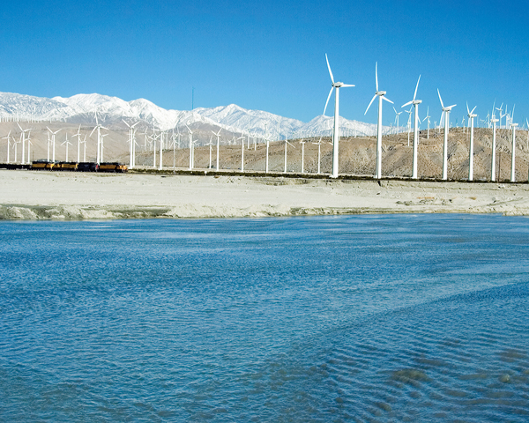
Multiple Water Sources
Capture and recharge of Whitewater River stormflows began in 1918
Coachella Canal completed in 1949
CVWD and DWA contract for State Water Project (SWP) water in 1963
Recharge at Whitewater River Groundwater Replenishment Facility (GRF) begins in 1973
Water recycling began in 1965
Coachella Canal construction
Whitewater River GRF
17

Slide 18
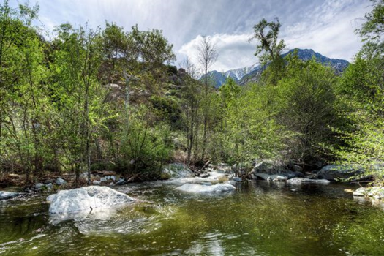
Local Surface Water
DWA stream diversions
Snow, Falls, and Chino Creeks
465 AF surface water use in DWA’s service area
49% agriculture
51% urban
Snow Creek
WY 2024-2025 Direct Use of Local Surface Water in the Indio Subbasin
Water Use Sector | Surface Water Use (AF) | Method of Measurement | Accuracy of Measurement
Agriculture¹ | 228 | 100% metered | ±2%
Industrial | 0 | Not applicable | --
Urban¹ | 237 | 100% metered | ±2%
Total Surface Water Use | 465

Slide 19
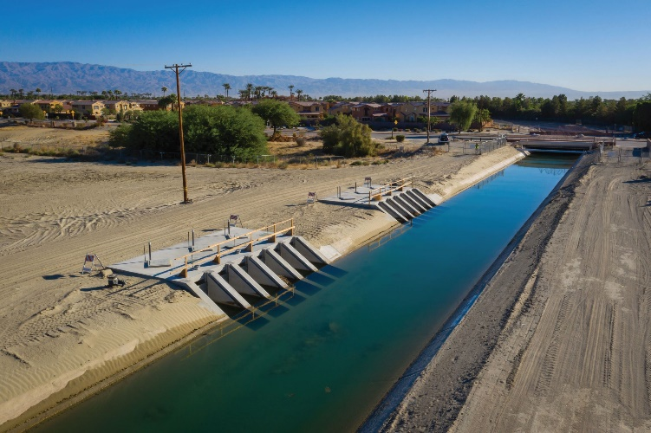
Imported Water – Direct Use
CVWD receives Colorado River water from Coachella Canal
279,852 AF imported water for direct use in Plan Area
85% agriculture
15% urban
2 percent increase from last year
Coachella Canal
WY 2024-2025 Imported Water for Direct Use in Plan Area
Water Use Sector | Water Source | Imported Water Use (AF) | Method of Measurement | Accuracy of Measurement
Agriculture¹ | Coachella Canal | 246,855 | 100% metered | ±2%
Urban² | Coachella Canal | 32,997 | 100% metered | ±2%
Industrial | Coachella Canal | 0 | 100% metered | ±2%
Environmental³ | Coachella Canal | 0 | Not applicable | --
Total Imported Water for Direct Use⁴ |  | 279,852

Slide 20
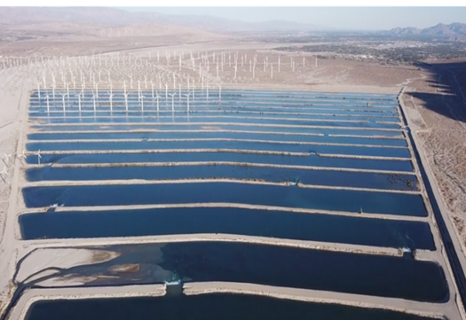
Imported Water – Groundwater Replenishment
Two sources of water used for replenishment:
DWA and CVWD receive State Water Project exchange water from Colorado River Aqueduct (CRA)
CVWD receives Colorado River water from Coachella Canal
265,471 AF imported water for replenishment
10 percent less than WY2024
WWR-GRF
WY 2024-2025 Imported Water for Replenishment in Plan Area
Water Use Sector | Water Source | Imported Water Use (AF) | Method of Measurement
Groundwater Replenishment | Coachella Canal⁶ | 12,932 | 100% metered
Groundwater Replenishment | SWP Exchange/CRA | 252,539 | 100% metered
Total Imported Water for Groundwater Replenishment |  | 265,471
Notes:
SWP exchange water is recharged at the WWR-GRF

Slide 21
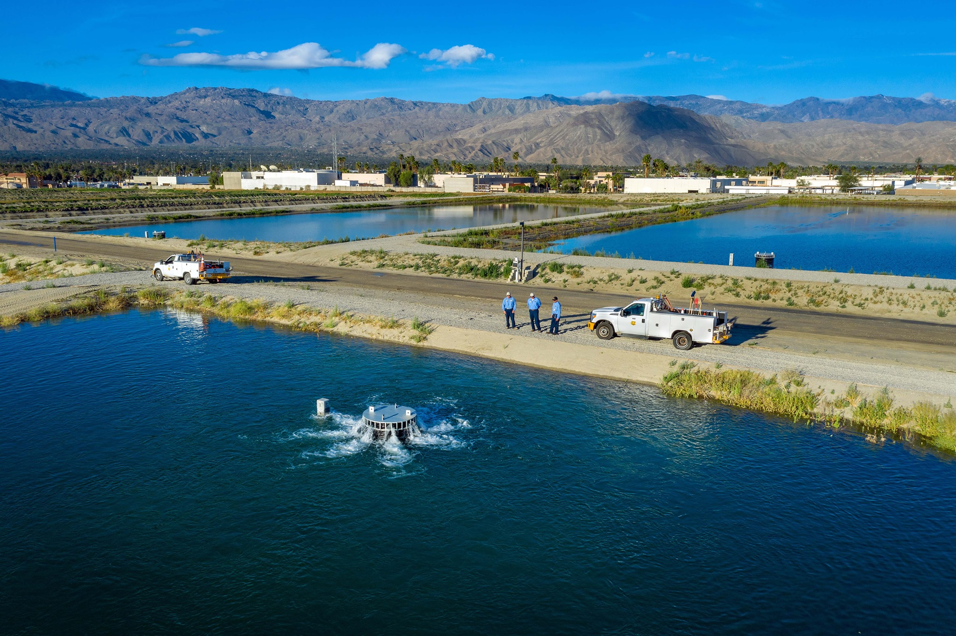
Imported Water – Groundwater Replenishment
WY 2024-2025 Total Groundwater Replenishment
Replenishment Facility | Water Source | Volume Recharged in WY 2025 (AF)
Whitewater – GRF | Imported Water | 252,539
 | Local Surface Water | 1,899
Palm Desert – GRF | Imported Water | 10,164
TEL – GRF | Imported Water | 2,768
Total |  | 267,370
PD-GRF
267,370 AF water for replenishment
10,164 AF at Palm Desert GRF
2,768 AF at Thomas E. Levy GRF
254,438 AF at Whitewater River GRF
Includes local surface water
10 percent decrease over last year
Notes:
SWP exchange water is recharged at the WWR-GRF

Slide 22
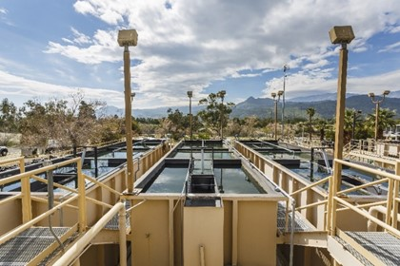
Recycled Water
Three water reclamation plants (WRPs) provide recycled water
Palm Springs WWTP/DWA WRP
CVWD WRP-7
CVWD WRP-10
13,164 AF recycled water produced
100% urban
DWA WRP
WY 2023-2024 Recycled Water Use in the Indio Subbasin
Water Use Sector | Water Source | Recycled Water Use (AF) | Method of Measurement | Accuracy of Measurement
Urban¹ | DWA WRP | 3,122 | 100% metered | ±2%
Urban¹ | CVWD WRP 7 | 2,055 | 100% metered | ±2%
Urban¹ | CVWD WRP 10 | 7,987 | 100% metered | ±2%
Total Recycled Water Use |  | 13,164
Notes:
6 percent increase

Slide 23
Questions?

Slide 24
Agenda
Welcome and Introductions
Annual Report Status
Groundwater Elevation Data
Groundwater Extractions
Surface Water
Total Water Use
Change in Groundwater Storage
Plan Implementation Progress
Public Comment

Slide 25
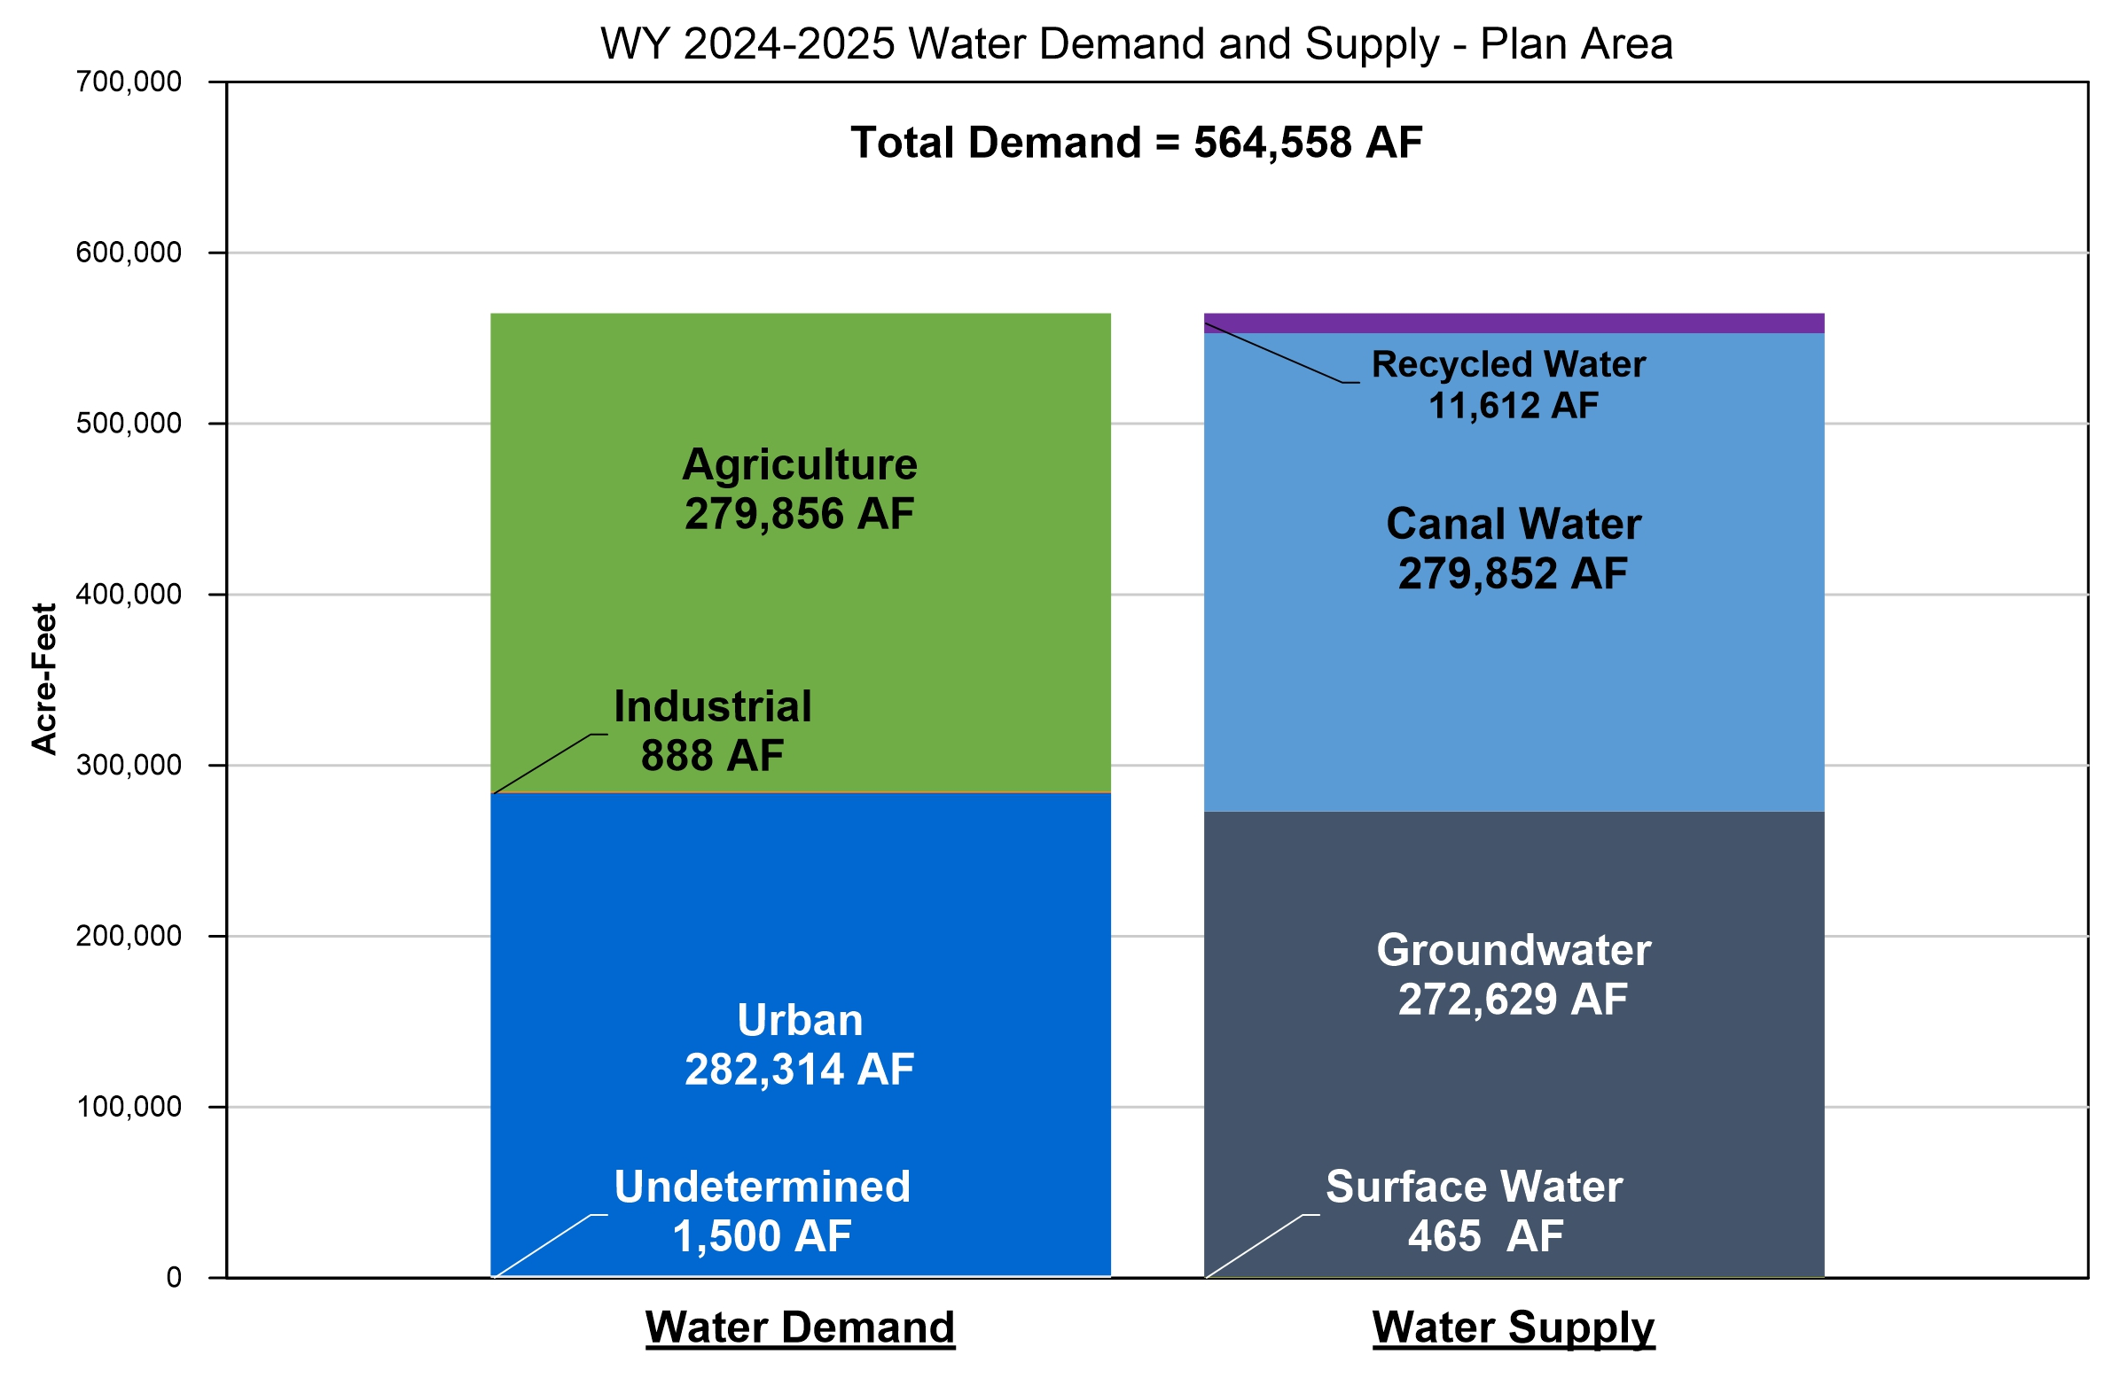
Total Water Use
WY 2024-2025 Water Demand and Supply – Plan Area
Notes:
SWP exchange water is recharged at the WWR-GRF

Slide 26
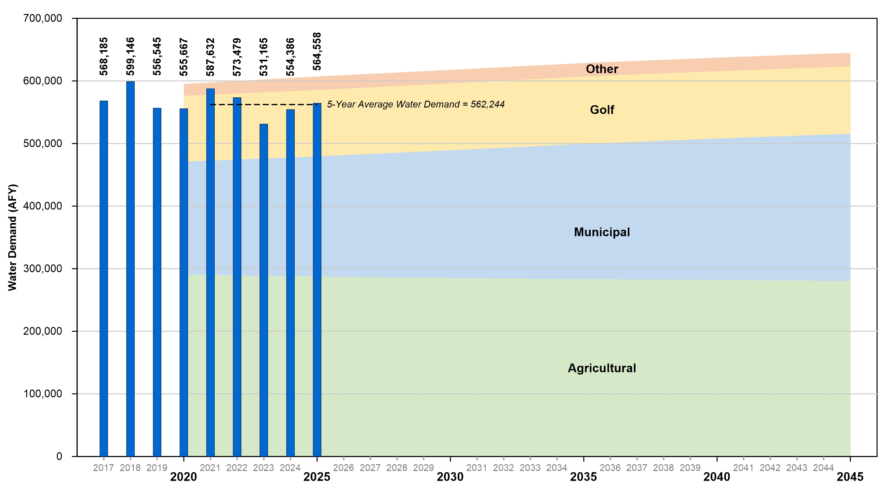
Total Water Use
Total Water Demand Actual and Forecasted – Plan Area
Notes:
SWP exchange water is recharged at the WWR-GRF

Slide 27
Questions?

Slide 28
Agenda
Welcome and Introductions
Annual Report Status
Groundwater Elevation Data
Groundwater Extractions
Surface Water
Total Water Use
Change in Groundwater Storage
Plan Implementation Progress
Public Comment

Slide 29
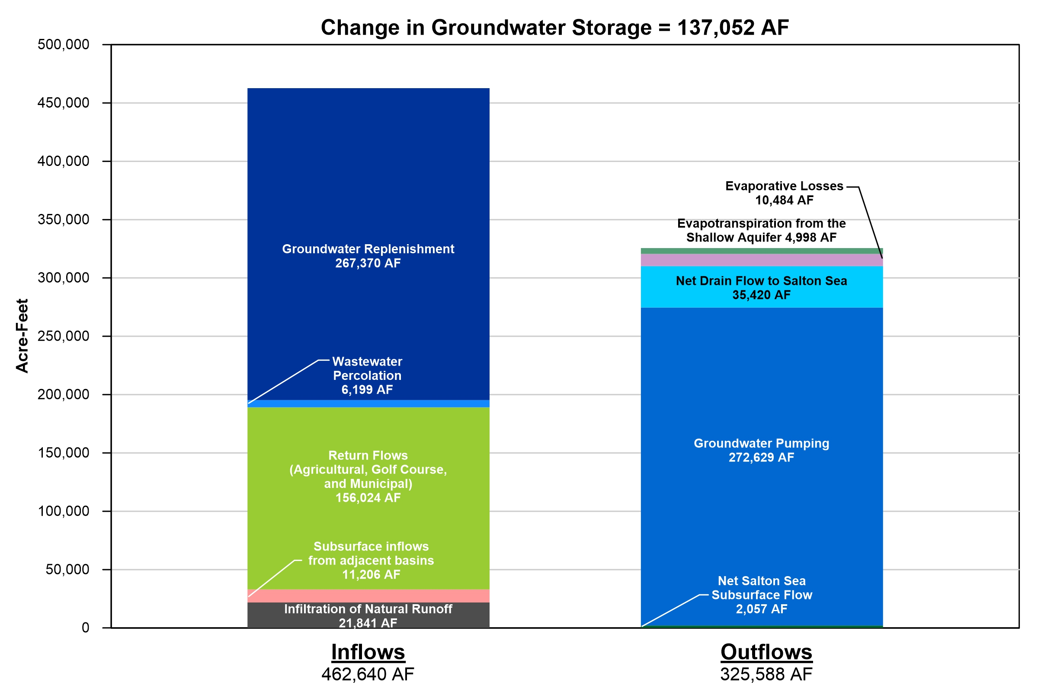
Change in Groundwater Storage
Comparison of Inflows and Outflows
Inflows
Replenishment
WW Percolation
Return Flows
Subsurface Flow
Natural Infiltration
Outflows
Evapotranspiration (ET)
Drains
Pumping
Subsurface Flow

Slide 30
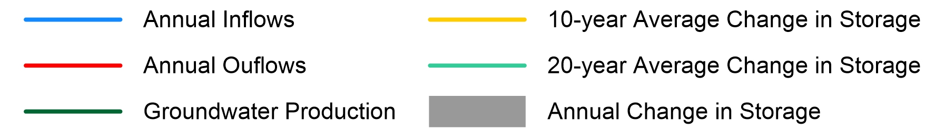
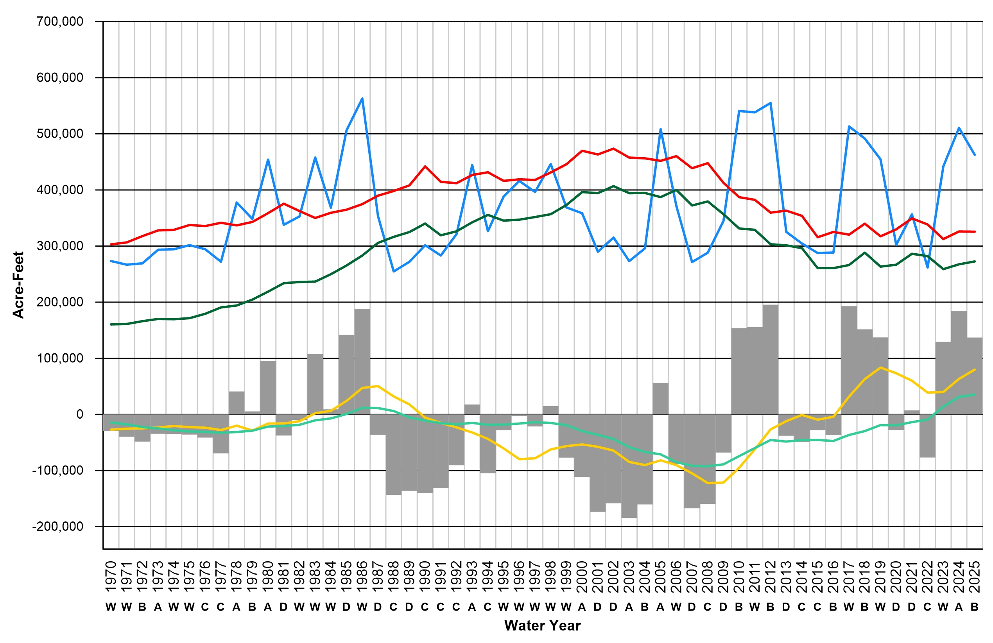
Change in Groundwater Storage
Annual change in storage
+137,052 AF
Average change in storage
Since 2009, 10-year average (yellow line) is positive and the 20-year average (green line) since WY 2023
Shows the Indio Subbasin is still sustainable
W = Wet, A = Above Normal, B = Below Normal, D = Dry, C = Critically Dry

Slide 31
Change in Groundwater Levels
Maps show change in groundwater levels
One year change (next slide)
Long-term change since 2009 historical lows (following slide)
Change in groundwater levels is a proxy for change in storage
Based on measured water levels at 356 wells throughout the Indio Subbasin

Slide 32
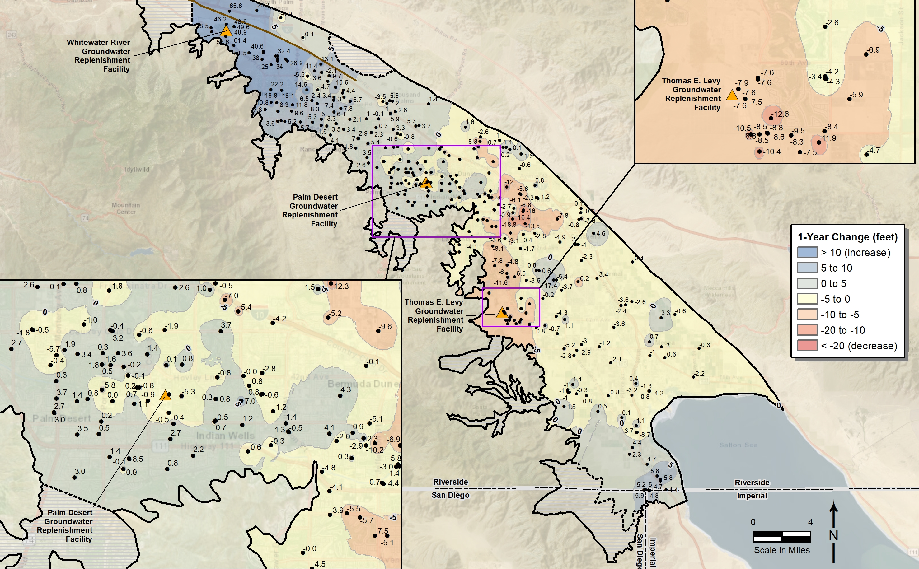
One Year Change
Groundwater levels generally increased in the past water year
Increases near WWR-GRF but declines downstream due to variability in recharge
Declines in the middle part of the Subbasin due to less TEL recharge
WY 2024 to WY 2025

Slide 33
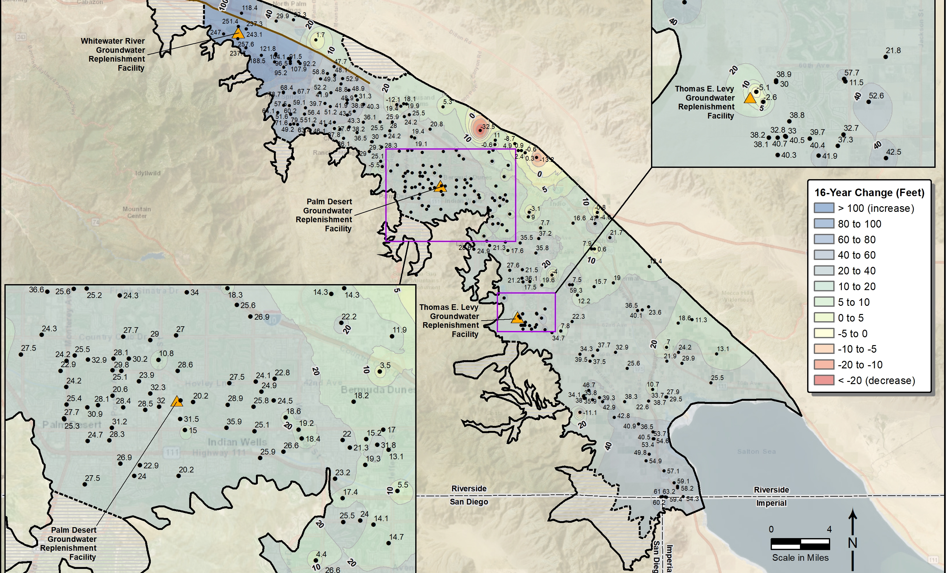
Long-Term Change
Basin-wide increases since 2009 historical lows
Water levels have increased or stabilized
Very localized declines in Mid-Valley area
WY 2009 to WY 2025

Slide 34
Questions?

Slide 35
Agenda
Welcome and Introductions
Annual Report Status
Groundwater Elevation Data
Groundwater Extractions
Surface Water
Total Water Use
Change in Groundwater Storage
Plan Implementation Progress
Public Comment

Slide 36
Projects & Management Actions
Water Conservation
Source Substitution & Replenishment
Water Quality Protection
1: Urban Water Conservation
10: Mid-Valley Pipeline Direct Customers
22: Eliminate Wastewater Percolation
2: Golf Water Conservation
11: East Golf Expansion
23: Wellhead Treatment
3: Agricultural Water Conservation
12: Oasis Distribution System
24: Small Water System Consolidations
13: WRP-10 Recycled Water Delivery
25: Septic to Sewer Conversions
Water Supply Development
14: WRP-10 Tertiary Expansion
26: CV-SNMP GW Monitoring Program Workplan
15: Canal Water Pump Station Upgrade
27: CV-SNMP Development Workplan
4: Increased Surface Water Diversion
16: WRP-7 Recycled Water Delivery
28: Colorado River Salinity Forum
5: Delta Conveyance Facility
17: WRP-4 Tertiary Expansion & Delivery
29: Source Water Protection
6: Lake Perris Seepage
18: DWA WRP Recycled Water Delivery
7: Sites Reservoir
19: PD-GRF Phase 2 Expansion
8: Future Supplemental Water Acquisitions
20: TEL-GRF Expansion
9: EVRA Potable Reuse
21: WWR-GRF Operation

Slide 37
2027 Alternative Plan Update
SGMA Plans are required to be evaluated every five years
Indio Subbasin has decided to prepare a stand alone update to the 2022 Alternative Plan
Development is underway
Updated demand forecasts
Updated supply forecasts
Climate change
Updated groundwater model
Extended to the San Gorgonio Subbasin boundary
New scenarios to simulate future groundwater management

Slide 38
Questions?

Slide 39
Public Comment
Input and feedback are welcomed
For Callers – you may need to press *6 to unmute

Slide 40

Next Steps
WY 2025 Annual Report can be downloaded:
Indio Subbasin Annual Report for WY 2024-2025 Council/Board Presentation
Coachella Valley Water District – TBD
Coachella Water Authority – TBD
Desert Water Agency – TBD
Indio Water Authority – TBD
www.IndioSubbasinSGMA.org

Slide 41
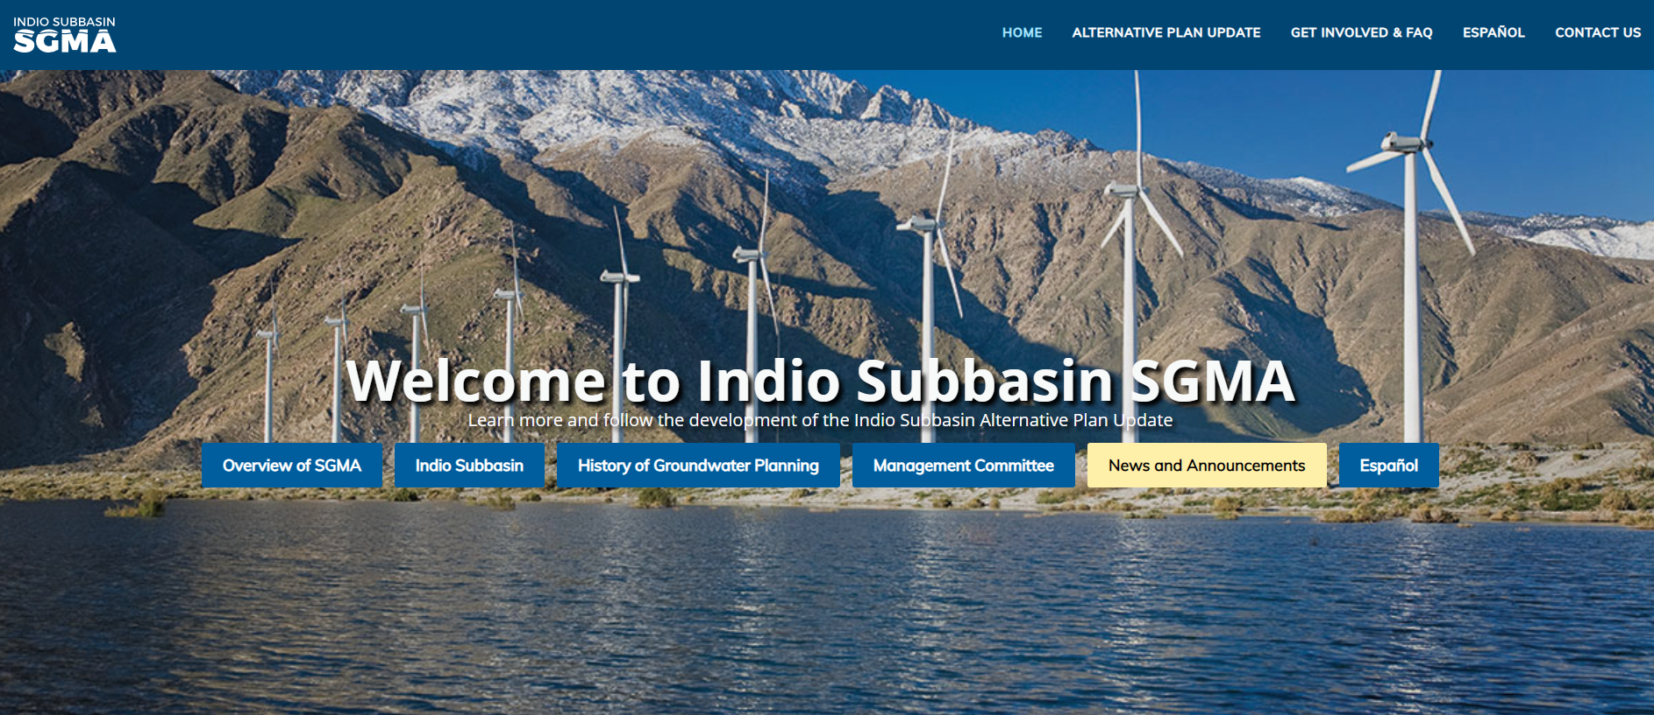
Stay Involved – Visit our Website
www.IndioSubbasinSGMA.org

